Slide 1
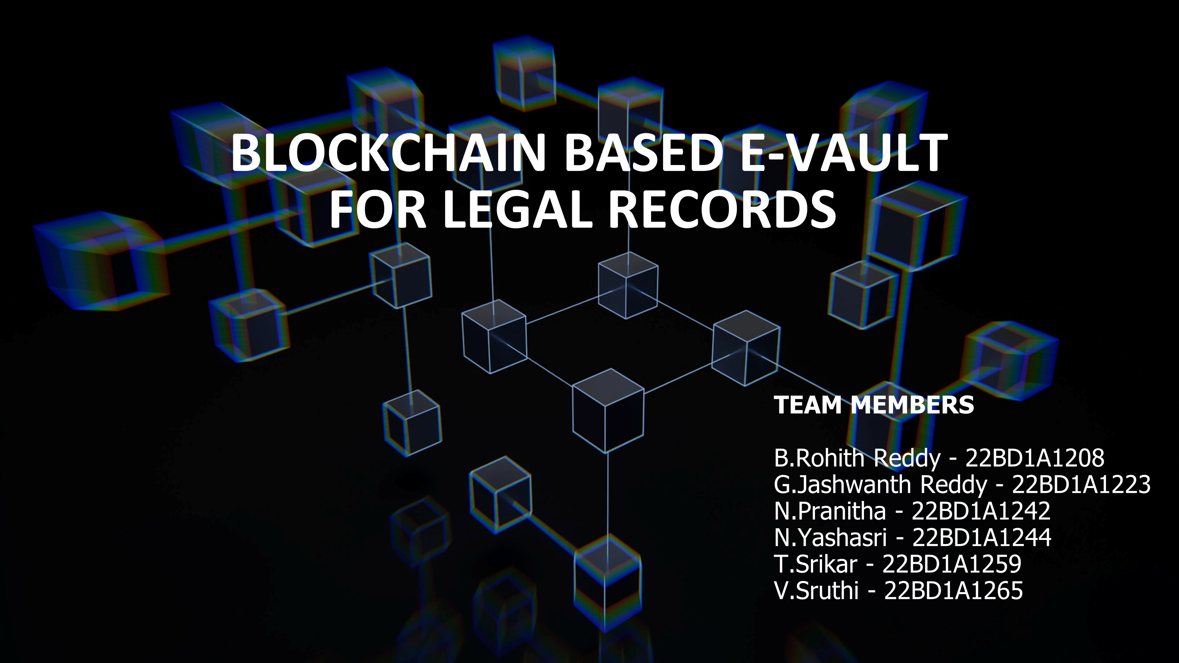
Functions in our project

Slide 2




Problem Statement
The objective of this project is to develop a blockchain-based Evault system for legal records that can ensure security, transparency, and accessibility for all stakeholders. The system should be able to store, manage, and share legal records securely and efficiently, with the potential to integrate with existing legal databases and case management systems.
Requirements:
1. The Evault system should be based on a blockchain platform such as Ethereum, Hyperledger, or Corda, should use smart contracts to manage access, permissions, and transactions.
2. The system should have user-friendly interfaces for lawyers, judges, clients, and other stakeholders to interact with the Evault, with features such as uploading and retrieving documents, tracking changes, and sharing information.
3. The system should ensure the privacy and confidentiality of legal records, with appropriate access controls, encryption, and authentication mechanisms.
4. The system should allow for seamless integration with existing legal databases and case management systems, to ensure interoperability and ease of use.
5. The system should be scalable and adaptable to accommodate future changes and upgrades.
Expected Outcomes:
1. A functional prototype of the blockchain-based Evault system for legal records, with a user-friendly interface and features such as document upload, retrieval, and sharing.
2. A detailed design document outlining the architecture, features, and technical specifications of the Evault system.
3. A business plan outlining the potential impact, market opportunities, and revenue models for the Evault system.
4. A presentation of the prototype, design document, and business plan.
Impact:
The development of a blockchain-based Evault system for legal records can have a significant impact on improving access to justice in India. It can lead to faster, more efficient court proceedings, reduced costs, improved data integrity, and increased trust in the justice system.

Slide 3
Technology used
Hyperledger Fabric: Guarantees confidentiality with its permissioned architecture and modularity. Its secure, efficient environment is reinforced by private transactions and robust access controls. With enterprise-grade support, it aligns seamlessly with reliability and legal standards in record management.
CouchDB: Rich query support with JavaScript-based MapReduce, flexible JSON document storage accommodating diverse data structures, decentralized data distribution for resilience, and granular user access control.
IPFS: Decentralized nature, ensuring redundancy and availability. IPFS's content-addressed storage enhances data integrity, and peer-to-peer architecture. Its protocol-agnostic design allows seamless integration with Hyperledger Fabric, promoting interoperability.
We employed HTML, CSS, JavaScript, Express, and Node.js for our front-end development to ensure a responsive and dynamic user interface. This technology stack offers seamless integration, enabling efficient communication with our Hyperledger Fabric backend. The combination of these technologies provides a robust and scalable foundation for creating user-friendly interfaces in our legal records management system.

Slide 4
Functions
1. Admin:
Get all users: Retrieve a list of all system users.
Get all records: Fetch all legal records stored in the system.
Notification alert: Manage and receive notifications for system alerts.
CouchDB and Explorer DB: Utilize CouchDB and Explorer DB for data storage.
Portainer: Employ Portainer for container management.
2. Judge:
Update: Modify and update case information.
Add document: Upload and attach documents to case files.
Grant and revoke access: Manage access permissions for stakeholders.
Judgement and status: Provide judgments and update case status.
Get all case files: Retrieve a comprehensive list of case files.
3. Lawyer:
Create: Initiate the creation of new legal cases.
Update: Modify and update case details.
Add document: Upload and associate documents with case files.
Grant and revoke access: Manage access permissions for stakeholders.
Get all case files: Access a complete list of case files.
4. Client:
Update: Modify personal information or case details.
Add document: Upload and submit relevant documents.
Get all case files: Access and review all case files associated with the client.

Slide 5
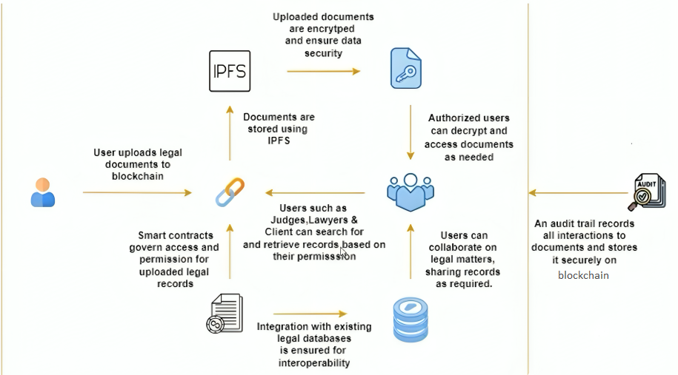




Project Workflow
Blockchain

Slide 6
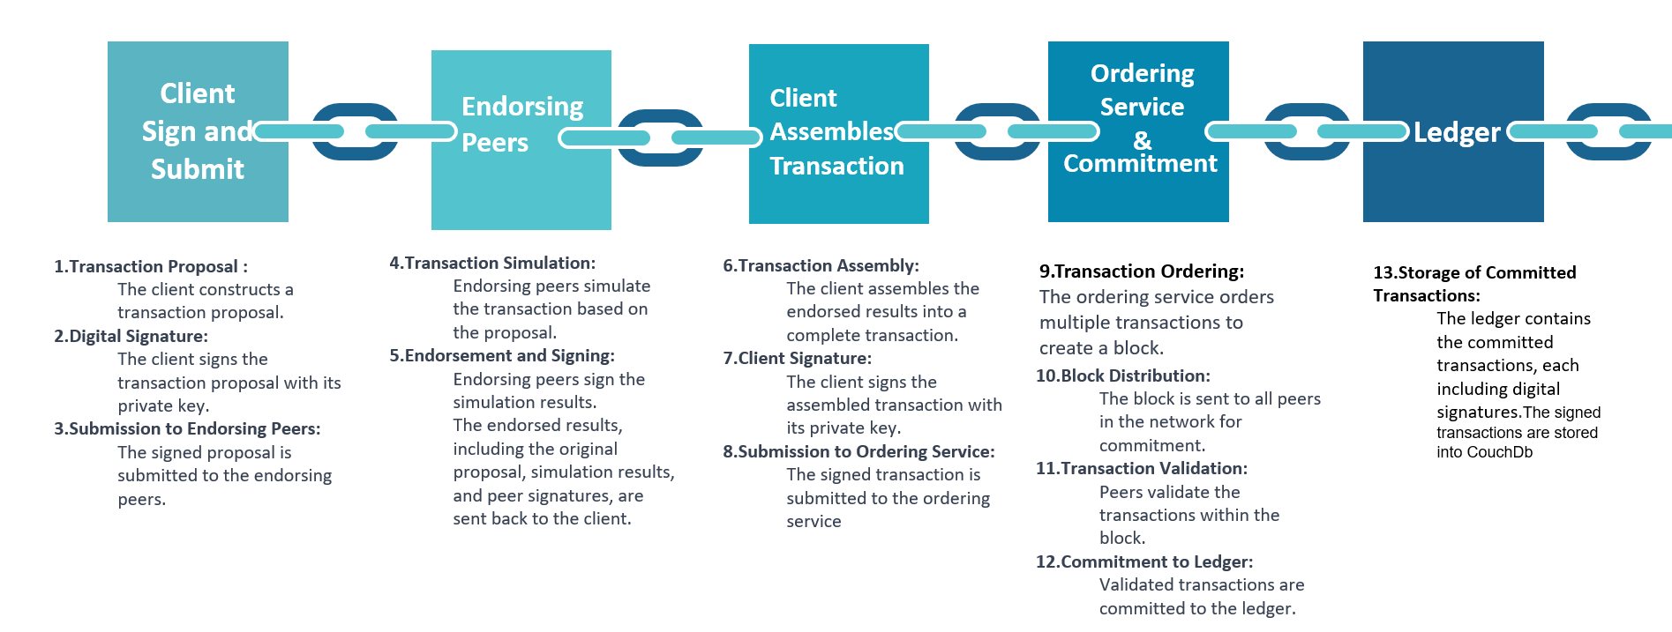
Transaction lifecycle and Client identity verification flow

