Slide 1
KMIT INFO AND BRANCH PREDICTION
-B . ROHITH REDDY
22BD1A1208
IT A

Slide 2
PROBLEM STATEMENT :
This project gives the brief information about kmit college . It gives the institution information , placement records , location of kmit college. The main aim of my project is branch prediction . This project predicts the branch and gives the probability using your eamcet rank. A person can easily know the branch by using his rank.

Slide 3
MODULE - 1
1.Kmit college information
2.Kmit college internships and placements
3.Kmit college location

Slide 4
Algorithm
Step 1 : Start
Step 2 : Collect all the information about kmit college and records of internships and placements.
Step 3 : Convert all the information to pdf format.
Step 4 : Copy the location link of kmit college.
Step 5 : Upload all the links using system function.
Step 6 : Stop.

Slide 5
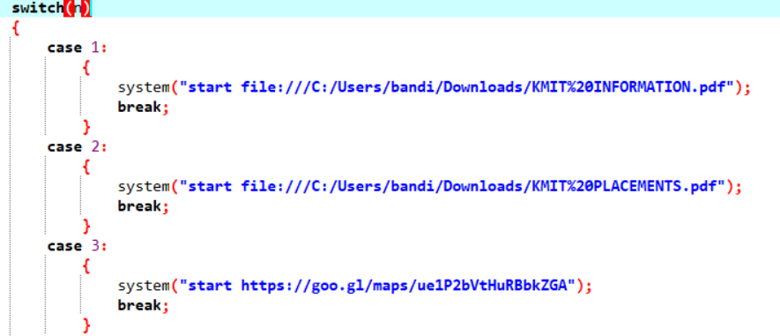
Here is the function I used to upload pdf links.
The files will open automatically by selecting the option.

Slide 6
MODULE - 2
KMIT BRANCH PREDICTION
This branch prediction totally depends on last rank , opening rank and given rank .
If we give the rank which we got , it will give you the probability of getting specific branch.
This branch prediction is totally based on last year cut off.

Slide 7
Algorithm
Step 1 : Start.
Step 2 : Assign a variable to eamcet rank and read that value.
Step 3 : Assign a variable to last rank and make last rank as 50000.
Step 4 : Call the functions .
Step 5 : stop.

Slide 8
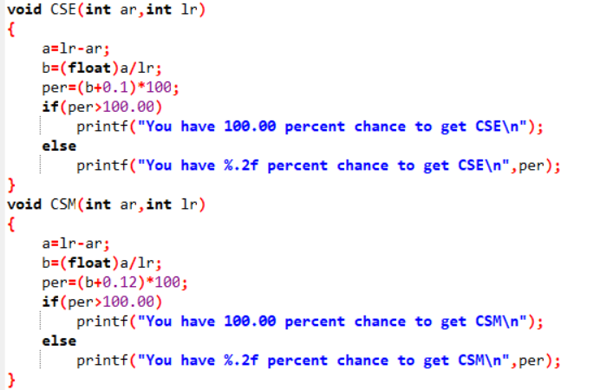
Here is the functions I used to calculate probability
lr = last rank
ar = actual rank
per = probability
NOTE : Adding 0.1 , 0.12 , 0.15 is totally based on opening rank.

Slide 9
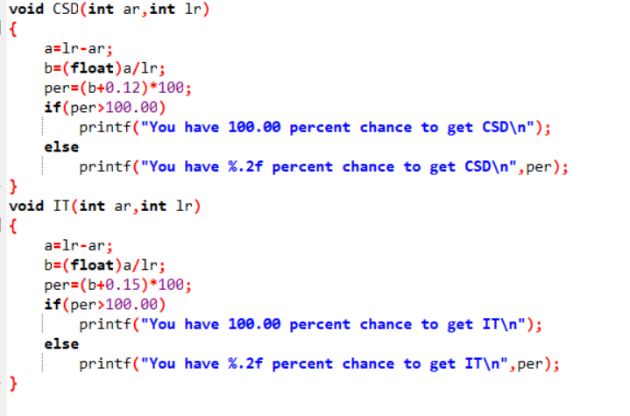
NOTE : The ranks which are more than opening rank have more than 100 probability . So , I used if else statement.

Slide 10
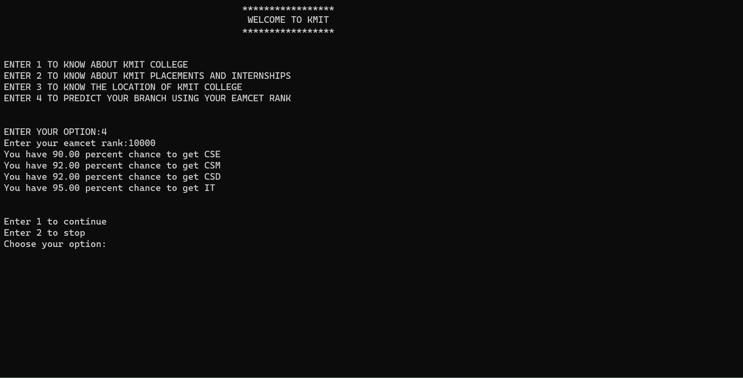
Output :

Slide 11
THANK YOU

