Slide 1
Redrob Step 3B Release
Beyond Keywords
Evidence-based candidate ranking for the Senior AI Engineer shortlist
100k
CPU
226.9s
Central release claim
candidate records processed offline
no GPU and no hosted API
final local frozen-tag runtime
Career evidence outranks skill lists, explanations stay grounded, and output order remains deterministic: score descending, then candidate_id ascending.
The release keeps ranking logic frozen, regenerates the final CSV from the tagged code path, validates the top 100 explanations, and reproduces the same shortlist offline in Docker.
1

Slide 2
Why keyword ranking fails
Keyword filters blur real ranking depth with copied buzzwords
The challenge is not counting AI terms. It is separating candidates who built ranking systems from candidates who only mention them.
Skill-list inflation
Title ambiguity
Recruiter noise
• Raw skills are easy to copy
• Advanced IR terms can appear without supporting work history
• Uncorroborated claims should not dominate ranking
• Senior titles can hide weak retrieval depth
• Research-heavy roles may not imply shipped ranking systems
• Descriptions matter more than labels
• Availability matters, but only within bounds
• Sparse profiles need conservative explanations
• Determinism matters for reviewer trust
2

Slide 3
What the role requires
The shortlist favors retrieval, ranking, evaluation, and product delivery evidence
Retrieval and ranking depth
Evaluation and shipping
Practical engineering
• Search relevance
• Recommendation systems
• Matching engines
• Learning-to-rank or ranking ownership
• Offline metrics or A/B tests
• Production deployment
• Monitoring and iteration
• User-facing impact
• Python services and APIs
• Data or search infrastructure
• Recent coding evidence
• Cross-functional product execution
This keeps the role definition tied to shipped systems instead of broad AI adjacency.
3

Slide 4
Evidence hierarchy
Career history outranks summaries, and summaries outrank skill lists
1
career_history.description
Highest-signal proof of what the candidate actually built
2
career_history.title
Useful only when paired with the description
3
profile.summary / headline
Good support, weaker than work history
4
skills / assessments
Lowest-trust source unless corroborated
This ordering is the main defense against resumes that list modern tools without showing ranking-relevant ownership.
4

Slide 5
System architecture
The pipeline persists every stage and only resumes when fingerprints still match
Audit
Normalize
Evidence
Credibility
schema and reference-date checks
→
candidate context and text prep
→
plain-language ledger extraction
→
contradiction and support checks
Behavioral
Score
Reasoning
Submit
availability and logistics bounds
→
deterministic component ranking
→
grounded top-100 explanations
→
validated submission writer
Each stage writes artifacts, hashes, and elapsed times under runs/<run_id>. Resume mode skips only when input, config, and upstream fingerprints remain unchanged.
5

Slide 6
Evidence-first matching
Plain language matters more than exact buzzwords
Recognized positive evidence
Operational evidence
Scoring summary
• search relevance
• recommendation systems
• personalized feed
• marketplace ranking
• A/B evaluation
• production deployment
• monitoring
• Python services
• base_fit_score
• × credibility_multiplier
• × availability_multiplier
• × 100
A candidate can rank well by describing real ranking or retrieval work even if their wording is not a perfect keyword match.
6

Slide 7
Defenses
Credibility and corroboration defenses keep copied AI language from dominating
Corroboration
Contradictions
Bounded modifiers
• Skills alone are weak evidence
• Work history must support advanced claims
• Career evidence can outweigh keyword-heavy profiles
• Title and description mismatches lower credibility
• Sparse support reduces trust
• Penalties are explicit and deterministic
• Availability range is 0.72 to 1.08
• Behavioral signals separate close candidates
• They do not rescue weak technical fit
7

Slide 8
Availability and logistics
Availability helps shortlist triage, but only inside a narrow multiplier band
0.72
1.08
shortlist triage zone
Signals used
What it changes
What it cannot do
• notice period
• last-active recency
• location logistics
• ordering among similar candidates
• recruiter urgency
• practical interview viability
• override weak ranking evidence
• invent missing experience
• replace human review
8

Slide 9
Explainability
The release explanation layer changed wording without changing scores or shortlist order
100/100
100/100
0
true
top-100 style lint passed
top-100 grounding passed
first-person recruiter leaks in final run
top-100 IDs, ranks, scores unchanged
The Step 3B patch only neutralized first-person source phrasing such as 'our product' into recruiter-facing narration. The final local release run preserved the approved score CSV hash and the exact top-100 candidate IDs, ranks, and scores.
Reasoning is selected from source-grounded evidence IDs, linted, and then checked again for grounding before release.
9

Slide 10
Runtime and reproducibility
The release stays offline and reproducible across local and Docker runs
3982 MB
7132 MB
local peak memory
Docker verification peak memory
false
true
hosted API during ranking
local and Docker submission hash match
Docker remained under the official 300-second limit but inside the project warning band, so a second network-disabled verification run was executed and matched the local output.
10

Slide 11
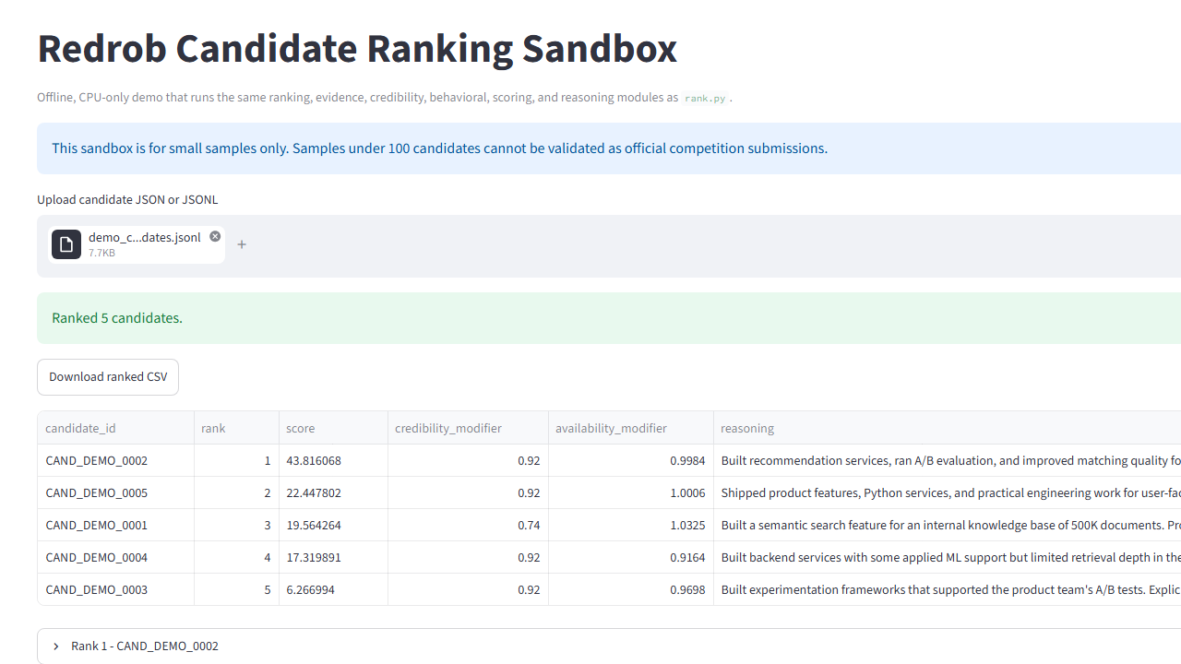
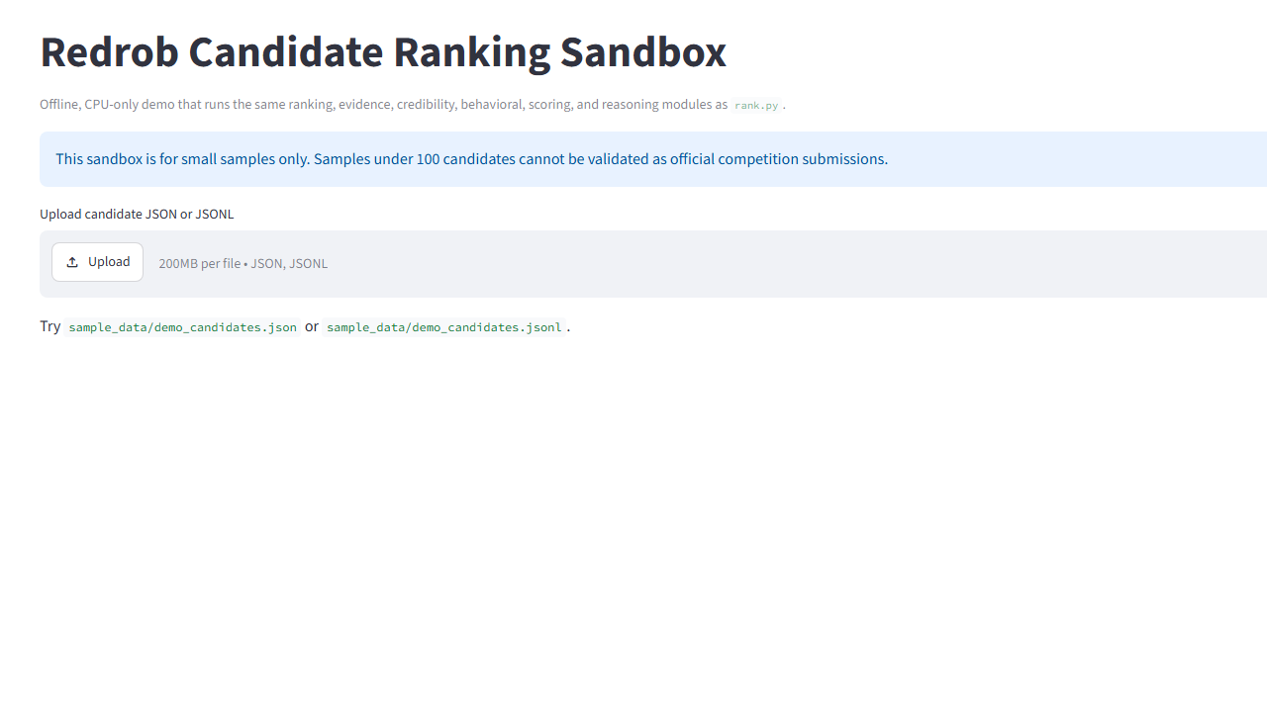
Sandbox
The recruiter sandbox uses the same ranking modules on small JSON or JSONL samples
• upload JSON or JSONL
• rank up to 100 candidates
• download ranked CSV
• marked as non-official for small samples
The app surfaces rank, score components, evidence excerpts, modifiers, and the same recruiter-facing reasoning generated by the production pipeline.
11

Slide 12
Limitations and next step
This system supports recruiter triage, not final hiring decisions
Limits
Responsible use
Practical next step
• depends on profile quality
• does not infer missing evidence
• no claims about hiring outcomes
• human review remains required
• top-ranked profiles should be spot-checked
• availability is secondary to role fit
• add recruiter feedback loop after the challenge
• keep offline guarantees
• reassess only with evidence-backed changes
12

