Slide 1
A Hybrid Model Predictive Control of PMSM Drives with Common Mode Voltage and Switching Loss reduction
Prepared by: Mr. Rohith Reddy
Electrical Engineering
School of Electrical and Computer Sciences
IIT Bhubaneswar
Under the supervision of:
Dr. Ankit Dalal

Slide 2

Table of Contents
Introduction
Common Motor Failures
Common Bearing Failures
Lubrication Composition
Strategies For Improving MTBF
Conclusion
References

Slide 3
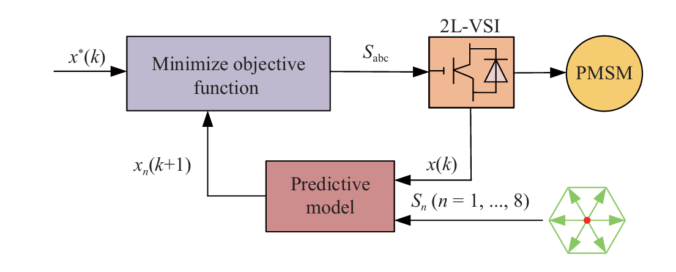
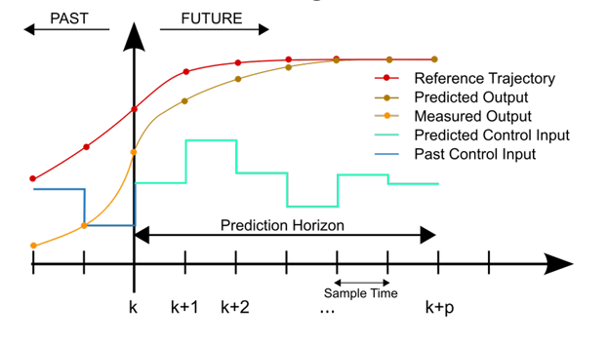
What is Model Predictive Control?
A control strategy that uses a system model to predict future behavior.
Key Principle: Receding Horizon
Predict system states over a future horizon.
Optimize a cost function to select the best control action.
Apply only the first control action from the sequence.
Repeat the process at each time step.
Advantages for Motor Drives:
Fast dynamic response.
Enforces current and voltage constraints naturally.
No need for cascaded PI controllers or modulators.
Can add new constraints easily by modifying cost function.

Slide 4
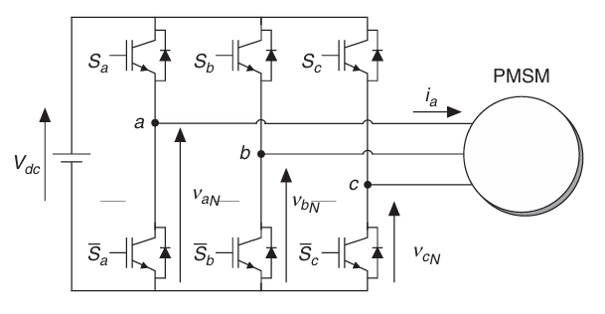
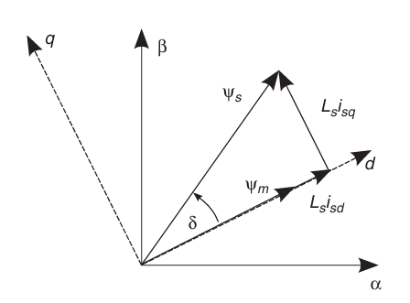


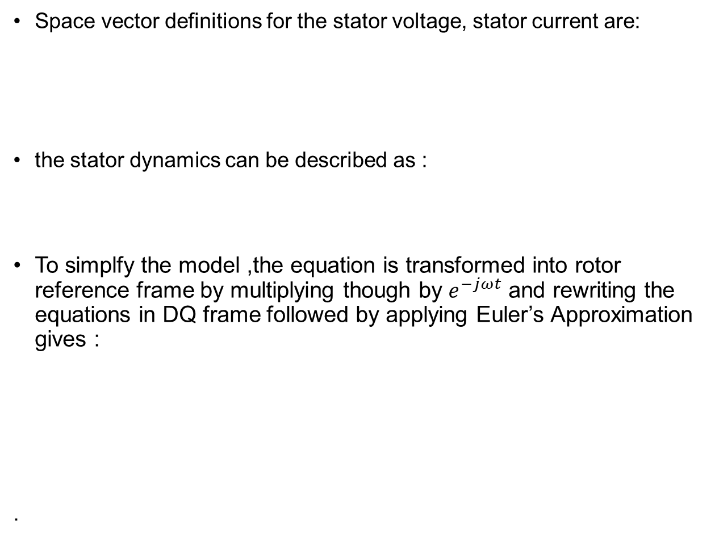


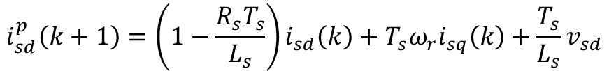
Model Predictive Control
Space vector definitions for the stator voltage, stator current are:
the stator dynamics can be described as :
To simplfy the model ,the equation is transformed into rotor reference frame by multiplying though by $e^{−jωt}$ and rewriting the equations in DQ frame followed by applying Euler’s Approximation gives :
.
$$v_{s}=\frac{2}{3}\left(v_{sa}+av_{sb}+a^{2}v_{sc}\right)$$
$$i_{s}=\frac{2}{3}\left(i_{sa}+ai_{sb}+a^{2}i_{sc}\right)$$
$$v_{s}=R_{s}i_{s}+\frac{dψ_{s}}{dt}$$
where
$$ψ_{s}=L_{s}i_{s}+ψ_{m}e^{jθ_{r}}$$
PMSM fed by a 3 phase inverter
$$i_{sd}^{p}\left(k+1\right)=\left(1−\frac{R_{s}T_{s}}{L_{s}}\right)i_{sd}\left(k\right)+T_{s}ω_{r}i_{sq}\left(k\right)+\frac{T_{s}}{L_{s}}v_{sd}$$
$$i_{sq}^{p}\left(k+1\right)=\left(1−\frac{R_{s}T_{s}}{L_{s}}\right)i_{sq}\left(k\right)−T_{s}ω_{r}i_{sd}\left(k\right)−ψ_{m}ω_{r}T_{s}+\frac{T_{s}}{L_{s}}v_{sq}$$
Vector diagram

Slide 5



Model Predictive Control
Here i_{d} produces main flux in the machine and i_{d} reference is set to zero.
PI controller is used for speed control and generates the reference for the torque-producing current
The electric torque produced by the machine depends on the flux magnitude and the quadrature component of the stator current vector and given by :
The mechanical rotor dynamics are described by the equation:
$$i_{sq}^{∗}$$
$$T_{e}=\frac{3}{2}pψ_{m}i_{sq}$$
$$\frac{dω_{r}^{m}}{dt}=\frac{1}{J}\left(T_{e}−T_{l}\right)−\frac{B}{J}ω_{r}^{m}$$

Slide 6
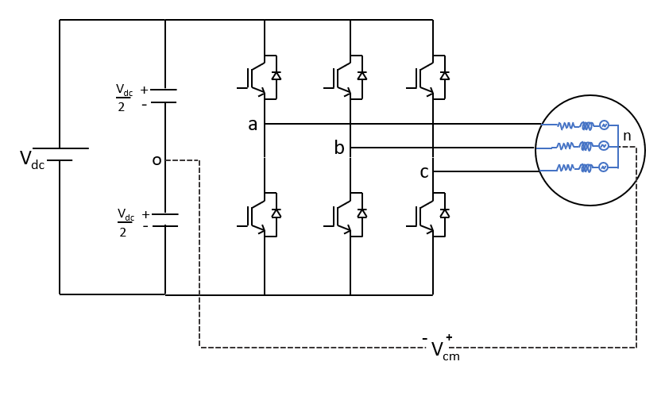
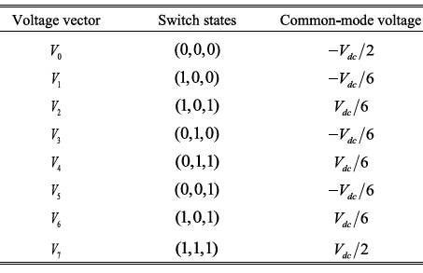

What is Common Mode Voltage ?
Common Mode Voltage(CMV) is defined as electrical potential measured from the load neutral point relative to the midpoint of DC link.
S_{x} is 1 if upper switch is ON and 0 otherwise, so there
are 8 possible voltage vectors.
$$V_{cm}= \frac{V_{ao}+V_{bo}+V_{co}}{3 } = \frac{V_{dc}}{3}\left(S_{a}+S_{b}+S_{c}\right)−\frac{V_{dc}}{2}$$

Slide 7
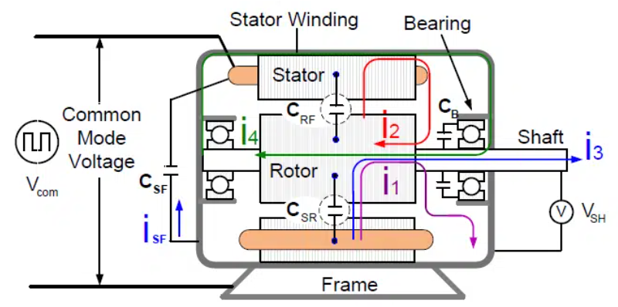
Motivation and Problem Statement
Challenges in PMSM Drives:
Common-mode voltage induces bearing currents and shaft voltages, and when coupled with parasitic capacitances, leads to EMI/EMC issues that degrade motor reliability.
Switching Losses in power electronic devices (MOSFETs/IGBTs) leads to heat generation and limits device lifetime.
The Core Problem: Reducing one (e.g. CMV) often worsens the other (e.g. switching losses ).

Slide 8
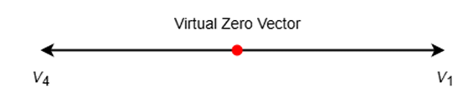
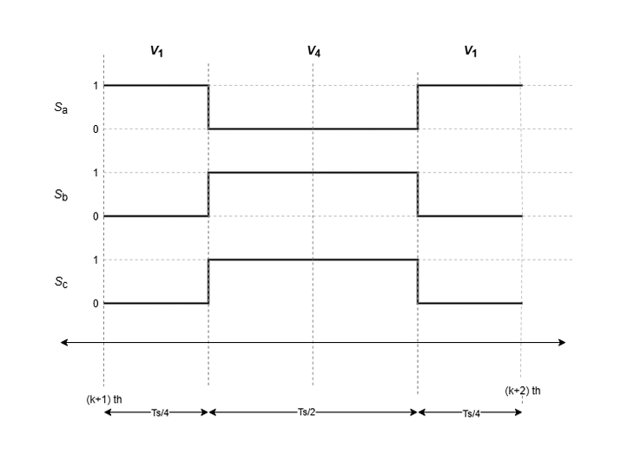
Hybrid Model Predictive Control
Since the zero-voltage vector generates a CMV of ±Vdc/2, avoiding it can restrict CMV to ±Vdc/6 but often at the cost of degraded tracking.
To mitigate CMV, both hardware and software-based approaches have been studied. Hardware methods usually rely on filters, while software based MPC strategies aim to reduce CMV without extra components.
To improve tracking while limiting CMV to ±Vdc/6 ,we can use virtual zero vectors without using extra components.
The virtual zero vector (VZV) is synthesized using the concept of volt second equivalence, where the pair of opposite active vectors is selected based on the previously applied active vector.
Symmetric Switching Sequence

Slide 9

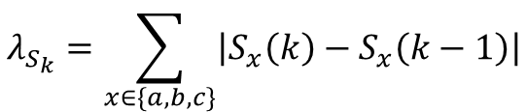

Hybrid Model Predictive Control
To address switching stress, an additional term is incorporated into the cost function to penalize state transitions that involve multiple commutations relative to the previous switching state.
The total number of switch transitions between two consecutive time steps is calculated as:
A limiting function is then applied and added to the cost function.
New cost function is .
This approach ensures that transitions involving more than one switch change are avoided.
$$λ_{S_{k}}=\sum_{x∈\{a,b,c\}}{\left|S_{x}\left(k\right)−S_{x}\left(k−1\right)\right|}$$
$$g_{opt}=g+Y_{lim}\left(λ_{S_{k}}\right)$$

Slide 10
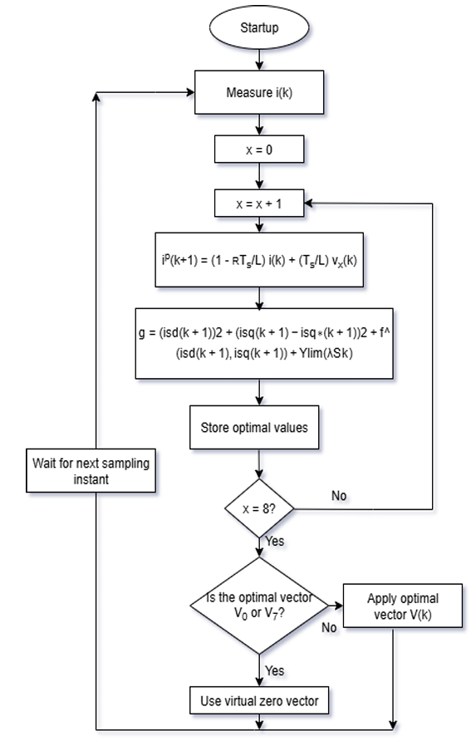
Hybrid Model Predictive Control
The proposed MPC is a hybrid control strategy that trades off CMV reduction, switching minimization, and tracking accuracy.
During each sampling period, the controller assesses the cost function for all candidate voltage vectors and selects the minimiser.
If an active vector yields the lowest cost, it is applied for the entire sampling period Ts to preserve tracking accuracy.
When the zero vector constitutes the optimal choice, a VZV is synthesized by applying a pair of opposite active vectors in symmetrical manner within the interval, this prevents large neutral-point excursions and keeps the CMV bounded to ±Vdc/6.
For all remaining cases, transitions are constrained to adjacent voltage vectors (single-switch changes) so as to minimize the number of switching events.
Flowchart of Hybrid MPC

Slide 11
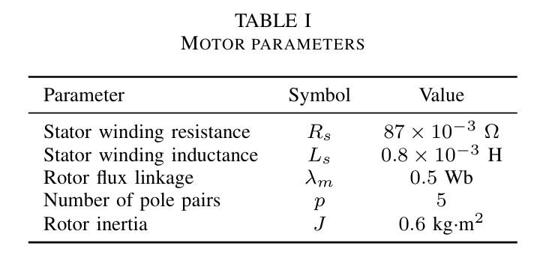
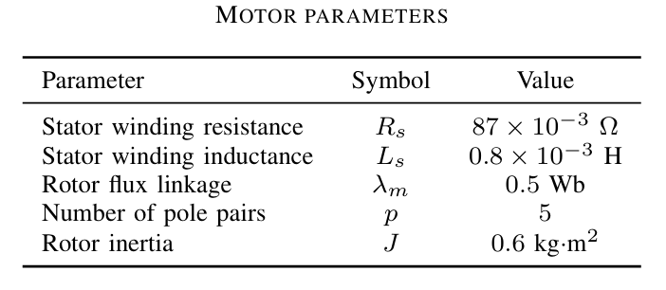
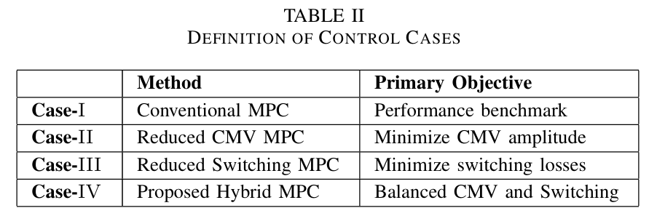
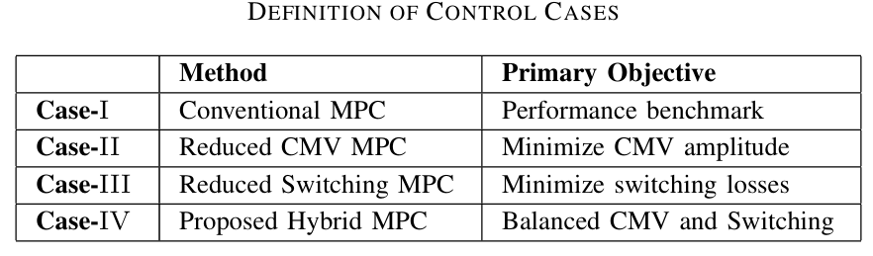
Simulation and Comparsion :
Simulations were carried out in MATLAB/Simulink using the PMSM parameters listed in Table-1.
The DC-link voltage was set to 560V and the prediction time to 1µs.The simulation duration was 5 s.
The speed reference was set to 100 rpm initially, stepped to 200rpm at 1.5 s, and decreased to 75 rpm at 3.5 s. The torque on motor was 0N·m until it stepped to 200N·m at 2.5s.
Since switching losses are proportional to the number of transitions, the total switching count provides a direct and effective metric for comparing the switching loss performance of various control algorithms.
Four control strategies as defined in Table-2 are compared.
For each controller, the following performance metrics were recorded and tabulated:
(i) total harmonic distortion (THD) of the stator currents
(ii) total number of switching events (summed across all inverter switches)
(iii) number of CMV spikes.

Slide 12
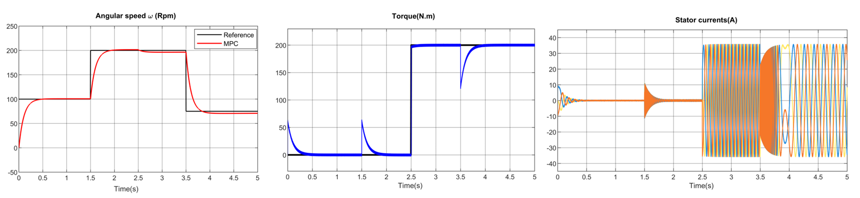
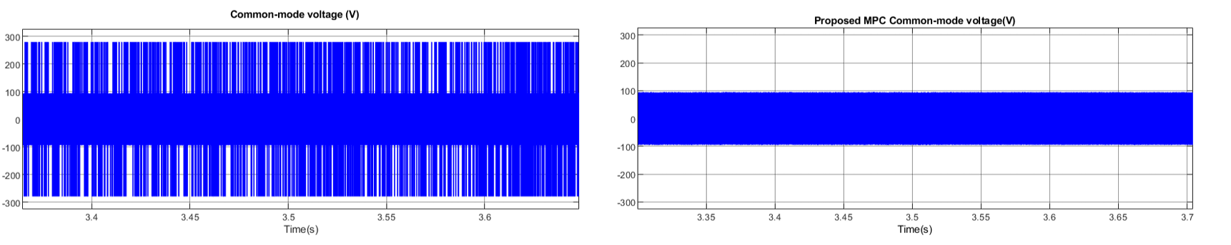
Simulation and Comparsion :

Slide 13
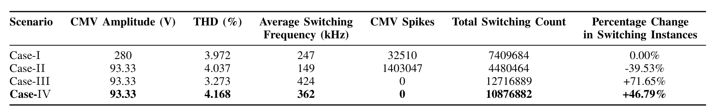
Simulation and Comparsion :
All four controllers demonstrated accurate speed reference tracking and torque delivery.
We can observe from above Table that Case-IV is a good trade-off between Case-II and Case-III. The Case-IV has no CMV spikes, and its average switching frequency is increased compared with the case I.
The proposed hybrid algorithm is a better compromise: it bounds the CMV to ±Vdc/6 and eliminates spikes, while increasing switching events by a more moderate 46.8% compared with the conventional method

Slide 14
Thank You
Questions ??

