Slide 1
Simulation of Outer Rotor PMBLDC Motor for Torque Improvement
Prepared by: M V Rohith Reddy
Electrical Engineering
School of Electrical and Computer Sciences
IIT Bhubaneswar

Slide 2

Problem Statement
Core Problem : How can we improve the torque output of an Outer Rotor Brushless DC (ORPMBLDC) motor?
The Fundamental Problem:
BLDC motors don't produce constant torque throughout rotation
Conventional drives use fixed commutation angles
This leaves significant torque potential untapped
Particularly critical for outer rotor designs where torque density is already higher.
Paper's Proposed Solution: Use Finite Element Method simulation with FEMM to analyse torque at various rotor positions and propose an optimal sinusoidal excitation strategy to maximize average torque.

Slide 3
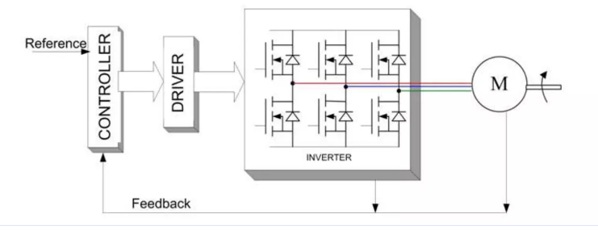
Brushless DC Motor
Brushless DC motor also known as electronically commutated motors(ECMs, EC motors) are synchronous that are powered by a DC electric source via an integrated inverter/switching power supply, which drives the motor.
Magnetic fields generated by the stator and rotor rotate at the same frequency.
No slip in the machine.
Stator consists of several coils which current is lead through creating a magnetic field that makes the rotor turns.
.

Slide 4
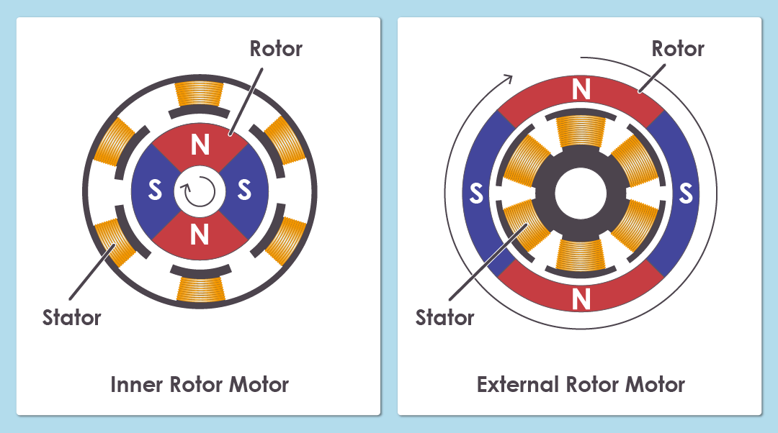
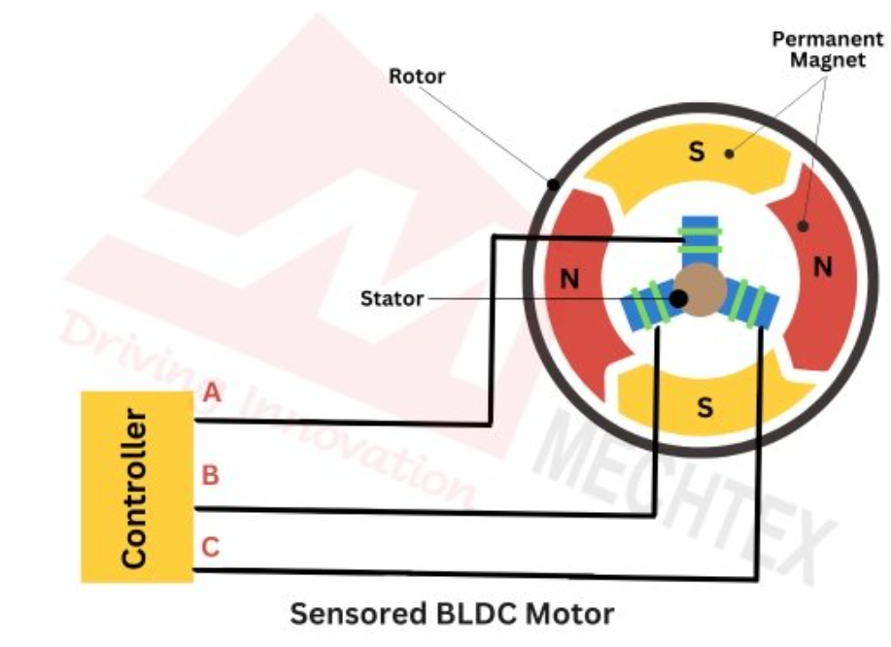
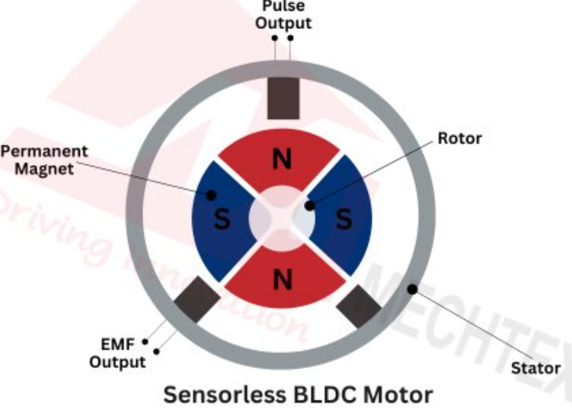
Types of BLDC Motor
BLDC Motor can be categorized by their design or control method:
Design: Inner runner and Outer runner
Inner runner: The rotor is on the inside, with coils on the outside, forming a standard motor structure.
Outer runner : The rotor is on the outside, with a stationary stator on the inside. This is the reverse construction of an inrunner.
By Control Method: Sensored and Sensorless
Sensored: Uses Hall effect sensors to detect the rotor's position, which helps the drive controller know when to switch the current.
SensorLess: Does not use sensors. The controller uses the back electromotive force (back EMF) generated by the motor to determine the rotor's position

Slide 5
Working of BLDC Motor
Electronic commutation energizes stator coils in a timed sequence (replacing brushes), producing a rotating magnetic field that drives the rotor.
Rotor position is detected using Hall sensors or sensorless methods (back-EMF/encoder), and the controller uses that info to time the commutation.
Torque comes from the interaction of the stator’s energized field and the rotor permanent magnets; the inverter controls current amplitude/phase to regulate torque and speed.

Slide 6
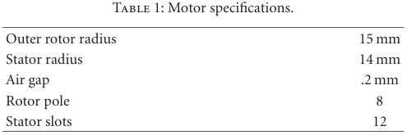
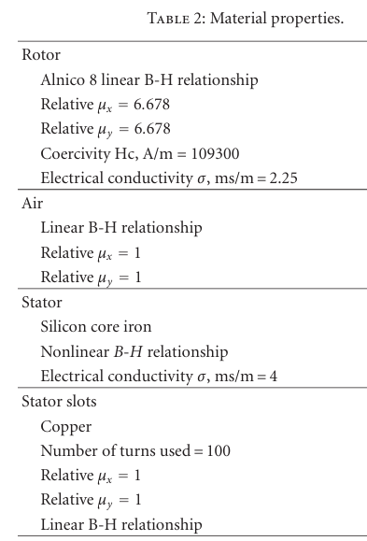
FEMM Simulation
The paper’s methodology is as follows:
Model the motor in FEMM using specifications from Table I,II.
Excite the Windings: Simulate 3-phase currents (A, B, C).
Sweep Parameters:
Rotor Angle: 0° to 90° (in 2.5° steps).
Phase Angle: 0° to 360° (in 5° steps).
Calculate Torque: Using the Maxwell Stress Tensor method.
Find Peak Torque for each rotor position.

Slide 7
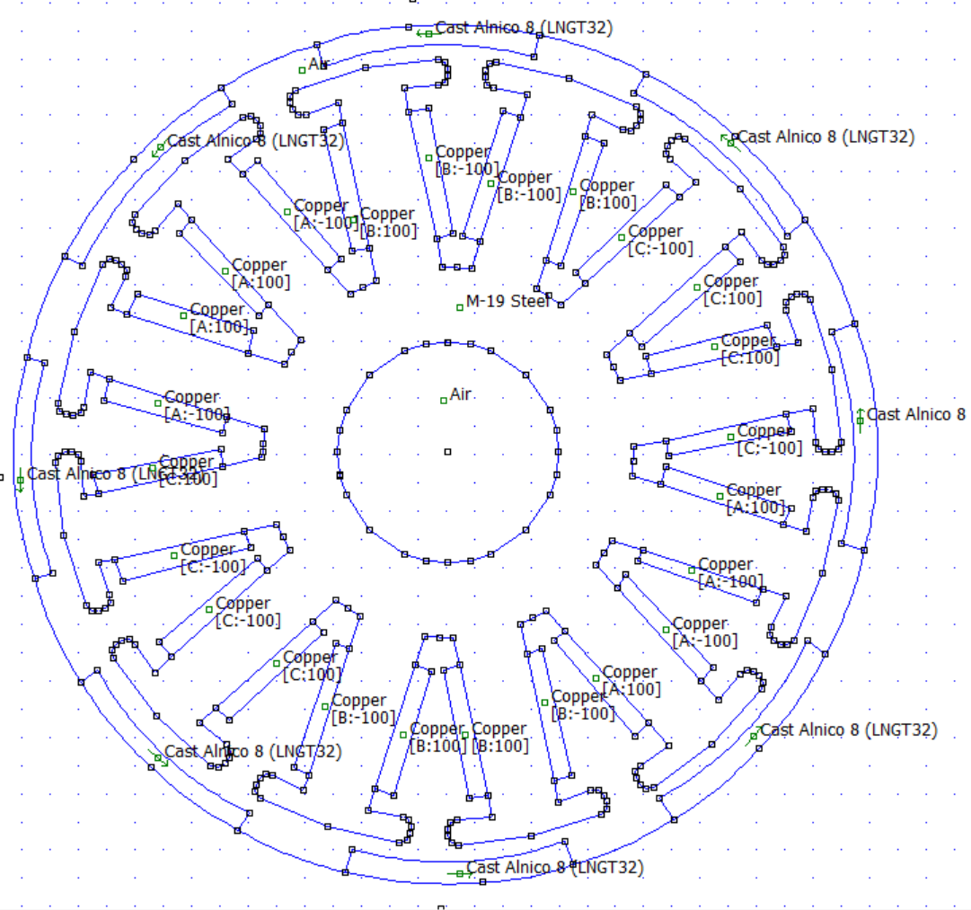
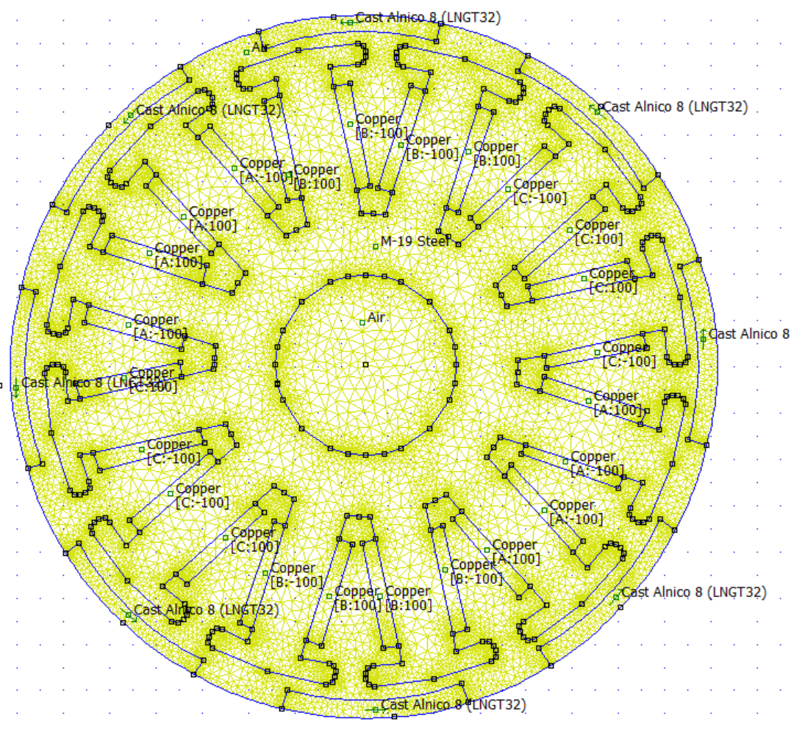
FEMM Simulation
Motor Model
FEMM meshed 2D Model

Slide 8
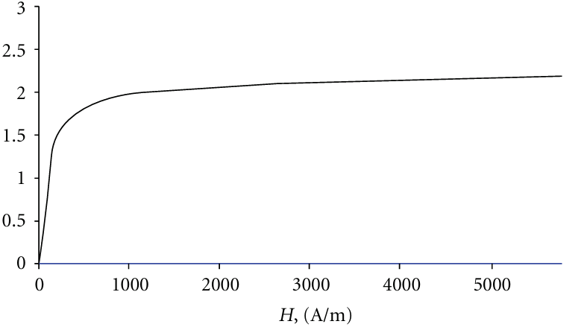
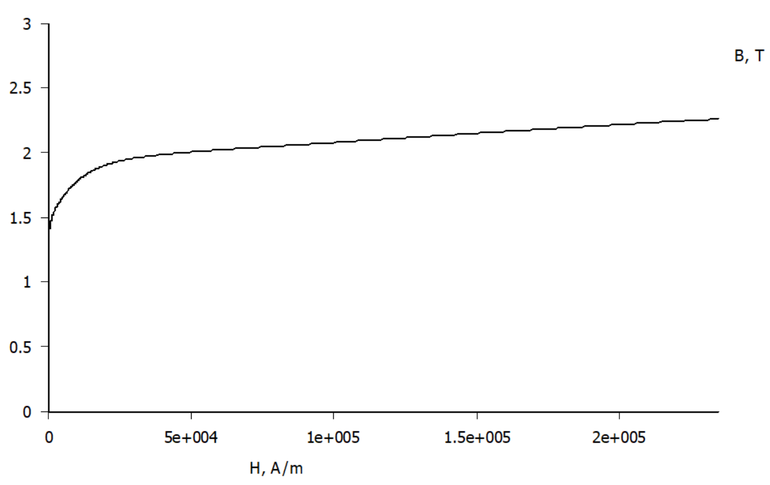


FEMM Simulation
The accuracy of this method is dependent on the model discretization and on the selection of the integration line or contour.
Using Maxwell stress tensor, the electromagnetic forces can be determined on the basis of the magnetic flux density, that is:
Rotor Linear BH Relationship
$$\vec{F}=\iint{\left[\frac{1}{μ_{0}}\vec{B}\left(\vec{B}⋅\vec{n}\right)−\frac{1}{2μ_{0}}B^{2}\vec{n}\right]ds}$$
$$\vec{T}=\vec{r}×\vec{F}$$
Stator Non Linear BH Relationship

Slide 9
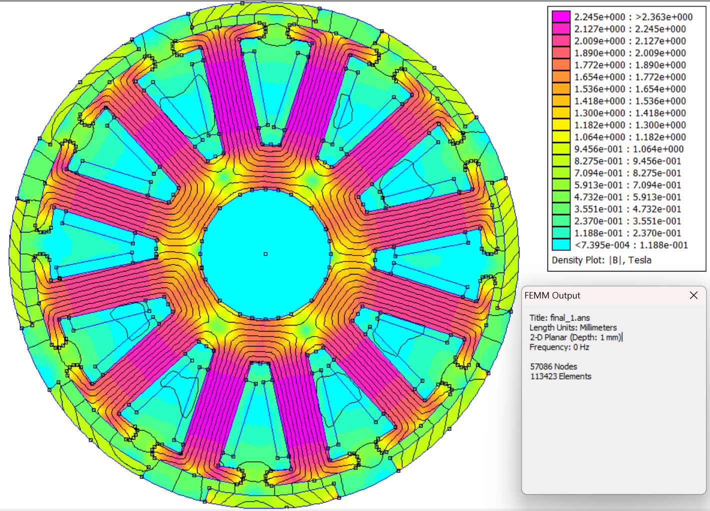
FEMM Simulation
The Motor has been modeled with 57086 nodes and 113423 elements in 2D plane.
Fine mesh in the Air Gap region is essential for accurate Torque calculation.
Stator and Rotor geometry is drawn in FreeCAD software and imported as DXF files to FEMM.
Manually rotating the rotor and changing currents 73x36 times is difficult, we can use lua script to automate the process.
Magnetic Flux Density Distribution

Slide 10
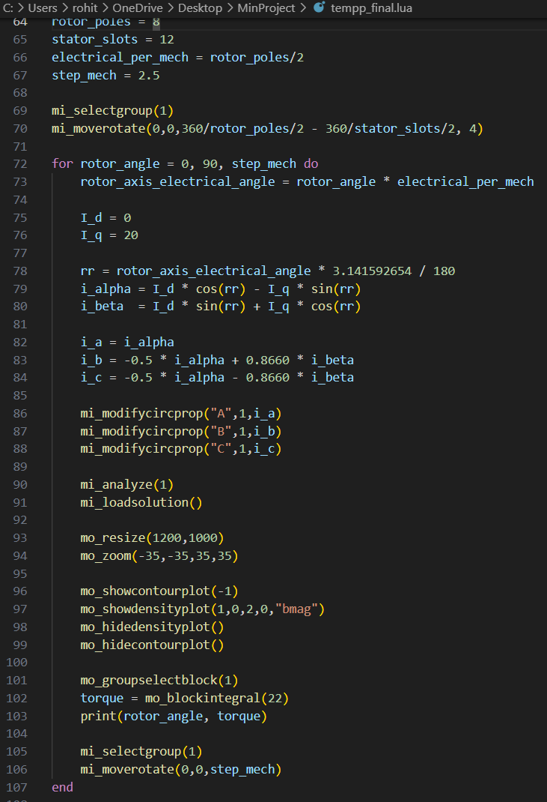
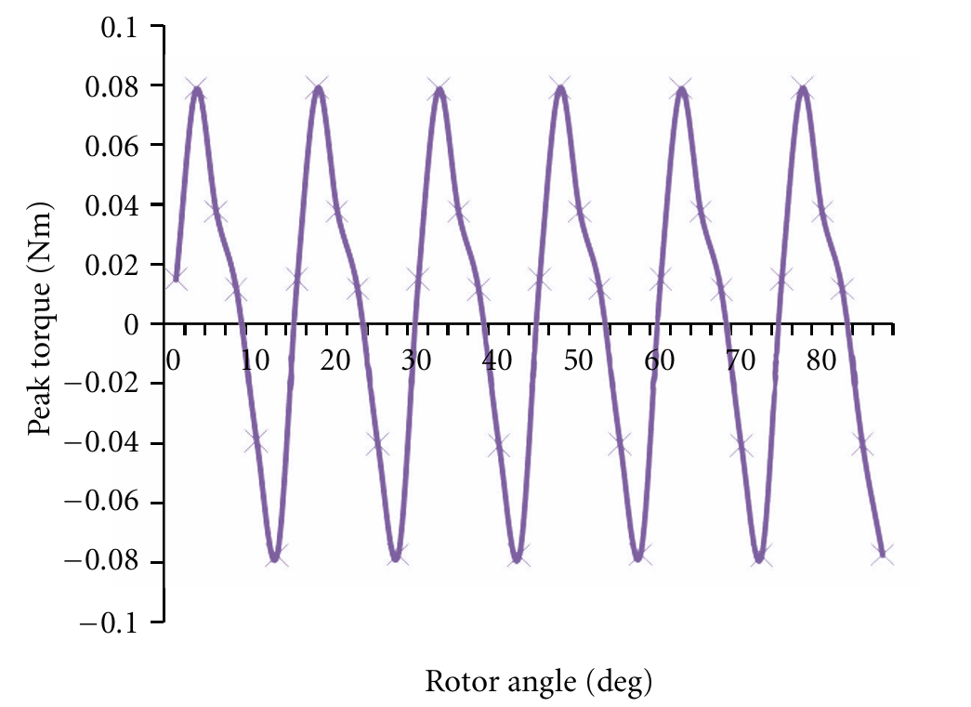
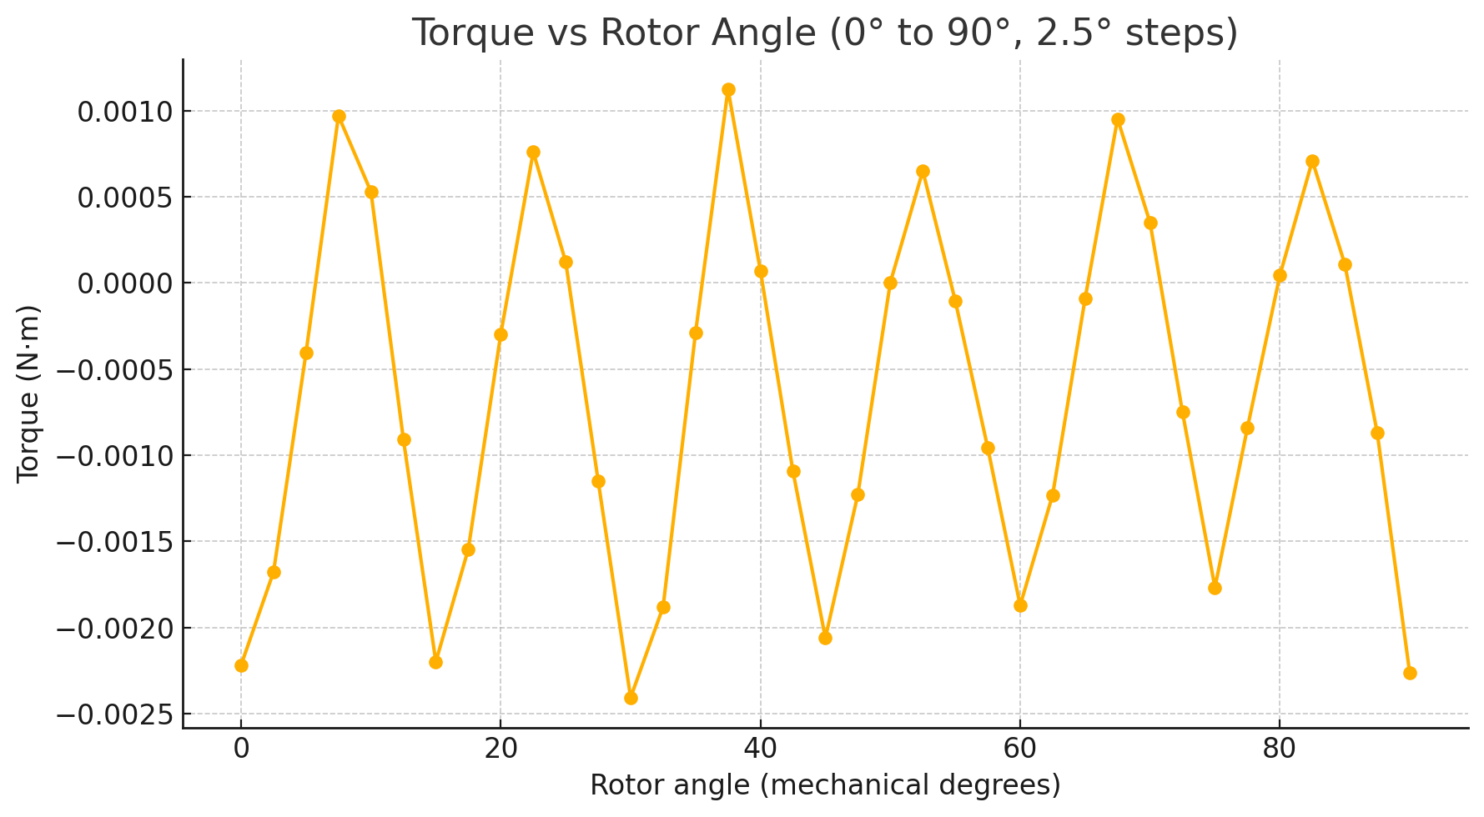
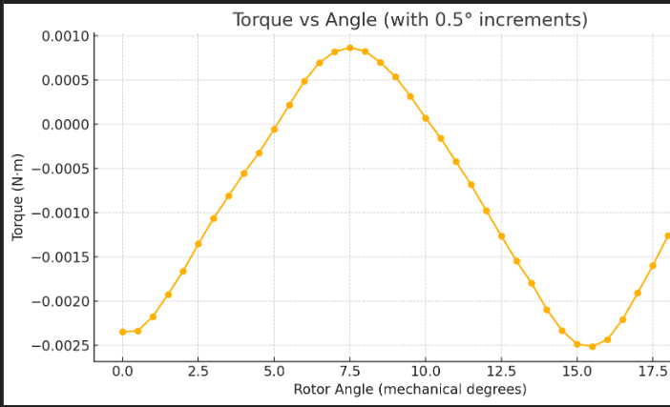
Lua Script for Rotation and Currents updating
Results from paper
Results from simulation

Slide 11
Summary and Learning Outcomes
Summary: The paper demonstrates a powerful method to maximize motor torque using FEM analysis and optimized excitation.
Your Learning:
Gained insights into Outer Rotor BLDC motor working and torque analysis.
Developed practical skills in using FEMM for electromagnetic simulation.
Familiarized with FreeCAD software for Motor design.
Understood basics of automation using Lua scripting.
Thank You
Questions??

