Slide 1

AIRPORT OPERATIONAL
DATABASE MANAGEMENT SYSTEM
SNO | NAME | ROLL NUMBER
1 | Marella Venkata Sai Rohith | 21CSB0F28
2 | Shreyas Chirasseril Sivan | 21CSB0F32

Slide 2
PROBLEM STATEMENT
To create a Database Management System to facilitate the smooth running of an airport. This sample database management system supports CRUD operations.
This system is designed to manage and streamline various operational aspects within an airport, including flight scheduling, resource allocation, and communication between different stakeholders. The primary objective is to create a centralized platform that enables efficient coordination and decision-making to enhance the overall operational efficiency of the airport.
The AODB system should integrate with existing airport systems and provide real-time data updates to ensure accurate and up-to-date information for all relevant parties.

Slide 3
ENTITIES
Terminal: The terminal table provides the relevant details regarding the terminals at an airport.
Flight Type: This entity describes the type and build of various types of aircrafts.
Hangar: Gives information of the location and capacity of a particular hangar to handle aircrafts.
Flight: This entity gives details regarding the flight numbers of various flights and the terminals each flight belongs to as well as it’s hangar number.
Baggage: Provides details of the baggage that has arrived for collection in an airport upon arrival. (Assuming that one flight will have only one baggage counter associated with it).

Slide 4
ENTITIES
Management Staff: This entity contains information regarding all the staff responsible for managing baggage and other important groundwork.
Runway: Provides details of dimension of the runway.
Airport: Contains data regarding several other destination airports.
Schedule: This entity contains details regarding the schedule of several flights such as their source and destinations, arrival and departure time etc.
Security: Provides details about the security staff in and around the airport.
ATC Staff: Contains details of all the air traffic control staff, managing the runway and air traffic.

Slide 5
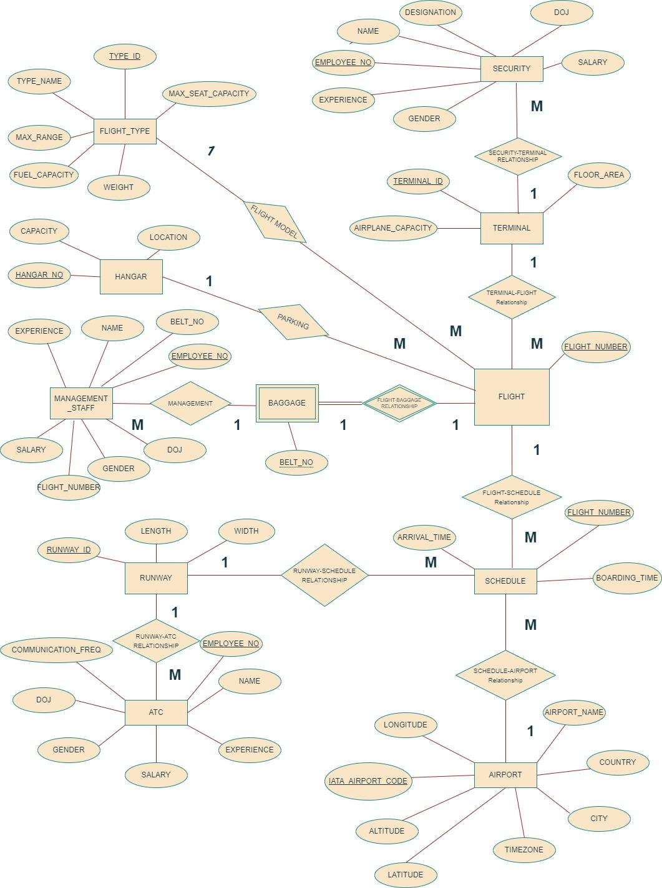
ENTITY RELATIONSHIP

Slide 6
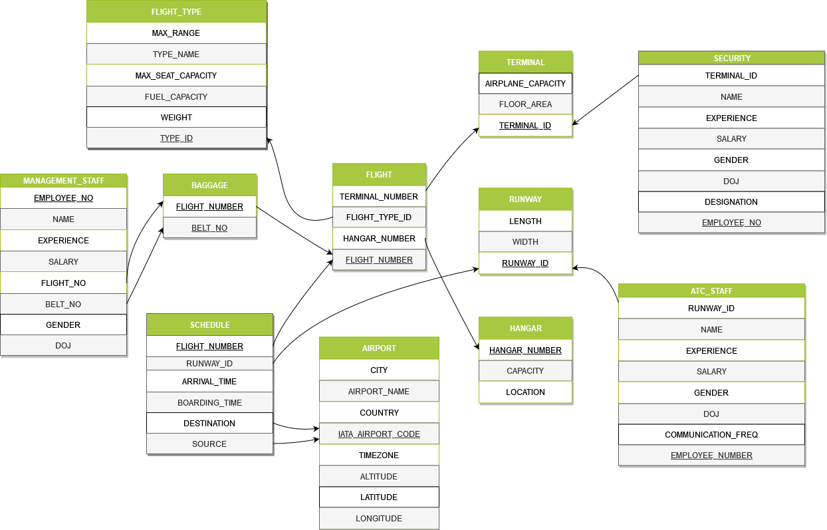
TABLE SCHEMA

Slide 7
TABLE CREATION
CREATE TABLE TERMINAL(TERMINAL_ID NUMBER PRIMARY KEY, FLOOR_AREA NUMBER,AIRPLANE_CAPACITY NUMBER);
CREATE TABLE FLIGHT_TYPE(TYPE_ID NUMBER PRIMARY KEY, TYPE_NAME VARCHAR2(30), MAX_SEAT_CAPACITY NUMBER, FUEL_CAPACITY NUMBER, WEIGHT NUMBER, MAX_RANGE NUMBER);
CREATE TABLE HANGAR(HANGAR_NUMBER NUMBER PRIMARY KEY, CAPACITY NUMBER NOT NULL, LOCATION VARCHAR2(25));
CREATE TABLE FLIGHT(FLIGHT_NUMBER NUMBER PRIMARY KEY, FLIGHT_TYPE_ID NUMBER, HANGAR_NUMBER NUMBER, TERMINAL_ID NUMBER , FOREIGN KEY(FLIGHT_TYPE_ID) REFERENCES FLIGHT_TYPE(TYPE_ID),FOREIGN KEY(HANGAR_NUMBER) REFERENCES HANGAR(HANGAR_NUMBER),FOREIGN KEY(TERMINAL_ID) REFERENCES TERMINAL(TERMINAL_ID));

Slide 8
TABLE CREATION
CREATE TABLE BAGGAGE(FLIGHT_NUMBER NUMBER NOT NULL,BELT_NO NUMBER NOT NULL,PRIMARY KEY(FLIGHT_NUMBER, BELT_NO), FOREIGN KEY(FLIGHT_NUMBER) REFERENCES FLIGHT(FLIGHT_NUMBER));
CREATE TABLE MANAGEMENT_STAFF(EMPLOYEE_NO NUMBER PRIMARY KEY,NAME VARCHAR2(50),EXPERIENCE NUMBER,SALARY NUMBER,GENDER VARCHAR2(2),DOJ DATE,BELT_NO NUMBER NOT NULL,FLIGHT_NO NUMBER,FOREIGN KEY (BELT_NO,FLIGHT_NO) REFERENCES BAGGAGE(BELT_NO,FLIGHT_NUMBER));
CREATE TABLE RUNWAY(RUNWAY_ID NUMBER PRIMARY KEY, WIDTH NUMBER, LENGTH NUMBER);
CREATE TABLE AIRPORT(IATA_AIRPORT_CODE VARCHAR2(25) PRIMARY KEY,AIRPORT_NAME VARCHAR2(50),COUNTRY VARCHAR2(20),CITY VARCHAR2(20),TIMEZONE VARCHAR2(50),ALTITUDE NUMBER,LATITUDE NUMBER(10,4),LONGITUDE NUMBER(10,4));

Slide 9
TABLE CREATION
CREATE TABLE SCHEDULE(FLIGHT_NUMBER NUMBER PRIMARY KEY, SOURCE VARCHAR2(25), DESTINATION VARCHAR2(25), BOARDING_TIME VARCHAR2(6), ARRIVAL_TIME VARCHAR2(6),RUNWAY_ID NUMBER, FOREIGN KEY(RUNWAY_ID) REFERENCES RUNWAY(RUNWAY_ID), FOREIGN KEY(FLIGHT_NUMBER) REFERENCES FLIGHT(FLIGHT_NUMBER),FOREIGN KEY(SOURCE) REFERENCES AIRPORT(IATA_AIRPORT_CODE),FOREIGN KEY(DESTINATION) REFERENCES AIRPORT(IATA_AIRPORT_CODE));
CREATE TABLE SECURITY(EMPLOYEE_NO NUMBER PRIMARY KEY,NAME VARCHAR2(30),EXPERIENCE NUMBER,SALARY NUMBER,GENDER VARCHAR2(2),DOJ DATE,DESIGNATION VARCHAR2(30),TERMINAL_ID NUMBER,FOREIGN KEY(TERMINAL_ID) REFERENCES TERMINAL(TERMINAL_ID));
CREATE TABLE ATC_STAFF(EMPLOYEE_NO NUMBER PRIMARY KEY,NAME VARCHAR2(30),EXPERIENCE NUMBER,SALARY NUMBER,GENDER VARCHAR2(2),
DOJ DATE,COMMUNICATION_FREQ NUMBER,RUNWAY_ID NUMBER,FOREIGN KEY(RUNWAY_ID) REFERENCES RUNWAY(RUNWAY_ID));

Slide 10
VALUES INSERTION
1. TERMINAL
INSERT INTO TERMINAL VALUES(1,1200,12);
INSERT INTO TERMINAL VALUES(2,1300,16);
INSERT INTO TERMINAL VALUES(3,1500,15);
2. FLIGHT_TYPE
INSERT INTO FLIGHT_TYPE VALUES(1,'BOEING 737',220,94770,78130,7040);
INSERT INTO FLIGHT_TYPE VALUES(2,'BOEING 767',180,90700,80100,10400);
INSERT INTO FLIGHT_TYPE VALUES(3,'AIRBUS A220',160,21500,54400,6290);
INSERT INTO FLIGHT_TYPE VALUES(4,'AIRBUS A320',170,27200,58900,6200);
INSERT INTO FLIGHT_TYPE VALUES(5,'AIRBUS A330',405,139100,158700,11720);
INSERT INTO FLIGHT_TYPE VALUES(6,'BOEING 777',380,181300,134800,15000);
INSERT INTO FLIGHT_TYPE VALUES(7,'BOEING 787 DREAMLINER',300,126200,119900,13500);

Slide 11
VALUES INSERTION
INSERT INTO FLIGHT_TYPE VALUES(8,'DOUGLAS DC8',270,88500,54300,4800);
INSERT INTO FLIGHT_TYPE VALUES(9,'AIRBUS A300',230,68000,127000,7500);
INSERT INTO FLIGHT_TYPE VALUES(10,'AIRBUS A310',200,61000,127000,8000);
HANGAR
INSERT INTO HANGAR VALUES(1,25,'SECTOR 1');
INSERT INTO HANGAR VALUES(2,27,'SECTOR 1');
INSERT INTO HANGAR VALUES(3,31,'SECTOR 2');
INSERT INTO HANGAR VALUES(4,18,'SECTOR 3');
INSERT INTO HANGAR VALUES(5,15,'SECTOR 3');
FLIGHT
INSERT INTO FLIGHT VALUES(101,1,1,3);
INSERT INTO FLIGHT VALUES(102,2,2,3);

Slide 12
VALUES INSERTION
INSERT INTO FLIGHT VALUES(103,1,3,2);
INSERT INTO FLIGHT VALUES(104,7,4,3);
INSERT INTO FLIGHT VALUES(105,9,5,1);
INSERT INTO FLIGHT VALUES(106,4,2,2);
INSERT INTO FLIGHT VALUES(107,6,4,3);
INSERT INTO FLIGHT VALUES(108,6,5,2);
INSERT INTO FLIGHT VALUES(109,5,3,1);
INSERT INTO FLIGHT VALUES(110,8,1,1);
BAGGAGE
INSERT INTO BAGGAGE VALUES(101,1);
INSERT INTO BAGGAGE VALUES(102,2);
INSERT INTO BAGGAGE VALUES(103,3);
INSERT INTO BAGGAGE VALUES(104,4);
INSERT INTO BAGGAGE VALUES(105,5);

Slide 13
VALUES INSERTION
INSERT INTO BAGGAGE VALUES(106,6);
INSERT INTO BAGGAGE VALUES(107,7);
INSERT INTO BAGGAGE VALUES(108,8);
INSERT INTO BAGGAGE VALUES(109,9);
INSERT INTO BAGGAGE VALUES(110,10);
MANAGEMENT_STAFF
INSERT INTO MANAGEMENT_STAFF VALUES(10101,'SHREYAS',1,10000,'M','12-JAN-2022',1,101);
INSERT INTO MANAGEMENT_STAFF VALUES(10102,'ROHITH',3,10000,'M','12-JAN-2020',2,102);
INSERT INTO MANAGEMENT_STAFF VALUES(10103,'SHRAVAN',18,50000,'M','22-JUL-2005',3,103);
INSERT INTO MANAGEMENT_STAFF VALUES(10104,'KUMAR',18,50000,'M','30-MAR-2005',4,104);

Slide 14
VALUES INSERTION
INSERT INTO MANAGEMENT_STAFF VALUES(10105,'RAM',21,155000,'M','02-APR-2002',5,105);
INSERT INTO MANAGEMENT_STAFF VALUES(10106,'SITA',5,30000,'F','24-JAN-2018',6,106);
INSERT INTO MANAGEMENT_STAFF VALUES(10107,'DIVYA',2,10000,'F','28-FEB-2021',7,107);
INSERT INTO MANAGEMENT_STAFF VALUES(10108,'ANAND',3,20000,'M','30-MAY-2020',8,108);
INSERT INTO MANAGEMENT_STAFF VALUES(10109,'AMAN',3,20000,'M','22-JUN-2020',9,109);
INSERT INTO MANAGEMENT_STAFF VALUES(10110,'ROHAN',2,10000,'M','11-JAN-2021',10,110);
RUNWAY
INSERT INTO RUNWAY VALUES(1,45,4000);
INSERT INTO RUNWAY VALUES(2,45,3500);
INSERT INTO RUNWAY VALUES(3,60,3700);

Slide 15
VALUES INSERTION
AIRPORT
INSERT INTO AIRPORT VALUES('MCT','MUSCAT INTERNATIONAL AIRPORT','OMAN','MUSCAT','GST',15,23.6017,58.2900);
INSERT INTO AIRPORT VALUES('DXB','DUBAI INTERNATIONAL AIRPORT','UAE','DUBAI','GST',19,25.2531,55.3656);
INSERT INTO AIRPORT VALUES('HYD','RAJIV GANDHI INTERNATIONAL AIRPORT','INDIA','HYDERABAD','IST',617,17.2403,78.4294);
INSERT INTO AIRPORT VALUES('MAA','CHENNAI INTERNATIONAL AIRPORT','INDIA','CHENNAI','IST',16,12.9941,80.1709);
INSERT INTO AIRPORT VALUES('COK','COCHIN INTERNATIONAL AIRPORT','INDIA','COCHI','IST',9,10.1518,76.3930);
INSERT INTO AIRPORT VALUES('TRV','THIRUVANANTHAPURAM INTERNATIONAL AIRPORT','INDIA','THIRUVANANTHAPURAM','IST',3,8.4834,76.9198);
INSERT INTO AIRPORT VALUES('BOM','CHHATRAPATI SHIVAJI MAHARAJ INTERNATIONAL AIRPORT','INDIA','MUMBAI','IST',11,19.0902,72.8628);

Slide 16
VALUES INSERTION
INSERT INTO AIRPORT VALUES('SIN','SINGAPORE CHANGI AIRPORT','SINGAPORE','CHANGI','SGT',6,1.3545,101.9886);
SCHEDULE
INSERT INTO SCHEDULE VALUES(101,'HYD','DXB','15:00','19:00',3);
INSERT INTO SCHEDULE VALUES(102,'HYD','MCT','05:00','09:00',3);
INSERT INTO SCHEDULE VALUES(103,'DXB','HYD','10:00','14:00',2);
INSERT INTO SCHEDULE VALUES(104,'BOM','HYD','21:00','22:30',1);
INSERT INTO SCHEDULE VALUES(105,'MAA','HYD','01:00','02:30',2);
INSERT INTO SCHEDULE VALUES(106,'HYD','SIN','13:00','17:40',2);
INSERT INTO SCHEDULE VALUES(107,'COK','HYD','11:00','12:25',1);
INSERT INTO SCHEDULE VALUES(108,'HYD','TRV','10:20','11:50',2);
INSERT INTO SCHEDULE VALUES(109,'HYD','BOM','12:00','13:20',1);
INSERT INTO SCHEDULE VALUES(110,'SIN','HYD','18:00','22:40',3);

Slide 17
VALUES INSERTION
SECURITY
INSERT INTO SECURITY VALUES(10201,'SHREYAS',1,10000,'M','12-JAN-2022','HEAD SECURITY',1);
INSERT INTO SECURITY VALUES(10202,'ROHITH',3,10000,'M','12-JAN-2020','ASSISTANT SECURITY',1);
INSERT INTO SECURITY VALUES(10203,'MARUTI',18,50000,'M','22-JUL-2005','OFFICER',3);
INSERT INTO SECURITY VALUES(10204,'SHIVA',18,50000,'M','30-MAR-2005','OFFICER',2);
INSERT INTO SECURITY VALUES(10205,'RAMN',21,155000,'M','02-APR-2002','ASSISTANT SECURITY',3);
INSERT INTO SECURITY VALUES(10206,'LAKSHMI',5,30000,'F','24-JAN-2018','OFFICER',2);
INSERT INTO SECURITY VALUES(10207,'DEVI',2,10000,'F','28-FEB-2021','OFFICER',1);
INSERT INTO SECURITY VALUES(10208,'LAXMAN',3,20000,'M','30-MAY-2020','OFFICER',3);
INSERT INTO SECURITY VALUES(10209,'ARON',3,20000,'M','22-JUN-2020','OFFICER',3);
INSERT INTO SECURITY VALUES(10210,'RAHUL',2,10000,'M','11-JAN-2021','OFFICER',2);

Slide 18
VALUES INSERTION
ATC_STAFF
INSERT INTO ATC_STAFF VALUES(10301,'SHREYAS',1,10000,'M','12-JAN-2022',120,1);
INSERT INTO ATC_STAFF VALUES(10302,'ROHITH',3,10000,'M','12-JAN-2020',130,1);
INSERT INTO ATC_STAFF VALUES(10303,'RUDRA',18,50000,'M','22-JUL-2005',122,3);
INSERT INTO ATC_STAFF VALUES(10304,'RAJAT',18,50000,'M','30-MAR-2005',134,2);
INSERT INTO ATC_STAFF VALUES(10305,'KRISHNA',21,155000,'M','02-APR-2002',128,3);
INSERT INTO ATC_STAFF VALUES(10306,'DEEPTI',5,30000,'F','24-JAN-2018',131,2);
INSERT INTO ATC_STAFF VALUES(10307,'DHRITI',2,10000,'F','28-FEB-2021',132,1);
INSERT INTO ATC_STAFF VALUES(10308,'BALRAM',3,20000,'M','30-MAY-2020',133,3);
INSERT INTO ATC_STAFF VALUES(10309,'BHARAT',3,20000,'M','22-JUN-2020',125,3);
INSERT INTO ATC_STAFF VALUES(10310,'ARJUN',2,10000,'M','11-JAN-2021',124,2);

Slide 19
NORMALIZATION
TERMINAL
CANDIDATE KEY SET= {TERMINAL_ID}
PRIME ATTRIBUTES= {TERMINAL_ID}
NON PRIME ATTRIBUTES= {FLOOR AREA, AIRPLANE_CAPACITY}
1 NF
There are no multivalued attributes, hence already in 1NF.
2 NF
There is no partial dependency, hence already in 2 NF.
3 NF
There is no transitive dependency between prime attributes and non-prime attributes, hence already in 3 NF.
BCNF
All FD’s have determinant as superkey/candidate key, hence it is in BCNF.

Slide 20
NORMALIZATION
FLIGHT_TYPE
CANDIDATE KEY SET= {TYPE_ID}
PRIME ATTRIBUTES= {TYPE_ID}
NON PRIME ATTRIBUTES= {TYPE_NAME, MAX_SEAT, FUEL_CAPACITY,WEIGHT, MAX_RANGE}
1 NF
There are no multivalued attributes, hence already in 1NF.
2 NF
There is no partial dependency, hence already in 2 NF.
3 NF
There is no transitive dependency between prime attributes and non-prime attributes, hence already in 3 NF.
BCNF
All FD’s have determinant as superkey/candidate key, hence it is in BCNF.

Slide 21
NORMALIZATION
HANGAR
CANDIDATE KEY SET= {HANGAR_NUMBER}
PRIME ATTRIBUTES= {HANGAR_NUMBER}
NON PRIME ATTRIBUTES= {CAPACITY, LOCATION}
1 NF
There are no multivalued attributes, hence already in 1NF.
2 NF
There is no partial dependency, hence already in 2 NF.
3 NF
There is no transitive dependency between prime attributes and non-prime attributes, hence already in 3 NF.
BCNF
All FD’s have determinant as superkey/candidate key, hence it is in BCNF.

Slide 22
NORMALIZATION
FLIGHT
CANDIDATE KEY SET= {FLIGHT_NUMBER}
PRIME ATTRIBUTES= {FLIGHT_NUMBER}
NON PRIME ATTRIBUTES= {FLIGHT_TYPE_ID, HANGAR_NUMBER, TERMINAL_ID}
1 NF
There are no multivalued attributes, hence already in 1NF.
2 NF
There is no partial dependency, hence already in 2 NF.
3 NF
There is no transitive dependency between prime attributes and non-prime attributes, hence already in 3 NF.
BCNF
All FD’s have determinant as superkey/candidate key, hence it is in BCNF.

Slide 23
NORMALIZATION
BAGGAGE
CANDIDATE KEY SET= {FLIGHT_NUMBER BELT_NO}
PRIME ATTRIBUTES= {FLIGHT_NUMBER, BELT_NO}
NON PRIME ATTRIBUTES= NONE
1 NF
There are no multivalued attributes, hence already in 1NF.
2 NF
There is no partial dependency, hence already in 2 NF.
3 NF
There is no transitive dependency between prime attributes and non-prime attributes, hence already in 3 NF.
BCNF
All FD’s have determinant as superkey/candidate key, hence it is in BCNF.

Slide 24
NORMALIZATION
MANAGEMENT_STAFF
CANDIDATE KEY SET= {EMPLOYEE_NO}
PRIME ATTRIBUTES= {EMPLOYEE_NO}
NON PRIME ATTRIBUTES= {EXPERIENCE, SALARY, GENDER ,DOJ, BELT_NO ,FLIGHT_NO}
1 NF
There are no multivalued attributes, hence already in 1NF.
2 NF
There is no partial dependency, hence already in 2 NF.
3 NF
There is no transitive dependency between prime attributes and non-prime attributes, hence already in 3 NF.
BCNF
All FD’s have determinant as superkey/candidate key, hence it is in BCNF.

Slide 25
NORMALIZATION
RUNWAY
CANDIDATE KEY SET= {RUNWAY_ID}
PRIME ATTRIBUTES= {RUNWAY_ID}
NON PRIME ATTRIBUTES= {WIDTH, LENGTH}
1 NF
There are no multivalued attributes, hence already in 1NF.
2 NF
There is no partial dependency, hence already in 2 NF.
3 NF
There is no transitive dependency between prime attributes and non-prime attributes, hence already in 3 NF.
BCNF
All FD’s have determinant as superkey/candidate key, hence it is in BCNF.

Slide 26
NORMALIZATION
AIRPORT
CANDIDATE KEY SET= {IATA_AIRPORT_CODE}
PRIME ATTRIBUTES= {IATA_AIRPORT_CODE}
NON PRIME ATTRIBUTES= {AIRPORT_NAME , COUNTRY , CITY, TIMEZONE ,ALTITUDE , LATITUDE , LONGITUDE}
1 NF
There are no multivalued attributes, hence already in 1NF.
2 NF
There is no partial dependency, hence already in 2 NF.
3 NF
There is no transitive dependency between prime attributes and non-prime attributes, hence already in 3 NF.
BCNF
All FD’s have determinant as superkey/candidate key, hence it is in BCNF.

Slide 27
NORMALIZATION
SCHEDULE
CANDIDATE KEY SET= {FLIGHT_NUMBER}
PRIME ATTRIBUTES= {FLIGHT_NUMBER}
NON PRIME ATTRIBUTES= {SOURCE , DESTINATION , BOARDING_TIME , ARRIVAL_TIME ,RUNWAY_ID}
1 NF
There are no multivalued attributes, hence already in 1NF.
2 NF
There is no partial dependency, hence already in 2 NF.
3 NF
There is no transitive dependency between prime attributes and non-prime attributes, hence already in 3 NF.
BCNF
All FD’s have determinant as superkey/candidate key, hence it is in BCNF.

Slide 28
NORMALIZATION
SECURITY
CANDIDATE KEY SET= {EMPLOYEE_NO}
PRIME ATTRIBUTES= {EMPLOYEE_NO}
NON PRIME ATTRIBUTES= {NAME , EXPERIENCE , SALARY,GENDER , DOJ, DESIGNATION, TERMINAL_ID}
1 NF
There are no multivalued attributes, hence already in 1NF.
2 NF
There is no partial dependency, hence already in 2 NF.
3 NF
There is no transitive dependency between prime attributes and non-prime attributes, hence already in 3 NF.
BCNF
All FD’s have determinant as superkey/candidate key, hence it is in BCNF.

Slide 29
NORMALIZATION
ATC_STAFF
CANDIDATE KEY SET= {EMPLOYEE_NO}
PRIME ATTRIBUTES= {EMPLOYEE_NO}
NON PRIME ATTRIBUTES= {NAME ,EXPERIENCE,SALARY, GENDER ,
DOJ , COMMUNICATION_FREQ ,RUNWAY_ID}
1 NF
There are no multivalued attributes, hence already in 1NF.
2 NF
There is no partial dependency, hence already in 2 NF.
3 NF
There is no transitive dependency between prime attributes and non-prime attributes, hence already in 3 NF.
BCNF
All FD’s have determinant as superkey/candidate key, hence it is in BCNF.

Slide 30
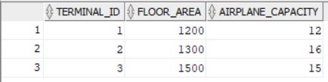
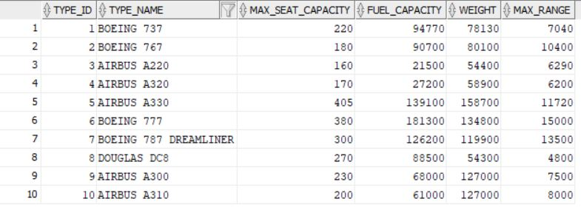
RELATIONS (TABLES)
TERMINAL
FLIGHT TYPE

Slide 31
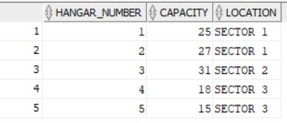
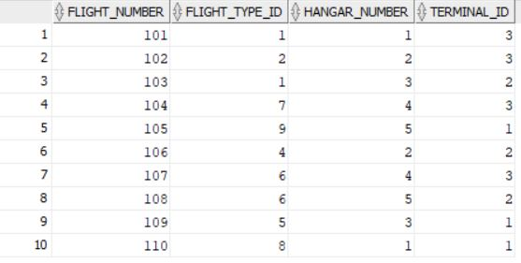
HANGAR
FLIGHT

Slide 32
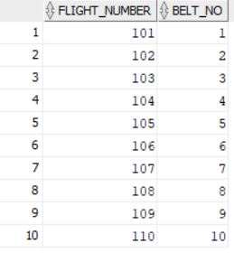
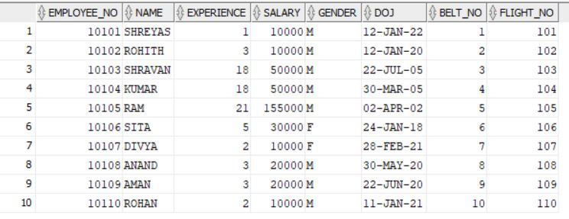
BAGGAGE
MANAGEMENT STAFF

Slide 33
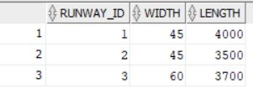
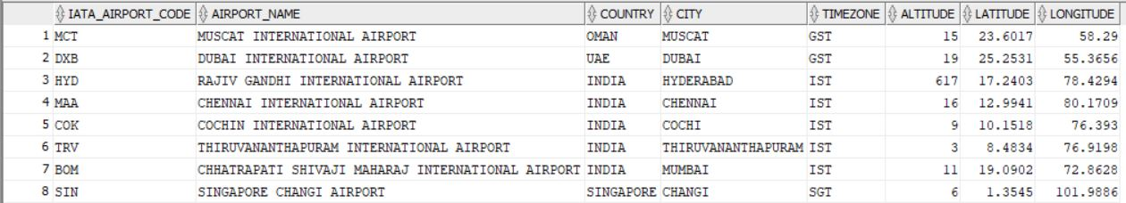
RUNWAY
AIRPORT

Slide 34
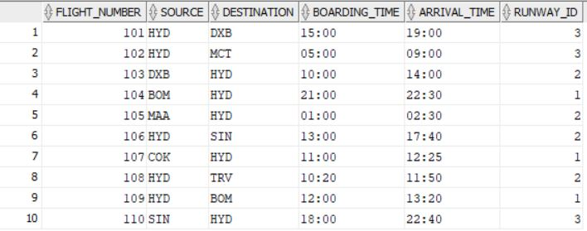
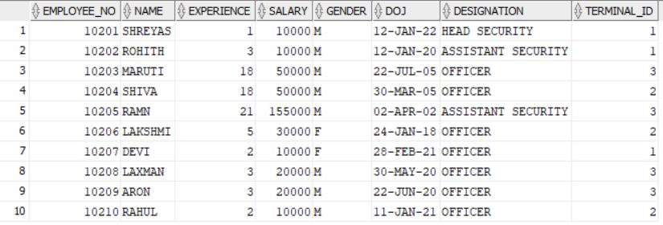
SCHEDULE
SECURITY STAFF

Slide 35
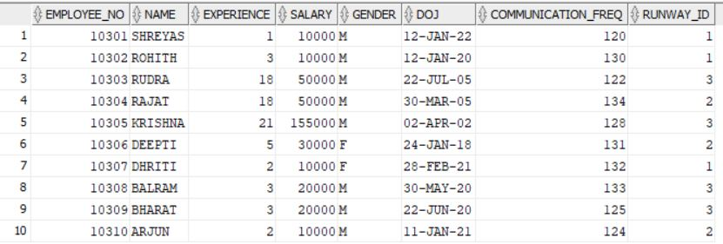
AIR TRAFFIC CONTROL STAFF

Slide 36


