Slide 1
PRESENTATION ON PROJECT
Searching Restaurant
By:
Mounika Uppala
Rohith Uppala

Slide 2
Content
Introduction
Operations
Steps in creating project
Technologies and Tools
Future scope

Slide 3
Introduction
This project is a basic Searching of Restaurant.
This can be used by both Administrator and User.
It gives information about Restaurants such as Phone Number, Time when the restaurant is open, Available food items etc.
Admin can add new Restaurants using this GUI.
User can provide his rating based on his experience.

Slide 4
Steps in creating project
Creating the ER diagram and Schema diagram
Creating the database
Creating fxml file for GUI
Connecting the database through JDBC
Creating a Java FX project using Model – view- Controller
Implementing the Business Logic
Debugging
Testing

Slide 5
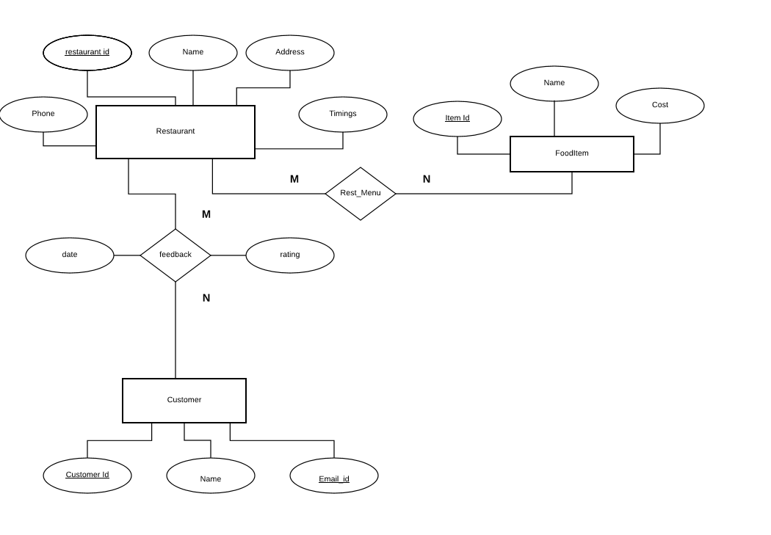
Entity Relationship Model

Slide 6
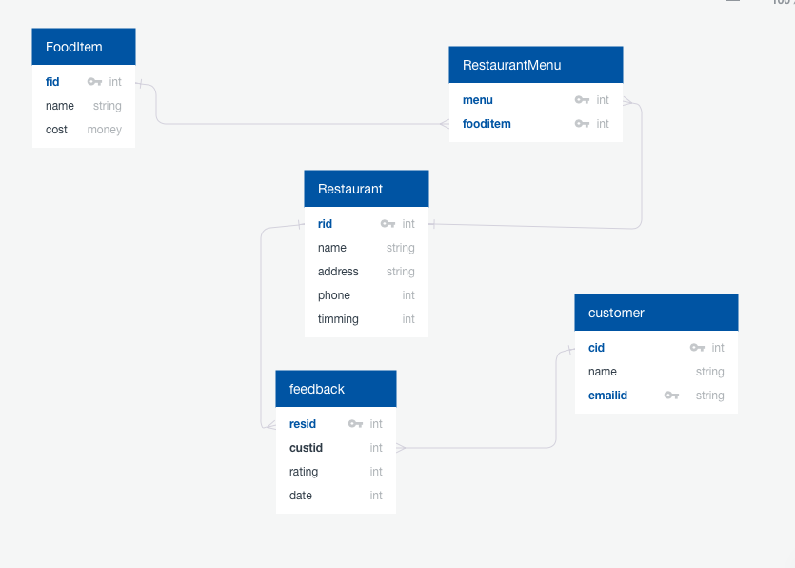
Schema Diagram

Slide 7
Technologies and Tools
Technologies
JAVA FX (GUI)
My SQL (Database)
Tools
Eclipse with JAVA FX
DB Visualizer or My SQL workbench
Scene Builder

Slide 8
Operations
Inserting a Restaurant
Searching Restaurant by Name or City
Searching all Restaurants
Giving and Updating the Rating
Deleting the Restaurant

Slide 9
DEMO

Slide 10
Future Scope
Creating Authentication for both Admin and Customer
Creating login session.
Based on access differentiating the operations
Adding the food Items
Making the User Interface better

Slide 11
Any Questions ?

Slide 12
Thank you

