Slide 1
VEGETABLE CLASSIFICATION
-RAIHAN M. KAMALUDDIN
-ROHITH REDDY MANDALA

Slide 2
INTRODUCTION AND MOTIVATION
In 2016, the US fruit and vegetable market was worth USD 104.7 billion. The top snacking foods in the United States are currently vegetables and fruits.
In grocery stores and supermarkets, a barcode is scanned for all the products to obtain their billing details but when it comes to pricing vegetables, the cashier usually has to manually enter the name of a particular vegetable or scan vegetables using a barcode when they are pre-packed by placing a sticker on them.
The use of image classification and identification technology can realize automatic recognition and pricing of vegetables, which has a relatively wide application value and a smarter system to overcome those problems.

Slide 3
PROBLEM STATEMENT
Building a model to classify vegetables which is trained on images into their appropriate categories using the vegetable image data set.
Using CNN(Python and PyTorch)
A Convolutional Neural Network (ConvNet/CNN) is a Deep Learning algorithm which can take in an input image, assign importance (learnable weights and biases) to various aspects/objects in the image and be able to differentiate one from the other.
Python is a programming language.
PyTorch is an open and free source machine learning library based on the Torch library, used for applications such as computer vision and natural language processing.

Slide 4
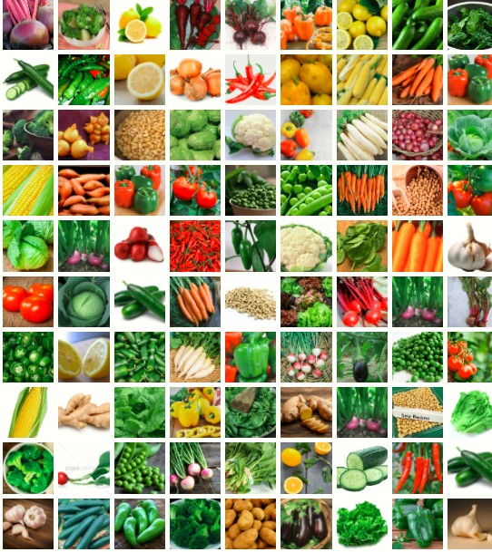

DATA SET
The dataset contains 2204 images of 23 various vegetables like Broccoli, Cabbage, Carrot, Tomato, Corn, Beetroot, Peas, Onions, chili, and more.
The images are resized to (220*220*3)
It contains 1577 images as a training data, 205 images as validation data and 402 images as testing data.

Slide 5
DATA PREPROCESSING FUNCTIONS
RESIZE
To resize an image, you call the resize() method on it, passing in a two-integer tuple argument representing the width and height of the resized image.
TO TENSOR
Tensors are a specialized data structure that are very similar to arrays and matrices. In PyTorch, we use tensors to encode the inputs and outputs of a model, as well as the model’s parameters. Tensors are similar to NumPy’s ndarrays, except that tensors can run on GPUs or other hardware accelerators.
NORMALIZATION
The goal of normalization is to change the values of numeric columns in the dataset to use a common scale, without distorting differences in the ranges of values or losing information.

Slide 6
WHY CNN?
In machine learning, a convolutional neural network is a class of deep, feed-forward artificial neural networks that has successfully been applied to analyzing visual imagery.
CNNs use a variation of multilayer perceptron's designed to require minimal preprocessing. They are also known as shift invariant or space invariant artificial neural networks (SIANN), based on their shared-weights architecture and translation invariance characteristics.

Slide 7
CNN BUILDING BLOCKS
Convolutional Layer
Convolutional layers are the major building blocks used in convolutional neural networks.
A convolution is the simple application of a filter to an input that results in an activation. Repeated application of the same filter to an input results in a map of activations called a feature map, indicating the locations and strength of a detected feature in an input, such as an image.
Pooling Layer
Pooling layers provide an approach to down sampling feature maps by summarizing the presence of features in patches of the feature map. Two common pooling methods are average pooling and max pooling that summarize the average presence of a feature and the most activated presence of a feature respectively.
Activation Function
An activation function in a neural network defines how the weighted sum of the input is transformed into an output from a node or nodes in a layer of the network.
Sometimes the activation function is called a “transfer function.” If the output range of the activation function is limited, then it may be called a “squashing function.” Many activation functions are nonlinear and may be referred to as the “nonlinearity” in the layer or the network design.
Fully Connected Layer
Fully connected layers connect every neuron in one layer to every neuron in another layer. The flattened matrix goes through a fully connected layer to classify the images.
The output from the convolutional layers represents high-level features in the data. While that output could be flattened and connected to the output layer, adding a fully-connected layer is a (usually) cheap way of learning non-linear combinations of these features.

Slide 8
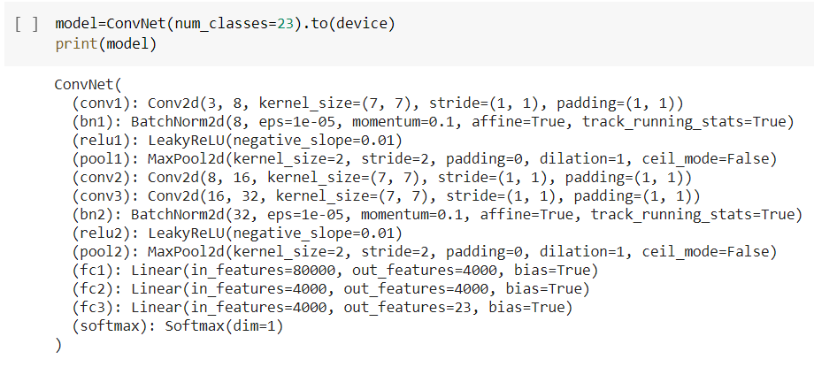
MODEL ARCHITECTURE
Our custom model has 13 layers, the first layer is the convolutional layer, the last three layers are the fully connected layers followed with the SoftMax activation function . It can be seen from Figure that the back of the first, fifth, and sixth layers are the convolution layer, the second and seventh layer is the batch normal. The first batch normal layer and second batch normal layer is directly followed by the LeakyReLu layer and MaxPool layer.

Slide 9
VOLUME DIMENSIONS TABLE
LAYERS | Activation Volume Dimensions | Number of parameters
INPUT | 220*220*3 | 0
CONV-1 (8-7) | 216*216*8 | 1184
POOL-1 (2) | 108*108*8 | 0
CONV-2 (16-7) | 104*104*16 | 2368
CONV-3 (32-7) | 100*100*32 | 4736
POOL-2 (2) | 50*50*32 | 0
FC-1 | (4000) | (80000+1)*4000
FC-2 | (4000) | (4000+1)*4000
FC-3 | (23) | (4000+1)*23

Slide 10
CHOSEN HYPERPARAMETERS OF OUR MODEL
Input size (220*220*3)
In Hidden Layers:
Convolution layers
Kernel size (7)
Stride (1)
Padding (1)
In_channels (3,8,16)
Out_channels(8,16,32)
Pooling Layer
Max Pooling
Activation Function
LeakyRelu
In Output Layers
FullyConnected Layer
In_features (80000,4000,4000)
Out_features (4000,4000,23)
Activation Function
SoftMax

Slide 11
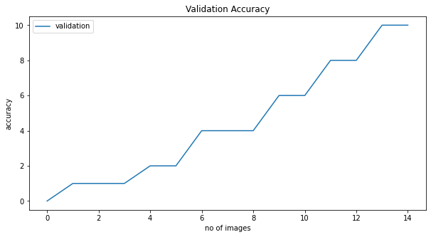
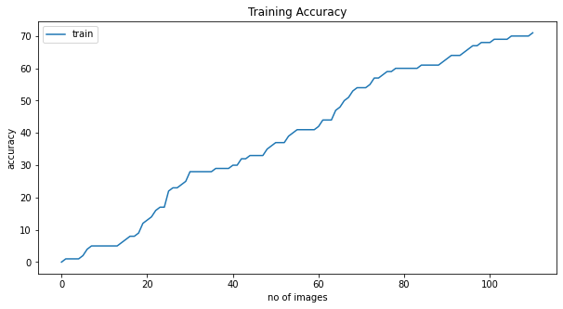
Results
At the moment our custom model has an accuracy of 0.050729 on the training data set and 0.053658 on the validation data set. The accuracy of both validation and training data set are analyzed in above figures.

Slide 12
TRIAL AND ERRORS
Transfer Learning
Initially, we tried transfer learning to the AlexNet model used to perform the image classification. This model had different parameters and layers. AlexNet has eight layers, with the first five being convolutional layers and the last three being fully connected layers. The pooling layer is at the back of the first, second, and fifth convolutional layers, while the SoftMax layer is at the last (output layer).
The issue faced with this model was that accuracy rate of vegetable image classification was much less than the current Custom model we developed.
Data Preprocessing Techniques
We tried some techniques in data pre-processing like Data Augmentation which includes flipping, rotation and cropping. As a result, the model became more perplexed and produced poor performance.
So, the above are the experiments we attempted while working on this project, and both of them failed to yield satisfactory results, so we moved on to our custom model.

Slide 13
FUTURE WORK
Improve the Data Set
Try Changing the model architecture
Try Changing the hyper parameters
Try Using Data Augmentation and Dropout
Try Transfer Learning

Slide 14
THANK YOU!

