Slide 1

FRUITS AND VEGETABLES RECOGNITION USING DEEP LEARNING
ROHITH REDDY MANDALA RUBIO MEDRANO CARLOS
Department of Computing Sciences
Texas A&M University-Corpus Christi
Corpus Christi, TX 78412

Slide 2
CONTENTS
Introduction
Challenges & Changes
Related Work
Proposed Work
Data Set
Differences
Conclusion
Future Work

Slide 3
INTRODUCTION
In the supermarket industry, item identification and billing are often done manually, which takes a lot of time and effort. Because the fruits and veggies lack a bar code, processing takes longer.
Before beginning the billing process, the seller may need to weigh the items to update the barcode, or the biller may need to manually enter the item's name or number. This not only increases the effort but also adds a significant amount of time to the process.

Slide 4
INTRODUCTION(CONT.)
As a result, a convolutional neural network-based classifier is proposed to classify fruits and vegetables by scanning them through a camera, in order to design a quick billing system to handle this problem.
The Algorithms I am using are:
IRCNN

Slide 5
Challenges & Changes
Challenges:
Data size
Time
Approach
Changes:
Reduced data to 10 categories.
Removed Auto Encoder

Slide 6
RELATED WORK
Most existing methods for classifying or recognizing vegetables and fruits are for use in daily life, such as automated harvesting or stocking supermarkets, as well as robotic picking, which can save a lot of money.
I found two papers with the goal of automating billing in retail sales, but the problem with such methods is that their dataset. They have a data set that is inefficient and insufficient.

Slide 7
PROPOSED WORK
The proposed framework classify fruits and vegetables By eliminating noise and detecting the most important parts of the images using filters or feature detectors. IRCNN are the algorithms we're utilizing for this.
IRCNN refers to Inception Recurrent Convolutional Neural Network.
It is a hybrid algorithm which is a combination of Inception Convolutional Neural Network and Recurrent Convolution Neural Network.
Inception Convolutional Neural Network allows us to take different size filters in one convolution layer and Recurrent Convolution Neural Network allows us to perform recurrent convolution operations. The same operations are repeated based on the number of time steps that are considered.
There are two important blocks in this algorithm they are IRCNN block and Transition Block.

Slide 8
PROPOSED WORK(CONT.)
IRCNN BLOCK:
Recurrent convolutions with varied kernel sizes are performed by the IRCNN block. The inputs to the next time step in the recurrent structure are the total of the convolutional outputs of the current time step and preceding time steps. Because the input and output dimensions do not change, this is effectively an accumulation of feature maps with respect to the time step. This enhances the target feature extraction accuracy.
TRANSITION BLOCK:
The transition block performs three actions (convolution, pooling, and dropout) depending on where the block is placed in the network.

Slide 9
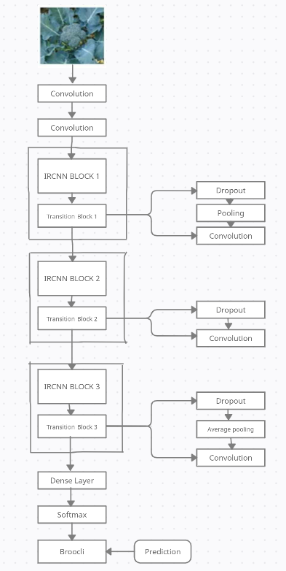
PROPOSED WORK(CONT.)
Input Shape | 256,256
Kernel sizes | (1,3)
Pooling Functions | Average & Max
Activation Functions | ReLu & Softmax
Loss | CrossEntropy
Optimizer | SGD
Hyper Parameters
Fig 2 IRCNN

Slide 10
DATA SET
There are currently no large datasets available for all types of fruits and vegetables, which is why I created my own dataset.
There will be 10 different categories of fruits and vegetables, including apples.
And each category contains 1100 images, so the entire dataset will contain 11,000 images.
The dataset will be divided into 3 sets where training contains 6000, validation contains 3000 and testing contain 2000 images.

Slide 11
DIFFERENCES
The following are the differences between my proposed method and existing methods:
In my proposed method, I use the hybrid algorithm IRCNN, which has never been used for fruit and vegetable classification before.
Another important difference is Dataset. The existing datasets all contain only photos of fruits and vegetables, but the one I generated includes humans holding vegetables or fruits toward the camera.

Slide 12

CONCLUSION
Successfully Implemented.
Results:
Screen Shots of Results:
Dataset/Metrics | Training Data | Validation Data | Test Data
Accuracy | 84.33% | 89.17% | 90.04%
Loss | 0.6488 | 0.5197 | 0.5389

Slide 13
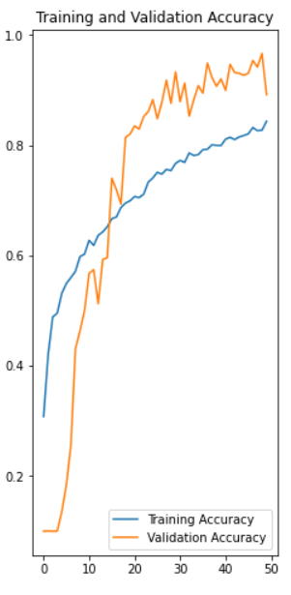
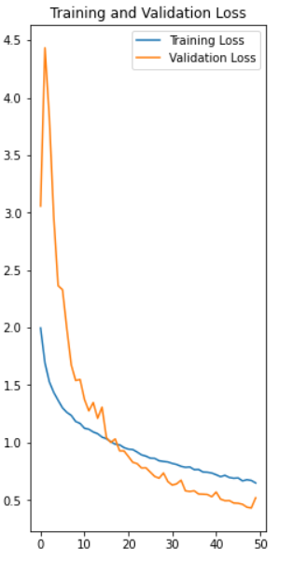
CONCLUSION(contd.)
Graphs:

Slide 14
FUTURE WORK
I will use complete dataset.
I will run more Epochs.
I will do transfer learning with different algorithms.
Instead of predicting one target label, I'll use probabilities to predict more than one label.

Slide 15
THANK YOU !

