Slide 1

Let’s Kickout Depression
HEALTHCARE

Slide 2

Team members:
jayachandran
Rohith
Davidraj Dominique
Sakthivel
Hari krishnan

Slide 3
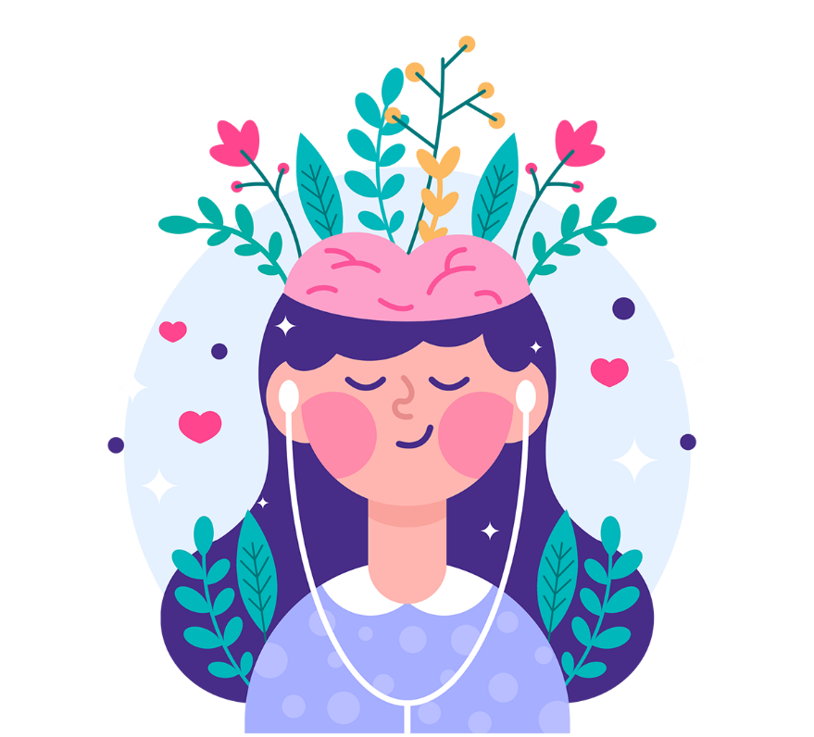
What is mental health?
Mental health refers to cognitive, behavioural, and emotional well-being .It is all about how people think, feel, and behave. People sometimes use the term “mental health” to mean the absence of a mental disorder.

Slide 4



Bliss’s motto:
Psychotherapy
Nutrition
Self Help

Slide 5
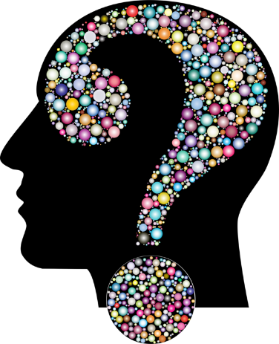
Psychotherapy:
Psychotherapy is the therapeutic treatment of mental illness provided by a trained mental health professional. Psychotherapy explores thoughts, feelings, and behaviours, and seeks to improve an individual’s well-being.
Brainwave entrainment
Chat bot
Music therapy
Group psychotherapy

Slide 6
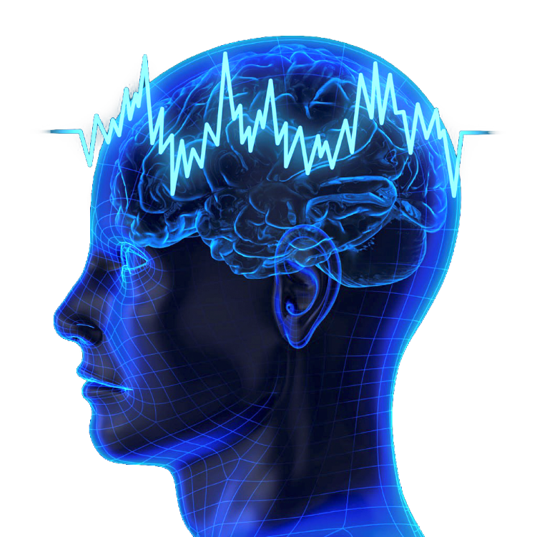
Brainwave entrainment
Brainwave Entrainment is an assisted form of meditation using pulses of sound . Entrainment is a process of synchronizing two different beats to be come harmonious. Brainwave entrainment works by pulsing a different sound in each ear to stimulate the brain into altered states of consciousness. Examples including Binaural Beats and Isochronic Tones, which are best experienced with headphones to assist with relaxation, deep sleep and focus.

Slide 7

Nutrition:
The relationship between our diet and our mental health is complex. However, research shows a link between what we eat and how we feel.
Eating well can help you feel better. You don't have to make big changes to your diet, but see if you can try some of these tips.
Eat regularly .This can stop your blood sugar level dropping, which can make you feel tired and bad-tempered.
Stay hydrated. Even mild dehydration can affect your mood, energy level and ability to concentrate.

Slide 8

Self help:
A self-help plan is a unique health plan where an individual addresses his or her condition by implementing strategies that promote wellness. Self-help plans may involve addressing wellness, recovery , triggers or warning signs
Exercises
Mood Swings Games
Meditation

Slide 9

Future implementation
Ai Chat bot
Group psychotherapy
Virtual counselling
Trauma healing program
Psychologist database
Ui enhancement

Slide 10


