Slide 1

B.Tech – BCSE497J – Project I
Behavioral Credit Decision Support System
Team members:
Adharsh S (23BDS0029)
Gowtham Kumar D (23BDS0186)
Rohith S M (23BDS0025)
Faculty guide :
Dr. Viswanathan A

Slide 2

Approval Mail From Guide
Get the approval for the following points from your guide through mail before 21-10-2026.(sample attached below)
All the above aspects are addressed and updated by the project team.

Slide 3
Aim
To build a human-in-the-loop Dual-Pillar credit decision support platform that gives bank loan officers an empirical, explainable, and auditable view of an applicant's default risk—combining a 15-dimensional supervised behavioral ML classifier from bank statements with a calibrated macro bureau benchmark—without automating the lending decision.
Dual-Pillar ML
Supervised Behavioral ML (ROC 0.7725) + Bureau Benchmark (ROC 0.7737)
Human-in-the-loop
The 2×2 ML matrix recommends; the loan officer takes the final decision
Auditable & DPDP
SHA-256 forward hash-chain tamper-evident log with external anchor

Slide 4
Abstract
Traditional credit bureaus evaluate static macro history, ignoring high-frequency banking cash flows and transaction-level liquidity dynamics.
We present a Dual-Pillar ML decision support system: Pillar 1 maps bank transactions via a 15-dimensional feature bridge to train a Platt-calibrated Random Forest (ROC-AUC 0.7725, PR-AUC 0.5304) on 30,000 credit records; Pillar 2 deploys a calibrated LightGBM benchmark (ROC-AUC 0.7737) with exact Tree-SHAP attributions on 196,806 bureau records.
A unified 2×2 ML Risk Matrix guides underwriters, backed by Tier 1 NLP categorisation, Isolation Forest anomaly checks, and a tamper-evident SHA-256 audit chain. The system recommends; the officer decides.
0.773 / 0.774
ROC-AUC (Pillar 1 RF / Pillar 2 LightGBM)
100%
Tier 1 NLP Categorisation (10-fold CV)
30k + 196k
Training records (UCI + Home Credit)
127
Automated pytest tests passing (100%)

Slide 5


Literature Review
Paper | Objective | Methodology | Pros / Cons | Findings
Yeh & Lien (2009) [1] | Compare data-mining methods for predicting card-client default | Six classifiers on UCI Taiwan data (30,000 clients) | Pro: Public benchmark dataset Con: Single market; no cash-flow data | Similar accuracy; neural network best at estimating true default probability
Lessmann et al. (2015) [2] | Update the credit-scoring classifier benchmark | 41 classifiers compared on 8 datasets | Pro: Broad, rigorous comparison Con: Static application data only | Ensembles outperform logistic regression, motivating gradient boosting
Khandani et al. (2010) [3] | Forecast consumer delinquency from transaction and bureau data | Machine-learning models on bank customer data | Pro: Shows transaction behaviour adds signal Con: Proprietary data; not reproducible | ML improves delinquency forecasts and yields sizeable cost savings
Bhatore et al. (2020) [4] | Review ML techniques used for credit-risk evaluation | Systematic literature review | Pro: Maps techniques and trends Con: No new model or deployment design | Highlights need for interpretable, deployable credit models

Slide 6
Literature Review (contd.)
Paper | Objective | Methodology | Pros / Cons | Findings
Ke et al. (2017) [5] | Make gradient boosting faster and lighter on large data | LightGBM: gradient-based one-side sampling and feature bundling | Pro: Fast training on tabular data Con: Raw scores need calibration | Up to ~20× faster training than conventional GBDT at similar accuracy
Lundberg & Lee (2017) [6] | Provide one consistent way to explain model predictions | SHAP: additive feature attributions from Shapley values | Pro: Consistent local explanations Con: Costly for arbitrary models | SHAP unifies earlier explanation methods under one framework
Platt (1999) [7] | Turn classifier scores into probabilities | Sigmoid (Platt) scaling fitted on held-out scores | Pro: Simple, few parameters Con: Assumes sigmoid-shaped distortion | Produces well-calibrated probabilities from raw outputs

Slide 7
Research Gap
1
Cash flow is under-used
2
Heuristics lack ML grounding
Traditional bureau scores evaluate static macro history, missing high-frequency daily income, EMI, and cash-flow liquidity signals.
Rule-based scorecards assign arbitrary heuristic weights without empirical grounding against verified loan default outcomes.
3
Opaque risk attributions
4
Tamper-vulnerable audit trails
Bank loan underwriters cannot accept black-box scores without exact local feature attributions and calibrated probabilities.
Credit decision logs lack cryptographic integrity guarantees, and statutory privacy erasure under DPDP Act 2023 breaks naive chains.

Slide 8


Objectives
Parse multi-bank statements with automated PII masking and 100% 10-fold CV Tier 1 NLP transaction categorisation.
Engineer a 15-dimensional behavioral feature bridge and train a Platt-calibrated Random Forest classifier on 30,000 credit records (ROC-AUC 0.7725).
Train and calibrate a LightGBM macro bureau benchmark on 196,806 records with exact Tree-SHAP feature attributions (ROC-AUC 0.7737).
Unify both pillars in a 2×2 ML Risk Matrix with unsupervised anomaly overrides and a tamper-evident SHA-256 audit chain.
Identified SDGs: 8, 9, 10
Target readiness: TRL 4
Outcomes
Live cloud prototype: behavioral-credit-system.streamlit.app
127/127 automated pytest tests passing (100% test coverage)

Slide 9
Framework/Architecture/Block Diagram
PILLAR 1
Bank statement CSV / PDF
Parse & validate
5 bank formats · PII masking · reconciliation
NLP & Feature Bridge
Tier 1 NLP (18 classes) · 15-Dim Feature Bridge
Pillar 1 Behavioral ML
Platt-calibrated RF · P_behav (ROC 0.7725)
INTEGRATION
2×2 ML Decision Matrix
P_behav (threshold 0.20) × P_bureau (threshold 0.20)
Q1 Approve · Q2 Bureau Alert · Q3 Behavioral Alert · Q4 Decline
Isolation Forest & Salary-slip Anomaly Overrides
PILLAR 2
Bureau fields (officer-entered)
Prepare inputs
CIBIL, age, tenure, loans, overdue days
Pillar 2 Bureau ML
Platt-scaled LightGBM · 196k Home Credit records
P_bureau + Tree-SHAP
Exact attributions · Brier score 0.0667
Human-in-the-loop: the officer reviews the evidence and takes the final decision
SQLite audit trail · SHA-256 hash chain · external head-hash anchor · DPDP tombstone erasure

Slide 10
Framework: 2×2 Decision Matrix
LOW BUREAU RISK (P_bureau < 0.20)
HIGH BUREAU RISK (P_bureau ≥ 0.20)
How the matrix is used
Behavioral ML: Platt-calibrated Random Forest P_behav with decision threshold 0.20 (ROC-AUC 0.7725).
Bureau Benchmark: Platt-calibrated LightGBM P_bureau with decision threshold 0.20 (ROC-AUC 0.7737) and Tree-SHAP.
Safety Overrides: Salary-slip mismatch or Isolation Forest cash-flow anomaly forces underwriter manual review.
Governance: Dual-Pillar ML matrix recommends; human loan officer retains final lending authority.
Q1 · Approve
Low behavioral risk, low bureau risk
Q2 · Bureau Alert
Healthy cash flow, but elevated bureau default risk
LOW BEHAVIORAL RISK (P_behav < 0.20)
Q3 · Behavioral Alert
Clean bureau history, but high cash-flow risk
Q4 · Decline
High behavioral risk and high bureau risk
HIGH BEHAVIORAL RISK (P_behav ≥ 0.20)

Slide 11
Functional Requirements
Behavioral ML Engine (Pillar 1)
FR1 Ingest multi-bank statements (CSV / PDF) with column mapping and data hygiene checks
FR2 Categorise transactions via Tier 1 NLP (18 classes) with manual override logging
FR3 Map 23+ cash-flow signals via 15-dim bridge to calibrated Behavioral ML (RF)
FR4 Detect cash-flow anomalies via Isolation Forest and verify salary slips (15% tolerance)
Bureau Benchmark & Platform (Pillar 2)
FR5 Predict macro default risk using Platt-calibrated LightGBM with exact Tree-SHAP attributions
FR6 Synthesize decisions onto 2×2 ML Risk Matrix with dynamic quadrant boundary plotting
FR7 Persist immutable decision records in SQLite with SHA-256 hash chaining and anchor verification
FR8 Provide DPDP-compliant cryptographic PII erasure without invalidating chain integrity
Explainable (Tree-SHAP)
Reproducible (Seed 42)
DPDP Act 2023 Compliant
Tamper-Evident SHA-256

Slide 12
Modules
1
Statement Ingestion & Security
2
Tier 1 NLP Categorisation
3
15-Dim Behavioral ML Bridge
CSV (5 bank formats) & text PDF parser
Regex PII masking & de-duplication
Salary-slip reconciliation (15% tolerance)
18-class TF-IDF + Logistic Regression
100% 10-fold cross-validated accuracy
Underwriter manual override & audit logging
Synthesizes 23+ cash flows to 15 features
Trained on 30,000 UCI Credit Card records
Platt-calibrated Random Forest (ROC 0.7725)
4
Unsupervised Anomaly Lab
5
Pillar 2 Macro Bureau ML
6
2×2 ML Decision & Audit
Isolation Forest (150 trees) for fraud/spikes
K-Means persona clustering (k=4) for peers
Parametric stress lab (income shock, rates)
Platt-calibrated LightGBM on 196,806 records
Exact Tree-SHAP local feature attributions
Completeness scoring & alert threshold (0.20)
Dual-Pillar 2×2 ML matrix quadrant placement
Tamper-evident SHA-256 forward hash chain
External filesystem anchor & DPDP erasure

Slide 13
Experiments and Results: Risk Benchmark
0.774
ROC-AUC (95% CI 0.767–0.781)
0.266
PR-AUC (~3.3× lift)
0.067
Brier score
196,806 Home Credit applicants; stratified 64 / 16 / 20 split, seed 42
Imputer and scaler fitted on train only; test set used once
Candidates: logistic regression, random forest, XGBoost, two LightGBM; chosen on validation PR-AUC, then ROC-AUC, then Brier
Platt-scaled probabilities; thresholds set on validation data

Slide 14
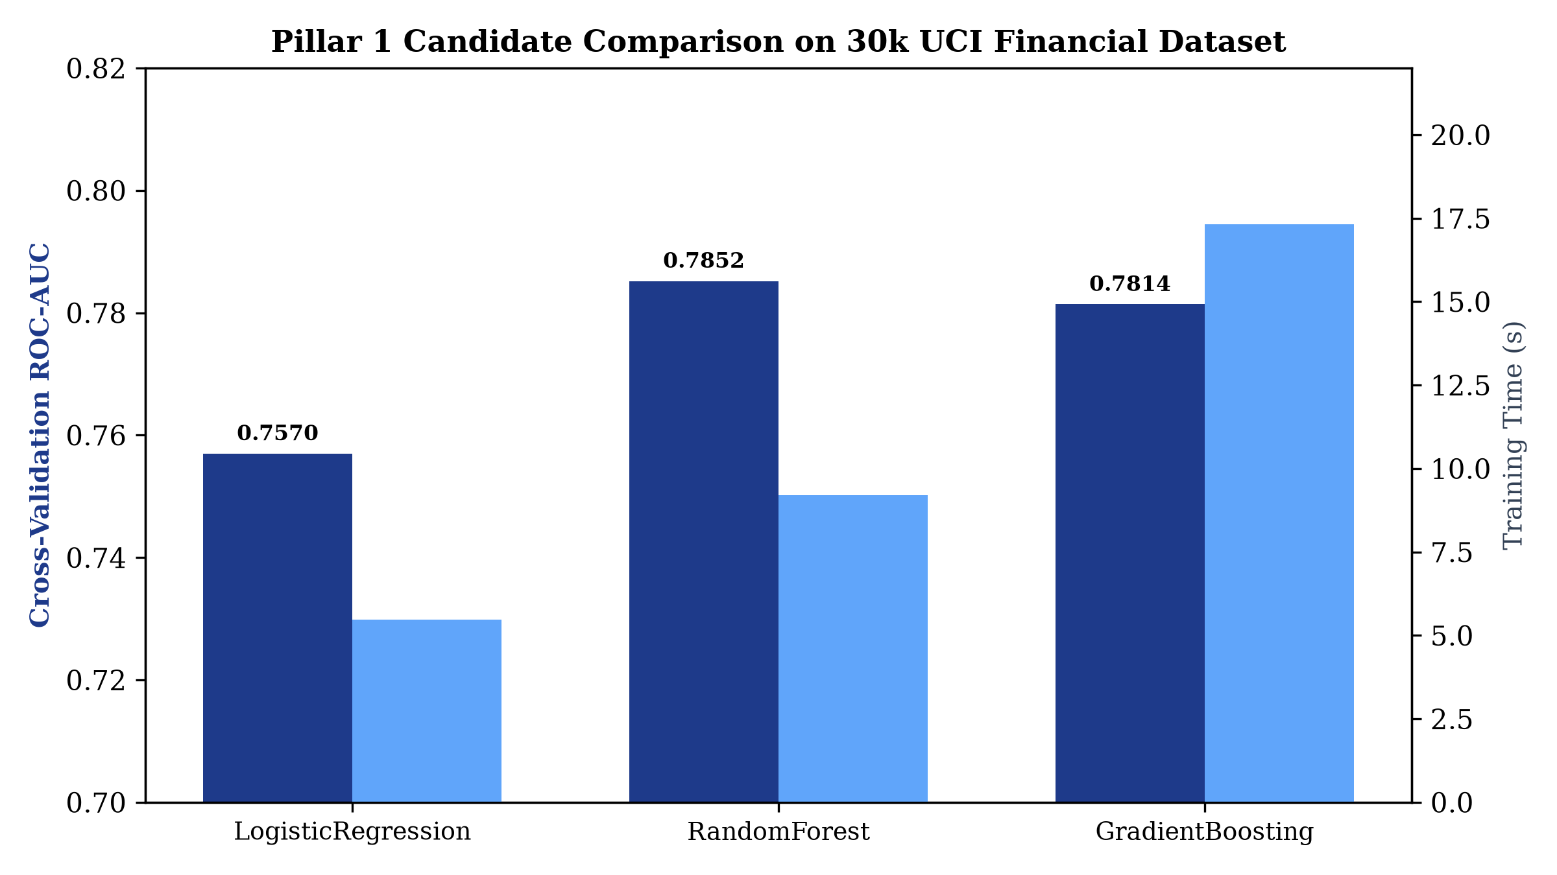
Experiments and Results: Pillar 1 Behavioral ML
0.7725
Platt-calibrated RF ROC-AUC (PR-AUC 0.5304, 30k UCI records)
81.53%
Test Accuracy (P_behav default threshold 0.20)
100%
Tier 1 NLP Categorisation (10-fold CV on 18 classes)
127 / 127
Automated pytest checks passing (100% test suite)
15 cash-flow dynamics mapped via bridge; Isolation Forest flags anomalies to ensure high-fidelity inference.

Slide 15
Conclusion and Future Work
Conclusion
Delivered a working Dual-Pillar Supervised ML platform pairing a 15-dimensional statement behavioral model with a macro bureau benchmark.
Engineered an empirical bridge to 30,000 UCI credit records, achieving ROC-AUC 0.7725 and PR-AUC 0.5304 on behavioral default risk.
Full explainability via Tree-SHAP attributions and complete auditability via SHA-256 hash chains; 127 tests pass, keeping the officer in command.
Future Work
Integrate live Open Banking / Account Aggregator (AA) API connectors for automated e-statement retrieval
Deploy transformer-based embeddings (e.g. FinBERT) for cross-lingual regional Indian banking narrations
Implement continuous model drift monitoring (Population Stability Index / Wasserstein distance)
Incorporate federated learning protocols for privacy-preserving multi-institutional credit benchmarking

Slide 16
Outcome Achieved
Achieved
Live Cloud Platform: behavioral-credit-system.streamlit.app
Public GitHub repository with documentation and clean source code
127 / 127 automated pytest tests passing (100% test coverage)
Comprehensive 58-page IEEE / VIT formatted final project report
Targeted
Conference paper (Scopus-indexed) on Dual-Pillar Supervised Credit Decision Systems
Pilot evaluation with cooperative banking institutions and credit unions
Copyright registration for 15-Dimensional Behavioral Bridge Architecture
github.com/rohith5709/behavioral-credit-decision-support-system · Live: behavioral-credit-system.streamlit.app

Slide 17
References
[1] I.-C. Yeh and C. Lien, “The comparisons of data mining techniques for the predictive accuracy of probability of default of credit card clients,” Expert Syst. Appl., vol. 36, no. 2, pp. 2473–2480, 2009.
[2] S. Lessmann, B. Baesens, H.-V. Seow, and L. C. Thomas, “Benchmarking state-of-the-art classification algorithms for credit scoring: An update of research,” Eur. J. Oper. Res., vol. 247, no. 1, pp. 124–136, 2015.
[3] A. E. Khandani, A. J. Kim, and A. W. Lo, “Consumer credit-risk models via machine-learning algorithms,” J. Bank. Financ., vol. 34, no. 11, pp. 2767–2787, 2010.
[4] S. Bhatore, L. Mohan, and Y. R. Reddy, “Machine learning techniques for credit risk evaluation: A systematic literature review,” J. Bank. Financ. Technol., vol. 4, pp. 111–138, 2020.
[5] G. Ke et al., “LightGBM: A highly efficient gradient boosting decision tree,” in Proc. NeurIPS, 2017, pp. 3146–3154.
[6] S. M. Lundberg and S.-I. Lee, “A unified approach to interpreting model predictions,” in Proc. NeurIPS, 2017, pp. 4765–4774.
[7] J. C. Platt, “Probabilistic outputs for support vector machines and comparisons to regularized likelihood methods,” in Advances in Large Margin Classifiers, MIT Press, 1999, pp. 61–74.
[8] Home Credit Group, “Home Credit Default Risk,” Kaggle dataset, 2018.
[9] Government of India, “The Digital Personal Data Protection Act, 2023,” Act No. 22 of 2023.

