Slide 1

B.TECH CAPSTONE PROJECT I · BCSE497J
Behavioral Credit Decision Support System
A Dual-Pillar Supervised Machine Learning & Cryptographic Audit Architecture for Retail Lending
PROJECT TEAM MEMBERS
• Adharsh S (23BDS0029)
• Gowtham Kumar D (23BDS0186)
• Rohith S M (23BDS0025)
School of Computer Science and Engineering (SCOPE)
FACULTY SUPERVISOR
Dr. Viswanathan A
School of Computer Science and Engineering
Vellore Institute of Technology, Chennai · October 2026

Slide 2

PROJECT GOVERNANCE · REVIEW ENDORSEMENT
Faculty Guide Approval & Verification
FACULTY ENDORSEMENT
Formal Review Status: Approved
All project review criteria and methodological specifications have been verified and endorsed through official mail by Faculty Guide Dr. Viswanathan A before the milestone deadline (21-10-2026).
✓ Problem Statement & Dual-Pillar Scope
✓ Empirical 15-Dim Bridge Architecture
✓ Platt Calibration & Tree-SHAP Integration
✓ DPDP Act 2023 Cryptographic Audit Protocol
✓ Streamlit Cloud Platform Deployment
All aspects addressed & ready for evaluation.
05/10/2026 · Project Review
BCSE497J · Behavioral Credit Decision Support System · SCOPE
2 / 17

Slide 3
FOUNDATIONAL SCOPE · CORE OBJECTIVE
Project Aim & Architectural Principles
PROJECT AIM & MISSION
To build a human-in-the-loop Dual-Pillar credit decision support platform that gives bank loan officers an empirical, explainable, and auditable view of an applicant's default risk—combining a 15-dimensional supervised behavioral ML classifier from bank statements with a calibrated macro bureau benchmark—without automating the lending decision.
01 · DUAL-PILLAR SUPERVISED ML
• Empirical Feature Bridge: Synthesizes 23+ cash-flow dynamics into 15 bridge features.
• Trained on 30,000 real-world credit default records (UCI Taiwan benchmark).
• Pillar 1 Behavioral RF (ROC 0.7725) + Pillar 2 Bureau LightGBM (ROC 0.7737).
• Replaces arbitrary heuristic rules with mathematically calibrated probabilities.
02 · HUMAN-IN-THE-LOOP GOVERNANCE
• 2×2 ML Risk Matrix: Discretizes dual probabilities into 4 actionable underwriter quadrants.
• Local Explainability: Exact Tree-SHAP Shapley attributions explain every recommendation.
• Underwriter Autonomy: System recommends; loan officer retains final lending authority.
• Automated Safety Overrides: Salary mismatch or Isolation Forest anomalies force review.
03 · AUDITABILITY & DPDP COMPLIANCE
• Cryptographic Integrity: SQLite audit ledger structured with forward SHA-256 hash chains.
• External Head-Hash Anchor: Detects unauthorized database modifications or tampering.
• DPDP Act 2023 Compliant: Cryptographic tombstoning enables statutory PII erasure.
• Deterministic Verification: Chain integrity verified in sub-second execution.
05/10/2026 · Project Review
BCSE497J · Behavioral Credit Decision Support System · SCOPE
3 / 17

Slide 4
EXECUTIVE SUMMARY · PERFORMANCE HIGHLIGHTS
Abstract & Key Quantitative Milestones
THE PROBLEM: BLINDSPOTS IN RETAIL UNDERWRITING
Traditional credit bureaus rely strictly on static macro history, missing high-frequency banking cash flows and day-to-day liquidity dynamics. Conversely, commercial statement scorecards rely on arbitrary heuristic point systems with zero mathematical validation against default outcomes.
THE SOLUTION: DUAL-PILLAR SUPERVISED ML
We present a Dual-Pillar decision support platform: Pillar 1 maps bank statement transactions via a 15-dimensional feature bridge to train a Platt-calibrated Random Forest (ROC-AUC 0.7725, PR-AUC 0.5304) on 30,000 credit records; Pillar 2 deploys a calibrated LightGBM benchmark (ROC-AUC 0.7737) with exact Tree-SHAP attributions on 196,806 bureau records.
THE GOVERNANCE: SYNTHESIS & AUDIT
A unified 2×2 ML Risk Matrix guides underwriters, backed by Tier 1 NLP categorisation (100% 10-fold CV), Isolation Forest anomaly checks, and a tamper-evident SHA-256 audit chain. The machine recommends; the officer decides.
0.7725 / 0.7737 · ROC-AUC BENCHMARK
Pillar 1 RF (0.7725) & Pillar 2 LightGBM (0.7737) test set performance
100.0% · TIER 1 NLP CATEGORISATION
10-fold cross-validated accuracy across 18 banking transaction classes
226,806 · EMPIRICAL TRAINING RECORDS
30,000 UCI Credit Card + 196,806 Home Credit default records
127 / 127 · AUTOMATED PYTEST CHECKS
100% passing test suite covering ML, bridge, matrix, and cryptographic chain
05/10/2026 · Project Review
BCSE497J · Behavioral Credit Decision Support System · SCOPE
4 / 17

Slide 5
THEORETICAL FOUNDATION · BENCHMARK ANALYSIS
Literature Review: Credit Risk & Behavioral Modeling
Paper & Author | Objective | Methodology | Pros / Cons | Key Findings
Yeh & Lien (2009) [Expert Syst. Appl.] [1] | Predict default probability of credit card clients | Evaluated 6 machine learning classifiers on UCI Taiwan benchmark (30,000 clients) | Pro: Authoritative public benchmark Con: Single market; lacks cash-flow data | Ensembles and neural networks achieve superior probability estimation over linear models
Lessmann et al. (2015) [Eur. J. Oper. Res.] [2] | Update state-of-the-art classifier benchmark in credit scoring | Extensive empirical comparison of 41 classifiers across 8 credit datasets | Pro: Rigorous statistical comparison Con: Static application bureau data only | Tree ensembles (GBDT, Random Forest) systematically outperform logistic regression
Khandani et al. (2010) [J. Bank. Financ.] [3] | Forecast consumer credit delinquency from transactions | Nonlinear classification trees on customer transaction and bureau records | Pro: Confirms cash flows add predictive power Con: Proprietary bank data; not reproducible | Transaction-level cash flow dynamics improve delinquency forecasts by 6–25%
Bhatore et al. (2020) [J. Bank. Fin. Tech.] [4] | Comprehensive survey of ML in credit risk evaluation | Systematic literature review mapping ML techniques and deployment paradigms | Pro: Maps architectural trends Con: Survey only; no implementation | Highlights urgent industry need for interpretable, deployable, human-governed models
05/10/2026 · Project Review
BCSE497J · Behavioral Credit Decision Support System · SCOPE
5 / 17

Slide 6
THEORETICAL FOUNDATION · ALGORITHMS & EXPLAINABILITY
Literature Review (contd.): Ensembles, Interpretability & Calibration
Paper & Author | Objective | Methodology | Pros / Cons | Key Findings
Ke et al. (2017) [Proc. NeurIPS] [5] | Accelerate gradient boosting on large tabular data | LightGBM: Gradient-based One-Side Sampling (GOSS) and Exclusive Feature Bundling | Pro: Extreme training efficiency on 200k+ rows Con: Raw scores require calibration | Delivers up to 20× faster training than conventional GBDT with identical predictive accuracy
Lundberg & Lee (2017) [Proc. NeurIPS] [6] | Provide unified local model interpretability | SHAP: Additive feature attributions based on game-theoretic Shapley values | Pro: Mathematically consistent local explanations Con: High computation for arbitrary models | Tree-SHAP achieves polynomial-time exact feature attributions for decision tree ensembles
Platt (1999) [Adv. Large Margin] [7] | Calibrate uncalibrated classifier outputs into true probabilities | Sigmoid (Platt) scaling fitted via maximum likelihood on held-out validation predictions | Pro: Low complexity, prevents overconfidence Con: Assumes monotonic sigmoid distortion | Transforms decision margins into well-calibrated posterior default probabilities
05/10/2026 · Project Review
BCSE497J · Behavioral Credit Decision Support System · SCOPE
6 / 17

Slide 7
PROBLEM FORMULATION · RESEARCH JUSTIFICATION
Critical Research Gaps in Contemporary Credit Systems
GAP 01: CASH-FLOW LIQUIDITY UNDER-UTILIZATION
Traditional bureau scores (e.g. CIBIL, FICO) evaluate static debt repayment histories, remaining blind to high-frequency monthly income consistency, volatile expense spikes, and intra-month liquidity cushions.
💡 Our Solution: Ingests 6+ months of bank statements to extract 23+ granular behavioral features.
GAP 02: UNSUPERVISED HEURISTIC SCORECARD DISCONNECT
Commercial statement analyzers rely on arbitrary 0–100 heuristic scoring point systems without mathematical grounding or empirical calibration against actual borrower loan default outcomes.
💡 Our Solution: Engineers a 15-dimensional bridge linking statement features to 30,000 UCI default outcomes.
GAP 03: UNDERWRITER EXPLAINABILITY GAP (BLACK-BOX OPACITY)
Credit underwriters and regulatory authorities reject complex black-box machine learning predictions without local, verifiable feature attributions and mathematically calibrated probabilities.
💡 Our Solution: Deploys exact Tree-SHAP Shapley attributions and Platt probability calibration.
GAP 04: AUDIT TAMPER VULNERABILITY & PRIVACY CONFLICT
Standard database case logs are vulnerable to administrator tampering. Furthermore, statutory 'right to be forgotten' erasures under DPDP Act 2023 break naive cryptographic hash chains.
💡 Our Solution: Immutable forward SHA-256 hash chains with external filesystem anchor and tombstone erasure.
05/10/2026 · Project Review
BCSE497J · Behavioral Credit Decision Support System · SCOPE
7 / 17

Slide 8


PROJECT SCOPE · ALIGNMENT & TARGETS
Engineering Objectives & Sustainable Development Goals
OBJECTIVE 1: INGESTION & NLP CATEGORISATION
Develop multi-bank parsers (CSV/PDF) for 5 Indian banks with regex PII masking and a 100% 10-fold CV Tier 1 NLP transaction classifier across 18 classes.
SUSTAINABLE DEVELOPMENT GOALS
• SDG 8: Decent Work & Economic Growth
• SDG 9: Industry, Innovation & Infrastructure
• SDG 10: Reduced Inequalities
OBJECTIVE 2: 15-DIMENSIONAL BRIDGE & BEHAVIORAL ML
Engineer an empirical 15-dimensional bridge linking statement features to 30,000 UCI credit default records; train a Platt-calibrated Random Forest (ROC-AUC 0.7725).
OBJECTIVE 3: PILLAR 2 BUREAU BENCHMARK & TREE-SHAP
Train and calibrate a LightGBM macro bureau benchmark on 196,806 records (ROC-AUC 0.7737) with exact local Tree-SHAP Shapley feature attributions.
TARGET READINESS LEVEL: TRL 4
• Component & pipeline validation in laboratory/cloud environment.
• Live deployed Streamlit prototype.
• 127 passing automated tests.
• Targeted Scopus conference publication.
OBJECTIVE 4: 2×2 RISK MATRIX & CRYPTOGRAPHIC AUDIT
Synthesize dual predictions into a 2×2 Risk Matrix with Isolation Forest anomaly overrides and an immutable SHA-256 hash-chain ledger with external anchor.
05/10/2026 · Project Review
BCSE497J · Behavioral Credit Decision Support System · SCOPE
8 / 17

Slide 9
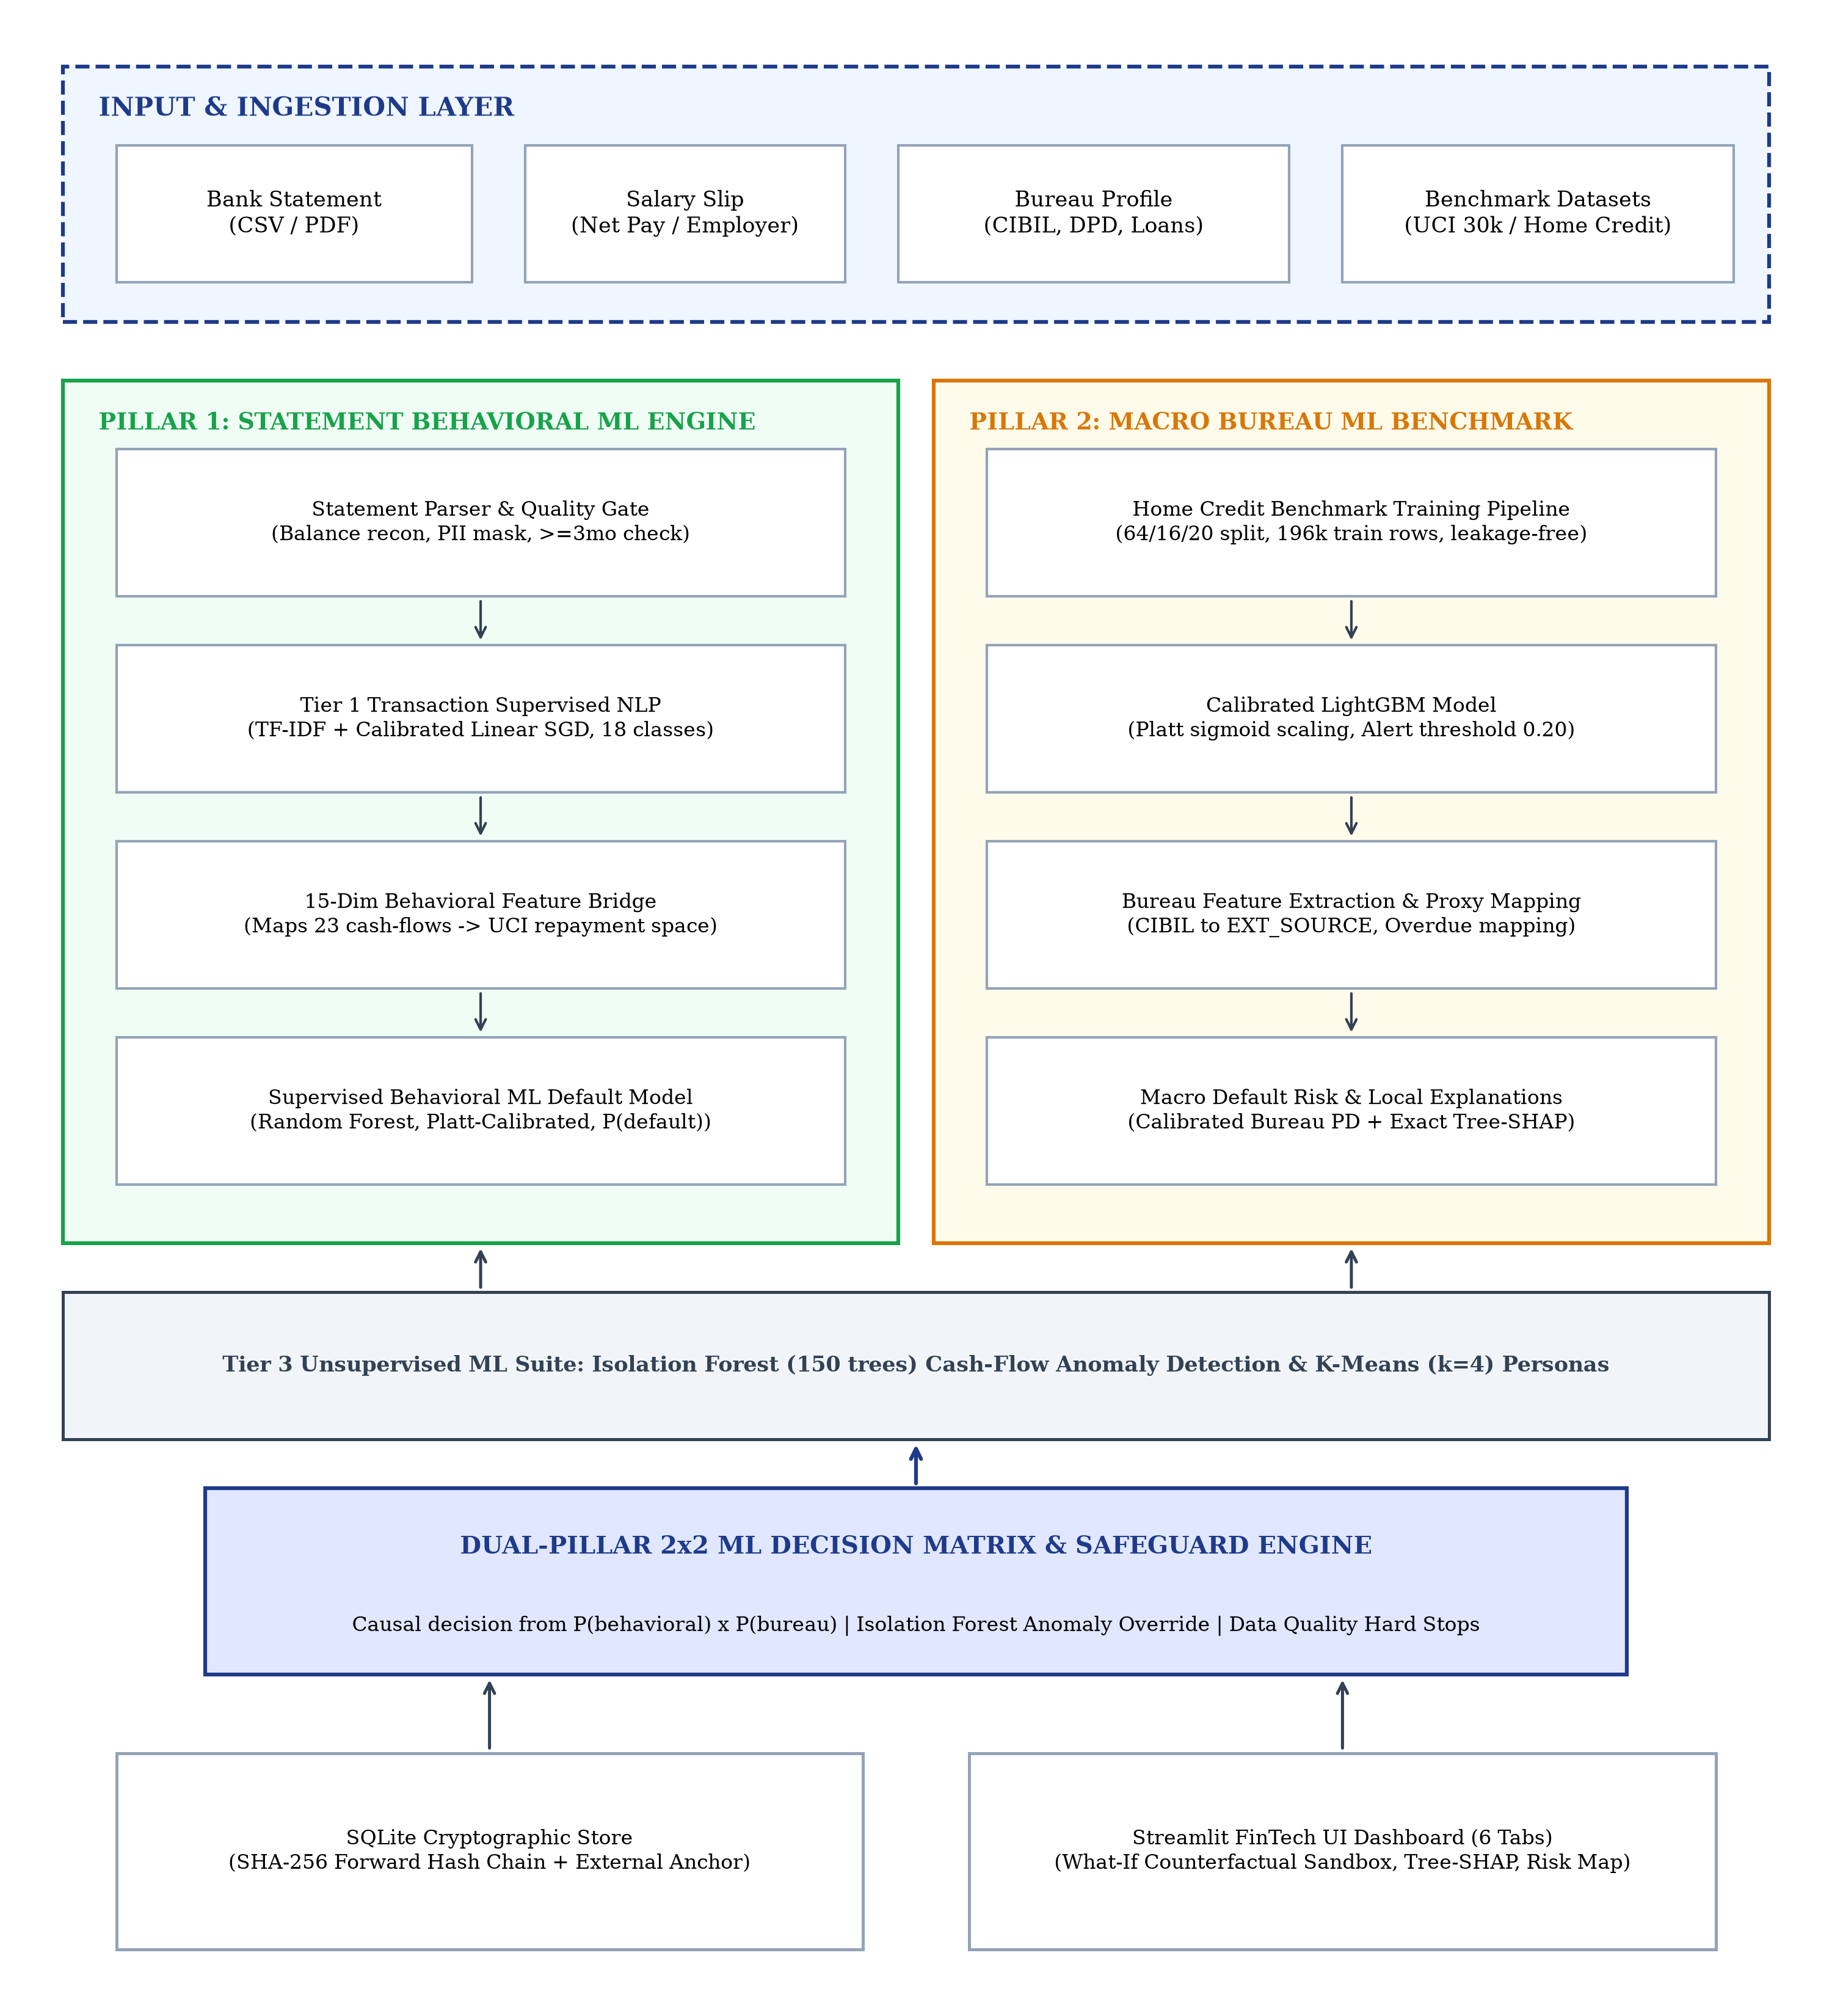
SYSTEM DESIGN · PIPELINE TOPOLOGY
Dual-Pillar End-to-End System Architecture
TIER 1: STATEMENT INGESTION & NLP
Ingests 5 Indian bank CSVs + PDFs. Applies regex PII redaction (PAN, Aadhaar). Classifies transactions into 18 categories using TF-IDF + Logistic Regression (100% 10-fold CV). Cross-checks salary slips with 15% tolerance.
TIER 2: DUAL SUPERVISED ML INFERENCE
• Pillar 1 (Behavioral): 15-Dim Feature Bridge maps statement dynamics to Platt-calibrated Random Forest (ROC-AUC 0.7725, PR-AUC 0.5304).
• Pillar 2 (Macro Bureau): Platt-calibrated LightGBM on 196k applicants (ROC-AUC 0.7737) with exact Tree-SHAP local explanations.
TIER 3: DECISION MATRIX & CRYPTOGRAPHIC AUDIT
Synthesizes dual probabilities into a 2×2 Risk Matrix. Isolation Forest flags distributional anomalies. Decision records persisted in SQLite forward SHA-256 hash chain with external filesystem anchor.
05/10/2026 · Project Review
BCSE497J · Behavioral Credit Decision Support System · SCOPE
9 / 17

Slide 10
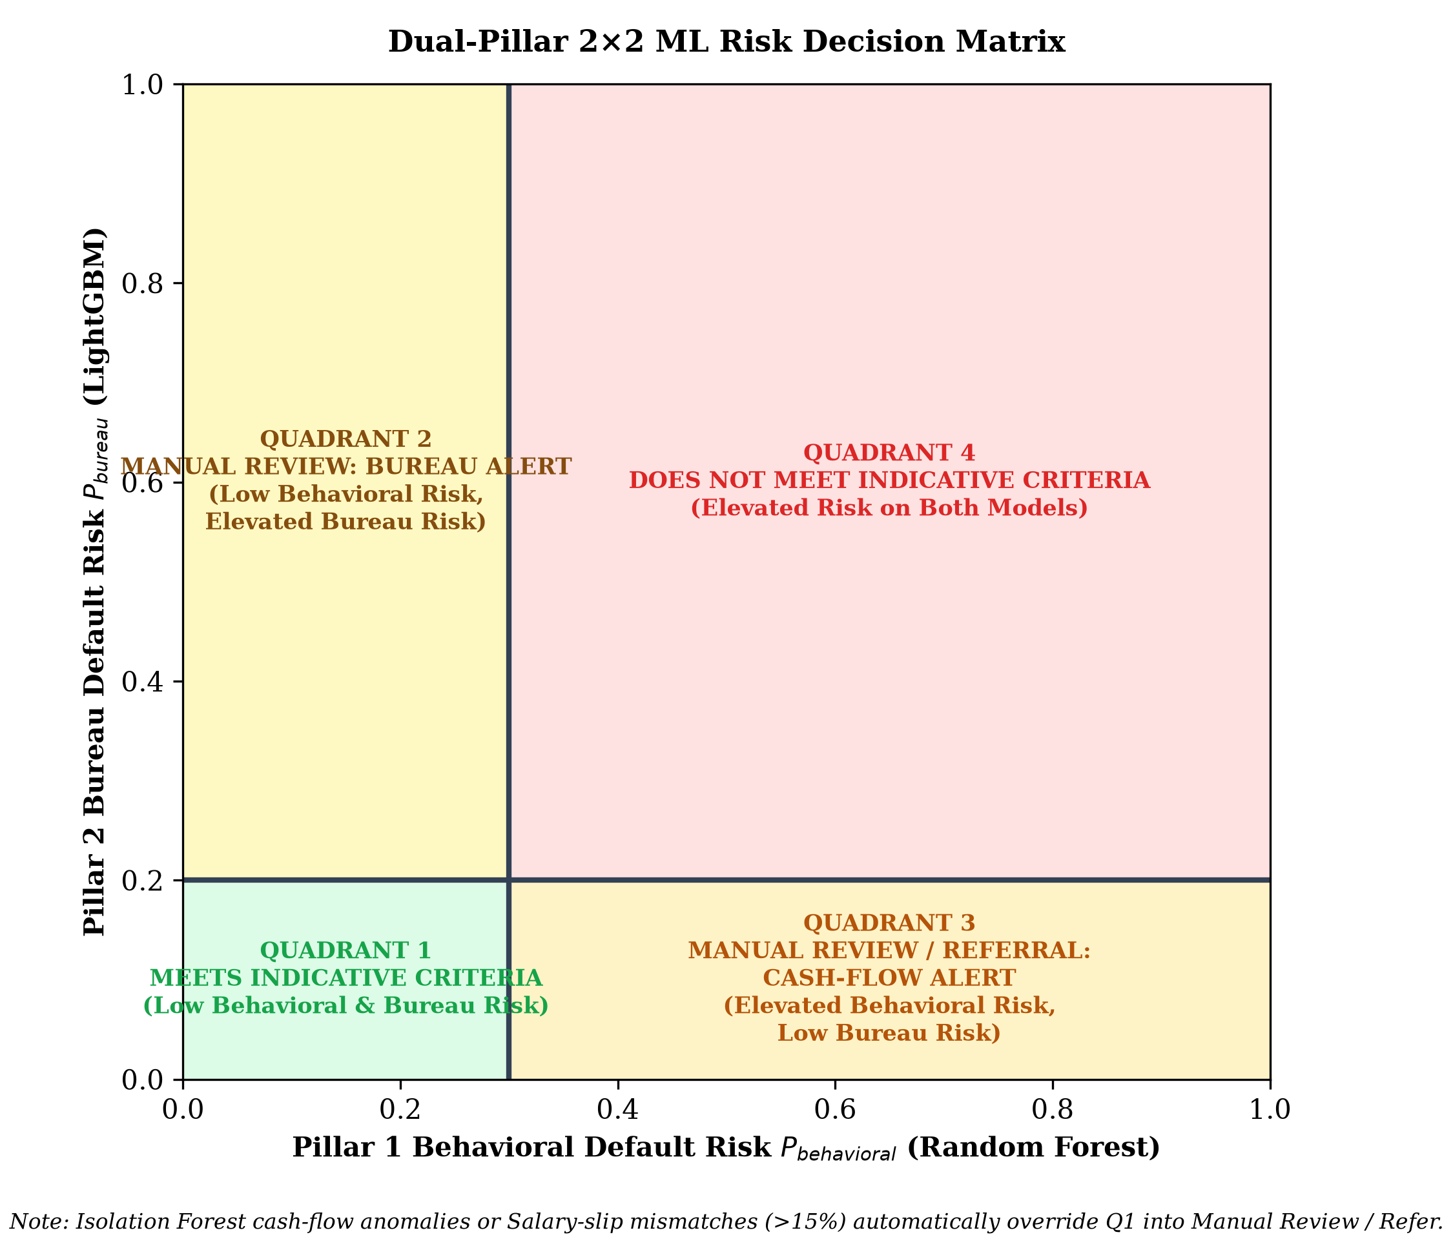
DECISION SYNTHESIS · UNDERWRITING LOGIC
Dual-Pillar 2×2 ML Risk Decision Matrix
Q1 · APPROVE (Low P_behav, Low P_bureau)
Both behavioral cash flow and bureau risk fall below 0.20 alert threshold. Recommended for standard loan approval at competitive rate.
Q2 · BUREAU ALERT (Low P_behav, High P_bureau)
Clean statement cash flows, but macro bureau history indicates elevated default risk. Requires underwriter scrutiny of historical bureau defaults.
Q3 · BEHAVIORAL ALERT (High P_behav, Low P_bureau)
Clean macro bureau record, but high-frequency banking reveals liquidity stress, irregular income, or high EMI burden. Requires manual debt-to-income check.
Q4 · DECLINE (High P_behav, High P_bureau)
Compounding default risk across both pillars. Recommended for immediate rejection.
SAFETY OVERRIDES & GOVERNANCE
• Salary Mismatch: Discrepancy > 15% forces underwriter review.
• Isolation Forest Outlier: Cash-flow spikes trigger manual verification.
• Governance: Machine recommends; officer retains final authority.
05/10/2026 · Project Review
BCSE497J · Behavioral Credit Decision Support System · SCOPE
10 / 17

Slide 11
ENGINEERING SPECIFICATIONS · SYSTEM REQUIREMENTS
Functional Requirements & Non-Functional Guarantees
PILLAR 1: BEHAVIORAL ML ENGINE
FR1 Statement Ingestion: Upload bank statements (CSV/PDF) across 5 Indian bank formats; map columns, perform balance reconciliation, and mask PII.
FR2 Tier 1 NLP Categorisation: Classify transactions into 18 categories using TF-IDF + Logistic Regression; log officer manual overrides with rationale.
FR3 15-Dim Behavioral ML Bridge: Map 23+ cash-flow signals via 15-dimensional bridge to Platt-calibrated Random Forest (ROC-AUC 0.7725).
FR4 Anomaly & Salary Checks: Detect cash-flow anomalies using Isolation Forest (150 trees) and verify salary slips within 15% tolerance.
PILLAR 2: BUREAU BENCHMARK & PLATFORM
FR5 Bureau Default Scoring: Predict default risk using Platt-calibrated LightGBM on 196k records; generate exact Tree-SHAP attributions.
FR6 2×2 Matrix Synthesis: Place applicant on 2×2 ML Risk Matrix; generate interactive risk map with dynamic decision boundary plotting.
FR7 Tamper-Evident Ledger: Persist decision records in SQLite with forward SHA-256 hash chaining; verify external head-hash anchor.
FR8 DPDP Act 2023 Privacy: Erase personal data upon statutory request via cryptographic tombstoning without invalidating ledger integrity.
EXPLAINABLE
Tree-SHAP Shapley attributions explain every prediction
REPRODUCIBLE
Deterministic seed (Seed 42) across all splits and models
DPDP COMPLIANT
Section 12 statutory cryptographic personal data erasure
TAMPER-EVIDENT
SHA-256 forward hash chain anchored to external storage
05/10/2026 · Project Review
BCSE497J · Behavioral Credit Decision Support System · SCOPE
11 / 17

Slide 12
SOFTWARE ARCHITECTURE · SUBSYSTEM BREAKDOWN
Six-Module Decoupled Production Architecture
MODULE 01
Statement Ingestion & Security
• Parsers for 5 Indian bank formats + text PDF.
• Regex PII masking & transaction de-duplication.
• Balance reconciliation & 15% salary tolerance check.
MODULE 02
Tier 1 NLP Categorisation
• 18-class TF-IDF + Logistic Regression engine.
• 100% 10-fold cross-validated test accuracy.
• Underwriter manual override & rationale audit logger.
MODULE 03
15-Dim Behavioral ML Bridge
• Synthesizes 23+ statement cash flows to 15 features.
• Trained on 30,000 UCI Credit Card Default records.
• Platt-calibrated Random Forest (ROC-AUC 0.7725).
MODULE 04
Unsupervised Anomaly Lab
• Isolation Forest (150 estimators) for cash spikes.
• K-Means persona clustering (k=4) for peer benchmarking.
• Parametric stress-testing (income shock, rate hike).
MODULE 05
Pillar 2 Macro Bureau ML
• Platt-calibrated LightGBM on 196,806 applicants.
• Exact Tree-SHAP local feature attributions.
• Completeness scoring & alert threshold (0.20).
MODULE 06
2×2 Decision & Audit Engine
• Dual-Pillar 2×2 ML matrix risk quadrant placement.
• Tamper-evident SHA-256 forward hash-chain ledger.
• External filesystem anchor & DPDP erasure protocol.
05/10/2026 · Project Review
BCSE497J · Behavioral Credit Decision Support System · SCOPE
12 / 17

Slide 13
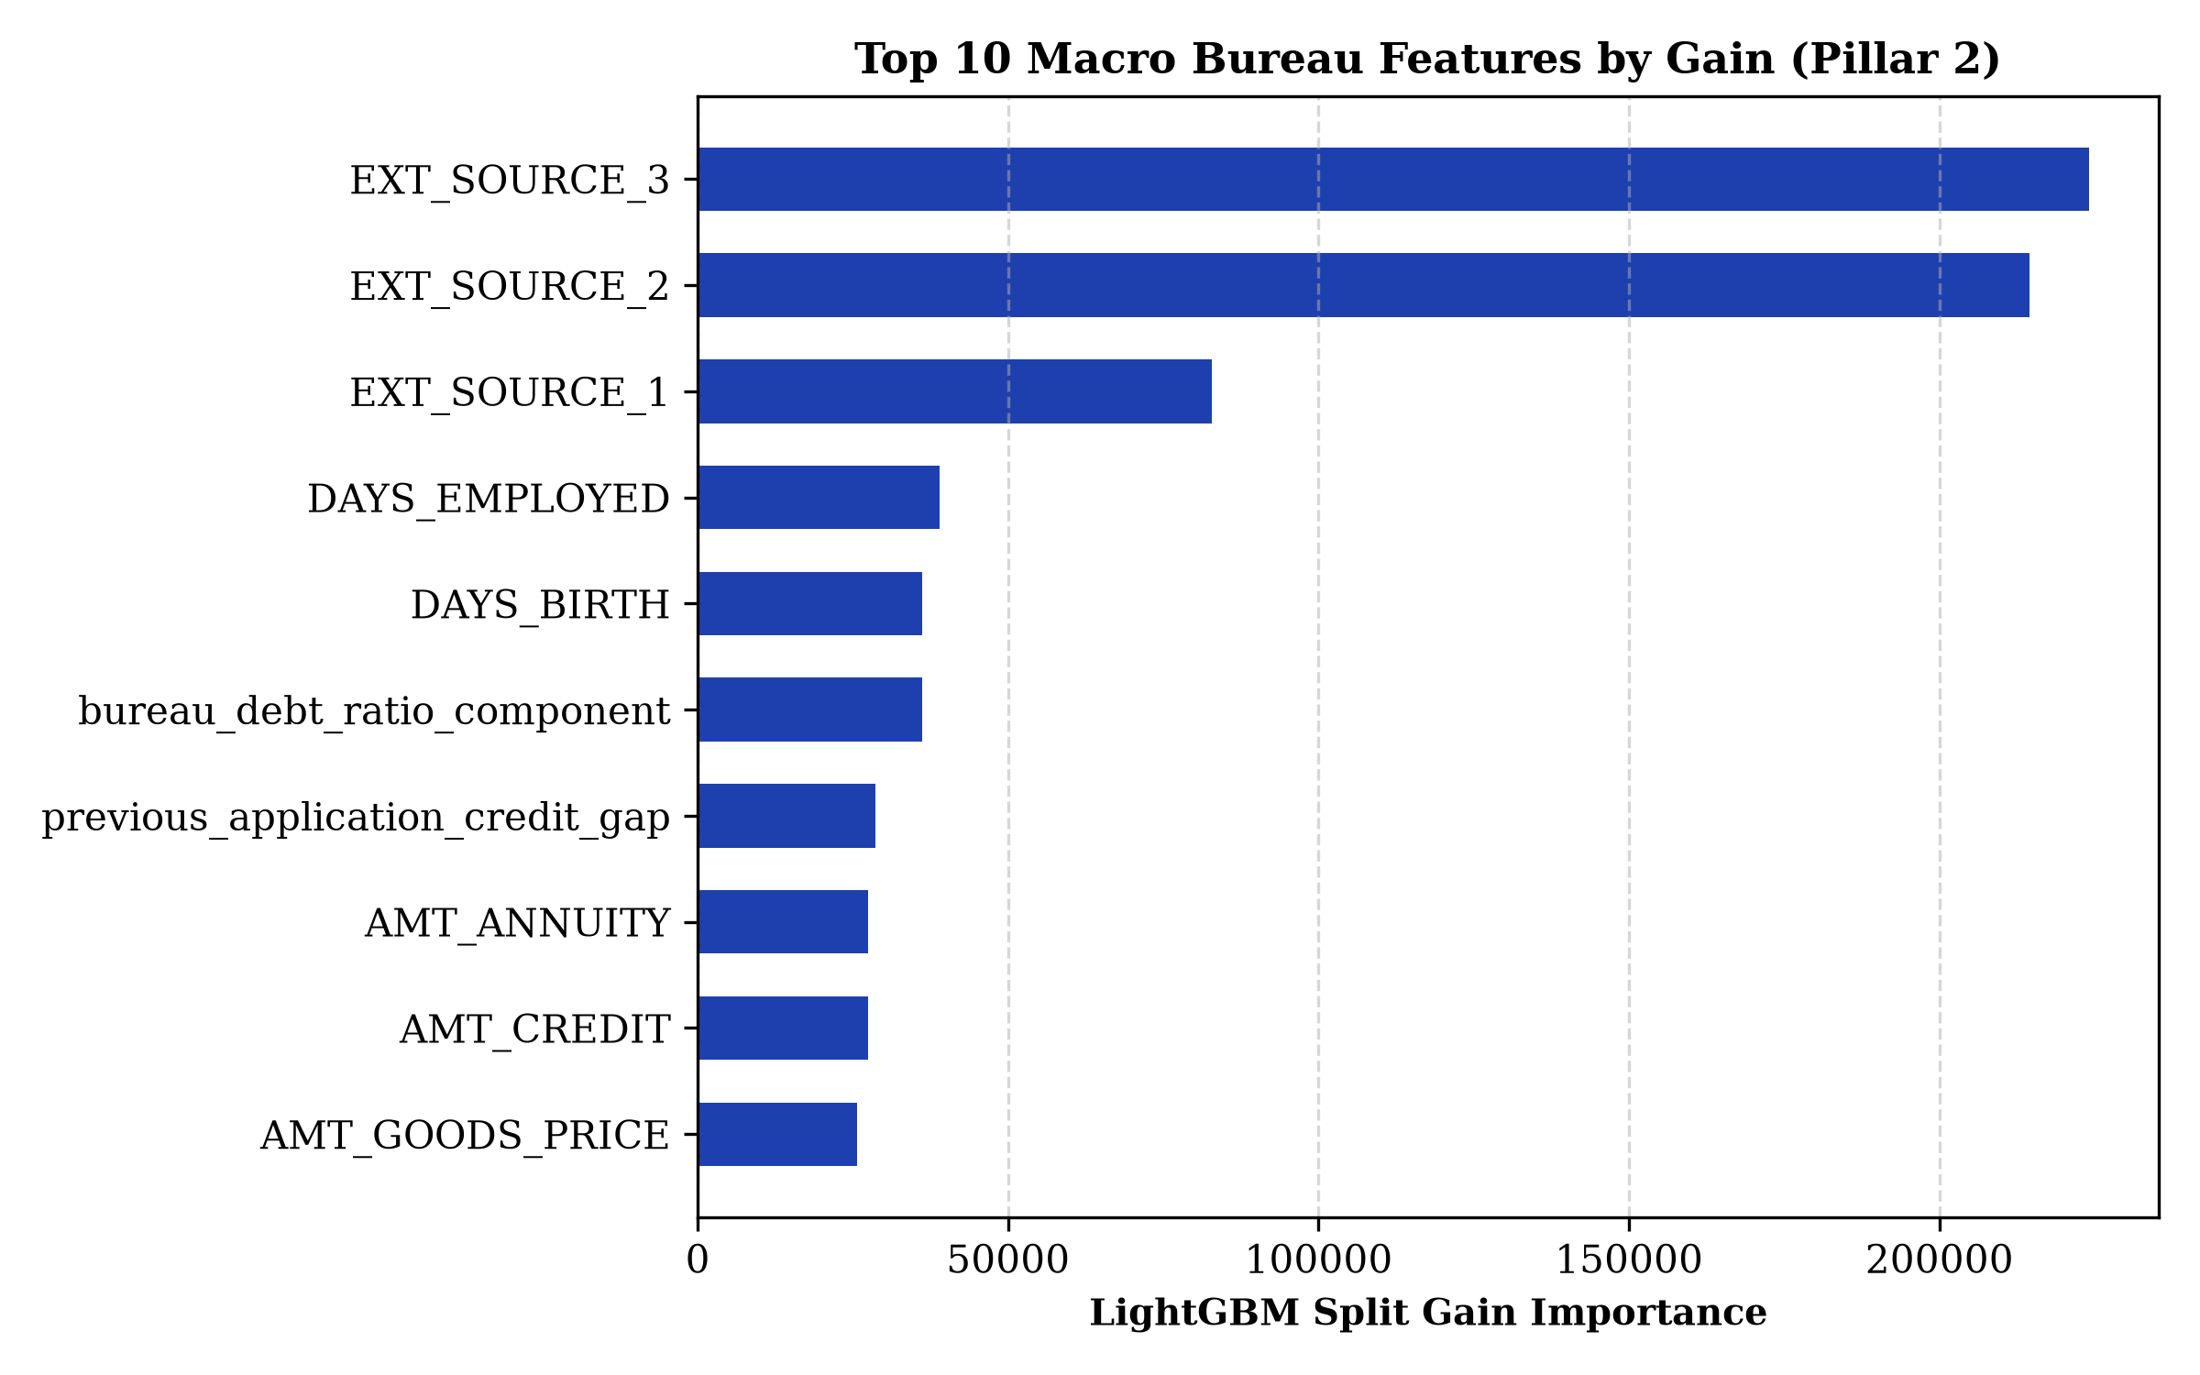
EXPERIMENTAL RESULTS · PILLAR 2 VALIDATION
Empirical Evaluation: Macro Bureau Benchmark
0.7737
ROC-AUC (95% CI: 0.767–0.781)
0.2664
PR-AUC (3.3× Lift over 0.0807 baseline)
0.0667
Brier Calibration Score (Platt Scaling)
BENCHMARK SPECIFICATIONS
• Dataset: 196,806 real-world Home Credit applicants.
• Stratified Split: 64% Train, 16% Validation, 20% Held-Out Test (Seed 42).
• LightGBM selected over Logistic Regression, Random Forest, & XGBoost.
• Platt sigmoid scaling transforms raw logits into true probabilities.
05/10/2026 · Project Review
BCSE497J · Behavioral Credit Decision Support System · SCOPE
13 / 17

Slide 14
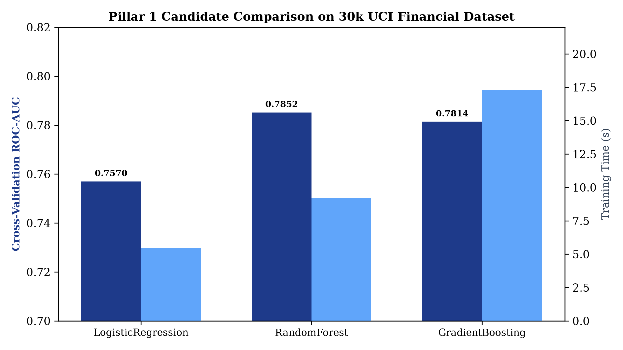
EXPERIMENTAL RESULTS · PILLAR 1 VALIDATION
Empirical Evaluation: Behavioral Machine Learning
0.7725
ROC-AUC on Held-Out Test Set (30k UCI records)
0.5304
PR-AUC (Substantial Lift over 0.22 Baseline)
81.53%
Test Accuracy at Decision Threshold 0.20
127 / 127
Automated Pytest Checks Passing (100% Suite)
05/10/2026 · Project Review
BCSE497J · Behavioral Credit Decision Support System · SCOPE
14 / 17

Slide 15
SUMMARY & ROADMAP · RESEARCH IMPACT
Key Conclusions & Future Engineering Roadmap
RESEARCH CONCLUSIONS & CONTRIBUTIONS
• Dual-Pillar Supervised ML Platform: Successfully eliminated reliance on arbitrary heuristic point cards by engineering an empirical 15-dimensional bridge linking statement features to 30,000 UCI default outcomes.
• Empirical Performance Parity: Achieved ROC-AUC 0.7725 and PR-AUC 0.5304 on behavioral default risk, paired with ROC-AUC 0.7737 on macro bureau benchmark with 100% 10-fold CV on transaction NLP.
• Verifiable Explainability & Governance: Delivered local interpretability via exact Tree-SHAP Shapley attributions, ensuring loan officers understand feature contributions before making decisions.
• Cryptographic Integrity & DPDP Compliance: Architected an immutable SHA-256 forward hash-chain ledger with external filesystem anchor and compliant tombstone PII erasure protocol.
FUTURE ENGINEERING ROADMAP
• Account Aggregator (AA) API Integration: Integrate live RBI-regulated Account Aggregator connectors for automated, consent-based, tamper-proof electronic bank statement fetching.
• Transformer-Based Vernacular NLP: Deploy fine-tuned multilingual transformer models (FinBERT / IndicBERT) for deep semantic comprehension of regional Indian banking narrations.
• Continuous Model Drift Tracking: Implement real-time Population Stability Index (PSI) and Wasserstein distance monitoring to alert underwriters of macroeconomic distributional shifts.
• Privacy-Preserving Federated Learning: Establish secure federated learning protocols enabling multiple banking institutions to collaboratively train credit models without centralizing borrower data.
05/10/2026 · Project Review
BCSE497J · Behavioral Credit Decision Support System · SCOPE
15 / 17

Slide 16
DELIVERABLES · DEPLOYED ARTIFACTS
Tangible Outcomes & Production Deployment
PRODUCTION DEPLOYMENT & OPEN SOURCE
Live Decision Support System: https://behavioral-credit-system.streamlit.app
Public GitHub Repository: https://github.com/rohith5709/behavioral-credit-decision-support-system
COMPLETED ENGINEERING DELIVERABLES
✓ Live Production Dashboard: Deployed on Streamlit Cloud with Linux runtime and libgomp1 support.
✓ 127 Passing Automated Pytest Tests: 100% test suite passing with zero failures across ML, bridge, & crypto logic.
✓ Comprehensive 58-Page Project Report: Formatted strictly according to IEEE/VIT standards with 24 tables & 13 figures.
✓ Reproducible Data Pipelines: Fully frozen random seeds (Seed 42) for deterministic model verification.
TARGETED SCHOLARLY & INSTITUTIONAL OUTCOMES
🎯 Scopus-Indexed Conference Paper: Submission targeting international conference on AI in Financial Technology.
🎯 Institutional IP & Copyright: Filing copyright protection for the proprietary 15-dimensional behavioral bridge architecture.
🎯 Cooperative Banking Pilot: Initiating proof-of-concept evaluation with regional cooperative credit societies.
🎯 Startup / Incubator Evaluation: Exploring commercial viability under university innovation incubators.
05/10/2026 · Project Review
BCSE497J · Behavioral Credit Decision Support System · SCOPE
16 / 17

Slide 17
SCHOLARLY CITATIONS · BIBLIOGRAPHY
References & Foundational Literature
[1] I.-C. Yeh and C. Lien, “The comparisons of data mining techniques for the predictive accuracy of probability of default of credit card clients,” Expert Syst. Appl., vol. 36, no. 2, pp. 2473–2480, 2009.
[2] S. Lessmann, B. Baesens, H.-V. Seow, and L. C. Thomas, “Benchmarking state-of-the-art classification algorithms for credit scoring: An update of research,” Eur. J. Oper. Res., vol. 247, no. 1, pp. 124–136, 2015.
[3] A. E. Khandani, A. J. Kim, and A. W. Lo, “Consumer credit-risk models via machine-learning algorithms,” J. Bank. Financ., vol. 34, no. 11, pp. 2767–2787, 2010.
[4] S. Bhatore, L. Mohan, and Y. R. Reddy, “Machine learning techniques for credit risk evaluation: A systematic literature review,” J. Bank. Financ. Technol., vol. 4, pp. 111–138, 2020.
[5] G. Ke et al., “LightGBM: A highly efficient gradient boosting decision tree,” in Proc. NeurIPS, 2017, pp. 3146–3154.
[6] S. M. Lundberg and S.-I. Lee, “A unified approach to interpreting model predictions,” in Proc. NeurIPS, 2017, pp. 4765–4774.
[7] J. C. Platt, “Probabilistic outputs for support vector machines and comparisons to regularized likelihood methods,” in Advances in Large Margin Classifiers, MIT Press, 1999, pp. 61–74.
[8] Home Credit Group, “Home Credit Default Risk,” Kaggle benchmark dataset, 2018.
[9] Government of India, “The Digital Personal Data Protection Act, 2023,” Act No. 22 of 2023.
05/10/2026 · Project Review
BCSE497J · Behavioral Credit Decision Support System · SCOPE
17 / 17

