Slide 1

Hummingbird ML-Agents Mini Project
A reinforcement learning agent trained with PPO in Unity, learning to find flowers and feed on nectar on its own.
Rohith
MCA (Generative AI), Dept. of Computer Applications, SRM IST
·
·
Guide: Dr. R. Thilagavathy

Slide 2
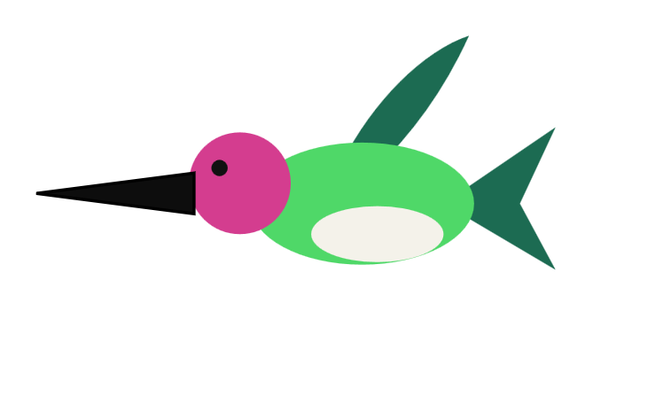

What is this project
A hummingbird that learns to find flowers and drink nectar through reinforcement learning, rather than being programmed with fixed rules for how to do it
Built in Unity using ML-Agents, trained with PPO
Based on Unity's official Hummingbirds course, adapted to run on Unity 6
The agent uses ray sensors and a small set of observations to sense flowers and boundaries, with no camera or pixel input
Trained first on a laptop CPU, then retrained on a rented NVIDIA L4 GPU instance to push the result further

Slide 3
Objectives
Build an agent that learns to fly and feed entirely on its own, without being given step-by-step rules to follow
Cover the full pipeline, from training to TensorBoard to a working exported model
Trained once on-device on a laptop CPU, then again on a rented GPU to compare the two
Understand how PPO actually works by building it, rather than just reading about it
Confirm the trained model runs standalone in Unity, with no Python trainer connected

Slide 4
Why reinforcement learning
Traditional game AI runs on fixed rules and doesn't improve on its own over time
Here, the agent tries different actions, gets rewarded or penalized, and gradually gets better through repetition
Every bit of the hummingbird's flying and feeding behavior came from that process, not from rules written in advance
Scripted AI
Learned AI
vs
Hardcoded rules, same every time
Learns by trial and reward

Slide 5
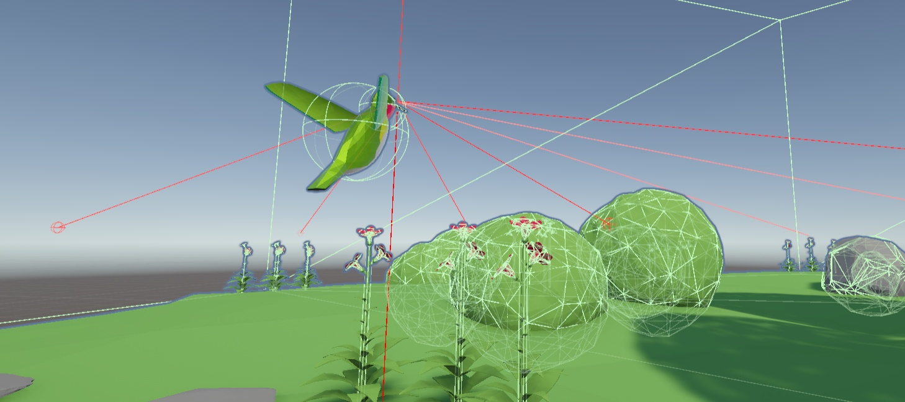
How the agent perceives its world
It reads ten numbers every step, covering its rotation, the direction to the nearest flower, and how well aligned it is
Three ray sensors, facing forward, up, and down, pick up nearby obstacles like the island's boundary
That's the only information it has to work with, there's no camera or image involved

Slide 6

How the agent acts
It controls five continuous values each step, three for movement and two for pitch and yaw
These are analog values rather than on-off switches, so the bird moves smoothly instead of snapping between positions
The loop is simple: observe, decide, act, and repeat, every single step
Observe
Decide
Act
repeats every step

Slide 7
The reward system
It earns a small reward for every tick it spends in contact with nectar, plus a bit more for approaching the flower head on
Hitting the island boundary costs a larger penalty
Those two signals were the only guidance it ever got
Nectar contact
Boundary hit
vs
+0.01 per tick reward
-0.5 per hit penalty

Slide 8
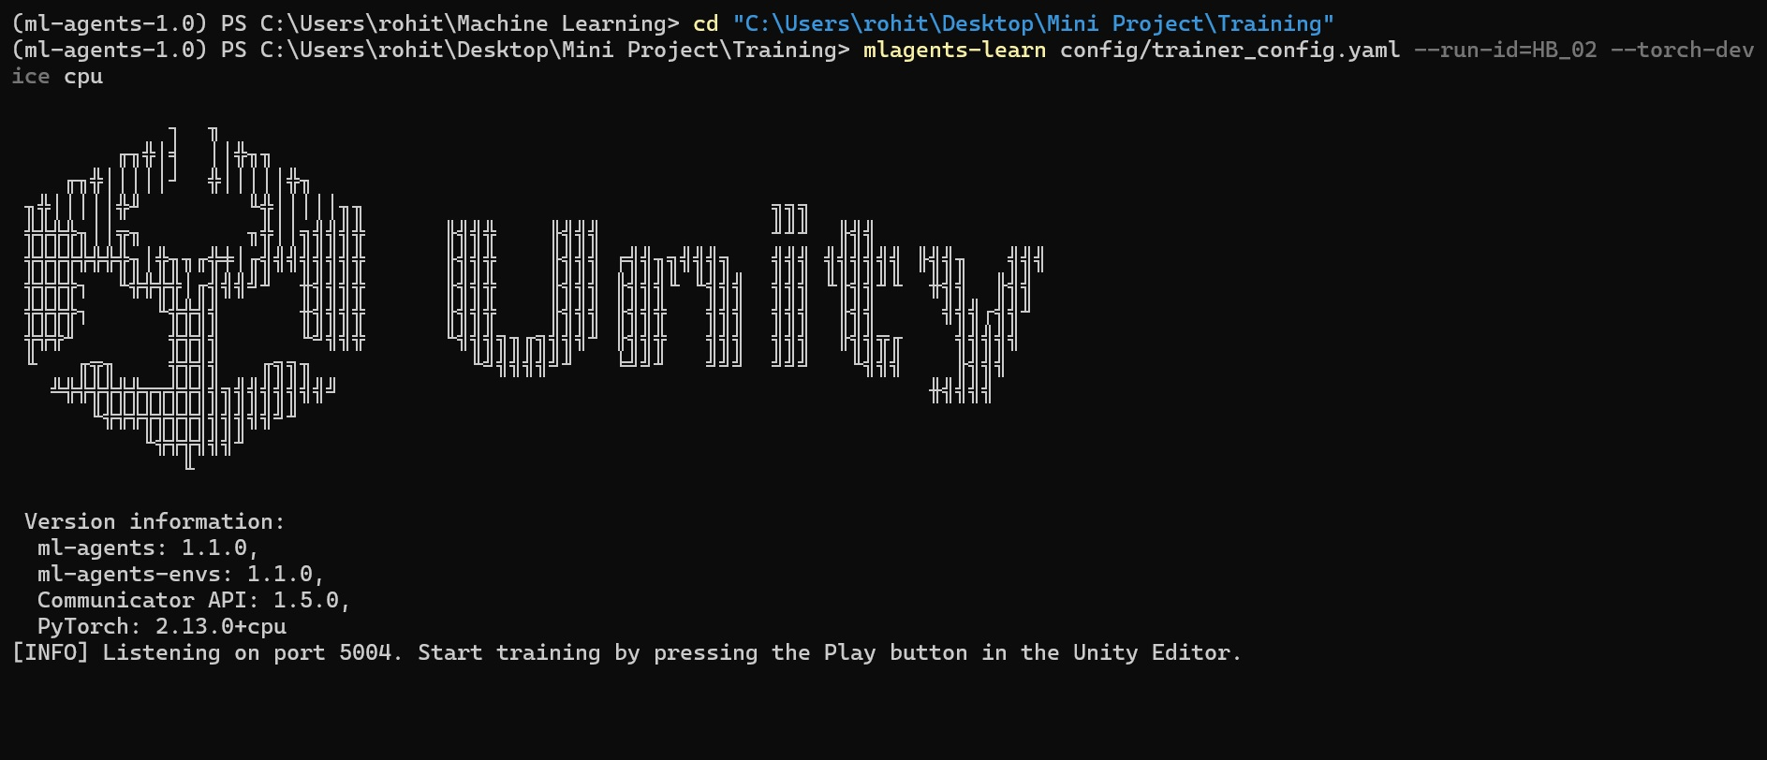
Training process
Training ran through a separate Python process using the PPO algorithm
It ran the full 50,000,000-step budget across two sessions, with 112 arenas training in parallel
The first run was CPU-only on the laptop; the final model was retrained from scratch on a rented NVIDIA L4 GPU instance

Slide 9
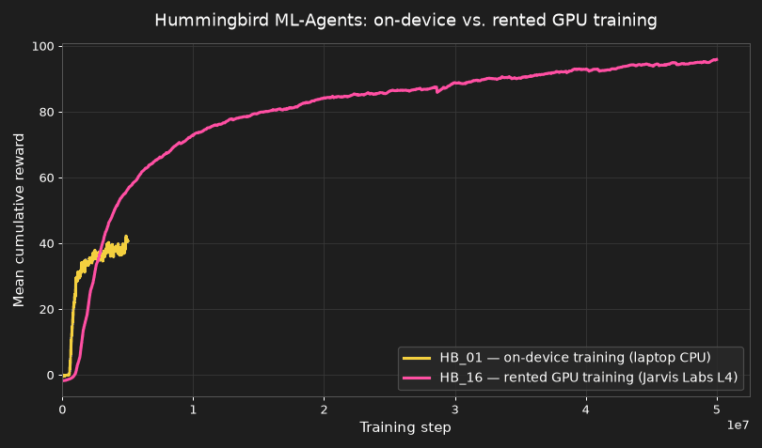
Results
96.58
Mean Reward best-ever 97.728
The trained model works even with Python fully disconnected, running on its own inside Unity
That beats the first baseline run's 41.29 by 56.44, a 2.35x improvement, with the sharpest gains in the last 10M steps
112 arenas gathering experience in parallel took the 50M step budget from 31 hours down to about 5
The curve is still rising at 50M steps, so the ceiling is a budget limit rather than a limit of the policy
HB_16 · NVIDIA L4 GPU instance, 50M steps
HB_01 · on-device, 5M steps

Slide 10
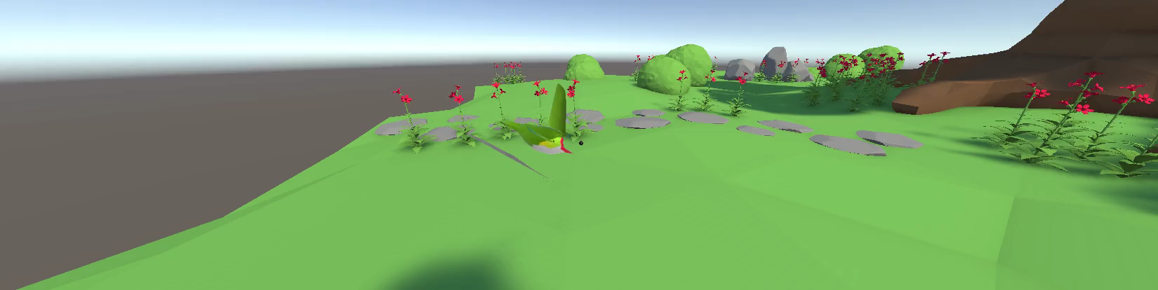
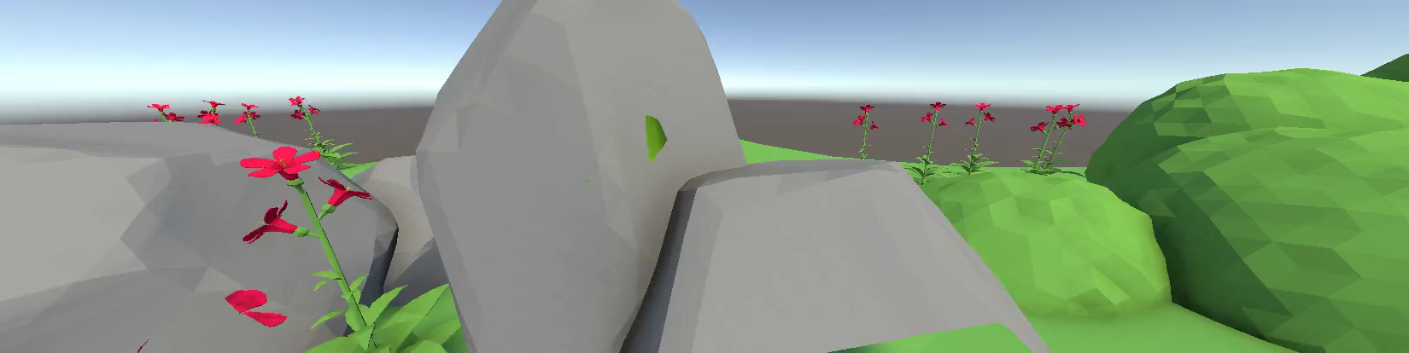

On-device vs rented GPU
On-device, laptop CPU
Rented NVIDIA L4 GPU instance
41.29
96.58
Mean Reward
Mean Reward
5,000,024 steps · 1 arena · stacked vectors 1 · integrated graphics only, GPU disabled
50,000,000 steps · 112 arenas · stacked vectors 3 · final 24.6M steps in about 2h38m
~31 hours training time
~5 hours training time
The on-device run proved the pipeline worked, but 8GB of RAM capped it at a single arena, and one unstacked observation frame left the agent with no way to sense its own velocity. Renting an NVIDIA L4 GPU instance lifted both limits at once: 112 arenas gathering experience in parallel, three stacked frames to difference into velocity, and a ten times larger step budget. The result is a 2.35x higher mean reward.

Slide 11
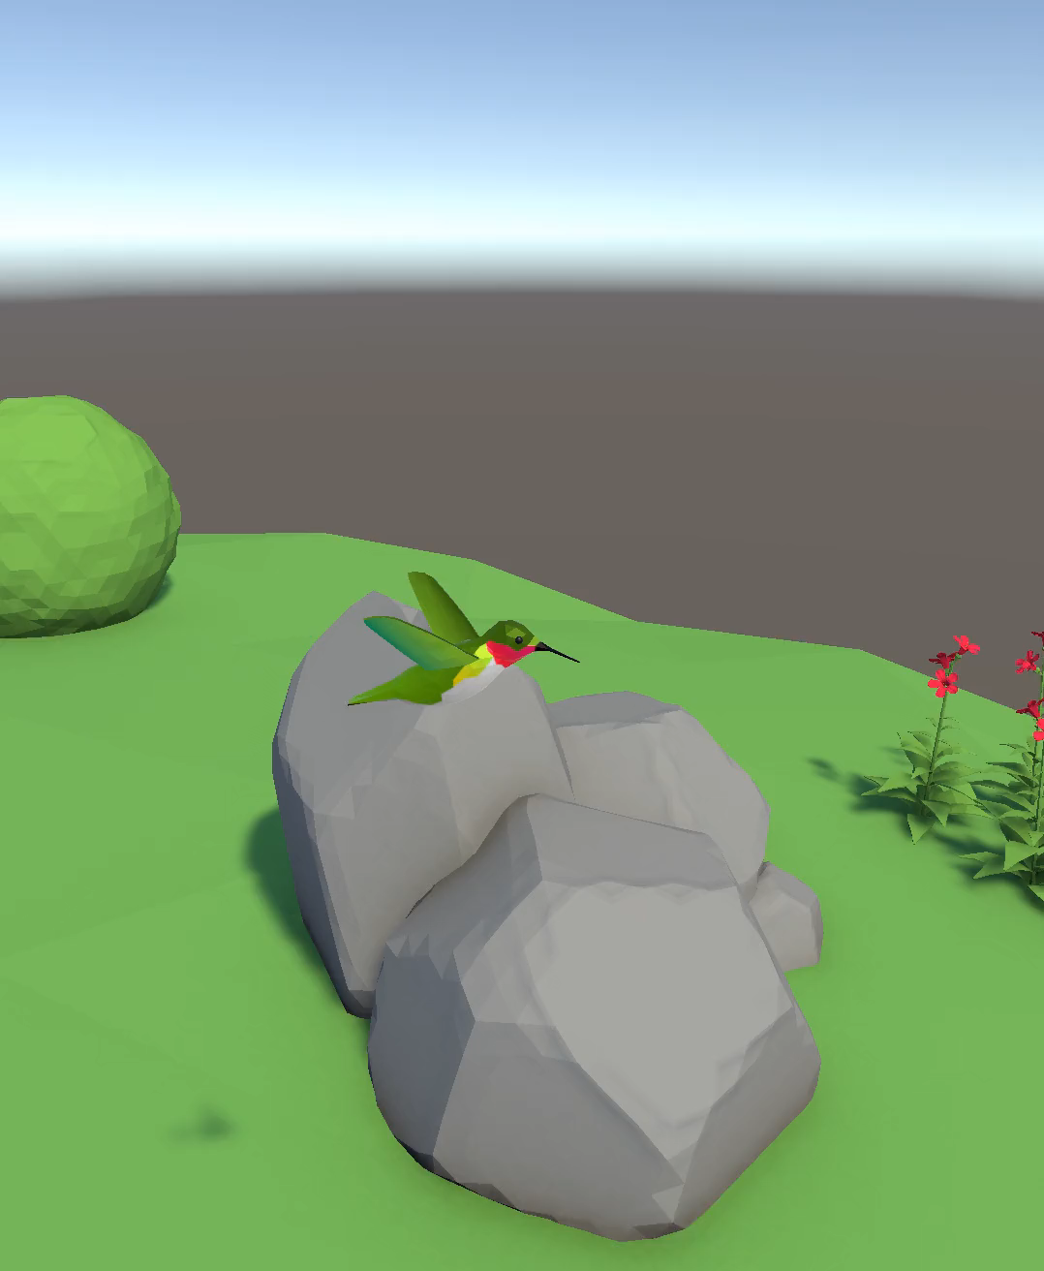
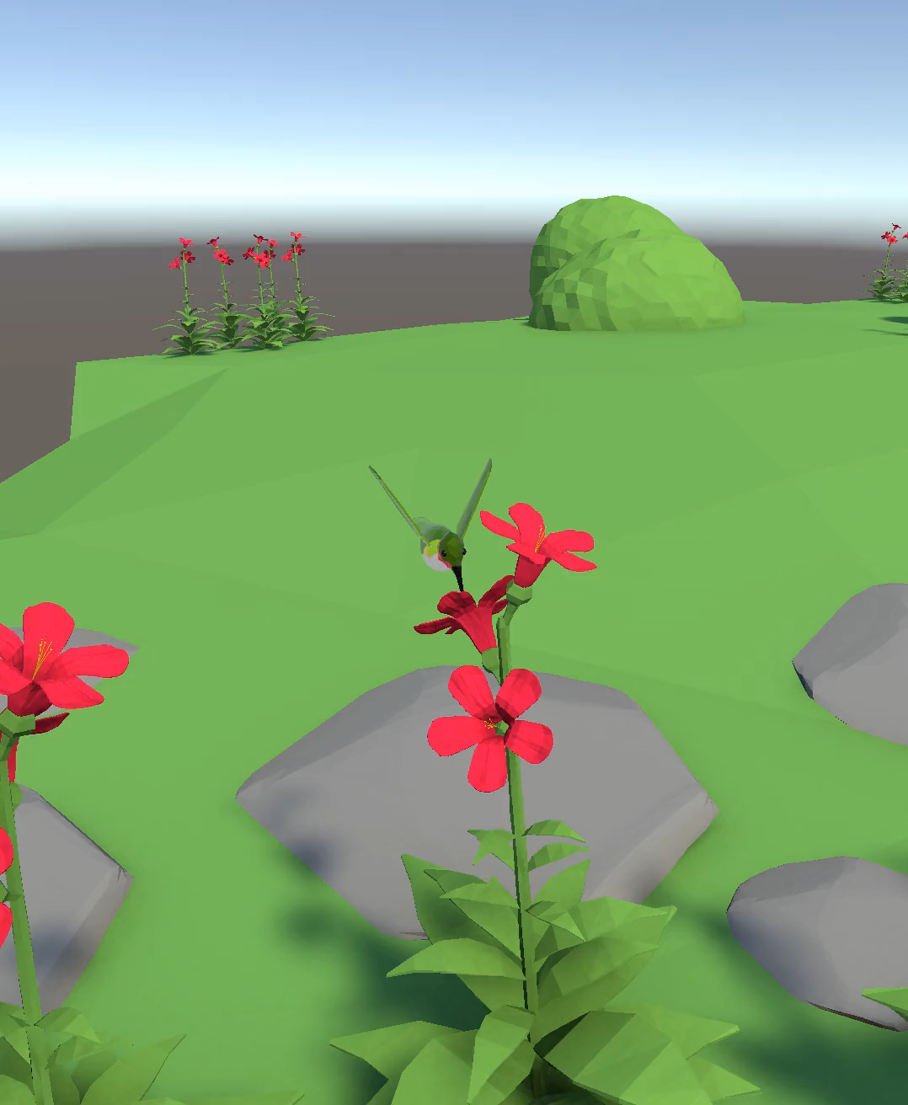
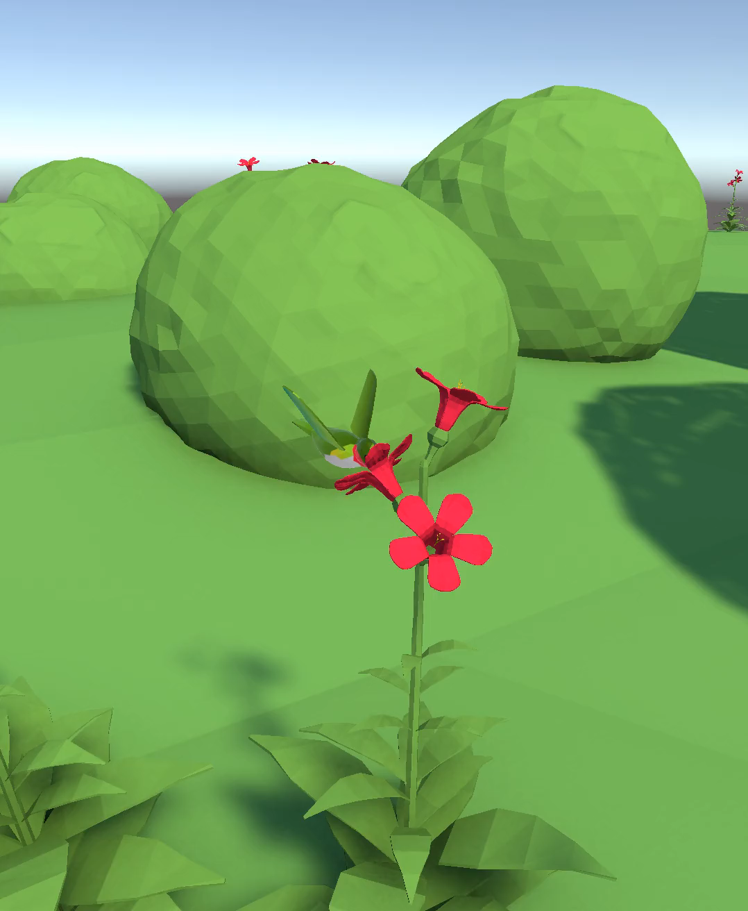
Progress across training
Early · 0.5M steps
Mid · 2.5M steps
Final · HB_16, 50M steps

Slide 12
Challenges along the way
The tutorial was written for an older Unity version, and much of the original code no longer matched the current engine or ML-Agents API
The laptop's 8GB of RAM couldn't handle multi-island training, and the environment was scaled down to a single island instead
One bug kept resurfacing after each attempted fix, and tracing it back eventually meant going into the training library's own source code
An unresponsive UI button turned out to be caused by two event systems quietly competing for the same click

Slide 13
Conclusion and what's next
The agent trained successfully and runs entirely on its own, with no live connection to Python required
Testing how the agent handles AI-generated flower layouts instead of hand-placed ones
Training on easier setups before harder ones, to see whether it learns faster that way
Having multiple birds compete for the same flowers during training itself, not just at deployment.
Adding a proper counter for the exact number of flowers fed on per episode, instead of relying on the current reward-based estimate.

Slide 14
Thank you
Hummingbird ML-Agents Mini Project, built with PPO in Unity ML-Agents 4.1.0.
Project review

