Slide 1

RAJALAKSHMI INSTITUTE OF TECHNOLOGY
(An Autonomous Institution, Affiliated to Anna University, Chennai)
DEPARTMENT OF CSE (ARTIFICIAL INTELLIGENCE AND MACHINE LEARNING)
ACADEMIC YEAR 2025 - 2026 SEMESTER III
ARTIFICIAL INTELLIGENCE LABORATORY
MINI PROJECT REPORT
REGISTER NUMBER | 2117240030118
NAME | ROHITH H
PROJECT TITLE | Al-Based Smart Parking System
DATE OF SUBMISSION | 31/10/2025
FACULTY IN-CHARGE | Mrs.M.Bhavani – Assistant professor
Signature of Faculty In-charge

Slide 2
TITLE:
AI - BASED SMART PARKING SYSTEM
INTRODUCTION
Artificial Intelligence (AI) enables machines to simulate human intelligence and perform tasks that normally require human cognition, such as learning, problem- solving, and decision-making.
Parking congestion is a common urban problem that causes delays and frustration. The Smart Parking System uses AI-based logic to manage and monitor parking spaces efficiently.
This project demonstrates how AI can optimize parking availability and reduce human effort.
PROBLEM STATEMENT
Finding available parking slots manually is time-consuming and often leads to congestion.
There is a need for an intelligent system that can automatically track, update, and display available parking slots in real-time to improve efficiency and reduce waiting time.
GOAL
To design a smart parking system using AI principles that efficiently allocates available parking slots and provides a clear status of occupied and empty spaces.
The goal is to simulate real-time parking management using Python logic.
THEORETICAL BACKGROUND
This project applies AI logic to simulate real-time decision-making in parking management.
The algorithm keeps track of occupied and empty slots dynamically and updates them after every vehicle movement.
While real-world smart parking systems use image processing or IoT sensors, this mini-project focuses on logical simulation using Python, which demonstrates the AI decision-making process clearly.
A simple rule-based AI algorithm is used:
If slot available → Park vehicle
If no slot → Display “Parking Full”

Slide 3
If vehicle exits → Free up slot
ALGORITHM EXPLANATION WITH EXAMPLE
Algorithm Steps:
1. Initialize the parking lot with a fixed number of slots.
2. When a vehicle parks, increment the occupied slot count.
3. When a vehicle exits, decrement the occupied slot count.
4. Display the updated parking status each time.
5. Prevent over-parking or removing vehicles when none exist.
Example:
total slots = 5 and 3 vehicles park,
Then Occupied = 3, Empty = 2.
If one vehicle leaves, Occupied = 2, Empty = 3.
IMPLEMENTATION AND CODE
Python code Class SmartParking:
Def init (self, total_slots): Self.total_slots = total_slots Self.occupied_slots = 0
Def park_vehicle(self):
If self.occupied_slots < self.total_slots: Self.occupied_slots += 1
Print(f”✅ Vehicle parked successfully. Slots filled: {self.occupied_slots}/{self.total_slots}”) Else:
Print(“❌ Parking Full! No space available.”) Def remove_vehicle(self):

Slide 4
If self.occupied_slots > 0:
Self.occupied_slots -= 1
Print(f”🚗 Vehicle exited. Slots filled: {self.occupied_slots}/{self.total_slots}”) Else:
Print(“⚠️ No vehicles to remove!”) Def show_status(self):
Empty_slots = self.total_slots – self.occupied_slots Print(“\n--- Parking Lot Status ---“)
Print(f”Total Slots: {self.total_slots}”)
Print(f”Occupied Slots: {self.occupied_slots}”) Print(f”Empty Slots: {empty_slots}”)
Print(“ \n”)
Parking = SmartParking(5) Parking.show_status()
Parking.park_vehicle()
Parking.park_vehicle() Parking.park_vehicle() Parking.show_status()
Parking.remove_vehicle()
Parking.show_status() parking.park_vehicle() parking.park_vehicle() parking.park_vehicle() parking.show_status()
OUTPUT

Slide 5
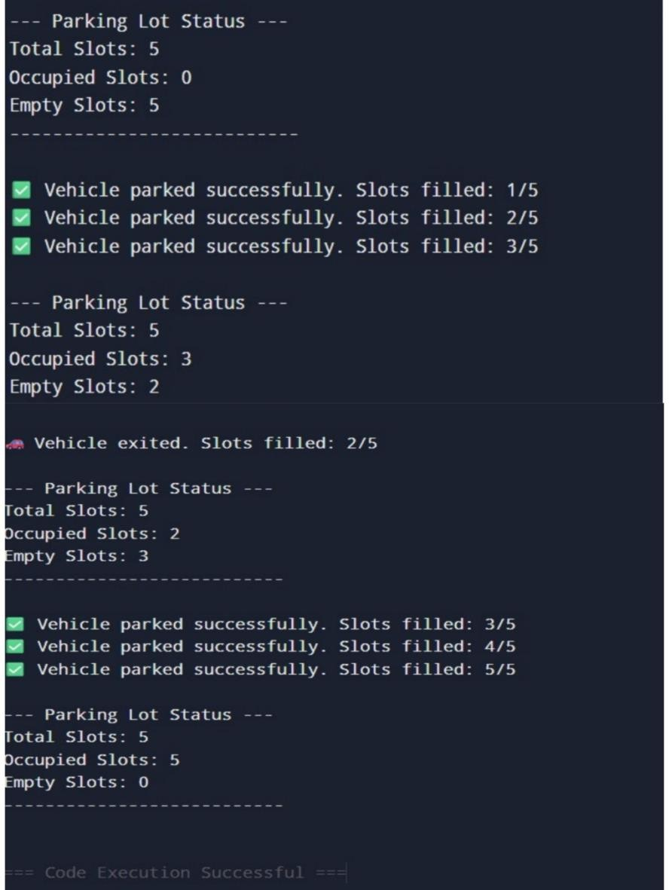
RESULTS AND FUTURE ENHANCEMENT
The Smart Parking System successfully simulates how AI logic can optimize parking management.
It efficiently tracks vehicle entries and exits and prevents overfilling.
In the future, this system can be enhanced using:
Camera sensors and image processing (OpenCV) for automatic vehicle detection.
IoT integration to monitor real-time data.
Mobile app interface for users to check slot availability.

Slide 6
GitHub link for code and output :
https://github.com/rohith639/AI-MINI-PROJECT-PROGRAM-AND-OUTPUT- GitHub link for report :
https://github.com/rohith639/2117240030118-AI-MINI-PROJECT-REPORT-/tree/main GitHub Link for ppt:
https://github.com/rohith639/2117240030118-AI-MINI-PROJECT-PPT-/tree/main
REFERENCES
1. Python Official Documentation — https://docs.python.org
2. OpenCV Documentation — https://opencv.org
3. Towards Data Science — Smart Parking System Articles
4. ResearchGate — AI in Smart Cities Papers
5. IEEE Xplore — AI Applications in Urban Systems

