Slide 1

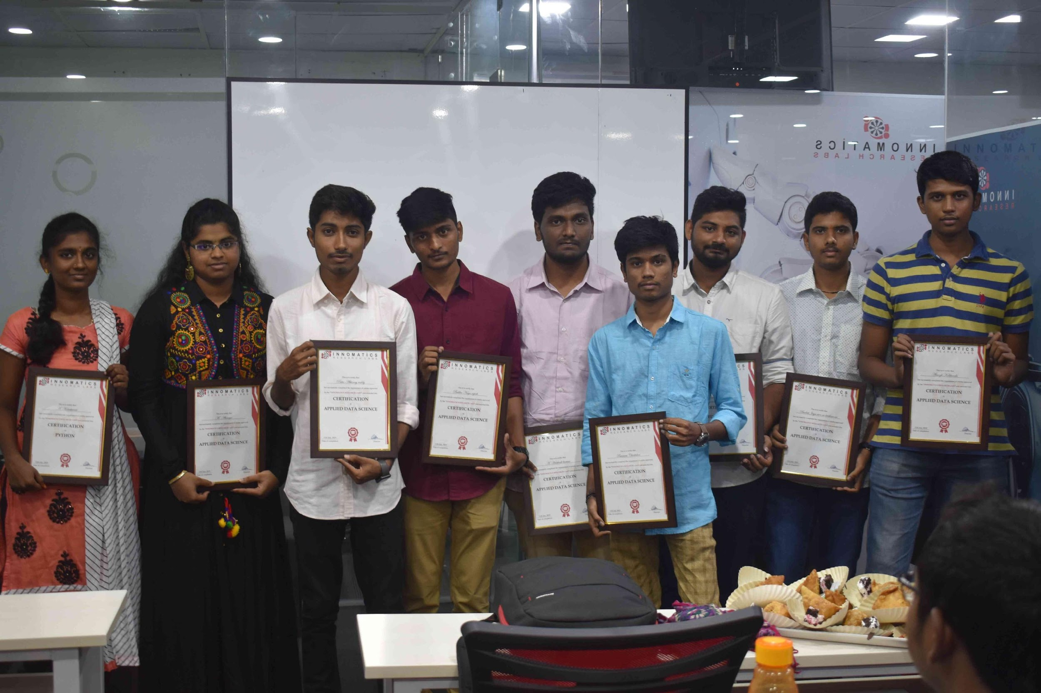
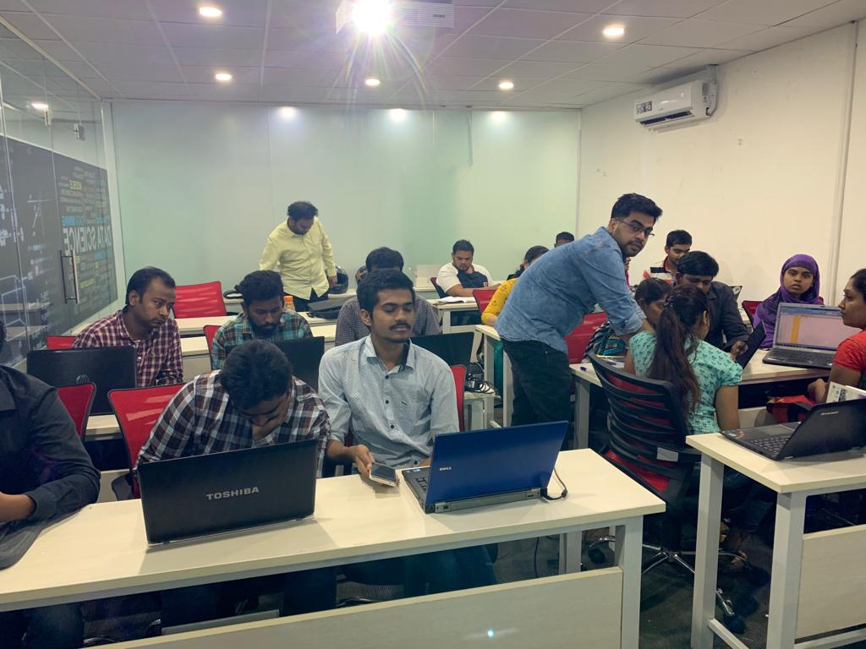

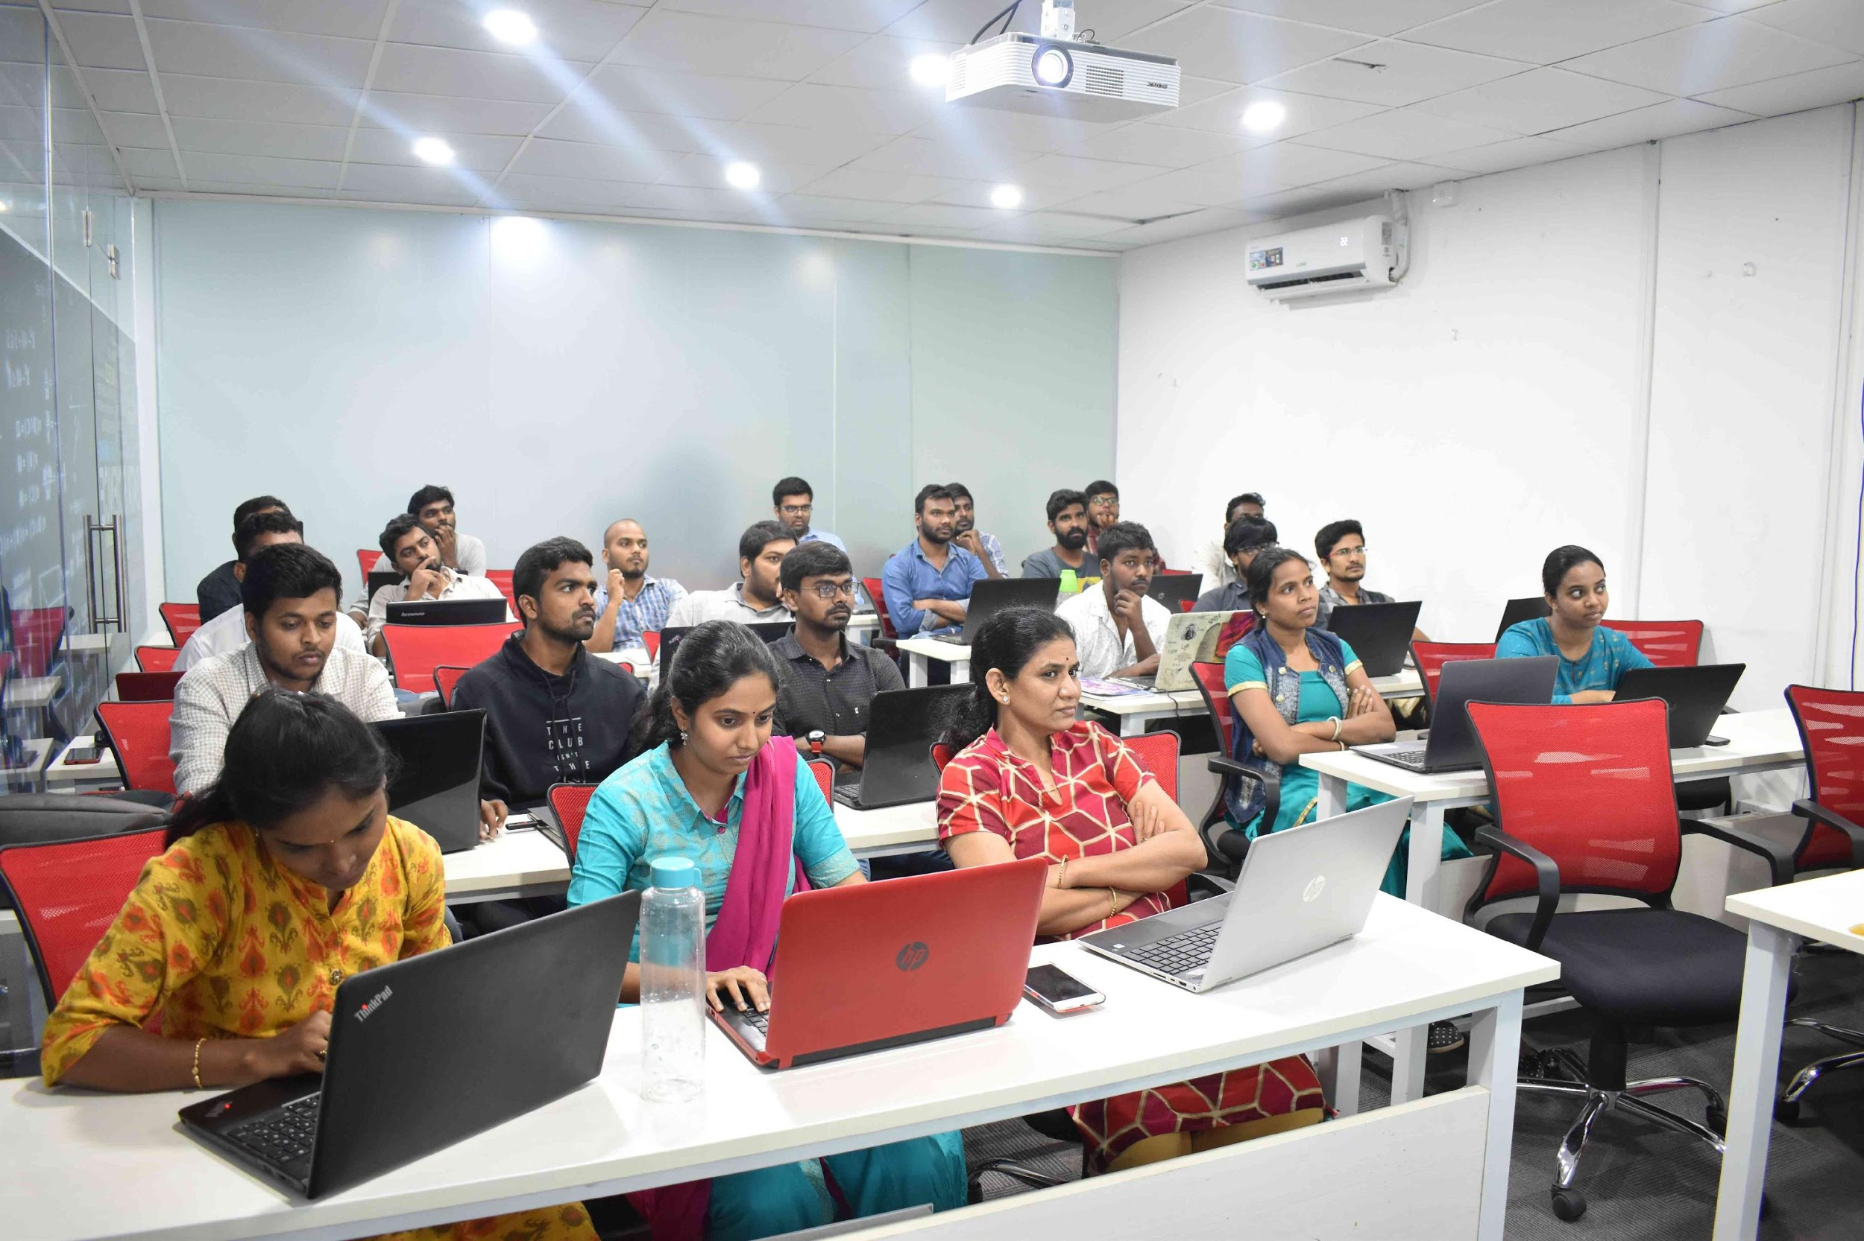
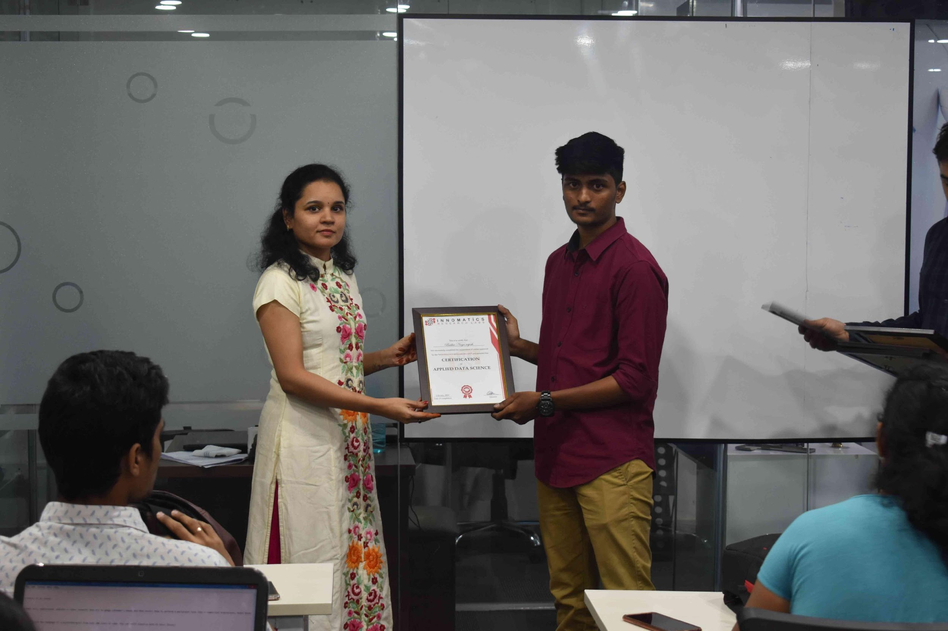
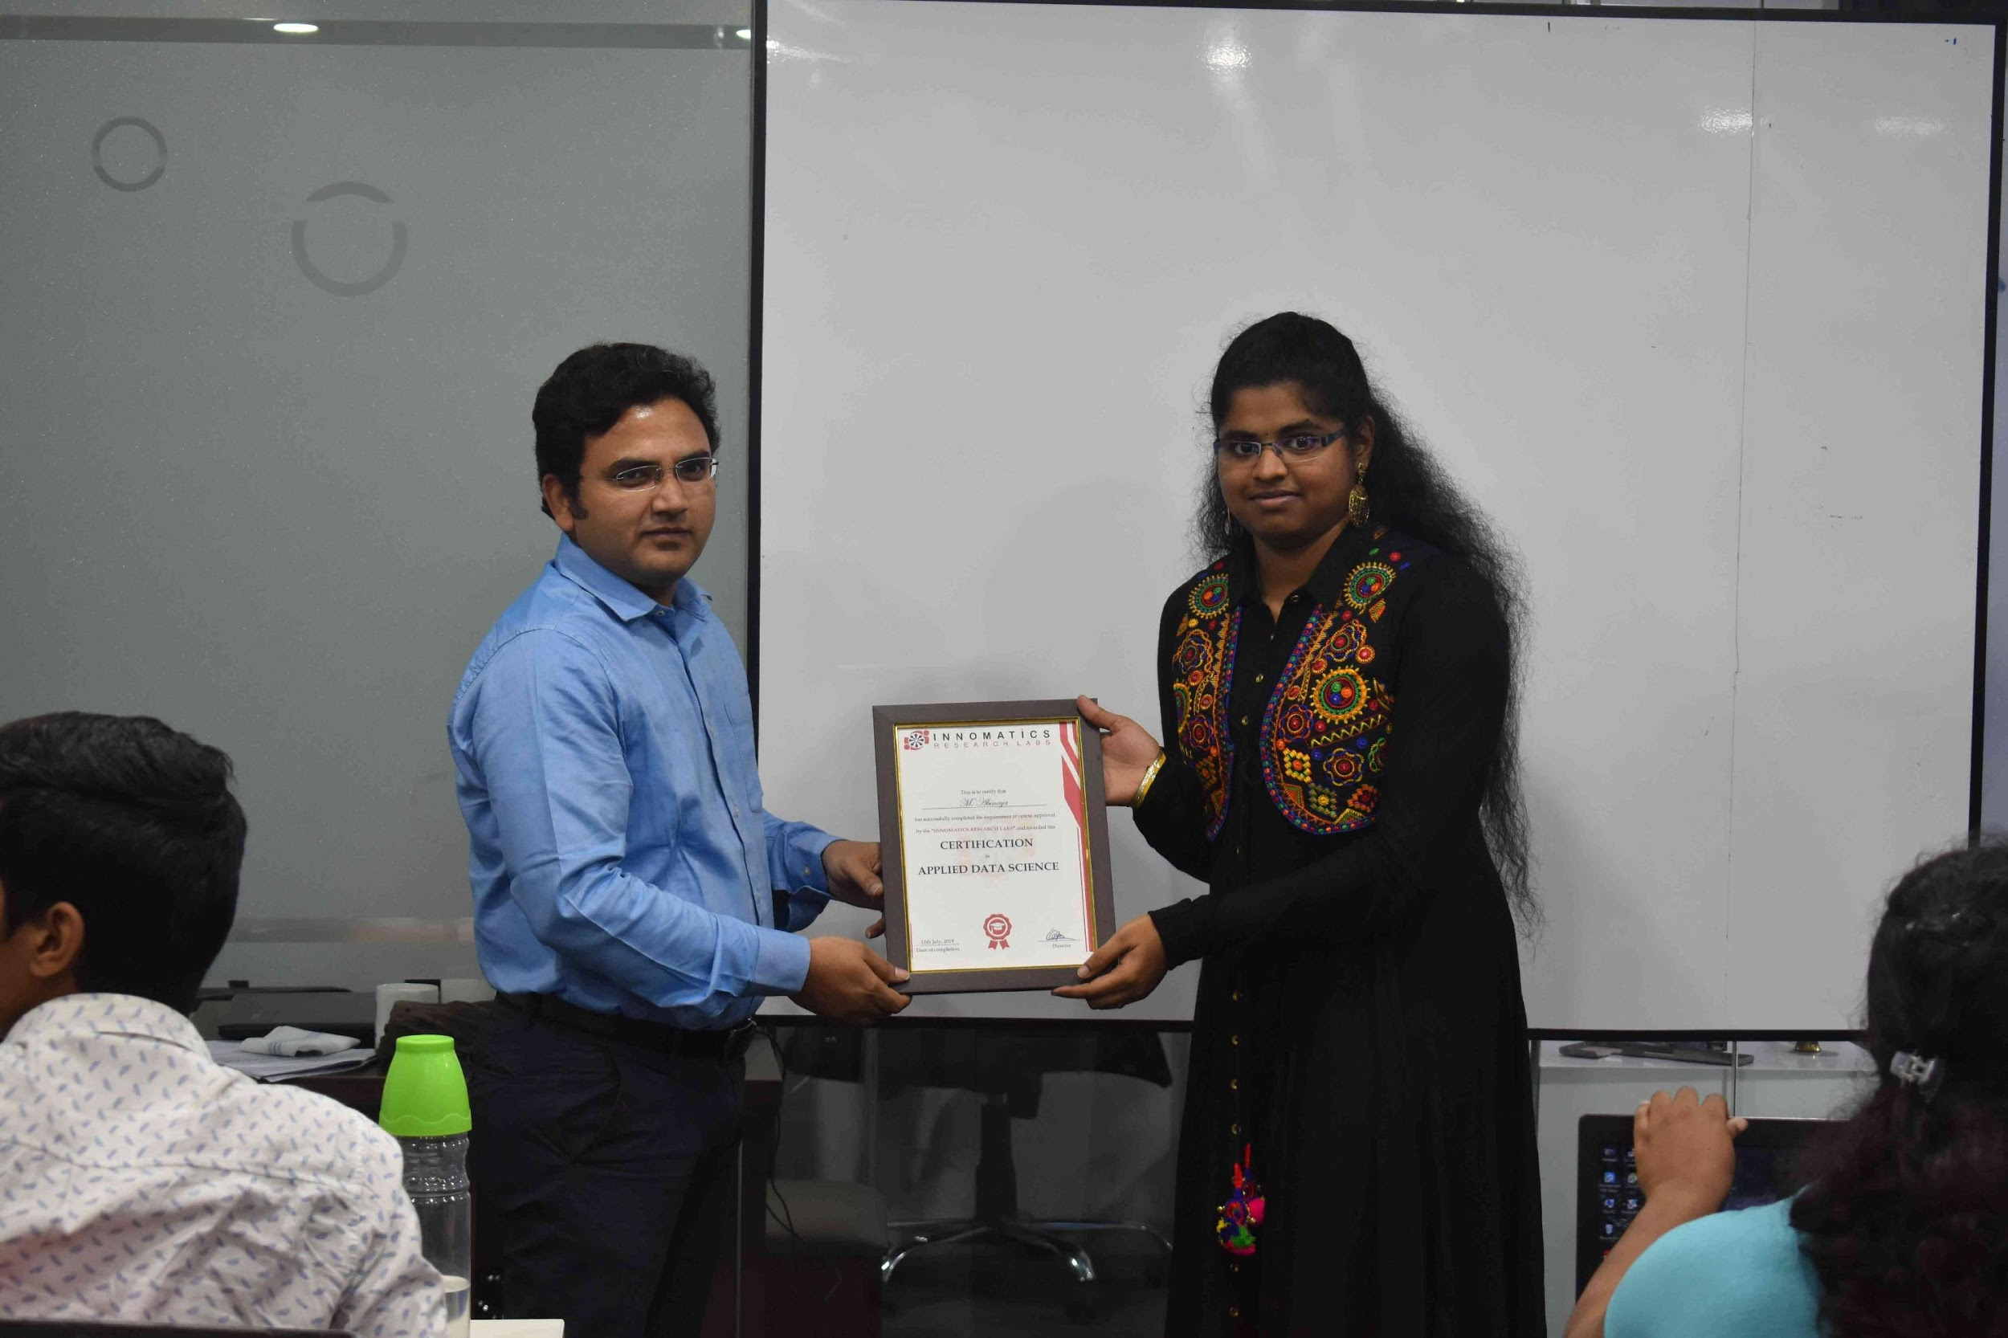

Slide 2
COVID Data Analysis across the World
Rohith Kumar

Slide 3
About me
This is Rohith Kumar
Background
Education: B-Tech (ECE), 2017
Work Experience: 3 years
Why you want to learn Data Science
At my work place, I look after the data collection under different projects and assist in data validation and Qualitative Data analysis . Over the period of time, working on data has created interest and excitement in me and therefore I am undertaking this course to enhance my knowledge and upgrade my skill set in the field of Data analytics and Data Science.
Any work experience
Currently working as Consultant at ICRISAT (International Crop Research Institute for Semi-Arid Tropics).

Slide 4
Agenda:
Business Problem
Objective of the Project
Web Scraping – Details (Websites, Processor you followed)
Summary of the Data
Data Cleaning
Data Manipulation
Univariate Analysis
BiVariate Analysis
Key Business Question
Conclusion (Key finding overall)
Q&A Slide
Your Experience of the Web Scraping – Data Analysis Project

Slide 5
Business Problem
Coronavirus disease 2019 (COVID-19) is a contagious disease caused by a virus, the severe acute respirator syndrome coronavirus 2 (SARS-CoV-2).
The disease has since spread worldwide, leading to the ongoing COVID-19 pandemic.
Therefore we will be studying the impact of COVID on the mortality of the populations across the countries in the world.

Slide 6
Objective of the Project
To analyze and study the effect of COVID on countries across the globe.
To study the spread of COVID and deaths associated across the continents.
To study the relation between COVID and various parameters through visualization tools.

Slide 7
Web Scraping
The required data for analyzing the COVID spread was scrapped from worldometers website (https://www.worldometers.info/coronavirus/).
The data appropriate for the study was available in the table format.
BeautifulSoup library was used in scraping the tabular data.
The scrapped data was converted into Dataframe and saved into the database.

Slide 8
Summary of the Data
The file was imported and was validated, cleaned and configurated with Dataframe functions and methods.
The data set contains information on Total cases, Total deaths, Total recovered, Total tests, Critical cases, New cases and many other variables across the different countries around the globe.
Shape of the data set was 219x21
The variables and parameters necessary for analysis were retained and rest were eliminated.

Slide 9
Data Cleaning & Data Configuration
The data obtained was converted in Pandas Dataframe.
The data set was cleaned from containing symbols, signs, null values etc.
The required new columns were integrated into the dataframe to make analysis much more easy.

Slide 10
Bivariate Analysis
Under the bivariate analysis, the relations between the variable were studied with the help of visualization tools
Bar plot
Scatter plot
Line plot
Boxplots
Heat map graph

Slide 11
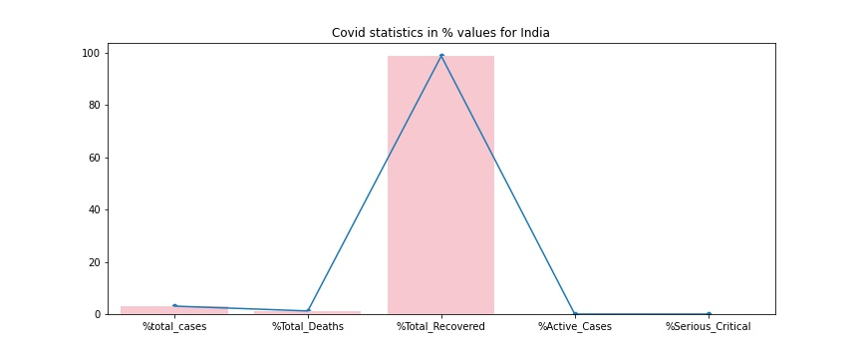
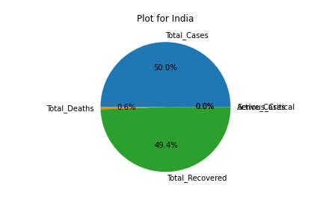
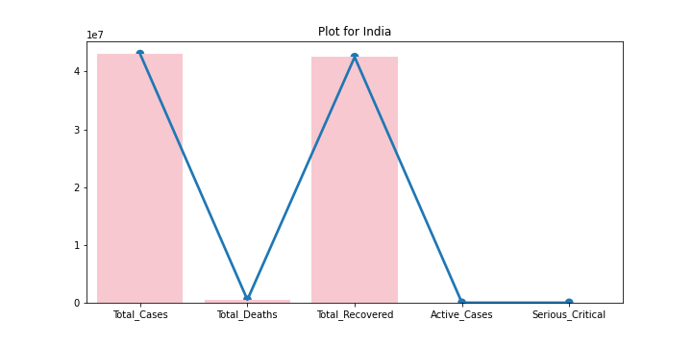
Key findings -India
In the context of India, the recovery rate is very high, around 98 percent of total cases. The total death% in India is around 1.21 % of total cases and stands at 3rd position in terms of number of deaths.
The total cases is 3.06 % of the population.
In terms of Recovery, India stands at 2nd position in the world after USA.
We stand at 1st position in terms of Serious critical COVID cases.

Slide 12
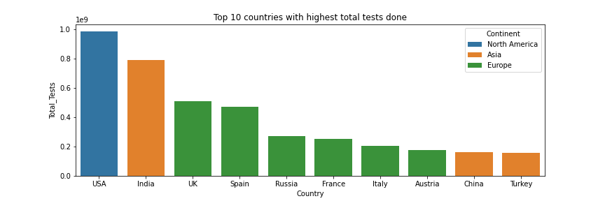
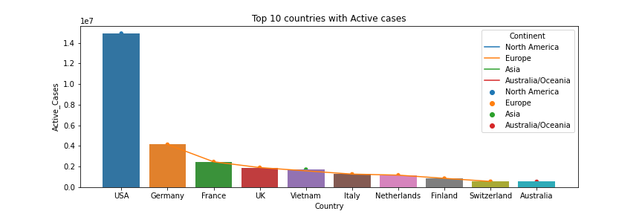
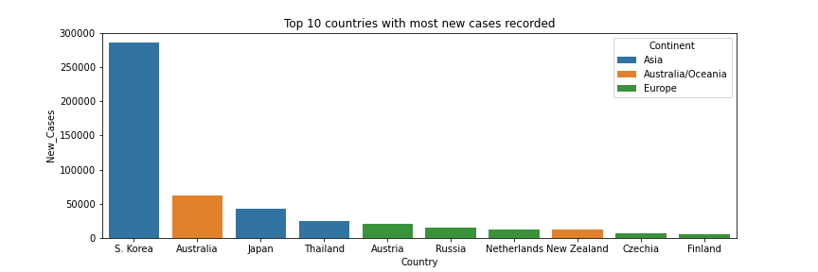
Key findings - World
USA (North America) has the highest active cases followed by Germany and France.
It is interesting to note that 7 countries out of 10 are from Europe continent. Europe was worst affected in terms of active cases, total cases, recoveries, test, death .
Africa has very less active cases did not made into the list.
India stands 2nd in terms of Total tests done with 56.38 % of the population.

Slide 13
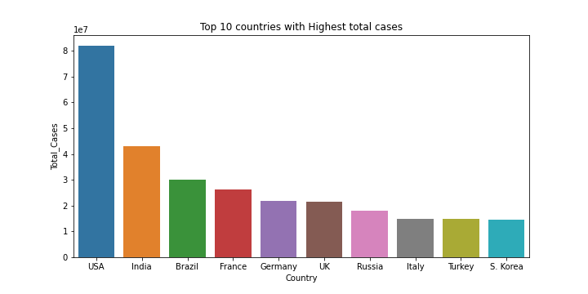
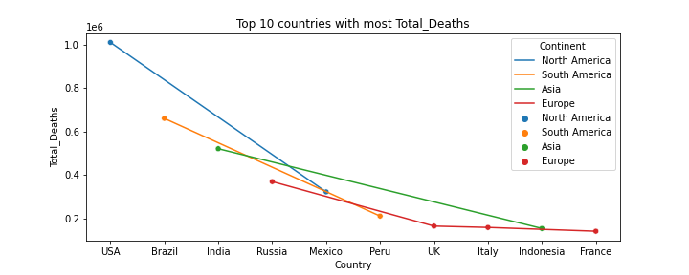
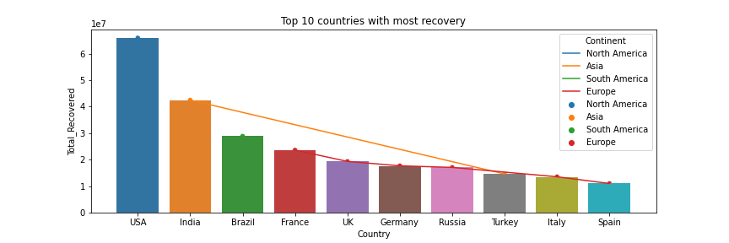
Key findings - World
The highest deaths were recorded in USA followed by Brazil and India.
It is interesting to note the African countries and Australia did not make into the list. They have the less number of deaths.
Most of the countries with high active cases has high recovery and deaths.

Slide 14
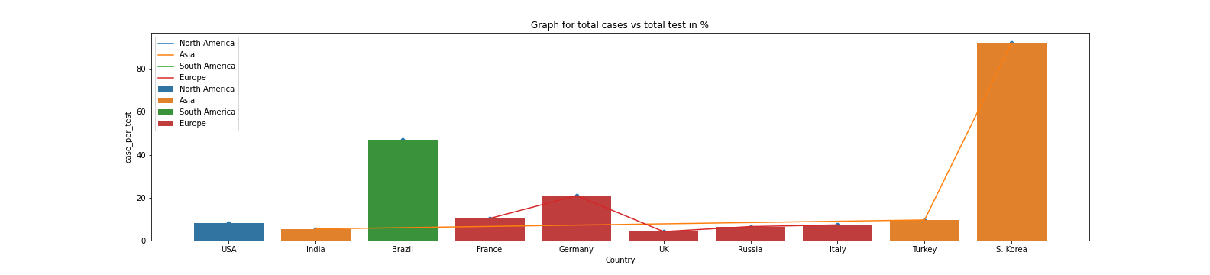
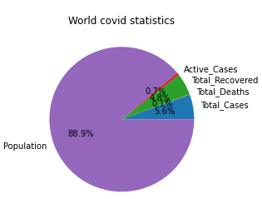
Key findings - World
Although USA and India have recorded high COVID cases but the ratio of total cases to total tests is low for both countries.
5.5% of Total tests were found positive with COVID in India.
The Ratio is very high for South Korea followed by Brazil showing very high positive cases for a unit of test done.
5.6 % of the world population got affected with COVID and 4.8 % of world population has recovered from COVID.
The Total deaths across the world account to 0.1 % of population.
With the different variants of virus coming in, the active cases across the world is at 0.7 % of the world population.

Slide 15
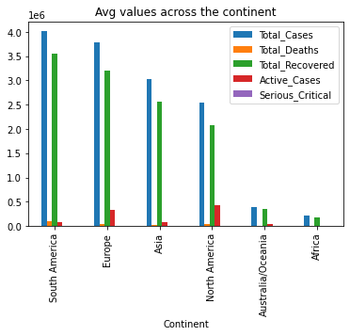
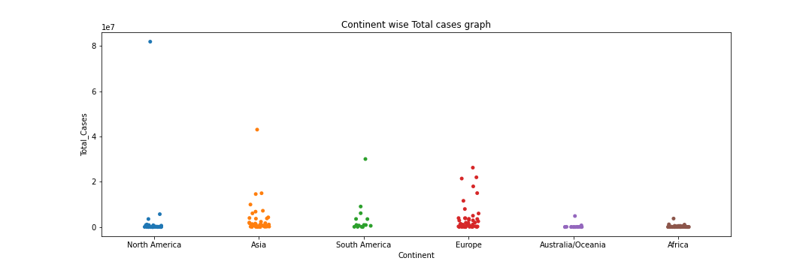
Key findings - Continents
South America has the highest total cases and recovered cases followed by Europe.
The Active cases is high in North America followed by Europe.
The total death across the South America is high compared to other continents.
Few countries across all the continents have large number of cases where as many countries have the cases spread across 0 to 1x10^7.

Slide 16
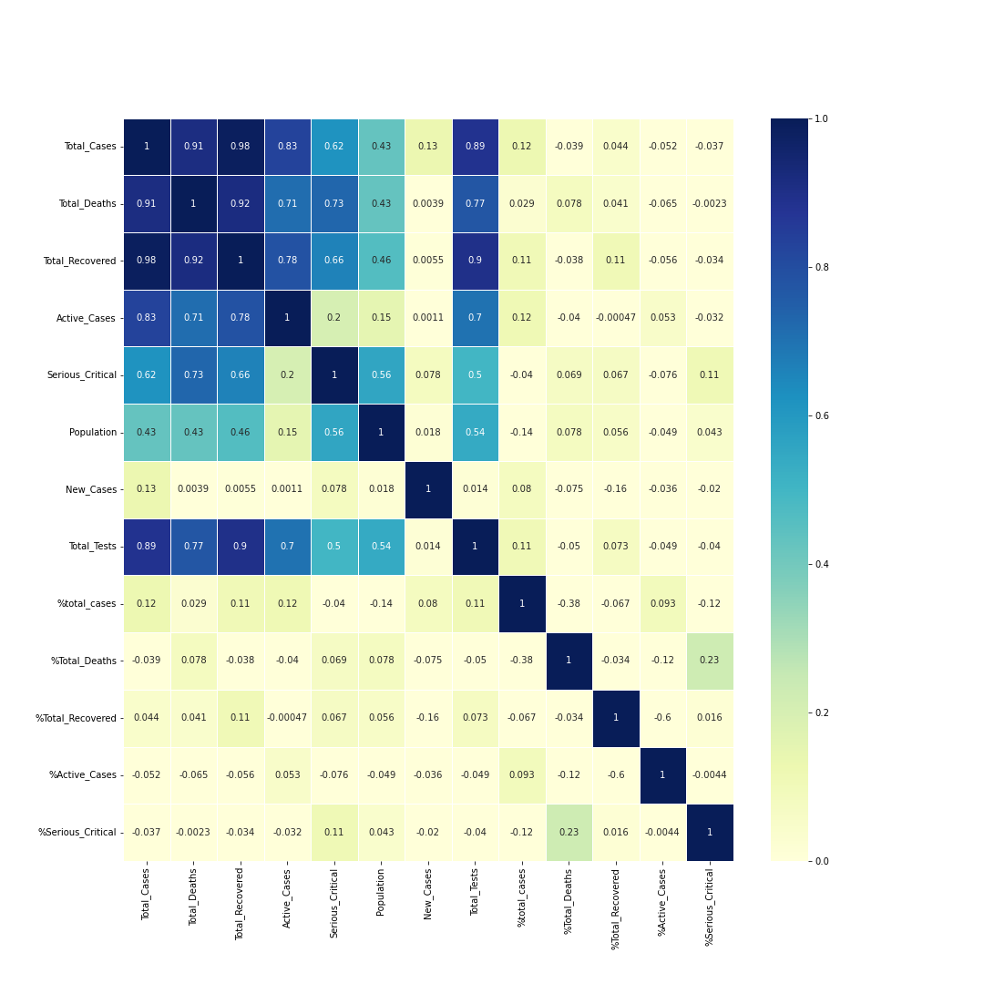
Analysis through Heat map
The Heat map shows a strong correlation among the variables Total cases, total deaths, total recovered, active cases, seriously critical and total tests.
These variables are linearly related to each other.
The correlation between population and other variables is ≤ 0.5 which is moderate

Slide 17
Future scope of project
Study the causal relations for high prevalence of COVID cases across the globe.
Effect of COVID and its severities, variation in symptoms across different countries with different geographical terrain and weather conditions.
Impact of COVID pandemic on health, economy, livelihoods, changes in food, diet, nutrition, lifestyle and behaviour.
Impact on industries, agriculture and agricultural value chains, demand and supply.

Slide 18
Experience of the Web Scraping – Data Analysis Project
Each and every step involved in implementing the project was not much exciting initially but turned out to be fun and alluring and engaging at later stages of project.
Mining the tabular data from the web was tricky and challenging task through out this project.
The most exciting and fun part of the project was using visualization tools to understand the data behavior and nuances. It has created a platform for the data to speak for itself and tell the stories and hidden patterns and mysteries in the data.
I found the use of heat map and strip plot very exciting.

Slide 19



Slide 20

THANK YOU

