Slide 1



Exhaustive Analysis of Indian Agriculture Using Power BI

Slide 2
Student Name : ROHITHA CH
Student ID : STU67740b22273901735658274
College Name : Anil Neerukonda Institute of Technology And Sciences

Slide 3

Learning Objectives
Understanding Power BI – Learn how to connect, transform, and visualize data using Power BI.
Data Collection & Cleaning – Understand the importance of data preprocessing before analysis.
Agricultural Data Analysis – Explore historical trends in crop production, pricing, and distribution.
Geospatial Mapping – Learn how to analyze agricultural production across states using maps.
Trend & Predictive Analysis – Identify patterns in agricultural output and market prices.
GOAL
Source :
www.freepik.com/

Slide 4
Learning Objectives
Decision-Making with Dashboards – Use interactive dashboards to gain insights for policymaking.
Optimization of Crop Planning – Help farmers and businesses make informed crop selection decisions.
Integration of External Data Sources – Learn how to connect live databases, APIs, and Excel sheets to Power BI for real-time agricultural analysis.
Report Sharing & Collaboration – Explore Power BI Service for publishing dashboards, setting up scheduled refreshes, and collaborating with teams.
GOAL
Source :
www.freepik.com/

Slide 5
Tools and Technologies Used :
Data Processing & Analysis:
Microsoft Excel – Used for cleaning and organizing raw agricultural data.
DAX (Data Analysis Expressions) – Used to create calculated measures in Power BI.
Visualization & Dashboard Development:
Power BI Desktop – The primary tool for building interactive dashboards.
Power BI Service – Used for publishing and sharing reports online.
Geospatial Tools (ArcGIS, Power BI Maps) – Used for state-wise crop production analysis.
Data Sources:
Government datasets – (Ministry of Agriculture, FAO, ICAR, etc.).
Weather & Climate Data from IMD – (Indian Meteorological Department).
Market Price Data from APMC – (Agricultural Produce Market Committee).

Slide 6
Methodology :
Data Collection:
Gather data from government sources, research papers, and online databases.
Types of data collected:
1. Crop production (tons per state).
2. Area under cultivation (hectares).
3. Rainfall patterns and climatic impact.
4. MSP (Minimum Support Price) data.
Data Cleaning & Transformation:
Remove duplicate records and handle missing values.
Standardize date formats, crop names, and units.
Convert raw data into structured tabular format for Power BI.

Slide 7
Methodology :
Data Loading & Processing:
Load cleaned datasets into Power BI.
Use DAX formulas for custom calculations like growth rate and percentage changes.
Data Visualization & Analysis:
Create dashboards to display:
1. State-wise crop production using maps.
2. MSP trends for different crops over time.
3. Rainfall impact on agricultural output.
Implement filters and slicers for interactive exploration.
Insights & Reporting:
Identify top-performing crops and states.
Compare past and present production trends.
Generate data-driven recommendations for policymakers.

Slide 8
Problem Statement :
India's agricultural sector is vast and complex, with challenges in data-driven decision-making, inefficient resource allocation, and price instability. This project aims to analyze agricultural production data using Power BI to identify patterns, predict trends, and improve policy-making.
Key Problems Identified:
Lack of Centralized Data – Agricultural data is scattered across various sources, making analysis difficult.
Seasonal Variations Affecting Production – Farmers struggle with fluctuating crop yields due to unpredictable weather conditions and lack of predictive insights.
State & District-Wise Production Disparity – There is an uneven distribution of crop production across different regions, affecting supply chains.
Lack of Crop-Specific Insights – Decision-makers lack real-time insights into which crops are performing well in specific regions.
Challenges in Minimum Support Price (MSP) Calculation – Farmers often do not get fair prices due to inefficient pricing mechanisms and lack of market transparency.

Slide 9
Problem Statement :
Lack of Forecasting Models – Without predictive analytics, stakeholders cannot anticipate
future trends and take preventive actions.
Data Interpretation for Policy Makers – Government officials and agricultural scientists require user-friendly dashboards to interpret insights efficiently.
Resource Allocation Inefficiencies – Due to the absence of proper analytics, resources like fertilizers, water, and labor are often mismanaged.
Limited Awareness Among Farmers – Farmers are not always aware of which crops will yield the highest profits based on past data.
Need for Sustainable Farming Practices – There is a rising demand to implement sustainable and data-driven farming techniques to reduce environmental impact.
Lack of Real-Time Monitoring Systems – The absence of real-time agricultural monitoring makes it difficult for farmers and policymakers to respond to sudden market shifts, climate changes, or pest outbreaks promptly.

Slide 10
Solution :
The project utilizes Power BI to create an exhaustive analytical dashboard for Indian agriculture, enabling better decision-making and forecasting.
Key Solutions Implemented:
Centralized Data Analysis – Integrated multiple datasets to create a unified view of agricultural production across India.
Seasonal Analysis & Forecasting – Used historical trends to predict seasonal production fluctuations and mitigate risks.
State & District-Level Insights – Created heatmaps and bar charts to highlight top-producing regions and disparities.
Crop-Specific Reports – Designed detailed dashboards for crop-wise production trends over multiple years.
Minimum Support Price (MSP) Predictions – Analyzed past MSP trends and production costs to suggest optimal pricing.

Slide 11
Solution :
Predictive Analytics Using Power BI – Utilized time-series forecasting to predict future production trends and market demands.
Interactive Dashboards for Policy Makers – Built interactive and filterable reports to assist policymakers in better decision-making.
Resource Optimization Strategies – Provided insights on fertilizer use, irrigation needs, and optimal crop selection based on data trends.
Farmer Awareness Programs – Designed insights that can be used to educate farmers about profitable crops and government subsidies.
Sustainability Analysis – Incorporated environmental impact data to promote water conservation and eco-friendly farming practices.
Implementation of Real-Time Data Monitoring – By integrating live data sources and IoT-based agricultural sensors with Power BI, stakeholders can track climate conditions, soil health, and market fluctuations in real time, enabling quick decision-making and risk mitigation.

Slide 12
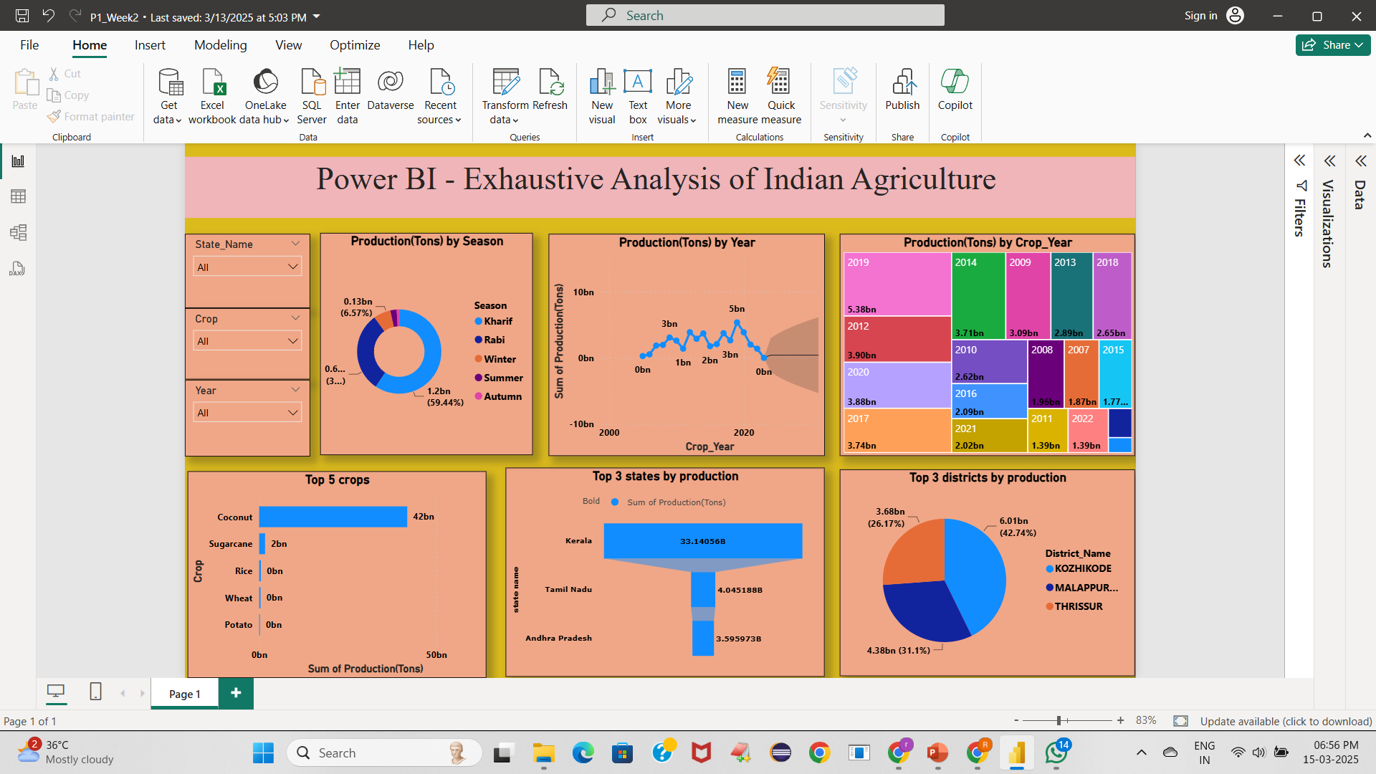
Screenshot of Output:
WEEK-1

Slide 13
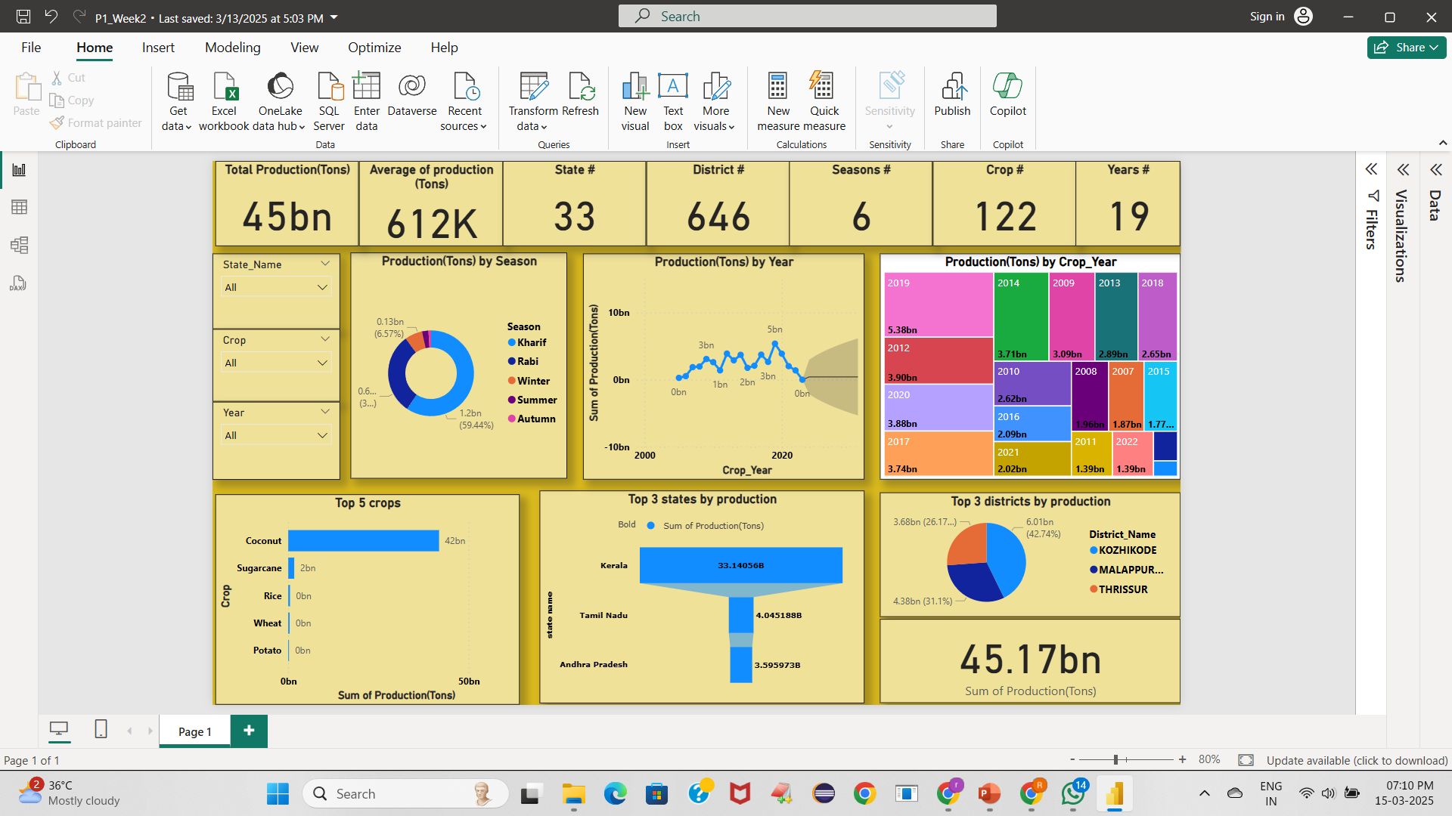
Screenshot of Output:
WEEK-2

Slide 14
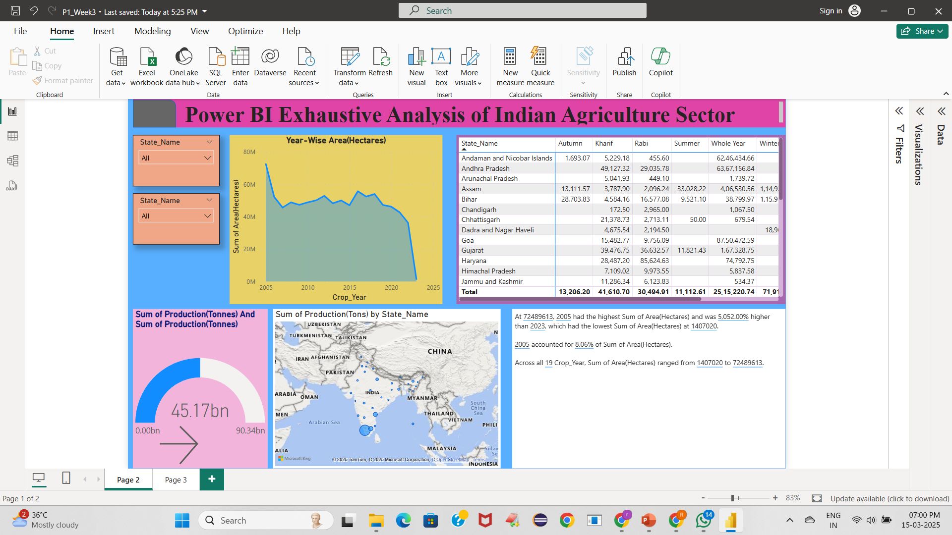
Screenshot of Output:
WEEK-3

Slide 15
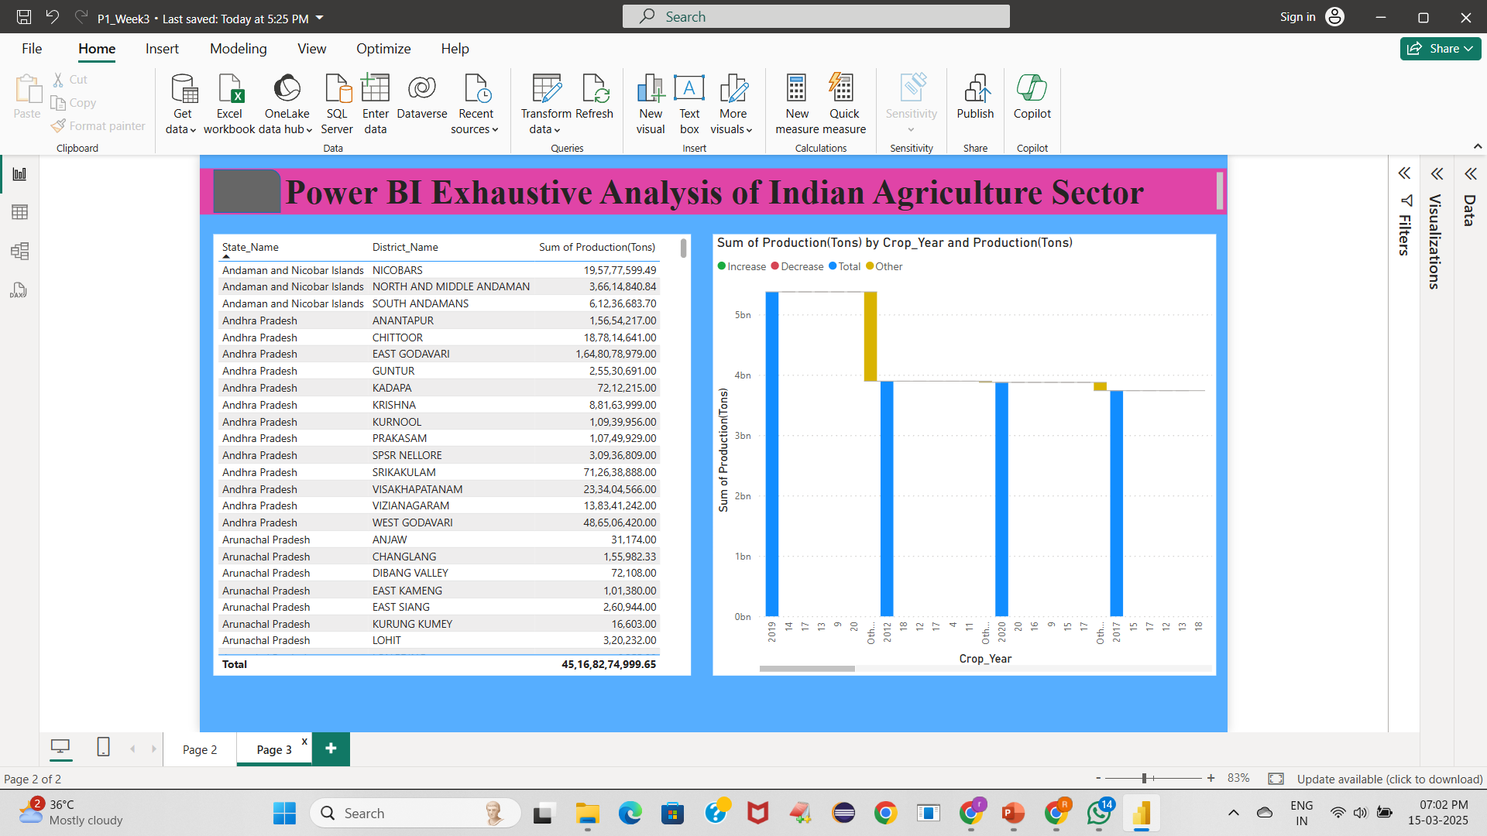
Screenshot of Output:
WEEK-3

Slide 16
Conclusion:
In conclusion, this project successfully demonstrates how data analytics, visualization, and business intelligence tools like Power BI and Tableau can revolutionize decision-making in various industries. By analyzing complex datasets, extracting meaningful insights, and presenting them through interactive dashboards, businesses can enhance efficiency, reduce risks, and improve overall performance.
The integration of SQL for data management, coupled with Power BI and Tableau for visualization, provides a comprehensive solution for addressing challenges related to data-driven decision-making. The methodologies applied in this project ensure accuracy, real-time updates, and ease of understanding for stakeholders.
Key Takeaways and Conclusion Points:
Enhanced Data-Driven Decision Making – The project empowers businesses with insightful analytics, enabling informed and strategic decisions.
Improved Efficiency and Productivity – By automating data collection and visualization, organizations can streamline processes and optimize resources.
Real-Time Monitoring and Analysis – With the implementation of real-time dashboards, stakeholders can track progress and adjust strategies accordingly.
Scalability and Adaptability – The solutions developed can be expanded to various industries, including finance, healthcare, and supply chain management.

Slide 17
Conclusion:
Bridging the Gap Between Raw Data and Actionable Insights – Power BI and Tableau transform complex datasets into meaningful insights, improving transparency and usability.
User-Friendly Visual Representations – Interactive dashboards simplify complex data, making it accessible for both technical and non-technical users.
Future Scope and Improvements – The project can be further enhanced by integrating AI-driven predictive analytics and machine learning models to provide even more advanced insights.
Sustainability and Long-Term Impact – Data-driven solutions contribute to resource optimization, cost reduction, and better planning for long-term success.
Improved Risk Management – Businesses can proactively identify trends and anomalies, minimizing risks and preventing potential financial losses.
Competitive Advantage – Companies that leverage data analytics gain a strategic edge over competitors by making smarter, data-backed decisions.
Increased Collaboration and Data Accessibility – Cloud-based dashboards and reports improve collaboration among teams and stakeholders.
Enhanced Customer Insights – Businesses can analyze customer behavior, preferences, and trends, leading to improved customer experiences and satisfaction.

Slide 18
Impact:
Improved Agricultural Productivity – Data-driven insights help farmers and policymakers optimize crop selection and farming practices.
Data-Backed Pricing Strategies – Helps in determining a fair Minimum Support Price (MSP) for farmers by analyzing historical data.
Enhanced Decision-Making for Policymakers – Government bodies can create better policies and subsidies based on accurate production and demand forecasts.
Better Resource Management – Provides insights on water usage, fertilizer application, and supply chain optimization to reduce wastage.
Predictive Analytics for Farmers – Forecasting crop yields and market prices helps farmers make informed planting decisions.

Slide 19
Future Scope:
Integration with AI & Machine Learning – Implementing AI-driven predictive models for climate risk analysis, pest detection, and yield prediction.
IoT & Real-Time Monitoring – Connecting IoT sensors to track soil quality, temperature, and moisture levels for precision farming.
Mobile Application for Farmers – Developing a mobile app that provides farmers with real-time insights, weather updates, and government scheme notifications.
Cloud-Based Live Dashboards – Expanding the project to use cloud-based Power BI for seamless real-time collaboration and access.
Blockchain for Supply Chain Transparency – Using blockchain technology to ensure fair trade and transparency in agricultural markets.
Expansion to Global Agricultural Analysis – Extending the model to analyze global agricultural trends and improve international trade policies.

Slide 20
Thank You!

