Slide 1

Navigating the Landscape: Exploring Employability and Essential Skills in the Evolving IT Industry
Mohtashim Haider Rohit
April 2024

Slide 2

OUTLINE
Executive Summary
Introduction
Methodology
Results
Visualization – Charts
Dashboard
Discussion
Findings & Implications
Conclusion
Appendix

Slide 3

EXECUTIVE SUMMARY
An analysis of a survey of the global developer community was used to assess current and future employability of developers per programming language and dev environment
Survey results showed a strong bias towards younger, well- educated male respondents from the United States, thus not or under-representing earlier generations and female coders
Strong deviations between survey results and actual job postings were found that could impede candidates looking for jobs in the industry
Irrespective of programming language, programmers can
expect to get a salary of >80k USD

Slide 4

INTRODUCTION
This analysis studies current and future trends in programming languages and infrastructure, and assesses their implications on the US job market
It leverages Stack Overflow Developer Survey 2019 data of
approximately 11’500 respondents
It takes into account data on the following four sub-topics:
Top 10 programming languages
Top 10 databases
Main platforms
Top 10 WebFrames
Data on job postings have been used as cross-reference.
Source for this data is the github job postings API

Slide 5

METHODOLOGY
Data Collection
As part of this analysis, two separate data sources have been consulted. The Stack Overflow 2019 data has been empirically collected and analysed in the form of descriptive statistics
Data has been scraped and retrieved via API
Exploratory analysis performed
Analysis of data distribution
Data cleansing of outliers, NaaN values, etc.
Data visualization with IBM Cognos dashboards in three categories
Current situation
Future trends
Demographics
Conclusions were drawn from comparatory analysis of Stack
Overflow survey and actual job postings scraped from web

Slide 6
RESULTS

Slide 7
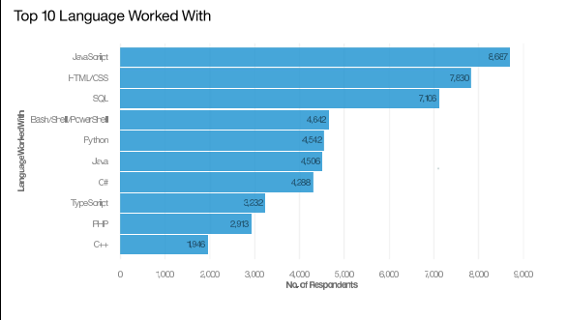
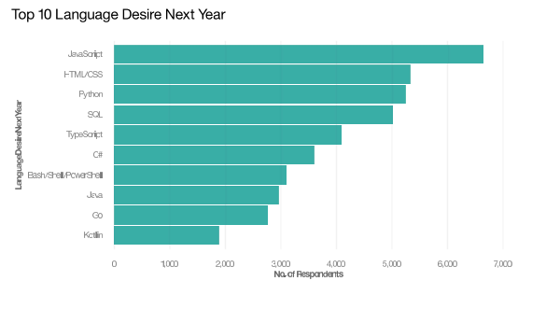
PROGRAMMING LANGUAGE TRENDS
Current Year Next Year

Slide 8
PROGRAMMING LANGUAGE TRENDS - FINDINGS & IMPLICATIONS
Findings Implications
JavaScript continues to be the no. one programming language in demand and use
Use of Python expected to increase by ~20%
Other programming languages to go down in usage (e.g. C++ or PHP)
Employers are expected to drive a high demand of JS job postings
Demand for web-based products drives need for multiple programming languages, especially JavaScript, Python, HTML and CSS
C++ and PHP tend to become sidelined or further specialized

Slide 9
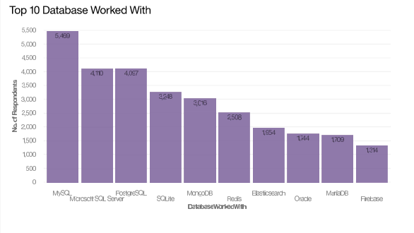
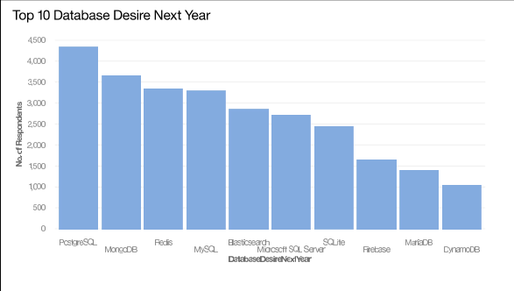
DATABASE TRENDS
Current Year
Next Year

Slide 10
DATABASE TRENDS - FINDINGS & IMPLICATIONS
Findings Implications
Use of MySQL expected to decrease approx. 40% and Microsoft SQL Server by 34%
Use of PostGreSQL remains steady
Generally, no major changes of DB providers expected in top 10
DB developers/engineers for PostGreSQL will continue to be in demand
Specialists of MySQL and Microsoft SQL Server should ensure to further grow their skills
No major changes in DB industry expected over the next year

Slide 11

DASHBOARD
https://github.com/rohithaider/IBM-Capstone

Slide 12
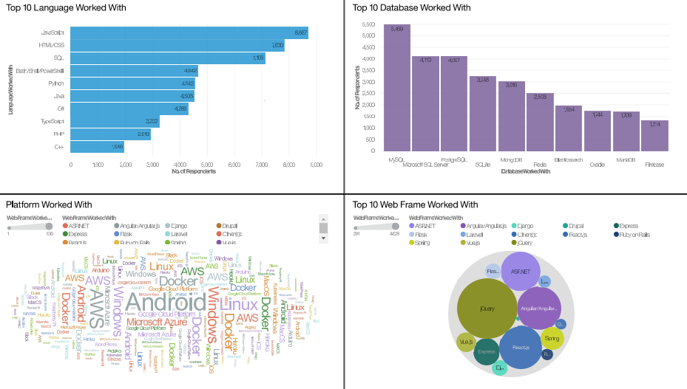
DASHBOARD TAB 1

Slide 13
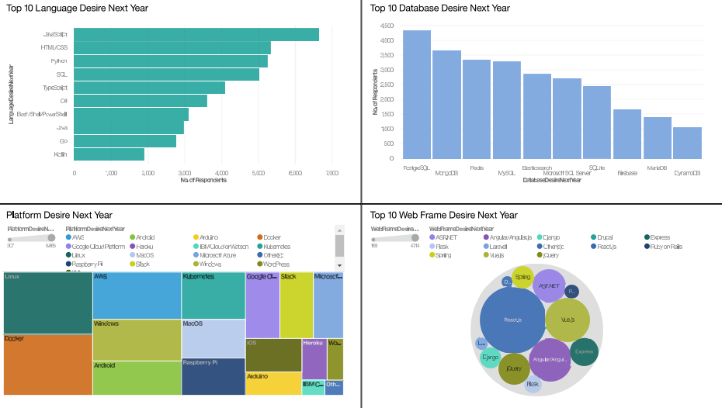
DASHBOARD TAB 2

Slide 14
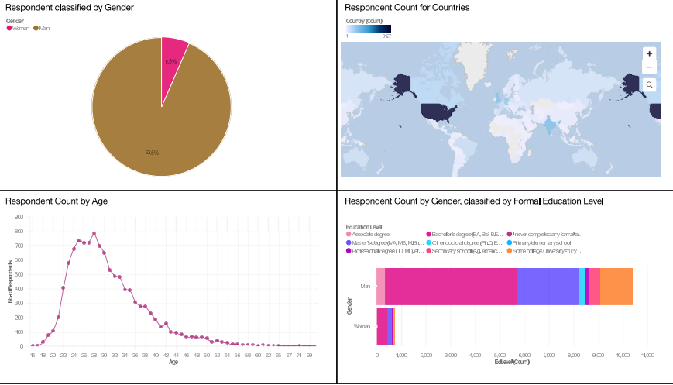
DASHBOARD TAB 3

Slide 15
DISCUSSION

Slide 16
OVERALL FINDINGS & IMPLICATIONS
Findings Implications
Survey results for programming languages do not reflect current job postings (high demand for C, JS and some Python)
There are almost no job postings for the trending databases for next year
Survey respondents are mainly between 22 and 40 years old, possibly pushing a age-bias
Job seekers could be mislead into obtaining the wrong skills when listening to the wrong sources
Employers have not caught up with DB trends, thus a sharp rise in job postings for trending DBs should be expected
Popular programming languages in job postings diverge from trending languages from survey respondents. This could be the result of age distributions in the survey and actual distribution in the industry (see job postings)

Slide 17

CONCLUSION
The survey and job postings have a very strong bias towards young male people from the US. It does not give a full view of the industry, but only a very focused snapshot
The very high demand of “C” job postings compared to other programming language does strongly contradict survey results
Irrespective of programming language, candidates can expect to earn about the same salary, most likely no less than 80k USD p.a.
Expected trends for database technologies might give rise for a sharp skill shortage and an increase in overall job postings in the coming years

Slide 18

APPENDIX
Include any relevant additional charts, or tables that you may have created during the analysis phase.

Slide 19
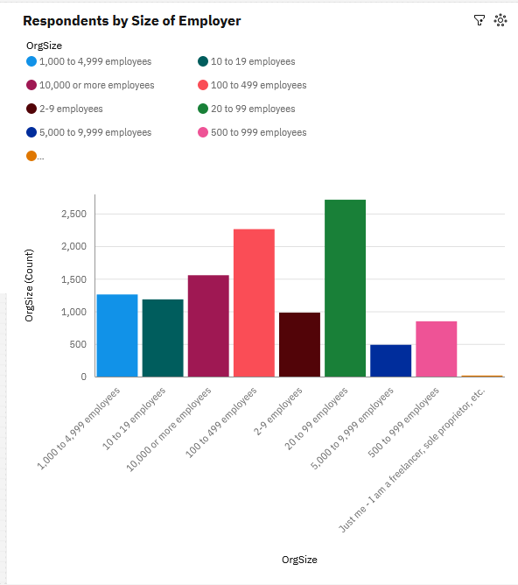
APPENDIX
Survey respondents tend to come from a broad array of employer sizes
The people thus give a good representation of the industry in terms of company variety

Slide 20
JOB POSTINGS
No. of Job Postings – Keyword “Technology”
10000
9000
8000
7000
6000
5000
4000
3000
2000
1000
0
C
Java
Python
Oracle
C#
JavaScript
C++
SQL Server
MongoDB
Scala
PostgreSQL
MySQL
Server

Slide 21
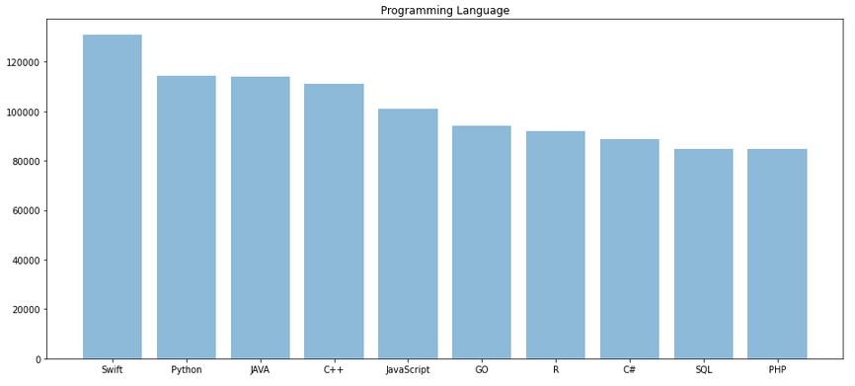
POPULAR LANGUAGES

