Slide 1


Big Mart Sales Performance Analysis
Revenue Optimization & Outlet Performance Strategy
Rohit Hajare | Python • Power Query

Slide 2
Business Problem
Big Mart operates multiple outlet types across different city tiers.
Revenue performance varies significantly across outlets.
Key challenges:
Uneven outlet performance
Unclear revenue drivers
Pricing and category optimization gaps
Strategic expansion decisions

Slide 3
Goals & Objectives
Identify key factors impacting item-level sales
Compare performance across outlet types and sizes
Analyze pricing influence on revenue
Provide actionable business recommendations

Slide 4
Dataset Overview0
Source: Big Mart Sales Dataset (Retail Data)
Total Records: 8,523 products
Total Features: 12 variables
Includes item attributes, outlet attributes, and sales data

Slide 5
Data Includes
Item Details: Type, MRP, Weight, Visibility
Outlet Details: Type, Size, Location Tier, Establishment Year
Sales Information: Item_Outlet_Sales (Target Variable)

Slide 6
Tools Used
Python – Data Cleaning & EDA
Power Query – Data Transformation
Libraries: Pandas, NumPy, Matplotlib, Seaborn

Slide 7
Data Cleaning Summary
Handled missing values (Item_Weight, Outlet_Size)
Treated zero visibility values
Removed statistical outliers (IQR method)
Verified data types and duplicates
Created final clean dataset for analysis

Slide 8
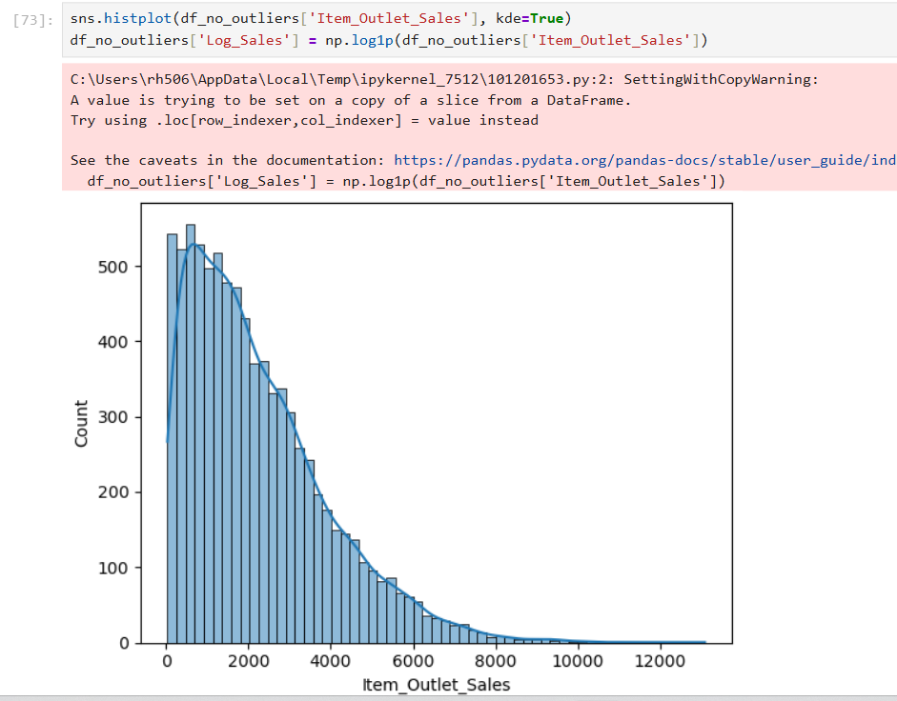
Sales Distribution

Slide 9
Sales Distribution Insights
Business Impact:
Sales distribution is positively skewed.
Majority of products generate moderate revenue.
Few high-performing products drive major revenue contribution.

Slide 10
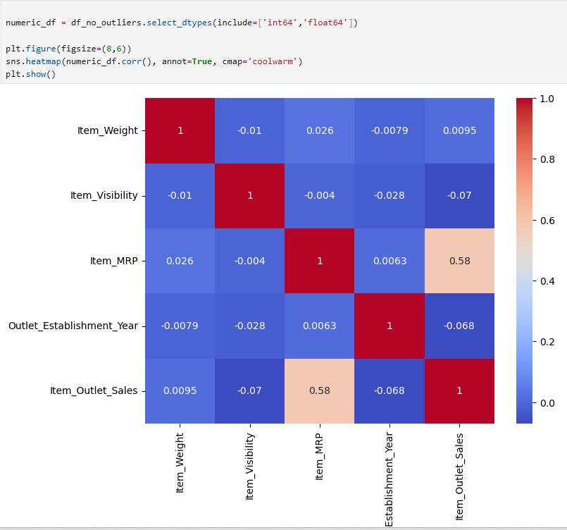
Correlation Analysis

Slide 11
Correlation insights
[Insert Correlation Heatmap Here]
Business Impact:
Item_MRP shows strongest positive correlation with sales (~0.58).
Visibility and weight show minimal impact.
Pricing plays a crucial role in revenue generation.

Slide 12
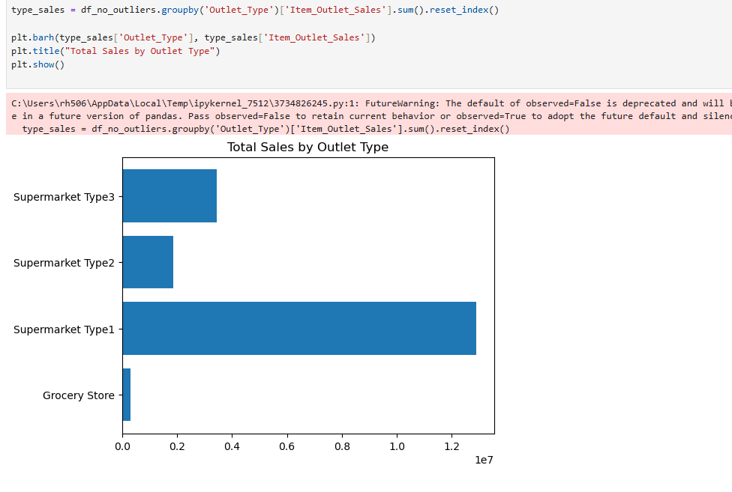
Sales by Outlet Type

Slide 13
Sales by Outlet Type insights
Business Impact:
Supermarket Type 3 generates highest revenue.
Grocery stores show lowest sales performance.
Outlet format significantly influences profitability.

Slide 14
Sales by Outlet Size

Slide 15
Sales by Outlet Size insights
Business Impact:
Medium-sized outlets outperform small outlets.
Store size impacts revenue contribution.
Optimal size strategy improves operational efficiency.

Slide 16
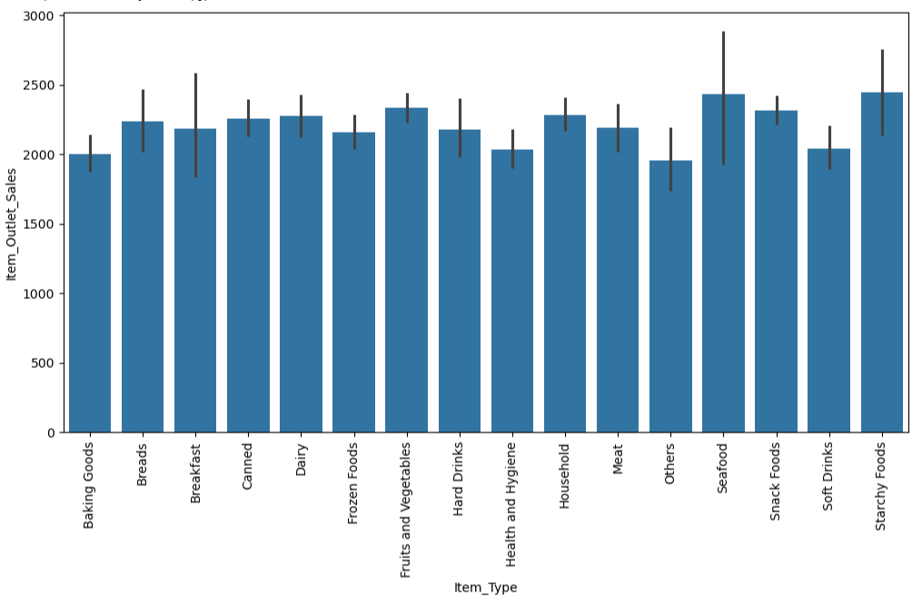
Sales by Item Type

Slide 17
Sales by Item Type Insights
Business Impact:
Starchy Foods & Seafood show higher average sales.
Sales distribution relatively balanced across categories.
Category-level optimization can boost margins.

Slide 18
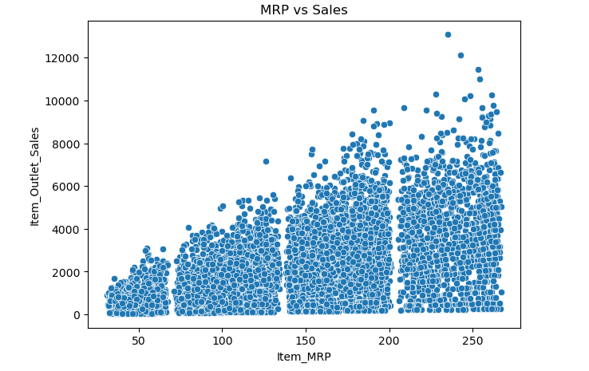
MRP vs Sales Relationship

Slide 19
MRP vs Sales Relationship Insights
Business Impact:
Strong positive relationship between price and sales.
Higher-priced items tend to generate higher revenue.
Pricing optimization can significantly increase profitability.

Slide 20
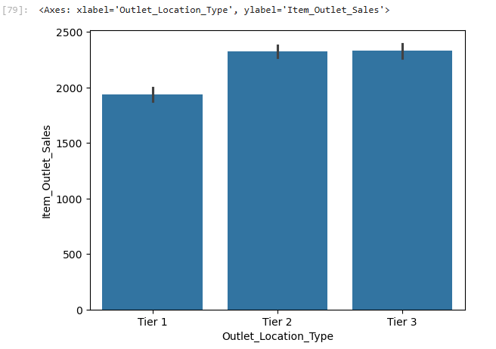
Sales by Location Tier

Slide 21
Sales by Location Tier Insights
Business Impact:
Revenue varies across Tier 1, Tier 2, and Tier 3 cities.
Location strategy influences sales stability.
Data-driven expansion planning recommended.

Slide 22
Key Business Takeaways
Pricing is the strongest sales driver.
Outlet format and size significantly impact performance.
Revenue concentration among specific products.
Strategic outlet expansion required.

Slide 23
Business Recommendations
Optimize pricing strategy based on demand patterns.
Expand high-performing outlet formats.
Improve small outlet operational strategy.
Focus marketing on high-performing categories.

Slide 24
Tableau Dashboard
[Insert Dashboard Screenshot Here]
Dashboard Sections:
• KPI Overview
• Outlet Performance
• Category Analysis
• Location Insights
• Interactive Filters

Slide 25
Conclusion
Identified key sales performance drivers.
Delivered actionable revenue optimization insights.
Data-driven strategy supports business growth.

