Slide 1
Enhancement of SSD using DRAM
By,
Priyanka Bhangale
Rohit Haryani

Slide 2
Contents
Background information
Overview of idea
Literature survey
Experiment analysis
Challenges
Changes
Results
Conclusion
References

Slide 3
Background Information
What is a Solid-State Drive (SSD)?
What is a workload?
How did we calculate workload?
Tools used: DiskSim, EagleTree and TestMyWorkload

Slide 4
Overview of Idea
Why SSD performance depends on workload?
Why test with real world workloads?
Proposed enhancement to improve SSD performance

Slide 5
Literature Survey
Corner Case Benchmark Tests
Synthetic Application Workloads
Real World IO Capture Workloads

Slide 6
Experimental Analysis
Workload generation
Filtering workload
Obtaining results

Slide 7
Workload Generation and Filtration
Generated using DiskSim and EagleTree simulators
Filtered using TestMyWorkload

Slide 8
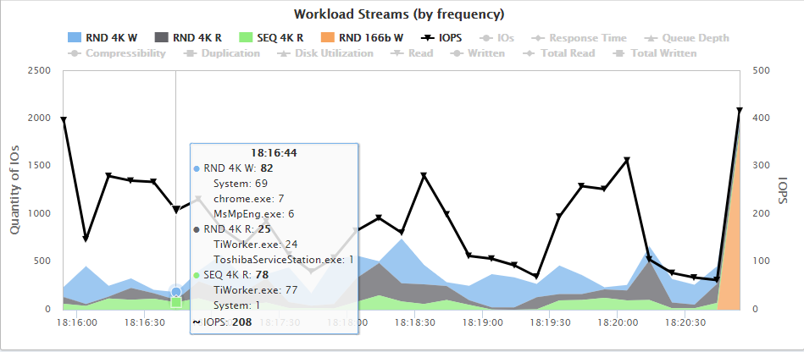
IOPS for TOSHIBA MQ01ABD100

Slide 9
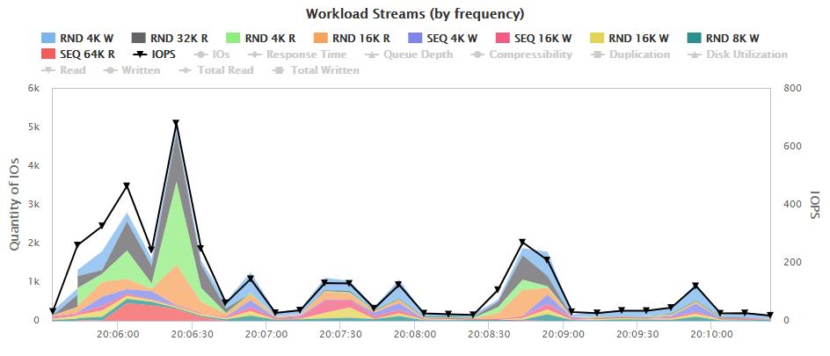
IOPS for NVMe SAMSUNG MZVLW1T0

Slide 10
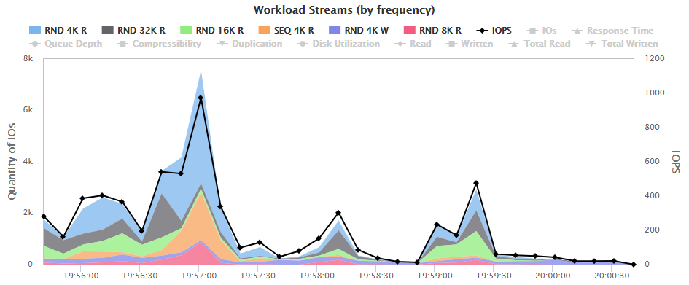
IOPS for NVMe SAMSUNG MZVLB512

Slide 11
Challenges
Measurement of battery
Different disk types
Long testing process
Unavailability of resources
Unrequired software installation for tests
Laptop getting heated
Heavy testing causes issues in multitasking

Slide 12
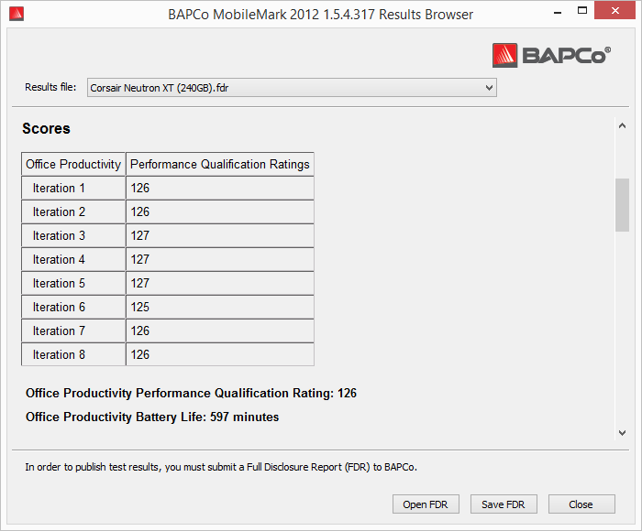
Example of MobileMark Battery Testing Software

Slide 13
Changes
Considered standard battery life for testing
Assuming SSD run as per specifications provided by the manufacturer

Slide 14
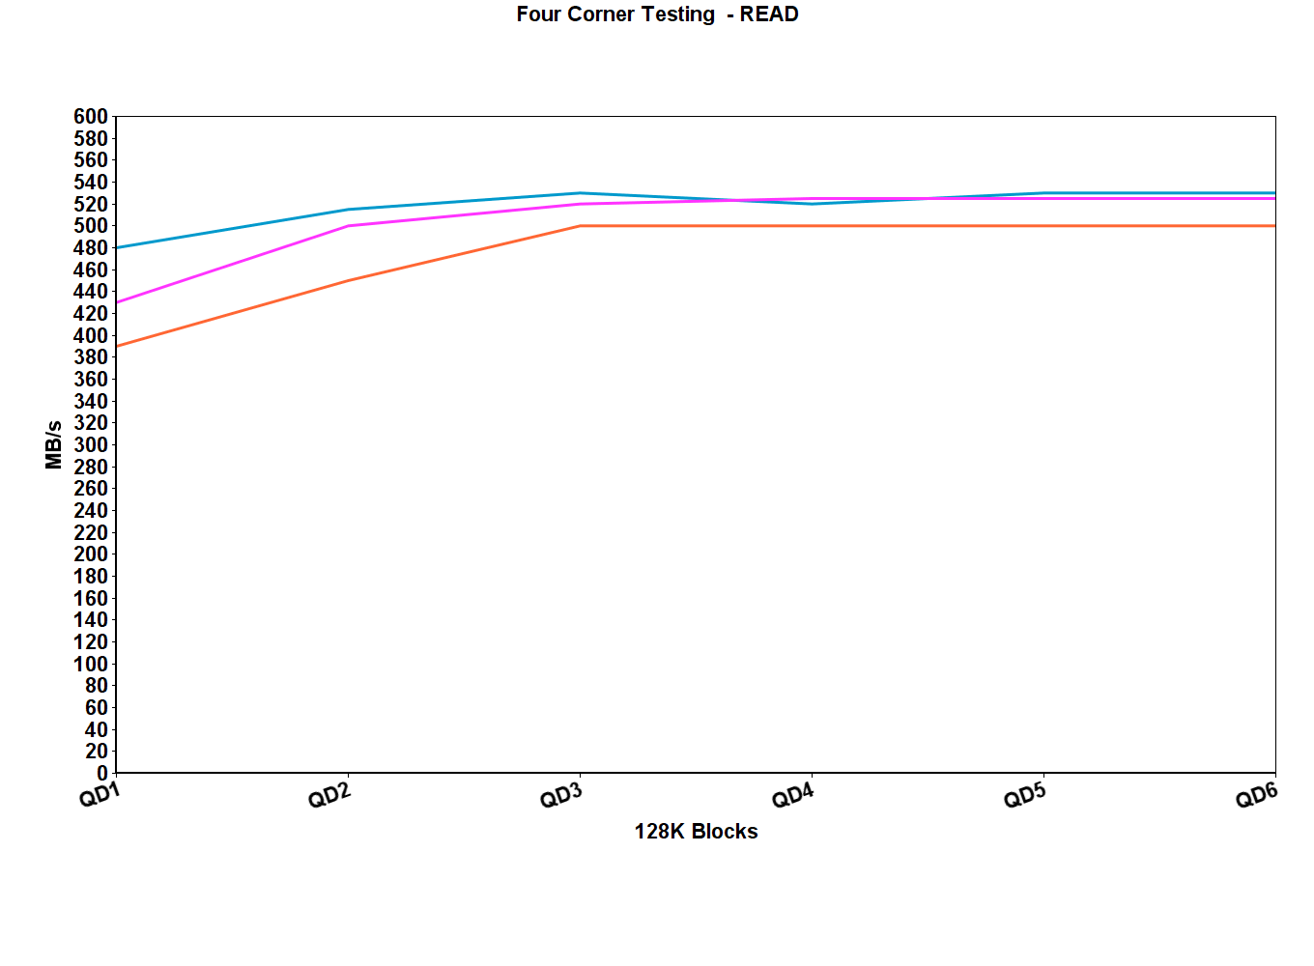
Results for READ

Slide 15
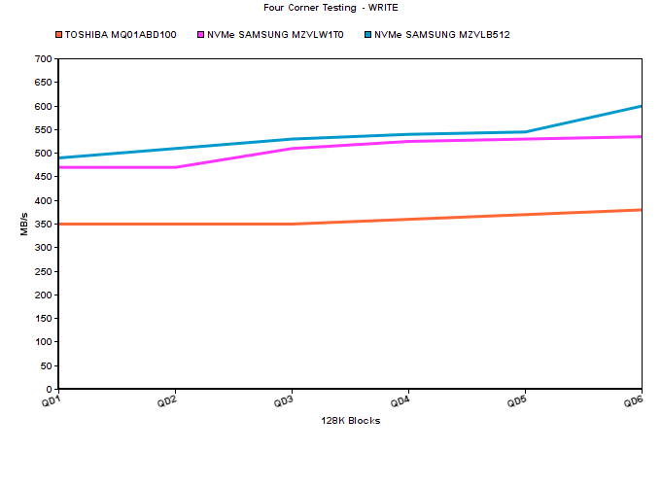
Results for WRITE

Slide 16
Conclusion
Mechanical hard drives have lower performance than SSD
SSD with DRAM perform better as cache can be stored efficiently in DRAM
Simple design construction as only one is required
Disadvantage: DRAM requires constant power supply (thus sleep mode turns on laptop faster than hibernate)
Disadvantage: Requires relatively refreshing of memory

Slide 17
References
Garima Ahuja, Shriya Grover, “Evaluation of SSD using Tree”, California State University Long Beach
Y. Shirota, S. Yoshimura, S. Shirai and T. Kanai, "Powering-off DRAM with aggressive page-out to storage-class memory in low power virtual memory system," 2016 IEEE Symposium in Low-Power and High-Speed Chips (COOL CHIPS XIX), Yokohama, 2016, pp. 1-2.
O. Mutlu, "Rethinking Memory System Design," 2016 Mobile System Technologies Workshop (MST), Milan, 2016, pp. 1-3.
C. K. Han et al., "A study on analyzing and modeling dynamic random access memory power under burn-in test condition," 2016 IEEE International Conference on Industrial Engineering and Engineering Management (IEEM), Bali, 2016, pp. 1674-1676.

Slide 18
THANK YOU

