Slide 1
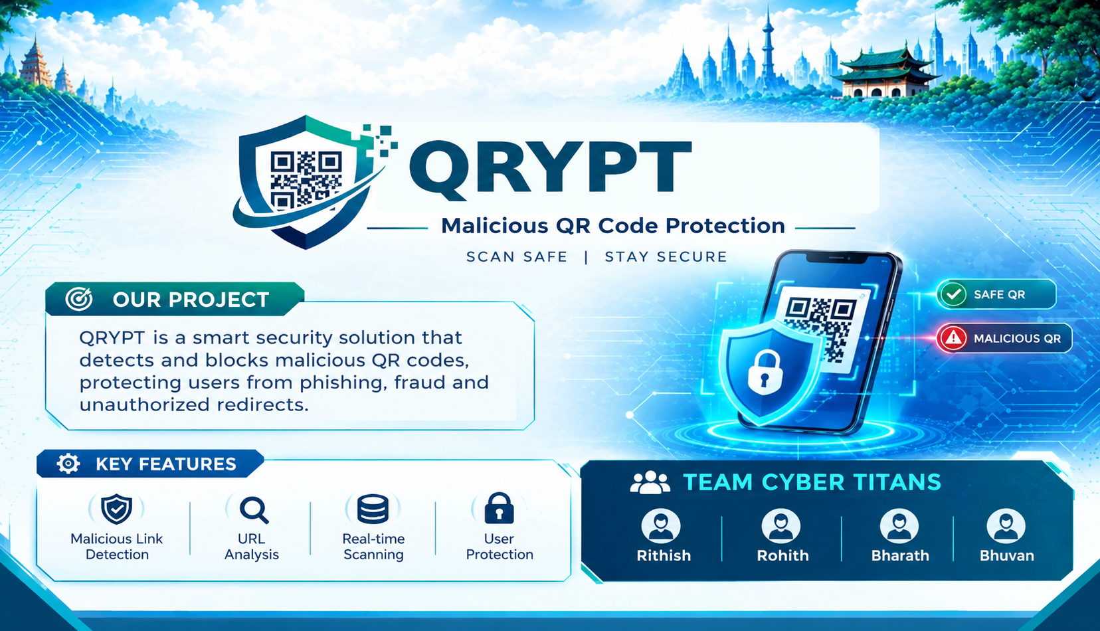
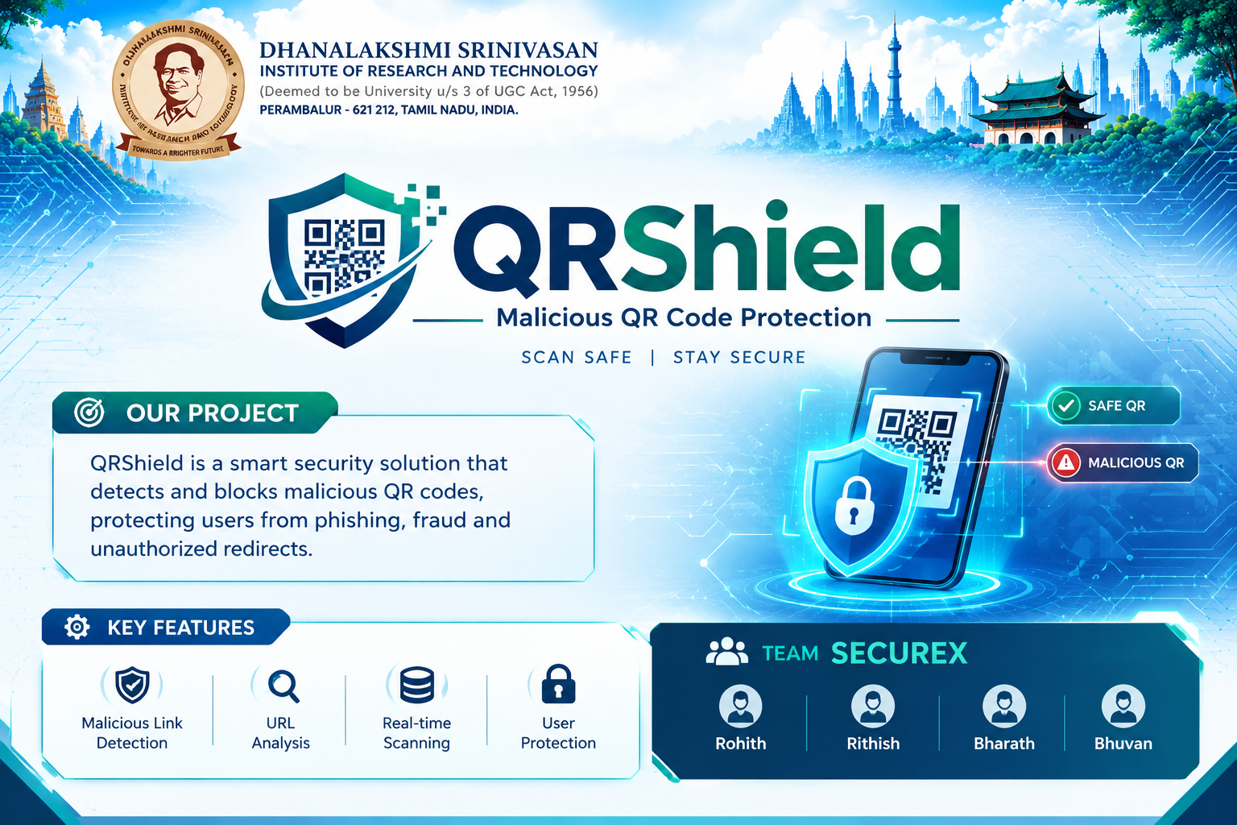
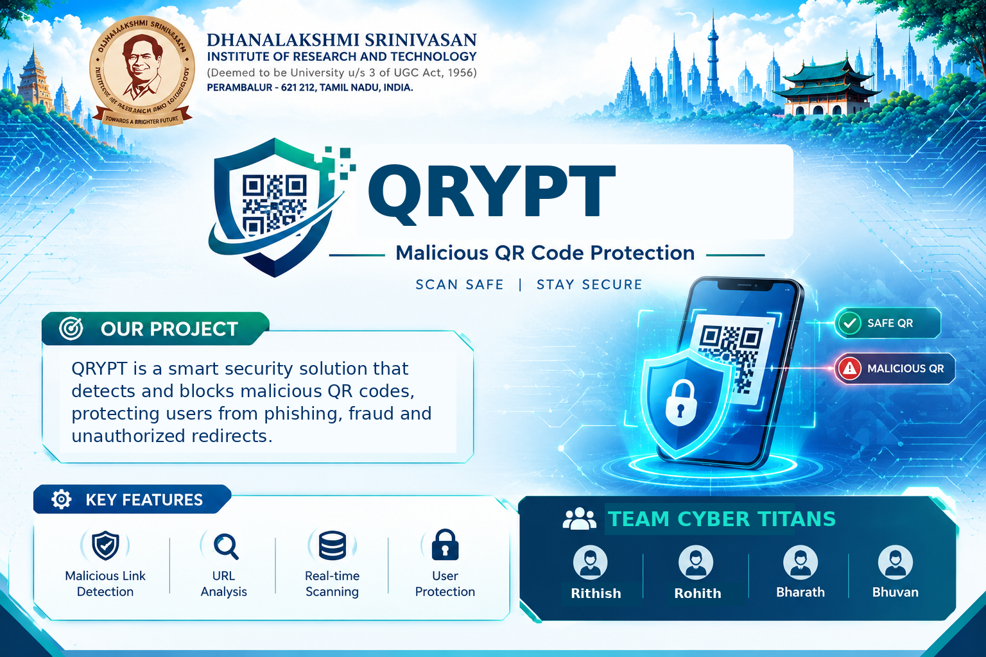
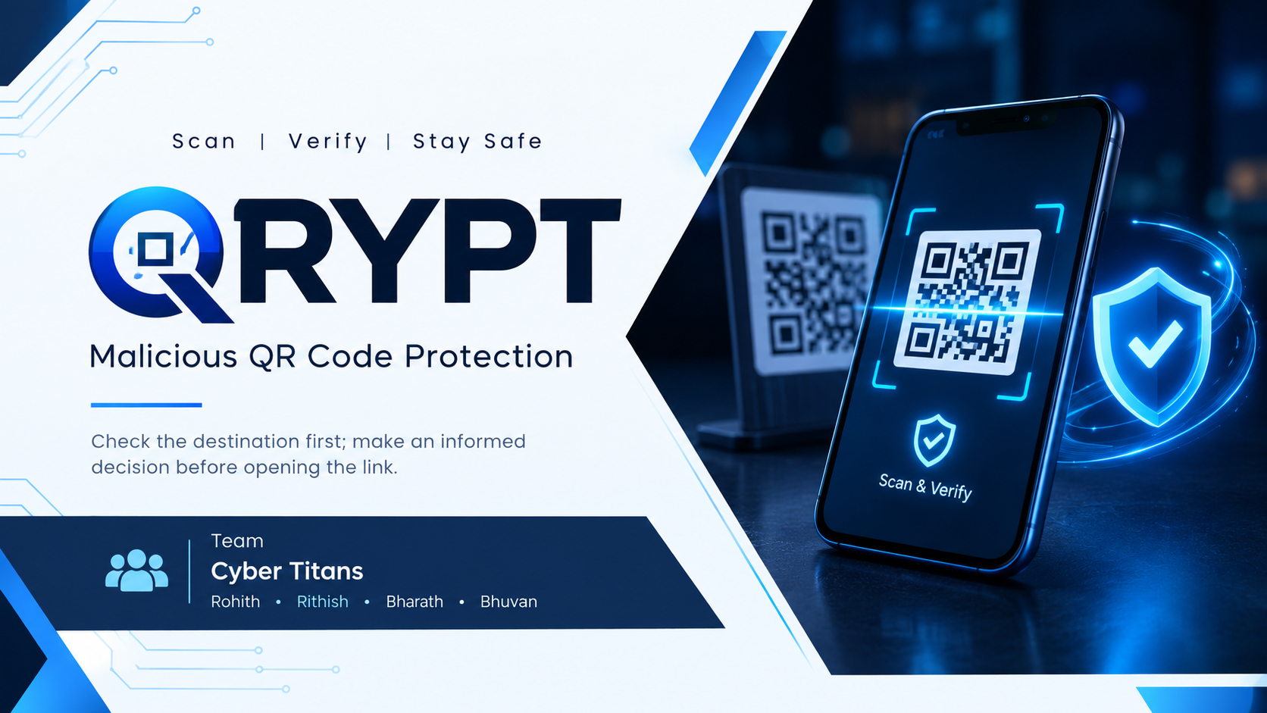


Slide 2
QRYPT | CYBER TITANS
PROBLEM STATEMENT
A replaced or tampered QR code can redirect users to a fraudulent website
THE PROBLEM
THE RISK
THE GAP
Fraudsters may place a fake QR sticker over a genuine code on parking meters, posters or payment displays.
Users may unknowingly visit phishing pages or enter personal and payment information.
A scan can reveal a link, but users may not know whether its destination is trustworthy.
OUR CHALLENGE
How might we help users inspect a QR code’s destination before opening the link?
Target setting: everyday public QR codes and payment-related displays.
Malicious QR Code Protection
2

Slide 3
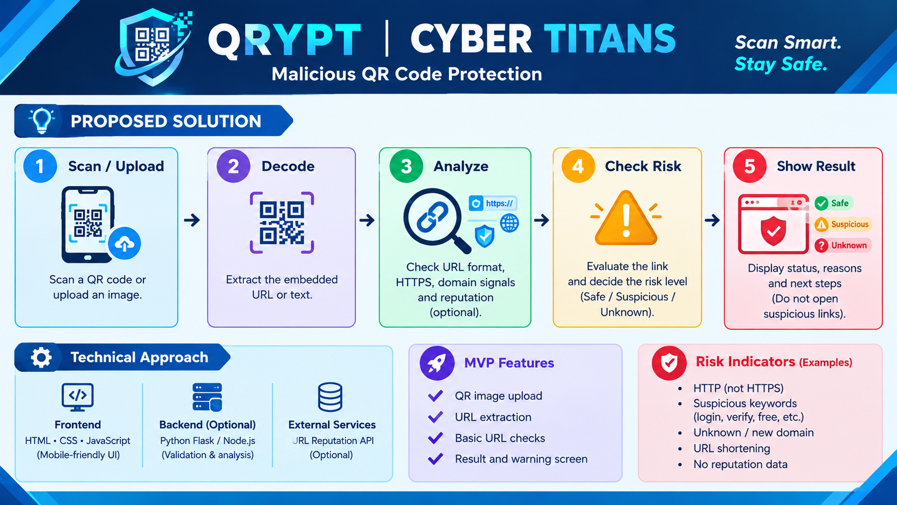
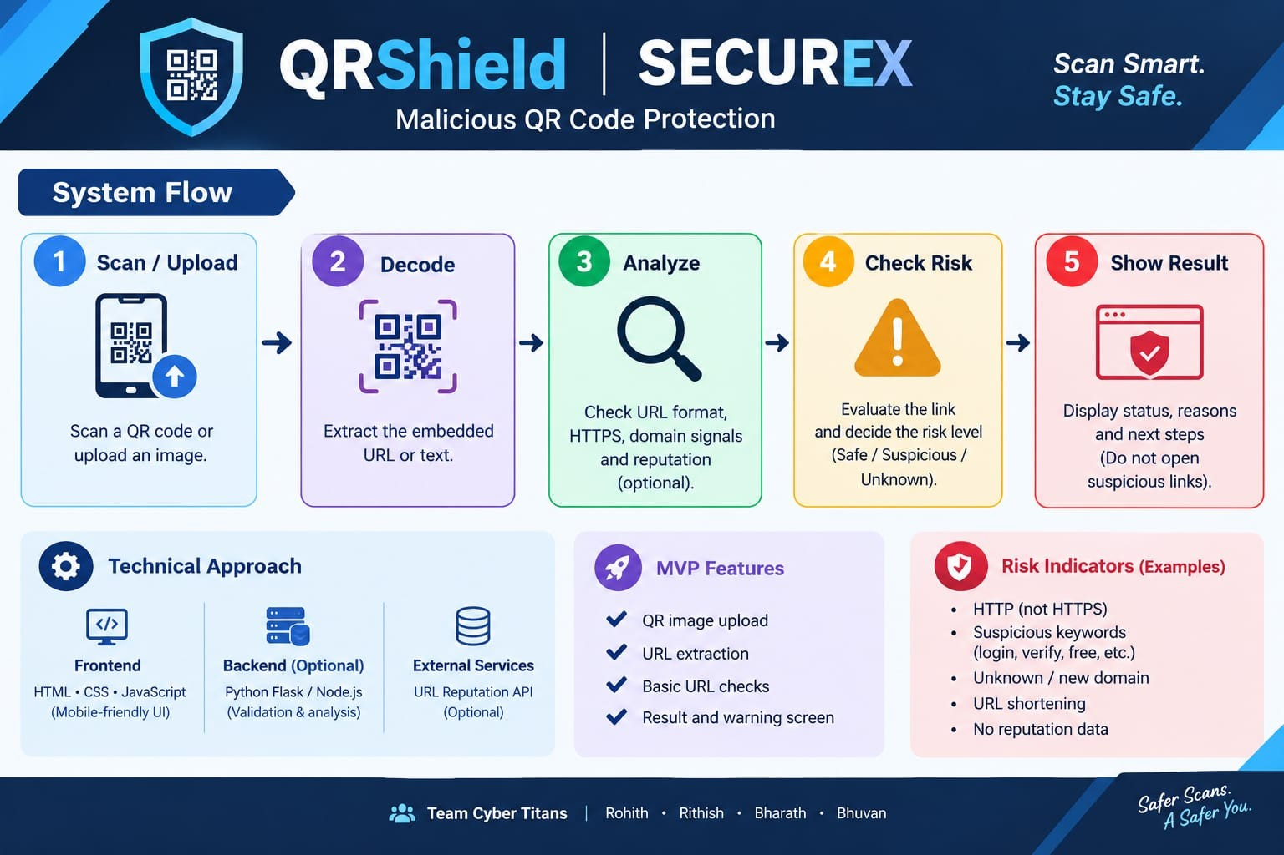
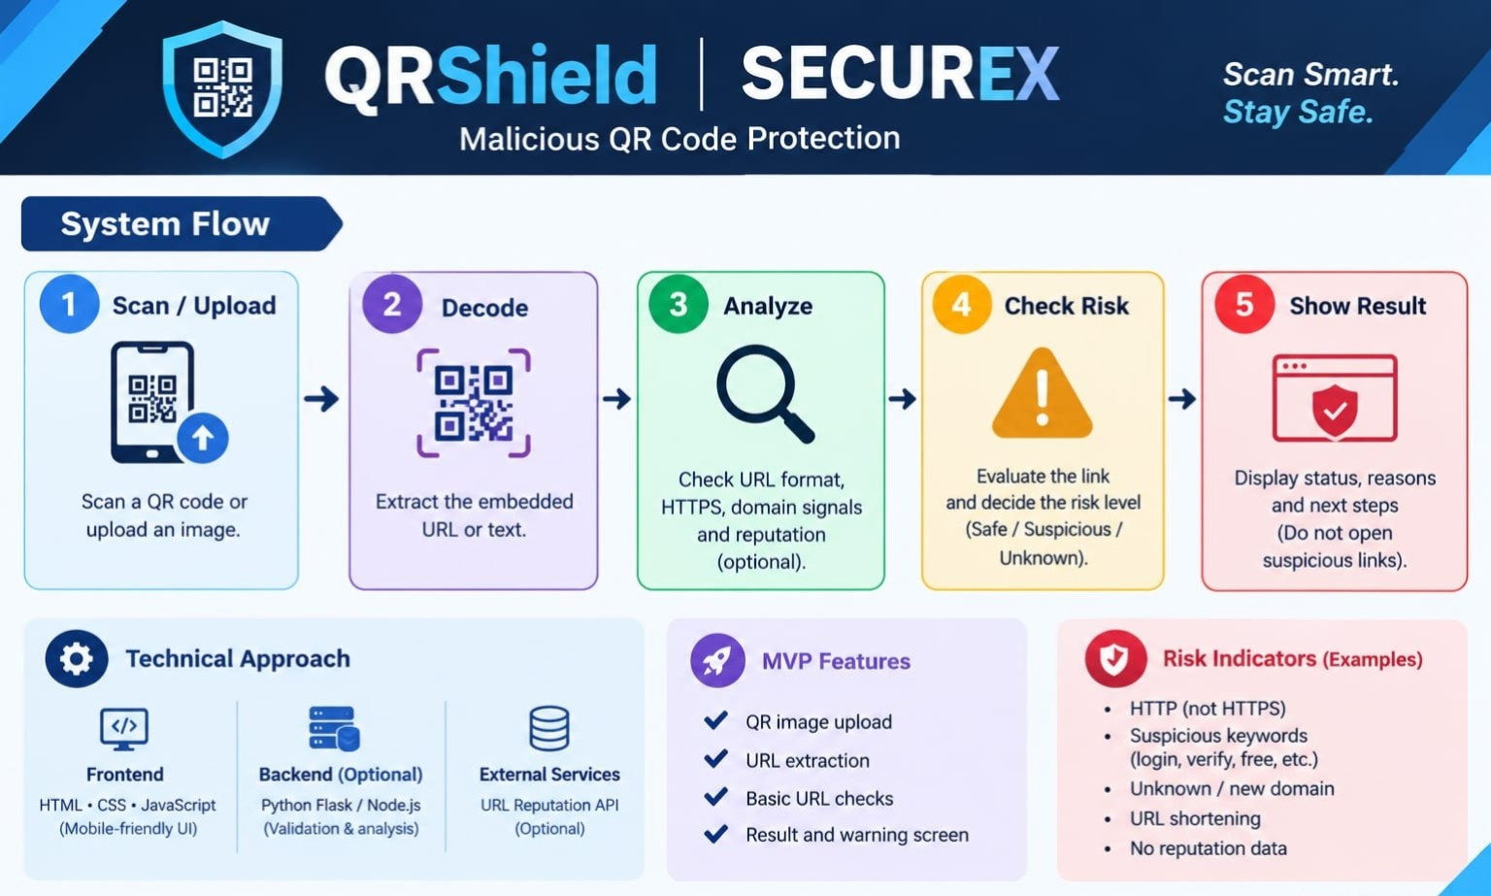

Slide 4
QRYPT | CYBER TITANS
TECHNICAL APPROACH
A modular prototype architecture suitable for a student team
QR INPUT
QR DECODER
URL CHECKER
RISK ENGINE
RESULT UI
Camera / image upload
→
Read QR content
→
Inspect link indicators
→
Rules + optional reputation service
→
Show status and next steps
FRONT END
BACK END (OPTIONAL)
TESTING
HTML • CSS • JavaScript
Mobile-friendly scan and result screens
Python Flask or Node.js
Validation and analysis endpoint
Use controlled sample QR images and URLs; record false alerts and missed warnings.
Build the decoder and transparent rule checks first; add reputation checks only if available.
Malicious QR Code Protection
4

Slide 5
QRYPT | CYBER TITANS
FEASIBILITY AND VIABILITY
A student-friendly minimum viable product with clear limitations
MVP FEATURES
CHALLENGES
MITIGATION
• QR image upload
• URL extraction
• Basic URL checks
• Result and warning screen
• New malicious domains
• False positives / negatives
• Shortened links
• API or network availability
• Explain warning reasons
• Mark uncertain links Unknown
• Never auto-open links
• Test varied sample cases
IMPLEMENTATION ROADMAP
01
02
03
04
──────→
──────→
──────→
QR decode
URL analysis
UI + alerts
Test + demo
A risk score is an indicator, not proof that a URL is safe or malicious.
Malicious QR Code Protection
5

Slide 6
QRYPT | CYBER TITANS
IMPACT AND BENEFITS
Safer everyday QR-code use through clear, user-centred warnings
PUBLIC USERS
BUSINESSES
Understand the destination before opening unexpected QR links.
Adds a user-side safety check for codes displayed in public spaces.
COLLEGES & EVENTS
CYBER AWARENESS
Demonstrate phishing awareness with safe sample QR codes.
Encourage users to inspect domains before entering sensitive data.
PROTOTYPE EVALUATION
Decode success
Alert quality
Speed
Clarity
Reads sample QR codes
Flags test cases as expected
Time to show a result
Users understand warnings
Expected outcome: a working prototype that supports safer decisions, not a perfect guarantee.
Malicious QR Code Protection
6

Slide 7
QRYPT | CYBER TITANS
REFERENCES AND CLOSING
QRYPT is a proposed project prototype in the cybersecurity focus area
URL REPUTATION CHECKS
A reputable URL reputation service may be evaluated for integration; verify current access terms before use.
QR DECODING LIBRARY
Use maintained documentation for the selected language and test in a controlled environment.
TESTING METHOD
Test safe sample URLs, suspicious demo URLs and unknown links without automatically opening them.
THANK YOU
TEAM CYBER TITANS | Rithish • Rohith • Bharath • Bhuvan
Malicious QR Code Protection
7

