Slide 1
IC VERIFY AI
AOI
AI-Powered Automated Optical Inspection
for IC Marking & Counterfeit Detection
IC
INSPECTION
Computer Vision • OCR • Reference Database • Inspection Analytics
PROJECT REVIEW
Mini Project • 2026
IC VERIFY AI • Automated Optical Inspection
Mini Project • Zeroth Review

Slide 2
02
Team & Guidance
Project ownership and academic supervision
TEAM MEMBERS
GUIDE / MENTOR
01 Rohith B
Ms. P.Kohila
B.E. Computer Science & Engineering
AP/Department of Computer Science & Engineering
02 Naveenkumar K
Institution
03 Premkumar G
V.S.B. College of Engineering Technical Campus
IC VERIFY AI • Automated Optical Inspection
Mini Project • Zeroth Review

Slide 3
03
Problem Statement
Why reliable IC marking verification is needed
THE CHALLENGE
TARGET
• Counterfeit and remarked ICs can enter electronics supply chains with visually similar markings.
• Manual inspection is slow, subjective and difficult to scale for high-volume screening.
• Tiny differences in part numbers, logos, fonts, package outlines and surface defects may be missed.
• A practical solution should combine image processing, text recognition and reference-data validation.
Detect
• Fake markings
• Remarked parts
• Surface defects
OUTPUT
Genuine / Counterfeit
with confidence indicators
IC VERIFY AI • Automated Optical Inspection
Mini Project • Zeroth Review

Slide 4
04
Existing Work
Current approaches and their limitations
01
02
03
04
Manual Visual Inspection
OCR-Only Systems
Basic Image Processing
Reference Lookup
• Human operator checks markings and package
• Slow and inconsistent at scale
• Extract printed characters
• May miss logo, font and surface anomalies
• Thresholding / contour-based inspection
• Limited contextual verification
• Compare part number with a database
• Does not alone prove physical authenticity
IC VERIFY AI • Automated Optical Inspection
Mini Project • Zeroth Review

Slide 5
05
Proposed Work
IC Verify AI — integrated automated inspection platform
01
02
03
04
05
UPLOAD
PREPROCESS
DETECT
VERIFY
DECIDE
→
→
→
→
IC image
Gray + denoise
+ threshold
IC region,
text & features
OCR + reference
comparison
Risk score +
inspection report
Core stack: React + Vite | FastAPI + Python | OpenCV | OCR/marking analysis | SQLite
IC VERIFY AI • Automated Optical Inspection
Mini Project • Zeroth Review

Slide 6
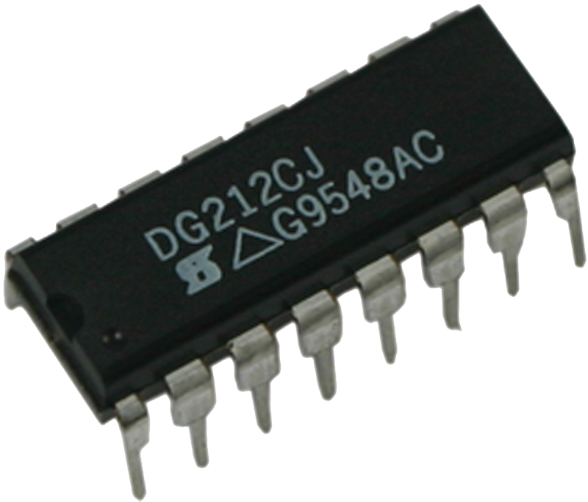
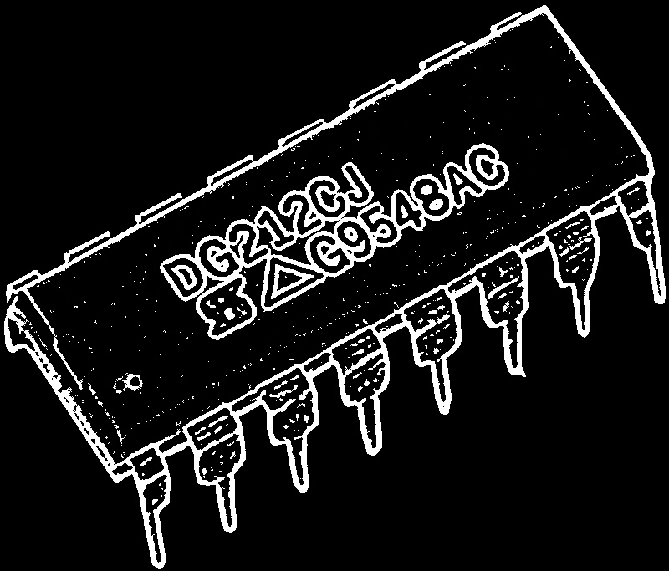
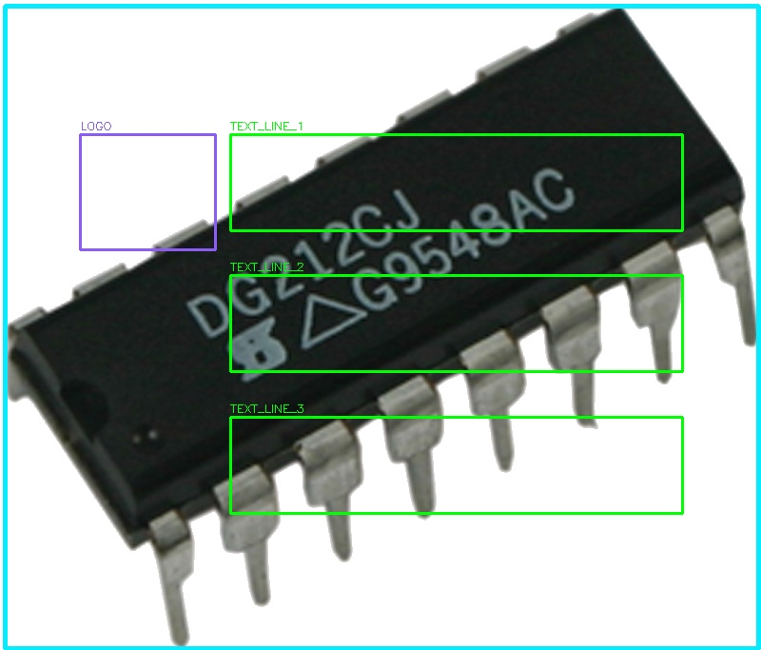
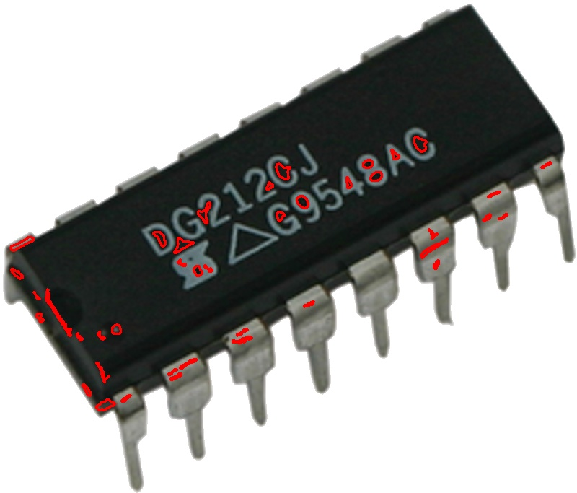
06
Supporting Details
Technical architecture, inspection stages and stored evidence
SYSTEM ARCHITECTURE
Frontend
React / Vite UI
API Layer
FastAPI endpoints
RAW
PREPROCESSED
CV Engine
OpenCV preprocessing & contours
Verification
OCR + marking parser
Data Layer
SQLite reference + history
DETECTION
DEFECT VIEW
IC VERIFY AI • Automated Optical Inspection
Mini Project • Zeroth Review

Slide 7
07
Problem Statement → Solution
How the proposed system addresses the identified gap
PROBLEM
PROPOSED METHOD
BENEFIT
Counterfeit markings
CV + OCR + pattern parsing
Identify likely part number, date code and batch marking
Logo / font mismatch
Reference attributes
Compare expected manufacturer/package marking characteristics
Surface defects
Contour-based analysis
Highlight scratches and abnormal surface regions
Slow manual review
Automated pipeline
Produce repeatable inspection evidence in seconds
Traceability
SQLite inspection history
Store results, confidence metrics and final decision
IC VERIFY AI • Automated Optical Inspection
Mini Project • Zeroth Review

Slide 8
08
References
Technical foundations and project resources
01
OpenCV Documentation
Computer vision, image preprocessing and contour analysis
opencv.org
02
FastAPI Documentation
Python API framework used for backend services
fastapi.tiangolo.com
03
React Documentation
Frontend component architecture and UI development
react.dev
04
Vite Documentation
Development server and frontend build tooling
vite.dev
05
Smart India Hackathon
Project context and innovation ecosystem
sih.gov.in
Note: Replace / add references required by your department’s review format.
IC VERIFY AI • Automated Optical Inspection
Mini Project • Zeroth Review

Slide 9
09
Queries
Questions, suggestions and review feedback
Q & A
We welcome your questions and suggestions.
Project scope • Technical approach • Accuracy • Future enhancements
IC VERIFY AI
IC VERIFY AI • Automated Optical Inspection
Mini Project • Zeroth Review

Slide 10
THANK YOU
IC VERIFY AI
Automated Optical Inspection for IC Marking Verification
Questions • Feedback • Suggestions
Mini Project — Zeroth Review

