Slide 1

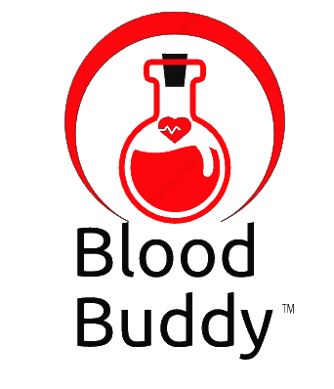
BLOOD BUDDY
Co-founders:
Sai Maneesh Reddy Kadire
Venkata Suchitra Varanasi
Sai Priya Anchuri
Rohith Babu Ginjupalli
Yaswanth Reddy Mallu

Slide 2
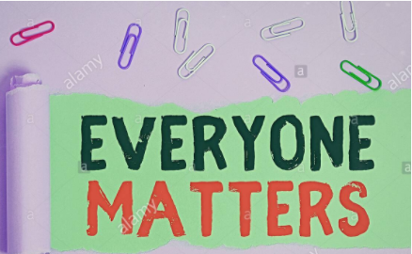
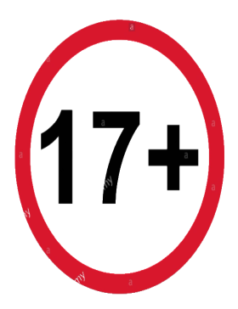
TARGET MARKET & VALUE PROPOSITIONS
Target Market:
Our app does not have any restriction on receivers or patients irrespective of age, location, income, lifestyle, gender and race.
But for donors we are targeted only for age greater than 17, because legal age to donate blood is 17.
Value Propositions:
We promise that no life will be loss due to lack of blood. And we are maintaining punctuality as our key motto.
We promise that we will contact the blood banks and trust near by, If no donor is near by the receiver location.
We promise 2 free doctor consultations for donor if donor reaches to highest rank.
Only for Donors

Slide 3
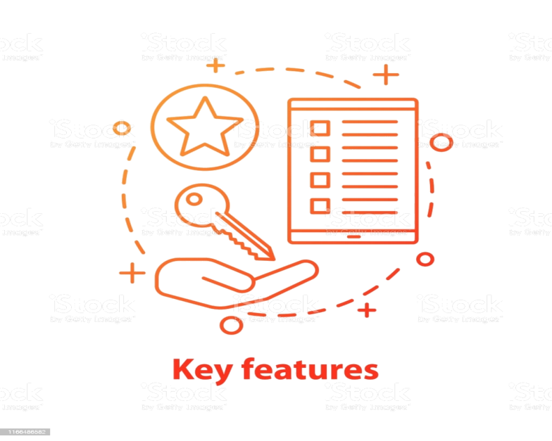
WINNING FEATURES & JUSTIFICATION
Winning Features:
Filtering users based on Location.
Send Notifications to only donors who has Similar to receiver BG.
Organizing Camps to habituate blood donation as a lifestyle.
Advertising about medical appliances offer and free consultation.
Slowly injecting our upcoming project related Organ donation.
Justification:
No LOSS OF LIFE due to
Improper communications which leads to late response.
Connecting donors on a single platform whenever there is an emergency.
Maintains different time phases, each phase triggers based on previous results.

Slide 4
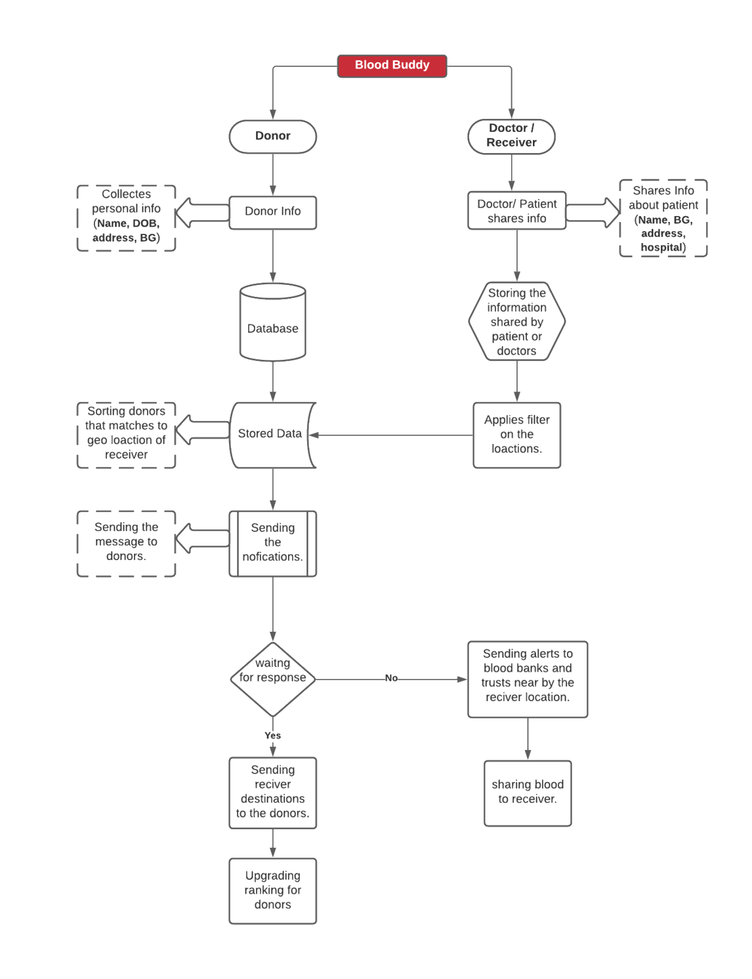
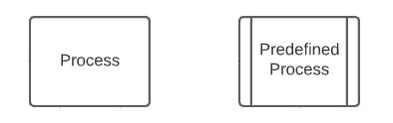
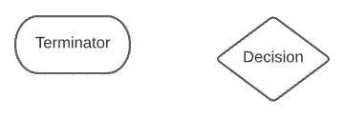
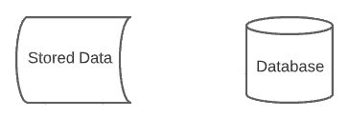
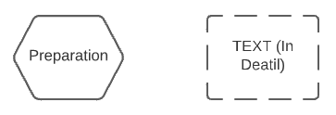
PROCESS OVERVIEW

Slide 5
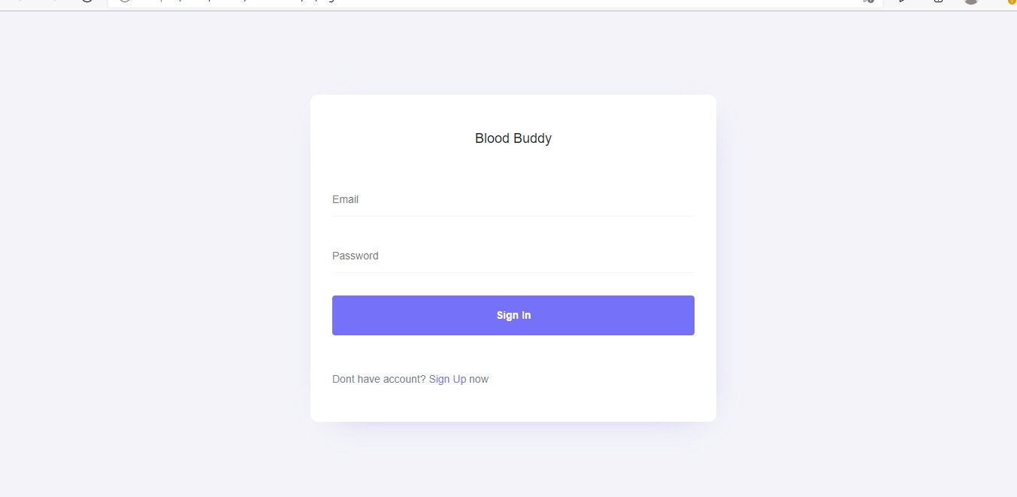
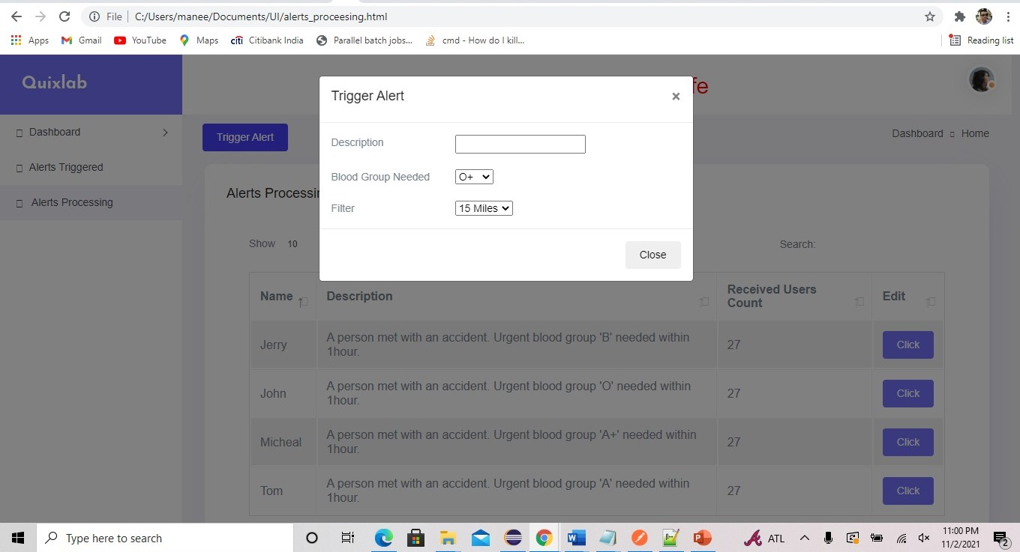
CURRENT PROGRESS & PLAN IMPLEMENTATION
Executions Stages:
Nov 4th – Design Presentation Submission.
Nov 6th – User Interface (UI) Completion.
Nov 9th – Database Design
Nov 20th – Backend completion
Nov 28th – Testing
Dec 5th – Final testing
Dec 11th – Submission
Current Progress:
Initiated with User Interface part.
Applications have 5 screens of total.
Completed 3 of them and the remaining are dependent on database.

Slide 6
Conclusion
We are using different concepts of Distributed Computing like availability, consistency, durability. Blood Buddy main motto is to share information to their appropriate destinations. Initiated with filtering the receiver geographic location and delivering the information to donors, that matches the receiver’s blood group in the form of notifications which increases the response rates.
Thank you
DC DYNAMITES

