Slide 1
CONQUERING FASHSION MNIST WITH CNNs USING COMPUTER VISION
TEAM NAME : THE INITIATORS
TEAM MEMBERS
ROHITH D
VINAY KUMAR VIDYA
SAI KUMAR PENTALA
INTEL INDUSTRY MENTOR NAME: Mr. MOHAN NIKAM
MENTOR NAME : KALPANA D

Slide 2
Abstract
In this study, we propose a CNN architecture to classify the FashionMNIST dataset. The proposed model consists of multiple convolutional layers, pooling layers, and fully connected layers. We utilize the rectified linear activation function (ReLU) for the convolutional layers and softmax activation for the final output layer to obtain class probabilities. To train and evaluate the CNN model, we split the FashionMNIST dataset into training and testing sets. We preprocess the images by normalizing pixel values and converting them into a suitable format for training the CNN. The model is trained using the training set, and its performance is evaluated using the testing set. We utilize popular optimization techniques such as stochastic gradient descent (SGD) with backpropagation to update the model weights and minimize the loss function during training. The application of CNNs on the FashionMNIST dataset not only provides accurate classification of fashion items but also opens doors for various practical applications such as image search, recommendation systems, and virtual try-on experiences in the fashion industry. The proposed CNN architecture serves as a foundation for further research and exploration in the field of computer vision and deep learning, aiming to improve the accuracy and efficiency of image classification tasks.

Slide 3
Introduction
The classification of the FashionMNIST dataset involves the task of categorizing images of fashion items into their respective classes. The FashionMNIST dataset serves as a replacement for the traditional MNIST dataset, which consists of grayscale images of handwritten digits. FashionMNIST, on the other hand, comprises images of various fashion items such as T-shirts, trousers, pullovers, dresses, coats, sandals, shirts, sneakers, bags, and ankle boots. It has become a popular benchmark dataset in the field of computer vision and serves as a challenging task for developing and evaluating image classification models.
The FashionMNIST dataset consists of a total of 70,000 images, divided into 60,000 training images and 10,000 testing images. Each image is a grayscale image with a size of 28x28 pixels. The dataset is evenly distributed among the ten different classes, with 6,000 images per class for training and 1,000 images per class for testing.
The classification process involves training a model on the training set, where the model learns to extract meaningful features from the images and map them to the corresponding fashion classes. The model's performance is then evaluated on the testing set, where its ability to generalize and accurately classify unseen fashion images is assessed.
To enhance the performance of classification models on the FashionMNIST dataset, various techniques can be employed. These include data augmentation, where additional training examples are generated by applying transformations such as rotations, translations, and scaling to the original images. Additionally, model regularization techniques like dropout and weight decay can be used to prevent overfitting.
Overall, the classification of the FashionMNIST dataset presents an interesting and challenging problem in the field of computer vision. It provides a platform for developing and evaluating robust and accurate image classification models, paving the way for advancements in fashion related applications and further research in the domain of computer vision and deep learning

Slide 4
A CNN consists of several layers, each serving a specific purpose:
Convolutional Layer: The first layer in a CNN is typically a convolutional layer. It applies a set of learnable filters to the input image, performing element-wise multiplication and summation to produce a feature map. This process helps extract local patterns and features from the image.
Activation Function: After each convolutional layer, an activation function is applied element-wise to introduce non-linearity to the model. The Rectified Linear Unit (ReLU) is a commonly used activation function, which sets negative values to zero and keeps positive values unchanged.
Pooling Layer: Pooling layers are used to reduce the spatial dimensions of the feature maps, effectively downsampling the input. The most common pooling operation is max pooling, where the maximum value within a specific region is selected as the representative value. Pooling helps to decrease computational complexity and extract important features invariant to small spatial translations
Fully Connected Layer: Once the feature maps have been downsized through convolution and pooling layers, they are flattened and passed through one or more fully connected layers. These layers connect every neuron in one layer to every neuron in the next layer, enabling the network to learn high-level representations by combining the learned low-level features
Output Layer: The last fully connected layer is typically the output layer, which produces the final classification or regression predictions. The number of neurons in this layer depends on the specific task. For instance, in image classification, there would be one neuron per class with a softmax activation function to generate probability scores.

Slide 5
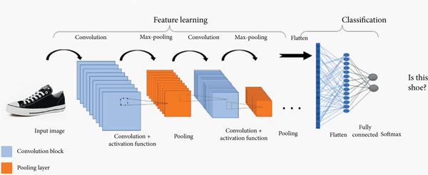
Architecture Diagram

Slide 6
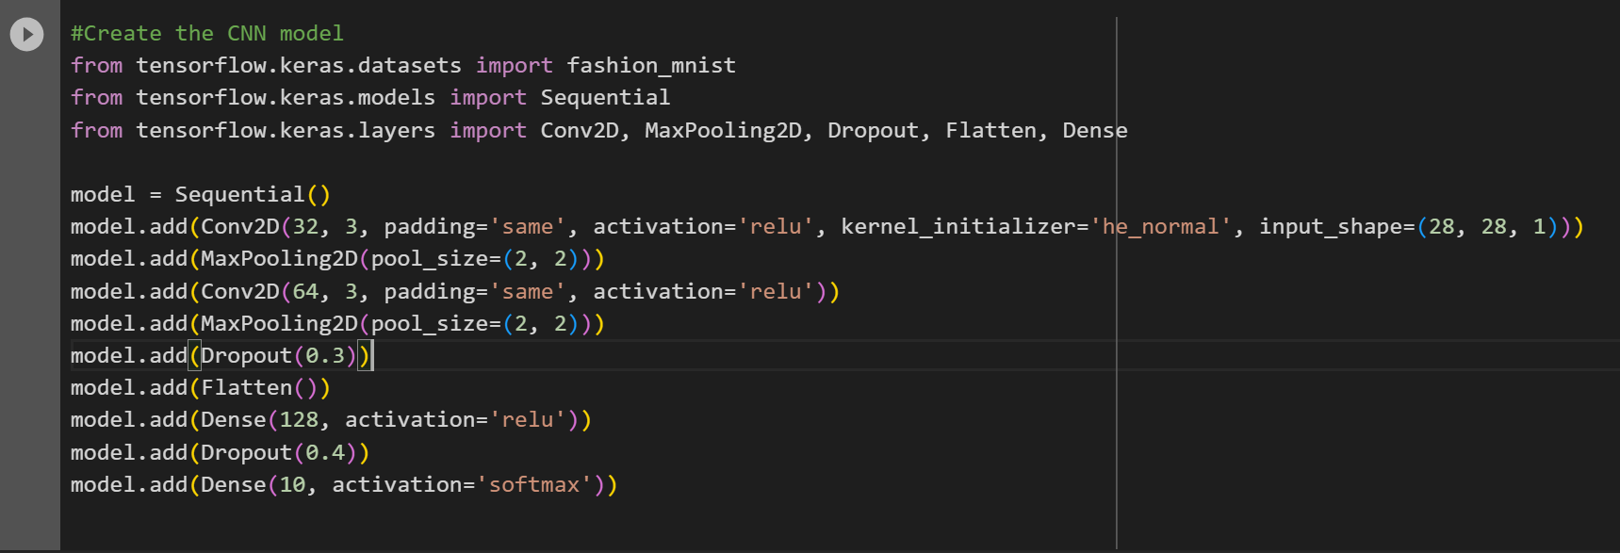
Model Code

Slide 7
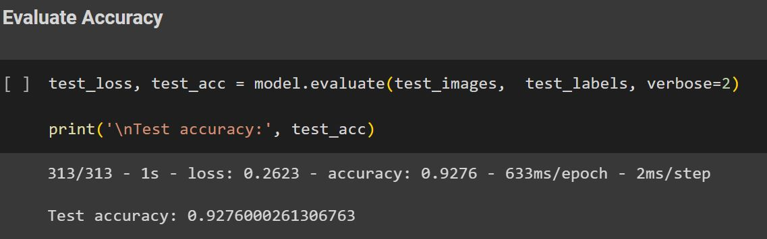
Accuracy of the Model
Accuracy : ~0.9276

Slide 8
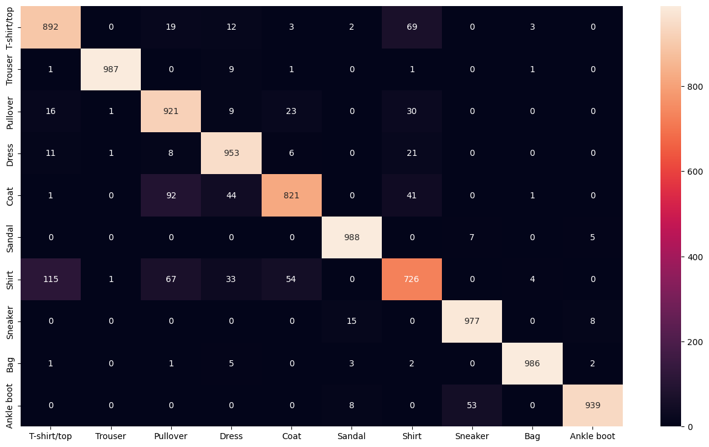
Confusion matrix

Slide 9
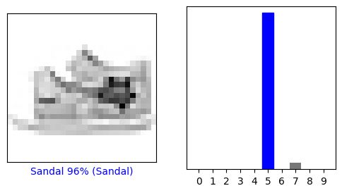
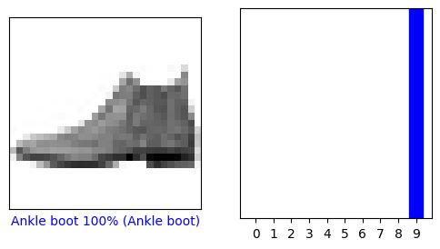
Output
Sample Predicted images

Slide 10
Concluison
1. With a complex sequential model with multiple convolution layers and 10 epochs for the training, we obtained an accuracy ~0.88 for test prediction. After investigating the validation accuracy and loss, we understood that the model is overfitting.We retrained the model with Dropout layers to the model to reduce overfitting.We confirmed the model improvement and with the same number of epochs for the training we obtained with the new model an accuracy of ~0.92 for test prediction.
2. Once the model has been developed in Jupyter Notebook it has taken an Inference time of 4s 36ms to classify and predict the images.
3. The same code which has been executed in Intel devcloud Tensorflow Toolkit, it has taken an Inference time of 2s 56ms to classify and predict the images.
4. But after applying the Intel Optimization OpenVino(IR), it has taken only 0.36ms to classify and predict the images.
5. So, from this we can conclude that the Classification of Fashion MNIST CNN model gives more Optimised predictions when Tensorflow keras code is converted to Intel Optimization OpenVino

Slide 11
With OpenVino optimization used with four layer ConvNets we were capable of attain an accuracy of 92.89%. We can clearly see how by tuning various hyperparameters like optimizers, batch size, number of epochs and regularization methods such as image augmentation and dropout increase the overall performance and significantly decrease the training time. F-MNIST can be a best drop-in substitution for MNIST although it is more difficult than MNIST dataset. We can implement or serve these models with open vino and regularization techniques for various types of image classification tasks and this dataset should be very much challenging when doing machine learning tasks. Configuring openvino needs years of experience and it is a black art, but tuning these parameters we can achieve magical results solving various computer vision tasks.
Inference time taken by the Model
-Inference time taken by the Model -Inference time taken by the model in Google Colab - 4s 4ms
-Inference time taken by the model in Intel devcloud - 2s 56 ms
-Inference time taken by the model after Intel Optimization Openvino - 0.36 ms

