Slide 1

OnboardAI: An AI-Assisted Employee Onboarding Platform
B.Tech (AI & DS)
UG-II (III-Semester)
Subject Coordinator:
Presented By:
Dr. Sakshi Ahuja
Assistant Professor
School of Artificial Intelligence
Kritika Sah (DL.AI.U4AID25031), Team Lead
Prisha Saini (DL.AI.U4AID25039), Tester
Rohith K Nair (DL.AI.U4AID25043), Developer
Pasham Srikar (DL.AI.U4AID25049), QA
AMRITA VISHWA VIDYAPEETHAM, DELHI NCR, FARIDABAD
Department of Artificial Intelligence & Data Science (AIDS)

Slide 2

CONTENTS
1. Problem Statement
2. Objectives
3. Proposed Methodology & Tools
4. Dataset Description
5. Data Understanding
6. Exploratory Data Analysis (I & II)
7. Data Preprocessing
8. Before vs After Preprocessing
9. Data Splitting & Leakage Audit
10. Preliminary Testing & Validation
11. Project Scope & Next Phase
12. Team Contribution & Conclusion
13. References

Slide 3
Problem Statement
• Onboarding a new employee is manual, document-heavy and slow.
  – HR verifies identity documents, certificates and bank forms by hand, one at a time.
  – New joiners wait days for answers to routine policy questions.
  – Nobody notices a hire has stalled until they are already weeks behind.
• Who is affected
  – New hires, a poor first fortnight drives early attrition.
  – HR teams, repetitive verification and the same questions answered repeatedly.
  – The organisation, replacing a new hire costs an estimated 6–9 months of salary.
• The specific gap this project addresses
  – Existing tools (BambooHR, Workday) are passive checklists: they record state, they do not read documents, answer questions, or predict who will stall.
  – We address the three tasks a checklist cannot do: verify a document, answer from company policy with a citation, and flag a hire at risk before HR notices.

Slide 4
Objectives of the Project
• 1. To build datasets representing onboarding documents, employee messages and onboarding journeys, and to characterise them statistically.
• 2. To preprocess text and tabular data into model-ready form, with justification for every transformation applied.
• 3. To analyse the data for distributions, class balance, correlations and quality defects before any modelling begins.
• 4. To split the data into training and testing sets without leakage, and to verify that split empirically.
• 5. To develop and evaluate ML models for document verification, intent and sentiment classification, and stall-risk prediction in the next phase.
Objectives 1–4 are complete and are the subject of this review. Objective 5 is next-phase work.

Slide 5
Proposed Methodology & Tools
• Pipeline
  – Step 1, Data collection / generation
  – Step 2, Data understanding & EDA
  – Step 3, Preprocessing (cleaning, vectorisation, scaling)
  – Step 4, Train / test split with leakage audit
  – Step 5, Model development
  – Step 6, Evaluation & comparison [next phase]
• Three parallel data streams
  – Text (documents) → document type verification
  – Text (messages) → intent + sentiment
  – Tabular (journeys) → stall-risk prediction
Area | Tools
Language | Python 3.13
Data / ML | scikit-learn, NumPy, pandas-free NumPy pipeline
Text | TF-IDF (word + char n-grams), TruncatedSVD (LSA)
Visualisation | Matplotlib
Backend | FastAPI, SQLAlchemy, SQLite
Frontend | React 19, Vite, Tailwind CSS
Testing | pytest (55 checks)

Slide 6
Dataset Description (Types)
Dataset | Samples | Features | Target | Classes | Type | Source
Onboarding documents | 4,950 | Text (TF-IDF) | Document type | 9 | Unstructured text | Generated, ml/synth.py
Employee messages | 3,360 | Text (TF-IDF) | Intent + Sentiment | 8 + 3 | Unstructured text | Generated, ml/text_synth.py
Onboarding journeys | 6,000 | 12 numeric | stalled (binary) | 2 | Structured tabular | Simulated, ml/risk_synth.py
• Why the data is synthetic
  – Real onboarding documents are identity and financial records (passports, bank details) that cannot lawfully be collected or published for a student project.
  – Real onboarding outcomes do not exist, because the system has not been deployed, so there is no history of who stalled.
  – Generators are built to make the task realistically hard: three scan-degradation tiers, cross-class text bleed, deliberately ambiguous messages, and a latent-variable process with an unobserved component.
• Limitation, stated plainly
  – These datasets measure internal consistency with a generator, not real-world capability. Replacing them with a real corpus (e.g. RVL-CDIP, 400k labelled document images) is the first item of future work.

Slide 7
Data Understanding
Measure | Documents | Messages | Journeys
Samples | 4,950 | 3,360 | 6,000
Classes | 9 | 8 intents / 3 sentiment | 2
Class balance (min/max) | 1.00 | 1.00 | 0.76
Mean length | 348 chars | 73 chars | n/a
Missing values | 0 | 0 | 0
Exact duplicates | 0 | 200 | 0
Data types | str | str | float64
• What we learned
  – Document and intent classes are balanced by construction (ratio 1.00), so accuracy is a fair headline metric.
  – The target is moderately imbalanced: 43.3% of journeys stall.
  – Strongest correlates of stalling:
    – avg_sentiment (-0.45)
    – docs_pending (+0.39)
    – pct_tasks_complete (-0.38)
    – progress (-0.35)
    – stage (-0.34)
  – Documents average 348 characters, far shorter than a real scanned certificate. A known limitation.
  – Defect found: the message corpus contains 200 exact duplicates (short messages such as "thank you" recur). Impact measured on the next slides.

Slide 8
Data Preprocessing: What, Why, Result
Step | Why it was done | Result
Lowercase + strip accents | OCR and typing produce inconsistent case | Applied to all text
Word 1–2 gram TF-IDF | Captures topical vocabulary and short phrases | 11,482 features
Character 3–5 gram TF-IDF | Survives OCR damage that destroys whole words | Unioned with word features
Sublinear TF | Dampens a term repeated many times in one document | Applied
min_df = 2 pruning | A token appearing once cannot generalise | 30,426 features dropped
StandardScaler (tabular) | Features span different units and ranges | Mean 0, SD 1 on all 12
Scaler fitted in a Pipeline | Stops test statistics leaking into training | Enforced by sklearn
• Not performed, and why
  – Missing-value imputation, there are no missing values in any dataset (verified, test TC-02).
  – Outlier removal, 2,683 IQR outliers exist but were retained. They are counts and waiting times whose long right tail is the signal of interest: a hire inactive for 25 days is the case the model must catch, not noise.

Slide 9
Preliminary Testing & Validation
Category | Cases | Examples
Data validation | 7 | Missing values, class balance, dtypes, domain ranges
Preprocessing | 3 | TF-IDF shape & sparsity, pruning, scaler output
Split integrity | 4 | Stratification, fold overlap, reproducibility
Functional | 4 | 7 demo documents each produce their expected verdict
Boundary | 3 | Zero-byte file, 10 MB + 1 byte, feature domain limits
Exceptional | 3 | HTML disguised as PDF, path traversal, malformed IDs
Access control | 2 | Cross-organisation and cross-department retrieval
Regression | 2 | Two previously-fixed extraction bugs
Performance | 2 | Pipeline < 5 s; classifier & retrieval < 150 ms
Security | 1 | PII stripped before text leaves the system
• 34 test cases · 55 checks · 55 passing
  – Run with: python -m pytest tests -q
• Approach
  – No language model is called in the suite, a test whose result depends on generation temperature cannot be a regression gate.
  – Uploads write to a temp directory, so no test touches the real database.
  – Two cases assert KNOWN DEFECTS rather than their absence, and fail if those defects grow worse.
• Not covered
  – No API, authentication, or frontend tests. No accuracy gate in CI.

Slide 10
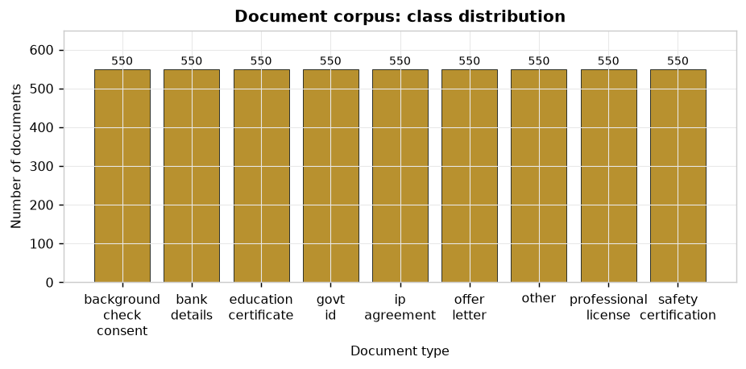
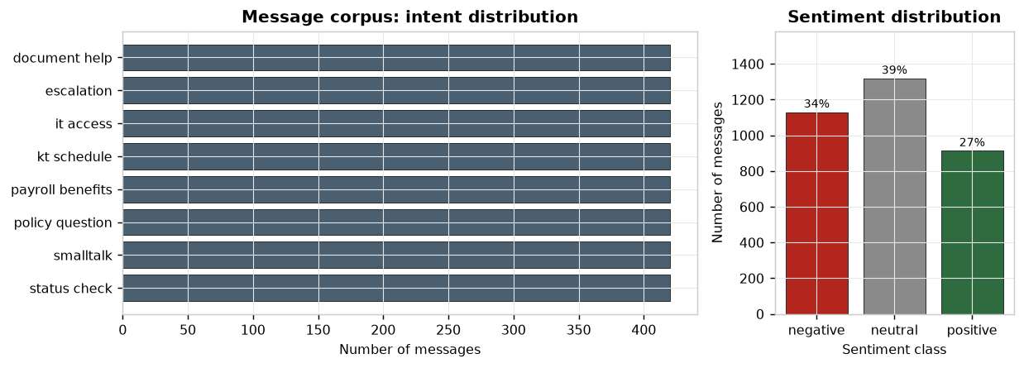
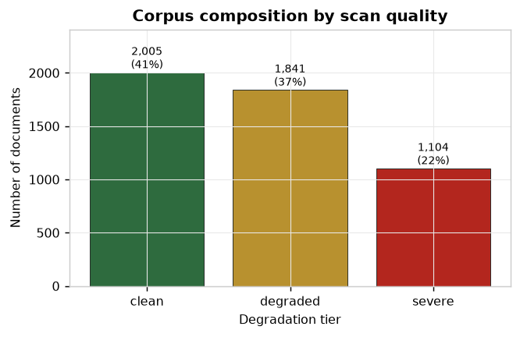
Exploratory Data Analysis (I): Distributions
• Observations
  – All 9 document classes hold exactly 550 samples, balanced by construction.
  – Intents are balanced, but sentiment is not: negative 34%, neutral 39%, positive 27%. Escalations are rarely cheerful, so class_weight='balanced' is used.
  – 22% of documents sit in the severe tier (cropped, 10–20% character noise). Holding back a hard slice is what makes a per-tier accuracy breakdown meaningful.

Slide 11
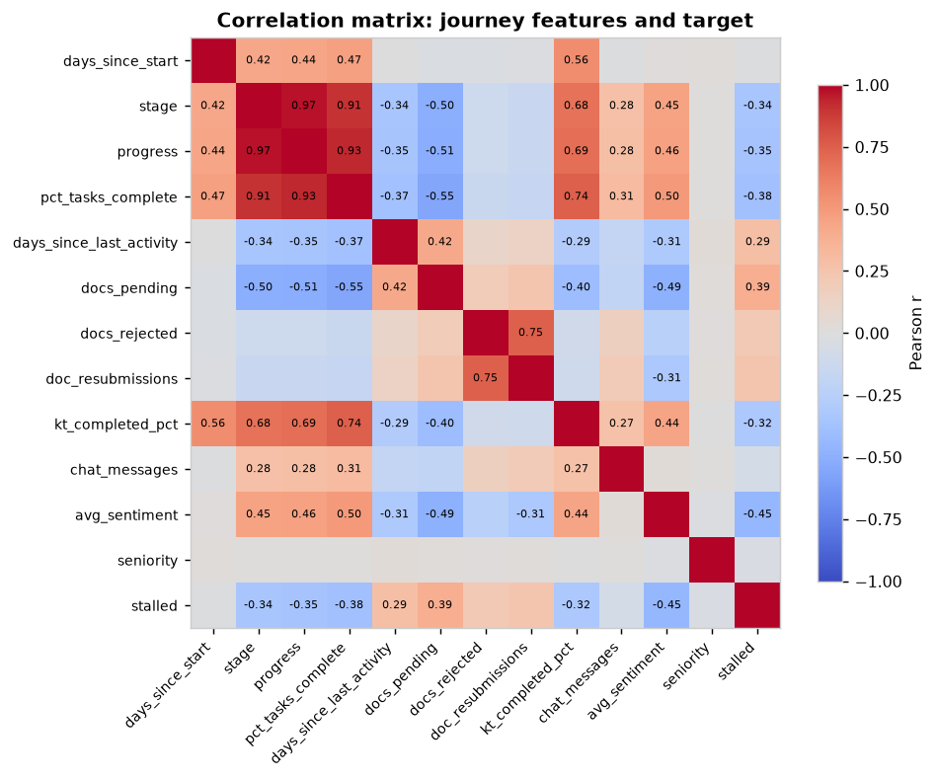
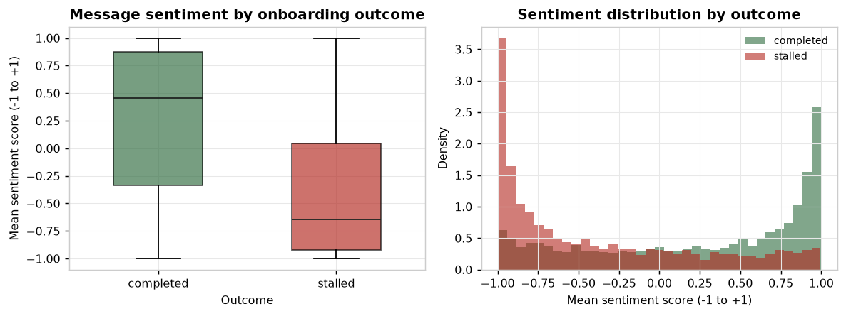
Exploratory Data Analysis (II): Relationships
• Observations
  – `stage` and `progress` correlate at +0.97. Severe multicollinearity: three progress-style features carry nearly the same information.
  – No single feature correlates with the target above |0.45|, consistent with a generator that deliberately withholds part of the cause.
  – Sentiment separates the outcomes in the expected direction but with heavy overlap, so it is a contributing signal rather than a decisive one.

Slide 12
Before vs After Preprocessing
Text vectorisation (document corpus)
Measure | Before | After
Representation | 4,950 raw text strings | Sparse matrix 4,950 × 11,482
Unique tokens | 11,056 raw tokens | 11,482 weighted n-gram features
Feature count | 41,908 (min_df=1) | 11,482 (min_df=2)
Density | Dense text | 99.26% sparse, 85 non-zeros/doc
Feature scaling (tabular dataset, first 6 of 12 features)
Feature | Mean before | SD before | Mean after | SD after
days_since_start | 31.43 | 16.71 | -5.8e-17 | 1.000
stage | 1.80 | 1.22 | -2.0e-17 | 1.000
progress | 36.11 | 23.52 | +4.5e-15 | 1.000
pct_tasks_complete | 0.36 | 0.22 | -1.2e-16 | 1.000
days_since_last_activity | 2.82 | 3.90 | -5.2e-16 | 1.000
docs_pending | 2.13 | 2.28 | +3.9e-17 | 1.000
All 12 features standardise to mean ≈ 0 and SD = 1, which is what makes the logistic-regression coefficients directly comparable.

Slide 13
Data Splitting & Leakage Audit
Dataset | Split | Train | Test | Stratified | Seed | Max class drift | Train/test overlap
Documents | 75/25 | 3,712 | 1,238 | Yes | 42 | 0.0001 | 0
Messages | 75/25 | 2,520 | 840 | Yes | 42 | 0.0000 | 70
Journeys | 75/25 | 4,500 | 1,500 | Yes | 42 | 0.0002 | n/a
• Why splitting matters before modelling
  – A model evaluated on data it trained on reports memorisation, not generalisation. The test fold must stay unseen until the model is final.
• Leakage controls applied
  – Vectoriser and scaler are fitted inside an sklearn Pipeline, so during cross-validation they re-fit on the training fold alone and never see the test fold.
  – Stratification holds every class proportion within 0.0001.
  – random_state = 42 everywhere, so splits are reproducible (verified, test TC-15).
• Defect found and measured, not assumed
  – 70 messages appear in BOTH folds (8.3% of that test set) because short messages repeat. We hypothesised this inflated the scores and tested it: accuracy on leaked rows was 0.9868 versus 0.9974 on clean rows, the leaked rows score LOWER. The duplicates are the genuinely ambiguous short messages. Fix is to deduplicate before splitting; impact is negligible but the defect is real.

Slide 14
Project Scope & Next Phase
• Intended application
  – HR teams onboarding employees across multiple organisations.
  – Users: new hires, HR administrators.
  – Deployment: web application, organisation-scoped.
• Completed in this phase
  – Problem definition and objectives
  – Three datasets built and characterised
  – EDA with 10 figures and written observations
  – Preprocessing with before/after evidence
  – Stratified splitting with a measured leakage audit
  – 55 automated validation checks
• Next phase
  – Data preparation → ML algorithm implementation → model training → testing → evaluation → model comparison
• Planned algorithms
  – Document type: Linear SVC / Logistic Regression on TF-IDF
  – Intent & sentiment: Logistic Regression on TF-IDF
  – Stall risk: Logistic Regression vs Gradient Boosting
  – Evaluation: accuracy, macro-F1, ROC-AUC, confusion matrices, 5-fold cross-validation, ablation studies
• Known limitations to address
  – Synthetic data → move to a real corpus (RVL-CDIP)
  – Message duplication → deduplicate before splitting
  – Multicollinearity among progress features
No accuracy, precision, recall or F1 figures are presented in this review: model implementation is next-phase work. Early prototypes of the next phase exist and are available in the appendix if the panel wishes to see them.

Slide 15
Team Contribution & Conclusion
Student | Roll Number | Role | Contribution in this phase
Kritika Sah | DL.AI.U4AID25031 | Team Lead | Problem definition, objectives, project scope, workflow and team coordination
Prisha Saini | DL.AI.U4AID25039 | Tester | 34 test cases, boundary and exceptional inputs, leakage measurement
Rohith K Nair | DL.AI.U4AID25043 | Developer | Data generators, preprocessing pipelines, splitting implementation, EDA code
Pasham Srikar | DL.AI.U4AID25049 | QA | Data quality checks, preprocessing verification, documentation, defect log
• Conclusion
  – Three datasets built and characterised: 4,950 documents, 3,360 messages, 6,000 journeys.
  – Key findings: classes balanced by construction; stalling correlates most with sentiment (-0.45); severe multicollinearity among progress features; a real duplication defect in the message corpus whose impact we measured rather than assumed.
  – Status: data preparation and splitting complete and verified. ML implementation begins next phase.

Slide 16
References
• [1] Y. Huang, T. Lv, L. Cui, Y. Lu, and F. Wei, "LayoutLMv3: Pre-training for document AI with unified text and image masking," in Proc. 30th ACM Int. Conf. Multimedia, 2022, pp. 4083–4091.
• [2] G. Kim et al., "OCR-free document understanding transformer," in Proc. ECCV, 2022, pp. 498–517.
• [3] J. Li, Y. Xu, T. Lv, L. Cui, C. Zhang, and F. Wei, "DiT: Self-supervised pre-training for document image transformer," in Proc. 30th ACM Int. Conf. Multimedia, 2022, pp. 3530–3539.
• [4] J. Devlin, M. W. Chang, K. Lee, and K. Toutanova, "BERT: Pre-training of deep bidirectional transformers for language understanding," in Proc. NAACL-HLT, 2019, pp. 4171–4186.
• [5] P. Lewis et al., "Retrieval-augmented generation for knowledge-intensive NLP tasks," in Advances in Neural Information Processing Systems, vol. 33, 2020, pp. 9459–9474.
• [6] Y. Gao et al., "Retrieval-augmented generation for large language models: A survey," arXiv:2312.10997, 2023.
• [7] S. Kapoor and A. Narayanan, "Leakage and the reproducibility crisis in machine-learning-based science," Patterns, vol. 4, no. 9, 2023.
• [8] T. Gebru et al., "Datasheets for datasets," Communications of the ACM, vol. 64, no. 12, pp. 86–92, 2021.
IEEE citation format. The full list of fifteen references appears in the project paper. Fourteen of the fifteen are from 2017 onwards.

Slide 17
Appendix: Work Completed Ahead of Schedule
• These slides are NOT part of the mid-term review.
  – The review covers work up to data splitting, which is slides 1–16.
  – The items that follow belong to the next phase. They are included only as backup material, to be shown if the panel asks what has been prototyped.
  – Nothing here is claimed as a mid-term deliverable, and no result below is presented as part of the assessed work.

Slide 18
Appendix: Working System Already Prototyped
• A running web application exists end to end
  – React 19 + Vite frontend; FastAPI + SQLAlchemy + SQLite backend.
  – Two role-based views: new hire and HR administrator.
  – Multi-organisation: data and policy are scoped per organisation.
• Capabilities wired into the request path
  – Document upload → automatic verification → approve / reject / escalate.
  – Policy question answering with mandatory source citation.
  – Risk score per employee, with per-feature explanation.
  – Structured event stream feeding the ML features.
• Six specialist agents with enforced boundaries
  – Onboarding, Document, IT Provisioning, Knowledge Transfer, Policy, Escalation.
  – Each holds only its own tools, enforced in code, the Policy agent cannot complete a task; the Onboarding agent cannot read the policy corpus.
  – Routing is done by our trained intent classifier, not by an LLM: cheaper, deterministic, and measurable against a confusion matrix.
• Privacy control
  – Personal identifiers (email, phone, Aadhaar, PAN, IFSC, account) are stripped before any text is sent to a model provider.
Available for live demonstration if the panel wishes to see it.

Slide 19
Appendix: Models Trained Ahead of Schedule
Model | Algorithm | Classes / Features | Held-out result
Document type | TF-IDF (word+char) → calibrated LinearSVC | 9 classes | 0.986 acc · 0.937 on severe scans
Intent | TF-IDF → Logistic Regression | 8 classes | 0.937 acc · CV 0.933 ± 0.004
Sentiment | TF-IDF → Logistic Regression | 3 classes | 0.996 acc, inflated, see below
Stall risk | Logistic Regression (vs Gradient Boosting) | 12 features | ROC-AUC 0.795 · CV 0.807 ± 0.002
• Shown only if asked. These belong to the final review, not this one.
• How we read our own numbers
  – The document classifier's honest figure is 0.937 on severely degraded scans, not the 0.986 headline. Clean scans reach 1.000, which tells us little.
  – Sentiment's 0.996 is a template-separability ceiling, not evidence the model understands sentiment. We do not present it as a capability.
  – All figures are measured on synthetic data and describe internal consistency with our generators, not real-world performance.

Slide 20
Appendix: Methodology We Are Most Confident In
• 1. We rejected our own perfect scores, three times.
  – The first document classifier scored 1.000 on every metric with zero cross-validation variance. We treated that as a broken benchmark, not a result, and rebuilt the corpus with three degradation tiers and cross-class text bleed until the severe tier read 0.937.
• 2. We tested a hypothesis about our own data and were proved wrong.
  – We found duplicate messages leaking across the train/test split and predicted this inflated our scores. Measured: accuracy on leaked rows 0.9868 versus 0.9974 on clean rows, the leaked rows score LOWER, because duplicates concentrate in the genuinely ambiguous short messages. The hypothesis was wrong and we report it as wrong.
• 3. We measured whether our components actually depend on each other.
  – Removing the NLP sentiment feature costs the risk model 0.0075 ROC-AUC. That is measured evidence the NLP layer feeds the ML layer, rather than three techniques sitting side by side.
• 4. We keep a register of our own defects.
  – Message duplication, multicollinearity among progress features, synthetic-data ceilings and short documents are all documented, and two automated tests assert the known defects exist so they cannot quietly worsen.

Slide 21
Appendix: Available for Live Demonstration
• Data and analysis (this review)
  – python -m ml.data_report → dataset card and quality audit
  – python -m ml.eda → all 10 figures regenerated from the data
  – python -m pytest tests -q → 55 checks, live
  – python -m tests.make_test_report → report with actual results
• System (next phase, if asked)
  – Upload an expired safety certificate → rejected automatically, with the expiry date quoted back.
  – Ask the same leave question as two different employees → 24 days vs 18 days, each cited to its own company's policy document.
  – Open the HR dashboard → stall-risk ranking with per-employee explanations.
  – Seven demo documents are prepared, each named for the verdict it should produce.
Everything above runs offline on a laptop. No paid API is used anywhere in the project.

