Slide 1

OnboardAI: An AI-Assisted Employee Onboarding Platform
B.Tech (AI & DS)
UG-II (III-Semester)
Presented By:
Presented By:
Dr. Sakshi Ahuja
Kritika Sah (DL.AI.U4AID25031), Team Lead
Prisha Saini (DL.AI.U4AID25039), Tester
Rohith K Nair (DL.AI.U4AID25043), Developer
Pasham Srikar (DL.AI.U4AID25049), QA
AMRITA VISHWA VIDYAPEETHAM, DELHI NCR, FARIDABAD
Department of Artificial Intelligence & Data Science (AIDS)
Notes:
[Kritika Sah, Team Lead] about 40 seconds
(slide 1 of the full deck)
Good morning. Our project is OnboardAI, a system that uses machine learning to help a company
bring new employees on board.
I am Kritika Sah and I led the team. With me are Pasham Srikar who handled quality assurance,
Rohith K Nair who wrote the code, and Prisha Saini who handled testing. Each of us will
present the part we were responsible for.
One thing before we start, so the scope is clear. This review covers our work up to data
splitting. We have not trained or evaluated any models yet, so we will not be showing
accuracy or F1 figures today. That work belongs to the next phase.

Slide 2
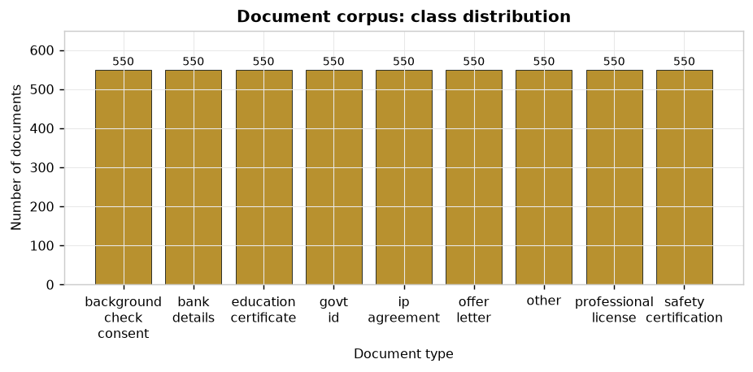
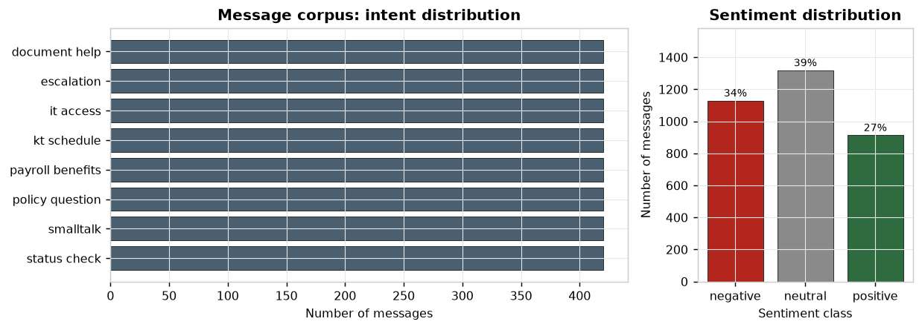
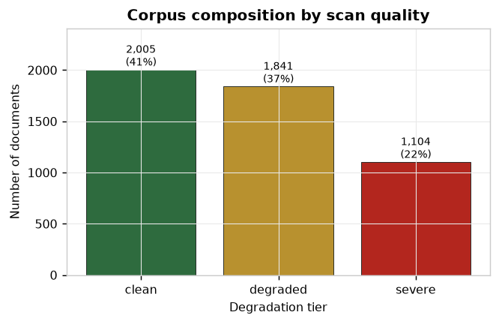
Exploratory Data Analysis (I): Distributions
• Observations
  – All 9 document classes hold exactly 550 samples, balanced by construction.
  – Intents are balanced, but sentiment is not: negative 34%, neutral 39%, positive 27%. Escalations are rarely cheerful, so class_weight='balanced' is used.
  – 22% of documents sit in the severe tier (cropped, 10–20% character noise). Holding back a hard slice is what makes a per-tier accuracy breakdown meaningful.
Notes:
[Rohith K Nair, Developer] about 75 seconds
(slide 8 of the full deck)
Thank you. I will cover the exploratory analysis, which we did before writing any model code.
Three charts here. On the left, the nine document classes each hold exactly five hundred and
fifty samples. That is balance by construction and it matters, because it means we can quote
plain accuracy without it being misleading.
Top right, the intents are also balanced, but sentiment is not. Negative messages outnumber
positive ones. That is deliberate rather than accidental. Escalation messages are rarely
cheerful and small talk is rarely furious, so forcing them to be equal would have made the
data less realistic, not more. We handle it with balanced class weights when we train.
Bottom left is the one I would draw your attention to. Twenty two per cent of our documents
are in the severe category. Those are cropped, the header is removed, ten to twenty per cent
of the characters are scrambled, and sentences from a different document type are mixed in.
We deliberately made a fifth of our own data very difficult. The reason is on the next slide.

Slide 3
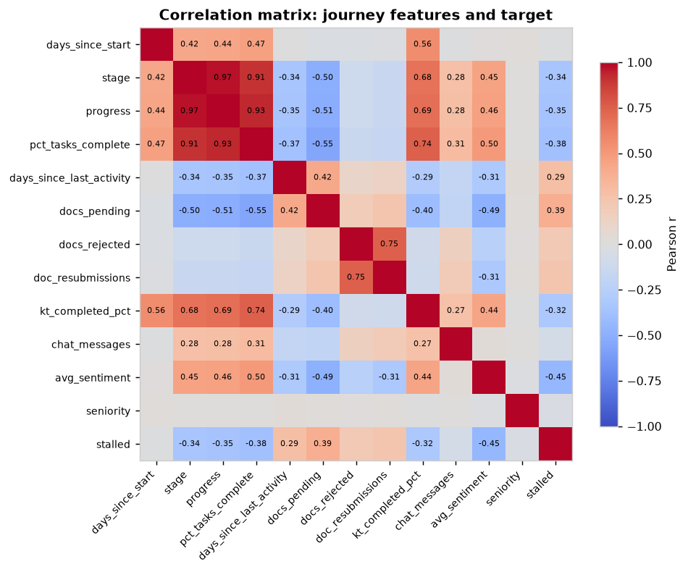
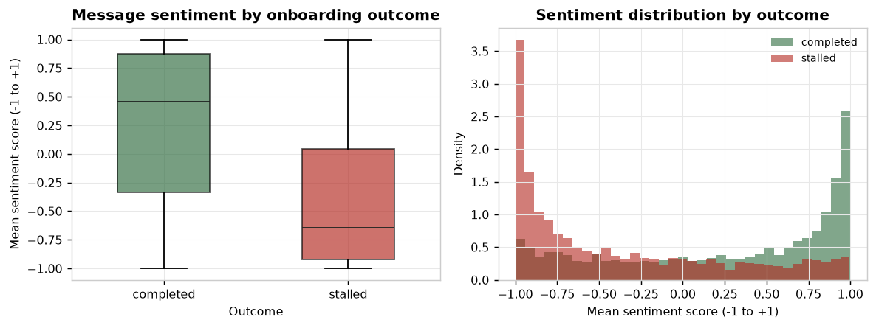
Exploratory Data Analysis (II): Relationships
• Observations
  – `stage` and `progress` correlate at +0.97. Severe multicollinearity: three progress-style features carry nearly the same information.
  – No single feature correlates with the target above |0.45|, consistent with a generator that deliberately withholds part of the cause.
  – Sentiment separates the outcomes in the expected direction but with heavy overlap, so it is a contributing signal rather than a decisive one.
Notes:
[Rohith K Nair, Developer] about 90 seconds
(slide 9 of the full deck)
These two charts changed how we think about our data.
The correlation matrix on the left shows how our twelve features relate to each other. The
block in the top left corner is the finding. Stage, progress and percentage of tasks complete
correlate above zero point nine with each other, reaching zero point nine seven for the
strongest pair.
Those three are measuring almost the same thing. They are three different names for how far
along somebody is. This explained something that had been puzzling us, which is why removing
any one of them changed our results so little. Individually each looked useful. Between them
they carry one piece of information.
Also worth noting, no single feature correlates with the outcome above zero point four five.
We expected that, because our generator deliberately keeps part of the cause hidden from the
features. If any feature had shown a correlation near one, it would mean we had accidentally
leaked the answer into the inputs.
On the right, sentiment does separate the two outcomes in the direction you would expect.
People who stall write more negatively. But look at the overlap. The distributions sit on top
of each other for most of their range. So sentiment contributes to a prediction, it does not
decide one. That is a more realistic expectation than the one we started with.

Slide 4

Data Preprocessing: What, Why, Result
Step | Why it was done | Result
Lowercase + strip accents | OCR and typing produce inconsistent case | Applied to all text
Word 1–2 gram TF-IDF | Captures topical vocabulary and short phrases | 11,482 features
Character 3–5 gram TF-IDF | Survives OCR damage that destroys whole words | Unioned with word features
Sublinear TF | Dampens a term repeated many times in one document | Applied
min_df = 2 pruning | A token appearing once cannot generalise | 30,426 features dropped
StandardScaler (tabular) | Features span different units and ranges | Mean 0, SD 1 on all 12
Scaler fitted in a Pipeline | Stops test statistics leaking into training | Enforced by sklearn
• Not performed, and why
  – Missing-value imputation, there are no missing values in any dataset (verified, test TC-02).
  – Outlier removal, 2,683 IQR outliers exist but were retained. They are counts and waiting times whose long right tail is the signal of interest: a hire inactive for 25 days is the case the model must catch, not noise.
Notes:
[Rohith K Nair, Developer] about 90 seconds
(slide 10 of the full deck)
This is the preprocessing, with a reason for each step rather than just a list.
The text goes through two different conversions at once. The first counts whole words and
weights them by how rare they are, so a word like the counts for nothing and a word like
passport counts for a lot. The second counts short runs of three to five letters.
That second one is the choice I would defend. When a scan is damaged, a whole word becomes
unrecognisable, so the word based method fails. But most of the short letter sequences inside
that word survive. So when one representation breaks down, the other still works. That is why
our badly damaged documents still score around ninety four per cent instead of collapsing.
The numerical data gets rescaled so every column sits on the same footing. Otherwise the
column holding a number of days would outweigh a column holding a score between minus one and
one, purely because its numbers are bigger.
Now the box at the bottom, which I think matters more than the table. Two steps that appear
in almost every preprocessing description are missing here, and I want to say why rather than
leave them out quietly.
We did not fill in missing values, because there are none. We checked every column and every
record and the count is zero. That is a consequence of generating our data rather than
collecting it, and it is one of the ways our dataset is easier than a real one.
We did not remove outliers either, although the standard rule flags a large number of them.
The features producing outliers are counts and waiting times. An employee who has been
inactive for twenty five days is exactly the case our system is supposed to catch. Deleting
that row would remove the problem we are trying to detect.

Slide 5
Before vs After Preprocessing
Text vectorisation (document corpus)
Measure | Before | After
Representation | 4,950 raw text strings | Sparse matrix 4,950 × 11,482
Unique tokens | 11,056 raw tokens | 11,482 weighted n-gram features
Feature count | 41,908 (min_df=1) | 11,482 (min_df=2)
Density | Dense text | 99.26% sparse, 85 non-zeros/doc
Feature scaling (tabular dataset, first 6 of 12 features)
Feature | Mean before | SD before | Mean after | SD after
days_since_start | 31.43 | 16.71 | -5.8e-17 | 1.000
stage | 1.80 | 1.22 | -2.0e-17 | 1.000
progress | 36.11 | 23.52 | +4.5e-15 | 1.000
pct_tasks_complete | 0.36 | 0.22 | -1.2e-16 | 1.000
days_since_last_activity | 2.82 | 3.90 | -5.2e-16 | 1.000
docs_pending | 2.13 | 2.28 | +3.9e-17 | 1.000
All 12 features standardise to mean ≈ 0 and SD = 1, which is what makes the logistic-regression coefficients directly comparable.
Notes:
[Rohith K Nair, Developer] about 60 seconds
(slide 11 of the full deck)
This is the before and after, with our actual numbers rather than a generic example.
The top table is the text. Four thousand nine hundred and fifty pieces of raw text become a
mathematical table of four thousand nine hundred and fifty rows by eleven thousand four
hundred and eighty two columns. We started with about forty two thousand possible features
and pruned it down to eleven and a half thousand by removing anything that appears in only
one document. A term appearing once cannot generalise, it can only memorise.
The result is over ninety nine per cent empty, which is normal and expected for text.
The bottom table is the numerical data. Every one of the twelve columns goes from its own
natural range to a mean of zero and a standard deviation of one. The reason that matters is
on the last line. Once everything is on the same scale, the model's internal weights become
directly comparable, which is what will let us say which factors actually drive a prediction.
Prisha will now take the data split and the testing.

Slide 6
Appendix: Models Trained Ahead of Schedule
Model | Algorithm | Classes / Features | Held-out result
Document type | TF-IDF (word+char) → calibrated LinearSVC | 9 classes | 0.986 acc · 0.937 on severe scans
Intent | TF-IDF → Logistic Regression | 8 classes | 0.937 acc · CV 0.933 ± 0.004
Sentiment | TF-IDF → Logistic Regression | 3 classes | 0.996 acc, inflated, see below
Stall risk | Logistic Regression (vs Gradient Boosting) | 12 features | ROC-AUC 0.795 · CV 0.807 ± 0.002
• Shown only if asked. These belong to the final review, not this one.
• How we read our own numbers
  – The document classifier's honest figure is 0.937 on severely degraded scans, not the 0.986 headline. Clean scans reach 1.000, which tells us little.
  – Sentiment's 0.996 is a template-separability ceiling, not evidence the model understands sentiment. We do not present it as a capability.
  – All figures are measured on synthetic data and describe internal consistency with our generators, not real-world performance.
Notes:
[Rohith K Nair, Developer] about 60 seconds
(slide 19 of the full deck)
These are the models we have already trained. I want to be clear that these belong to the
final review, not this one, and we are showing them only because we were asked.
Four models. Document type, intent, sentiment, and stall risk.
How we read our own numbers matters more than the numbers themselves.
The document classifier shows zero point nine eight six overall, but the figure I would quote
is zero point nine three seven, which is what it scores on the severely damaged scans. The
clean scans score a perfect one point zero, and that tells us almost nothing.
The sentiment figure of zero point nine nine six is not a capability claim and we do not
present it as one. It is high because our generator marks sentiment with stock phrases that a
simple model separates easily. That is a property of our data, not evidence the model
understands sentiment.
And every figure here is measured on synthetic data.

