Slide 1
Use of Location Data for effective taxi business improvement in New York

Slide 2
Data
Obtained Dataset from Kaggle (link).
Contains 1458644 rows of data with 11 features.
Expanded the features to 17 features.
Performed Visualisation steps to visualize and remove outliers.
Performed One-hot encoding to enable features to be used for training.

Slide 3
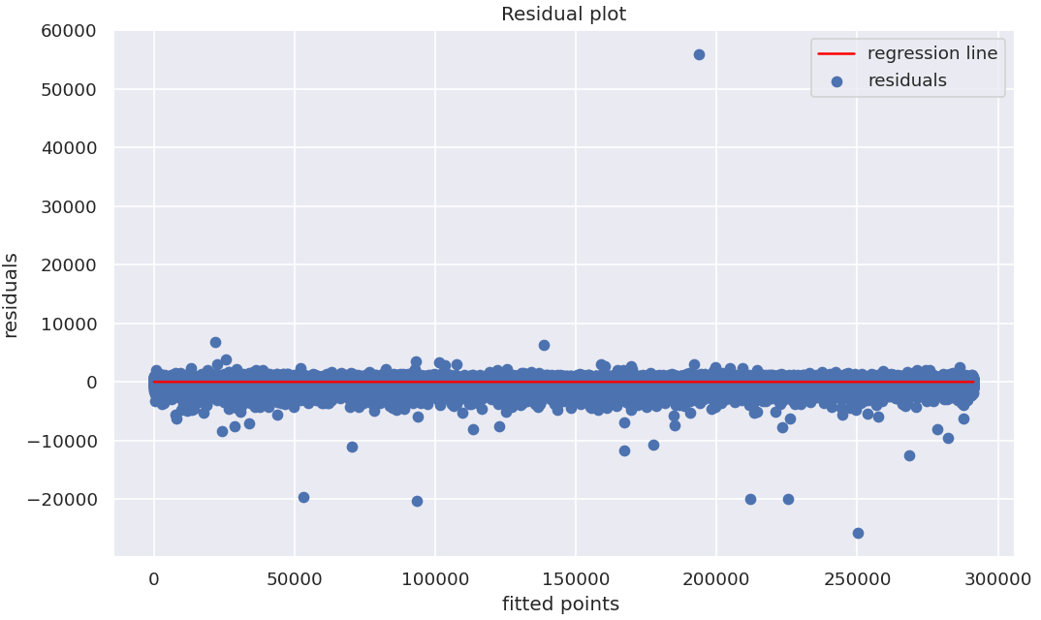
Regression Model
Used trip_distance as target and other features to train the Linear Regression model.
RMSE of the model : 473
Used residual as variation of different features are varying

Slide 4
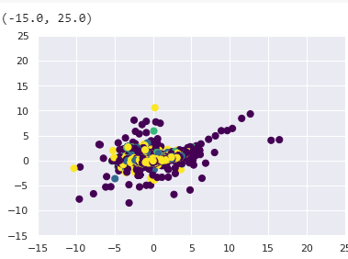
KMeans Model
Features used are varying to Regression model
Used four clusters to cluster data based on pickup location over various parts of the day like morning, midday, evening and latenight.

Slide 5
Conclusion
Clustering model needs a huge improvement by introducing new range of features.
Due to lack of free high computational GPU’s various results could not be computed.
Both Models can be improved by a good factor in the future.
Thus, this model gives us a new dimension to how cab drivers need to consider past data.

