Slide 1
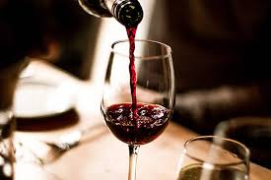
Red Wine Quality Prediction

Slide 2

PROPOSAL
Domain Background
Wine is an alcoholic drink made from fermented grapes. Its Latin name is vinum. By using different types of grapes and strains of yeasts, we can make different types of wines .These variation result change in biochemical reactions that involves fermentation and production process. Wines not made from grapes include rice wine and fruit wine such as pomegranate, plum.​The wine we are going to study is red wine. The earliest known traces of wine are from China, Iran, Sicily​.Red​ wine is made up of dark coloured grapes​. The​ actual colour of the wine is violet for young wines and red for mature wines and brown for older wines.​
It is important to know the quality of wine as it was consumed by billions of people around the world. The main aim of this project is to predict the quality of wine such that it is good or bad.

Slide 3
PROBLEM STATEMENT
The main aim of this project is to find the quality of wine such that it is either good or bad quality. Here we are taking binary classification model. The output is divided into two categories 0 and 1. If the quality is less than or equal to 5 then 0 ,if it is more than 5 then 1.

Slide 4
DATA SETS AND INPUTS
The dataset for this project is taken from kaggle
(​https://www.kaggle.com/uciml/red-wine-quality-cortez-et-al-2009​).The data set has the attributes
Fixed acidity: Most acids involved with the wine are non volatile.
Volatile acidity: Amount of acetic acid, if it was at a high amount then it leads to unpleasant, vinegar taste.
Citric acid: It is in small quantities. That it adds freshness and flavour to the wine.
Residual sugar :The amount of sugar remained after fermentation. If the sugar was greater than 45gms per litre then we call it as sweet wine.
Chlorides: amount of salt in the wine.

Slide 5
Free sulphur dioxide: free form of so2 prevents microbial growth and oxidation in wine.
Total sulphur dioxide: the amount free and bound forms of so2.
Density: it is the density of water in wine.
PH: it describes how either the wine is acidic or basic.if the ph is below 7 on a scale of 14 it is acidic. If the ph is above 7 on scale of 14 it is basic.
Sulphates: which are added to wine to contribute so2 gas .
Alcohol: the percentage of alcohol content in the wine.
quality(output variable): it describes the quality of wine that scores is between 0 to 10.

Slide 6
OUTPUT
The output attribute is ‘quality’. It is divided into two categories 0 and 1. 0 if quality is 5 or less than 5. And 1 if greater than 5.If the wine is 0 category then it is said to be bad quality .If it is category 1 , the wine is good quality. Remaining attributes are taken as input. Data set is balanced because the total number of zeros and ones are nearly same. After removing the duplicates there are nearly 1300 data points in the data set.

Slide 7
SOLUTION STATEMENT
The solution for this problem is to build a prediction model, which is suitable to predict the quality of wine. The classification models used are (Decision trees, Random Forest, Adaboost, support vector machine, logistic regression ) On the dataset to get the best model which fits the data well and performs well in predicting. We measure the model’s efficiency by using some metrics.

Slide 8
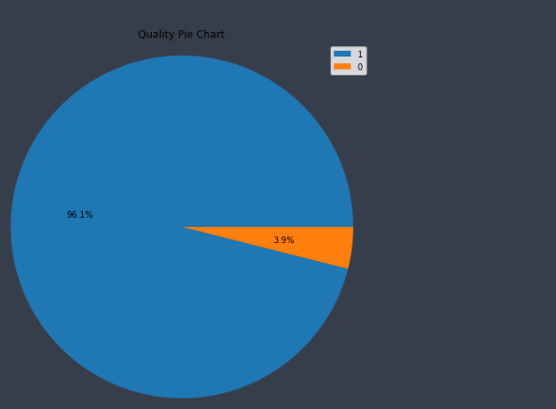
VISUALIZATION
We used pie chart to visualize the given data and represent what percentage is good wine(1) and what percentage is bad wine(0).

Slide 9
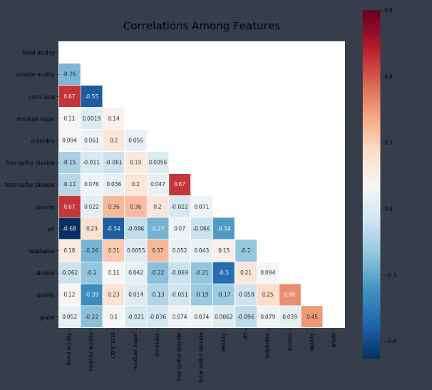
CORRELATION BETWEEN ATTRIBUTES BEFORE NORMALIZATION

Slide 10
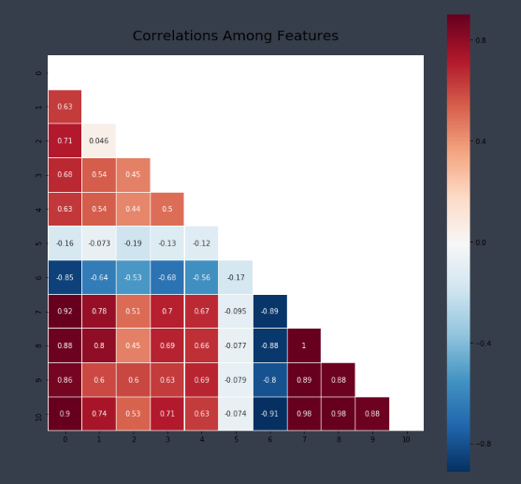
CORRELATION BETWEEN ATTRIBUTES AFTER NORMALIZATION

Slide 11
BENCHMARK MODEL
The benchmark model for this red wine quality datasets model can be SVC classifier which can be derived from sklearn.svm.
SVC is taken as the benchmark model because it offers best classification performance(best accuracy).
The best thing about SVC is it does not over fit the data.
Support Vector Machines is considered to be a classification approach, but can be employed in both types of classification and regression problems. It can easily handle multiple continuous and categorical variables.
The difference between the learned evaluation and the benchmark model score should be very huge.

Slide 12
EVALUTION METRICS
We used accuracy score as evaluation metrics to calculate the performance of a model. It is used to know how accurate our model is.
Accuracy score=(TP+TN)/(TP+TN+FP+FN) Where TP is true positive TN is true negative. FP is false positive. FN is false negative.

Slide 13
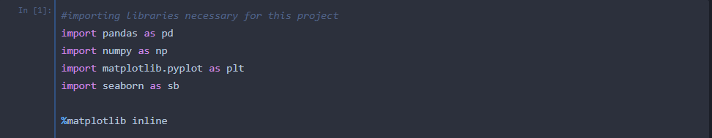
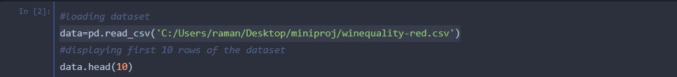
PROJECT DESIGN
The sequence of steps followed to solve the problem is:
• Exploring the data:
o ​We import necessary packages required
for solving the problem.
o ​We load the dataset.

Slide 14
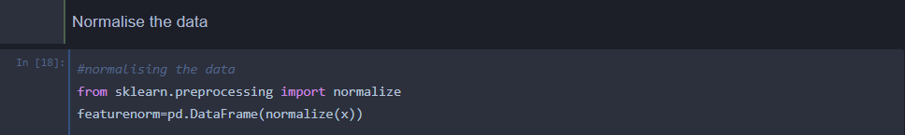
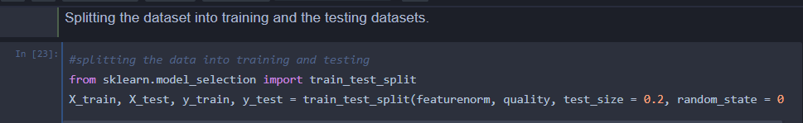
Data Pre-processing:
​o ​Identifying features and target attributes
​ o ​Normalizing numerical features that are highly skewed by applying logarithmic transformations.
o ​Splitting the data into training set and testing set.

Slide 15
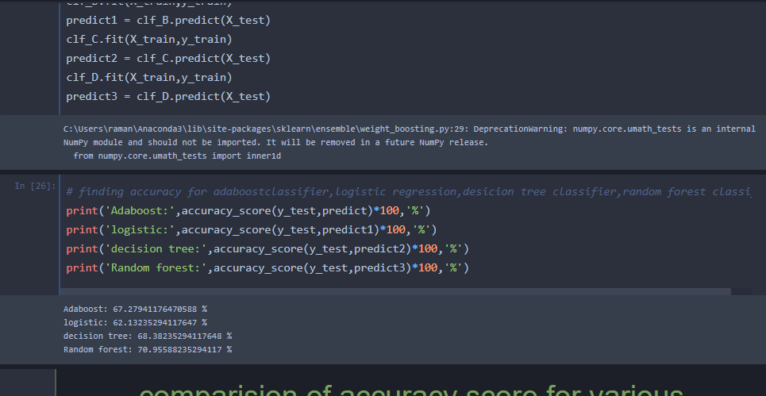
MODEL TUNING
O ​Apply various algorithms on the dataset.
•Decision trees
•Adaboost classifier
•Random Forest
•Support Vector Machine
•Logistic Regression
​

Slide 16
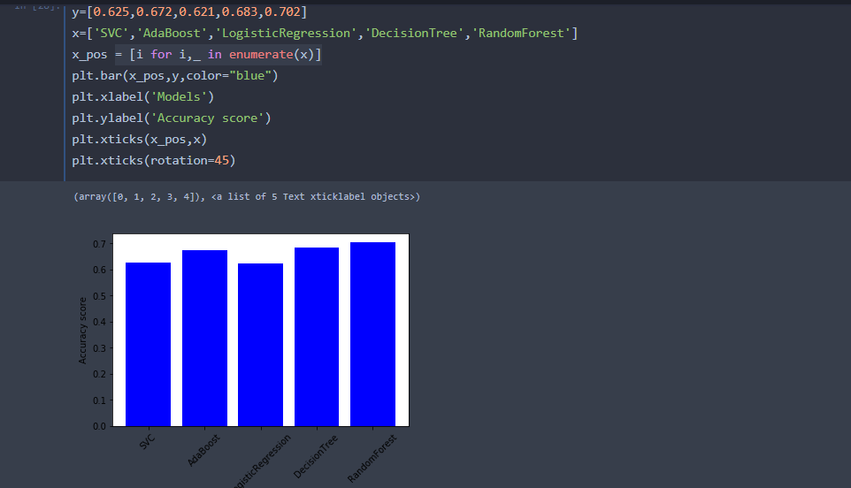
o ​Compare each algorithm with the Benchmark Model using metrics.
o ​Find the best model among them.

Slide 17
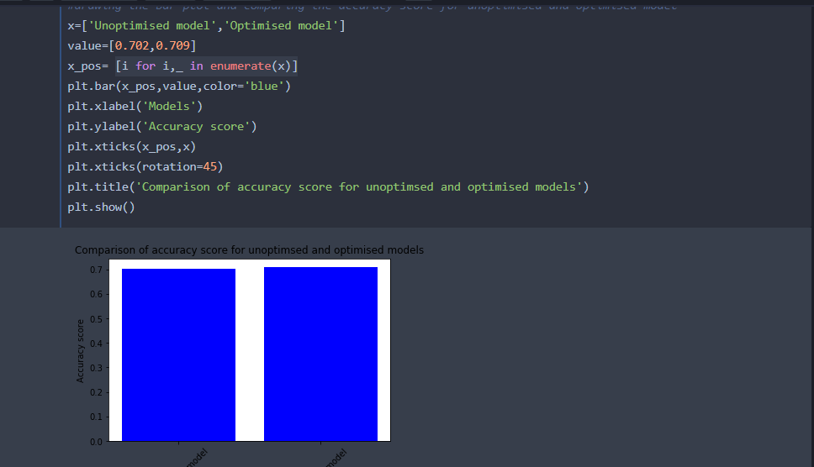
•Model Tuning:
o​ Tune the selected model with different combination of parameters so that the model performs well.

Slide 18
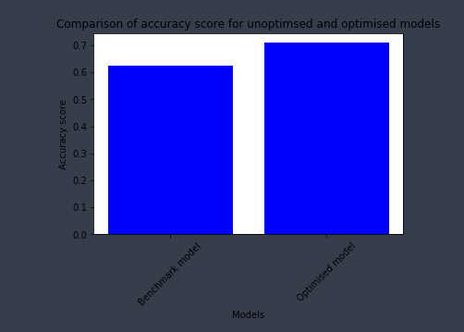
Model Evaluation and Validation
The model is evaluated by testing with the unknown data. There is a function named “check” in the project and its parameters are the attributes for predicting, quality of the wine. It gives the output as predicted quality. In this project we checked with the unknown data (2 values). One value is of good quality and other is of bad quality. The model correctly predicted the quality which means that the model is robust.
The final model’s scores are good when compared to Bench Mark model’s scores. So, we can consider our final model as new Bench mark model if any new classification algorithm wants to be applied. we tested the final model with unknown data. It gave the correct output. (For more information I will place the tested cell below this paragraph as a proof). So from here, we can say that the model can best predict whether there is presence of heart disease or not.

