Slide 1

UE19CS353 – Object Oriented Analysis and Design with Java
Theory ISA (Mini Project)
Presentation on
Cinema Ticket Booking System
By:
ROHITH M- PES2UG19CS336
ROSHAN SRIRAM- PES2UG19CS338
S KALYAN- PES2UG19CS341
6th Semester F
PES University, Bengaluru
(Established under Karnataka Act 16 of 2013)
Department of Computer Science & Engineering
Session: Jan - May 2022

Slide 2
Object Oriented Analysis and Design with Java (Mini Project)
Project Description
The main purpose of our online ticket booking system is to provide an alternate and convenient way for a customer to buy cinema tickets. It is an automatic system. After the data has been fed into the database, the staff does not need to do anything with the order once it is received through the system
https://github.com/rohithmgowda/movieticketbooking.git

Slide 3
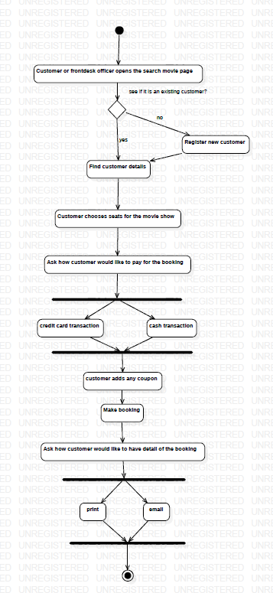
Object Oriented Analysis and Design with Java (Mini Project)
Activity Diagram

Slide 4
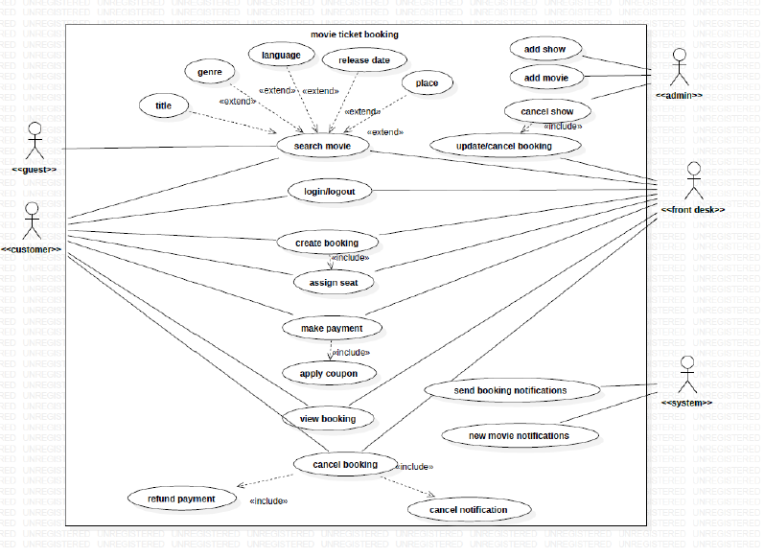
Object Oriented Analysis and Design with Java (Mini Project)
USE CASE Diagram

Slide 5
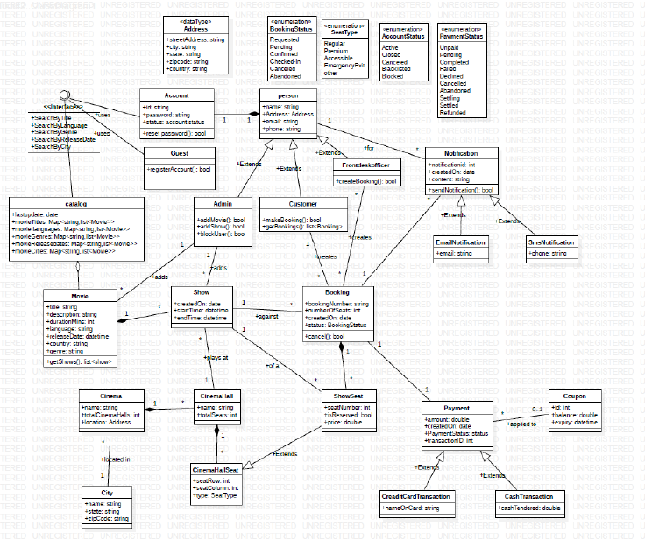
Object Oriented Analysis and Design with Java (Mini Project)
CLASS Diagram

Slide 6
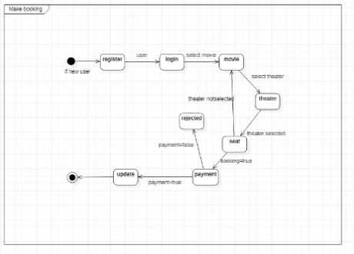
Object Oriented Analysis and Design with Java (Mini Project)
STATE Diagram

Slide 7
Object Oriented Analysis and Design with Java (Mini Project)
Tools and Frameworks Used
Front-end: Netbeans-IDE
Database: MySQL database
Version Control: Git
Class, activity and state diagrams: StarUML
JDBC (Java Database Connectivity)

Slide 8
Object Oriented Analysis and Design with Java (Mini Project)
Design Principle and Design Patterns Applied
Architectural patterns used
Layered Pattern :
As the name suggests, components(code) in this pattern are separated into layers of subtasks and they are arranged one above another.
Each layer has unique tasks to do and all the layers are independent of one another. Since each layer is independent, one can modify the code inside a layer without affecting others.
It is the most commonly used pattern for designing the majority of software. This layer is also known as ‘N-tier architecture’. Basically, this pattern has 4 layers.
1.Presentation layer (The user interface layer where we see and enter data into an application.)
2.Business layer (this layer is responsible for executing business logic as per the request.)
3.Application layer (this layer acts as a medium for communication between the ‘presentation layer’ and ‘data layer’.
4.Data layer (this layer has a database for managing data.)
Design pattern used:
Facade Structural Design Pattern for abstraction of complex Operations done with data. When there is even a small query done by the user such as login, the login data is collected and passed onto the model and the model searches with the database for a match and then takes an appropriate action based on this. From the user perspective the user has just given the login detail and pressed a button, but there is a lot of methods called in a chain for a suitable action to be taken.

Slide 9
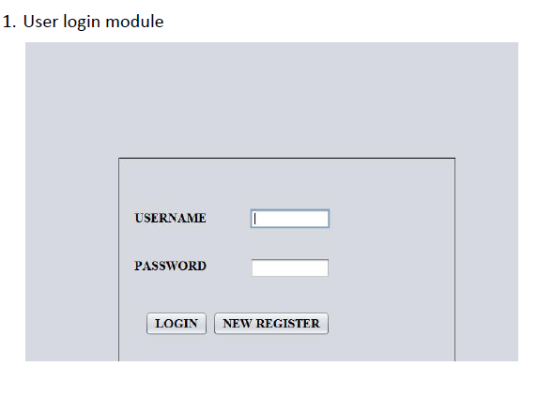
Object Oriented Analysis and Design with Java (Mini Project)
Screenshots

Slide 10
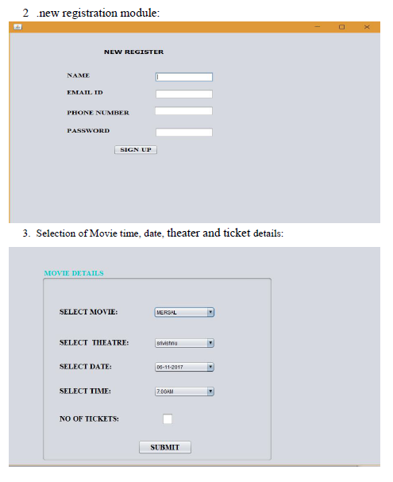
Object Oriented Analysis and Design with Java (Mini Project)
Screenshots

Slide 11
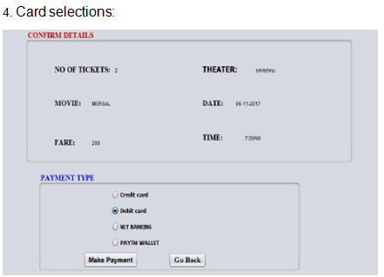
Object Oriented Analysis and Design with Java (Mini Project)
Screenshots

Slide 12
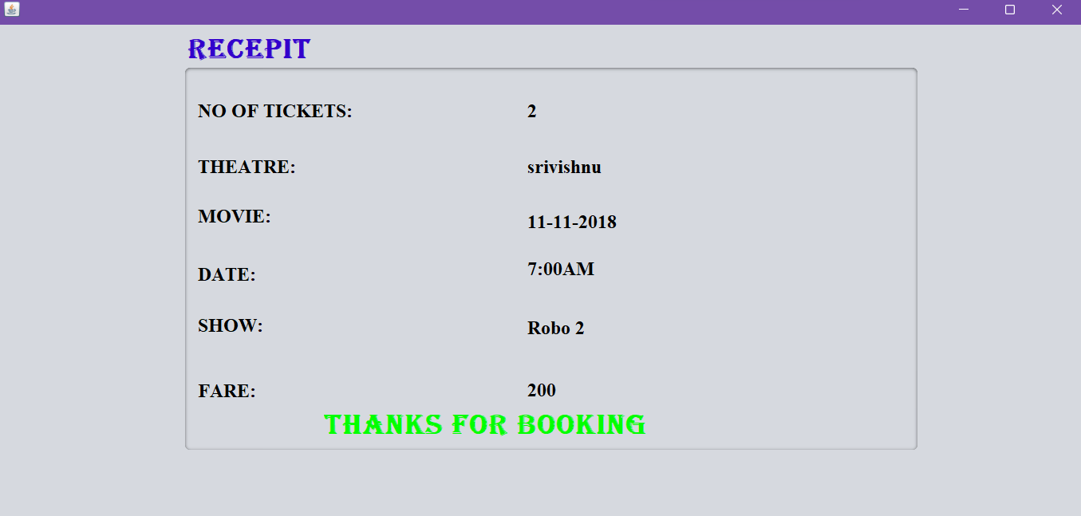
Object Oriented Analysis and Design with Java (Mini Project)
Screenshots

Slide 13
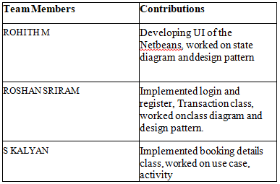
Object Oriented Analysis and Design with Java (Mini Project)
Team member contributions

Slide 14
Object Oriented Analysis and Design with Java (Mini Project)
Conclusion
So, First we login to the system with username and password that we already data has been fed into the database. Then it takes into another page where we select movie and then after we selecting movie another page comes then we select show timings. After selecting show timings it takes into another page there we select number of tickets we want. After selecting number of tickets it takes into another page there we print ticket with cost.

Slide 15
Object Oriented Analysis and Design with Java (Mini Project)
Reference
https://netbeans.apache.org/kb/docs/java-se.html
https://www.mysql.com/
https://towardsdatascience.com/10-common-software-architectural-patterns-in-a-nutshell-a0b47a1e9013

