Slide 1
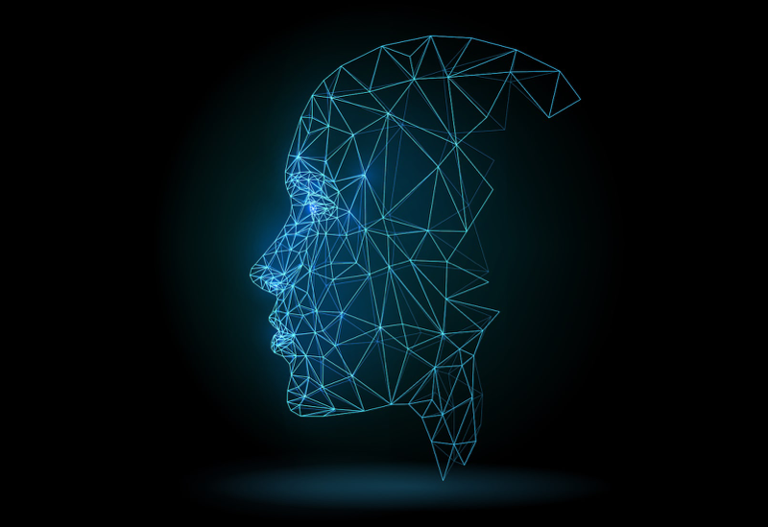
Attendance System using Face-Recognition
Project Guide
M . Rajesh Babu
Professor , CSE Department
Batch C14
R.Vamsi Krishna - Y17ACS536
Sk.Anusha - Y17ACS540
V.Anil Kumar - Y17ACS565
T.Prasannatha Babu - Y17ACS550

Slide 2
Table of Contents
Abstract
Introduction
Existing System
Proposed System
Implementation Overview
Convolutional Neural Networks
Limitations
Requirements

Slide 3
Abstract
Marking the attendance of people in a organization by using face-recognition technology

Slide 4
Introduction
Traditionally attendances are taken manually by using attendance sheet ,which is a time consuming process.
Moreover it is difficult to verify one by one student in a large classroom.
Face-recognition technology will do it by a single click and it requires less effort to take attendance.

Slide 5
Existing System
Previously attendance is taking through finger-scan.
Drawbacks :-
Consumes lot of time because one-by-one has to take attendance.
Finger print scanners are costly.

Slide 6
Proposed System
Taking attendance by using face recognition technology
Drawbacks :-
Lighting conditions will effect the accuracy of face recognition
Confusing between similar faces

Slide 7
Implementation
Training Phase :-
Image
Augmentation
Augmented Images
SVM
Face Features
FaceNet
Model

Slide 8
Implementation
Testing Phase :-
Extracted Faces
Image with group of people
Face-Detection
(MTCNN)
FaceNet
Reg-no | Attendance
Y17ACS536 | P
Y17ACS537 | A
Trained-Model
Face Features

Slide 9
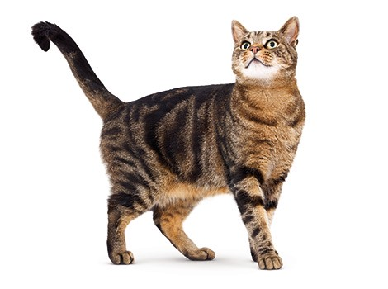
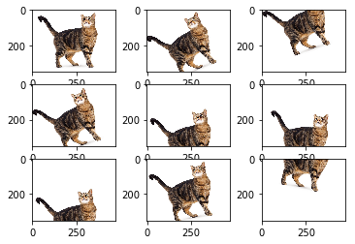
Implementation
Image Augmentation :-
Image data augmentation is a technique that can be used to artificially expand the size of a training dataset by creating modified versions of images in the dataset.
Training deep learning neural network models on more data can result in more effective models.

Slide 10
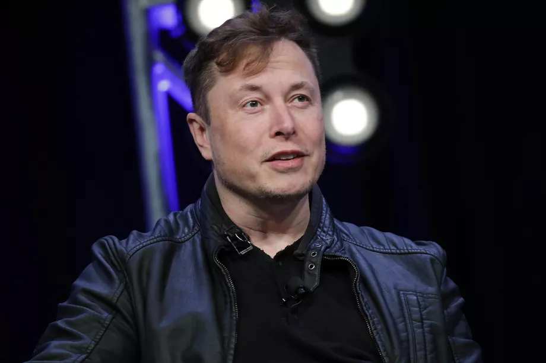
Implementation
Face Detection:-
It is a computer technology being used in a variety of applications that identifies human faces in digital images.
OpenCV is most popular library to detect faces in a image.

Slide 11
Implementation
Face Recognition :-
It is a technology capable of matching human face from a digital image against a database.
We can use a deep learning algorithm(ex:- CNN) to perform face recognition.
TensorFlow is most popular library to implement CNN.
Elon

Slide 12
Convolution Neural Networks
CNN is a type of feed-forward artificial neural network
Unlike ANN ,In CNN the neurons in one layer are connected to only some portion of neurons in another layer to decerase the time required for training.
Layers in CNN :-
Covolution Layer
ReLU Layer
Pooling Layer
Fully Connected Layer

Slide 13
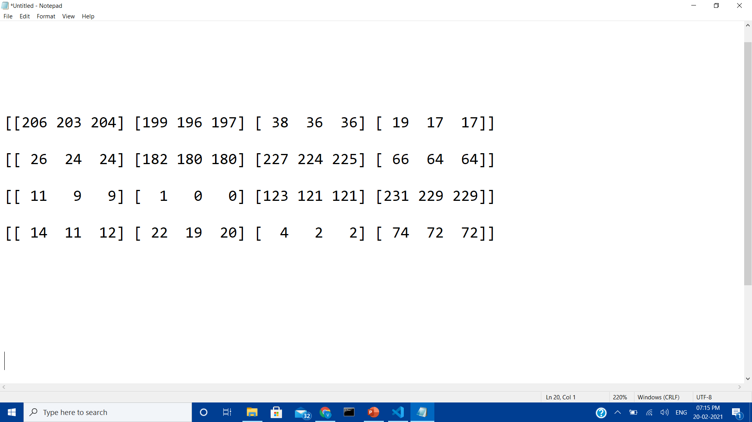

Convolution Neural Networks
Image is represented in the form of 3Dmatrix
Each pixel has 3 values RGB
But for classification we don’t need RGB colors we just need shape of object so we need to convert RGB image to Black&White
Black&White Representation Black pixel -> 1 White pixel -> -1

Slide 14
Convolution Neural Networks
Training Data
CNN
New Image
Model
Classifies the image

Slide 15
Convolution Neural Networks

Slide 16
Convolution Neural Networks

