Slide 1

Analyse International Debt Statistics
Rohith Obillaneni

Slide 2
Objective :
Creating interactive report by using World Bank’s Data to visualize and analyse the debt owed by the developing and financially unstable countries and economies.

Slide 3
Tasks of the BI Report :
Summarising World Bank's international debt data.
Finding the number of distinct countries.
Finding out the distinct debt indicators.
Totalling the amount of debt owed by the countries.
Country with the highest debt.
Average amount of debt across indicators.
The highest amounts of principal repayments.
The most common debt indicator.
Other viable debt issues and conclusion.

Slide 4
Data Info :
Sample File Name (international_debt.csv)
Length of date stamp (8 Digits)
Length of time stamp (4 Digits)
Number of Columns (5 Columns)
Column Names
Country Name
Country Code
Indicator Name
Indicator Code
Debt
Columns Data Type ( Characters)

Slide 5
Process of Creating Report
Preparing Data
Downloaded data from https://datacatalog.worldbank.org/dataset/international-debt-statistics
Imported in Power BI report.
Creating BI
Report
Creating Visualisations from Data and Measures.
Drawing out final conclusions.
Saving Report
Publishing and Saving the report in BI Service and Desktop.
Creating Measures and Renaming Column Names.

Slide 6
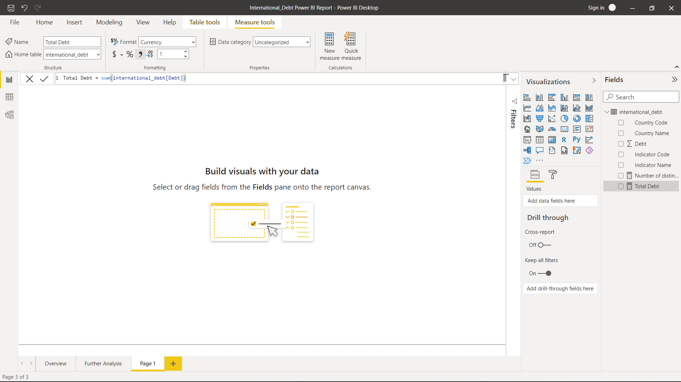
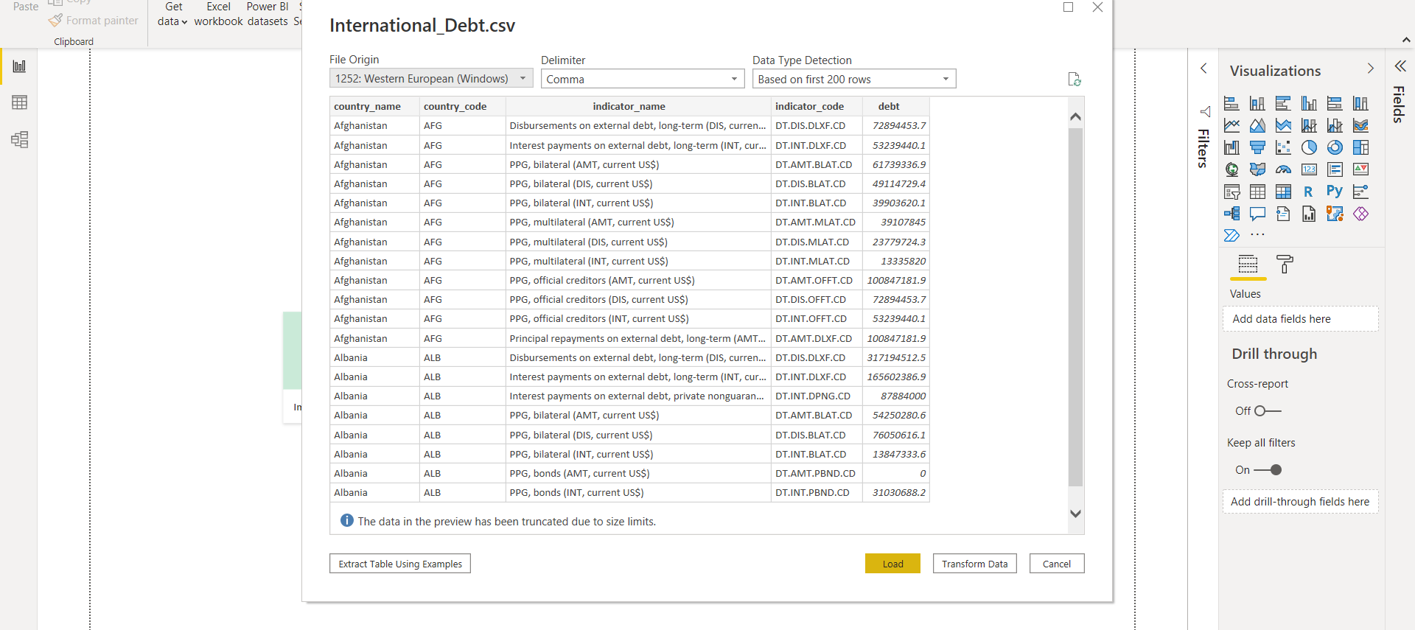
Preparing Data
First and second step, is to download the data and import it to the power query editor.
Third step, is to creating Measures and DAX Calculations.
Measures and generally created for making summary of the data.

Slide 7
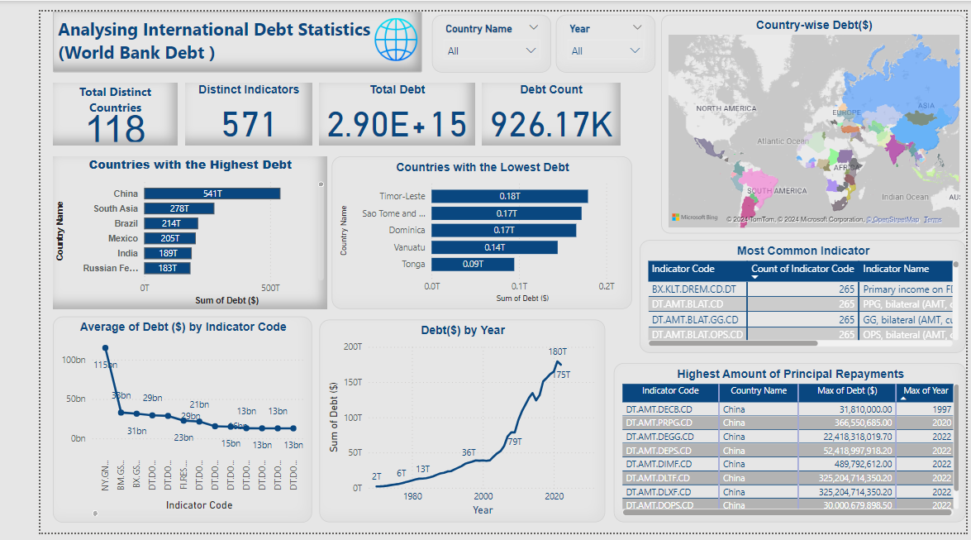
Creating BI Report
Creating Visuals using Matrix, Cards, Maps and etc,.
Filtering out some of the rows containing group of countries or Organisations.
Top N Filters are used for filtering top countries with respect to the required tables.

Slide 8
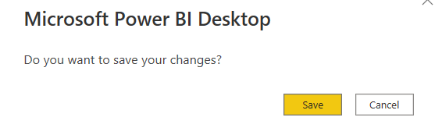
Saving Report

Slide 9

CONCLUSION
When we first take a look at the visual report, The China tops when it comes to the sum of debt. It’s probably happening because of the President Xi Jinping’s ambitious Belt and Road Strategy. For more info Xi Jinping’s Marco Polo strategy - Asia Times.
And the top 6 indicator codes have the same count when it comes to lending out the money, that explains most of the economies going through the same issue.
And the DT.AMT.DLXF.CD is one of the 6 indicators which includes repayment of long-term debts. Countries take on long-term debt to acquire immediate capital.
The major purpose could be development or making long term projects and maybe payment of long term loans.

