Slide 1

National Ticket Booking System
Presentation on,
Project
Submitted to,

Slide 2
Submitted by,
Rohit Janaba Hongekar
Roll Number - O23MCA110010
In partial fulfillment of
Master of Computer Application(MCA)
Batch - Jul 2023
Fourth Semester

Slide 3
Presentation Outline
Introduction
Objectives
Technology Platform Overview
Application Feature Overview
Implementation
Application Snapshots
Evalution
Results & Analysis
Future Scope & Improvements
Conclusion

Slide 4
Introduction
In today’s fast-paced digital world, the demand for efficient and automated systems is greater than ever, especially in public transportation. Traditional methods of booking train tickets—such as standing in long queues or relying on manual systems—are time-consuming, prone to errors, and inefficient in managing high volumes of passengers. The need for a streamlined, user-friendly, and reliable solution has led to the development of the Train Ticket Booking System.
This project is a web-based application designed to automate and simplify the process of booking train tickets. It is built using Java technologies, specifically Java Servlets for handling server-side logic, MySQL for managing backend data, and HTML/CSS for creating a clean and responsive user interface. The system enables users to register, log in, search for available trains, book and cancel tickets, and view their booking history. An admin panel is also included to manage trains, routes, and seat availability.

Slide 5
The integration of Java and MySQL ensures that the system is robust, scalable, and capable of handling multiple concurrent users while maintaining data consistency and security. The use of Servlets allows dynamic content rendering, session tracking, and efficient communication between the client and server. HTML and CSS provide a responsive design that enhances user experience across different devices.
This project not only improves the convenience and speed of booking tickets but also contributes to the broader goal of digital transformation in the transportation sector. It demonstrates the practical application of key concepts in web development and database management, making it a valuable learning experience as well as a real-world solution.

Slide 6
Objectives
The objective of the Train Ticket Booking System project is to develop a reliable, efficient, and user-friendly platform that enables passengers to search for trains, check availability, book tickets, make payments, and cancel reservations online. The system is designed to streamline the ticketing process, reduce dependency on physical counters, minimize errors, and provide real-time access to train schedules and seat availability, thereby enhancing the overall travel experience and operational efficiency of the railway network.

Slide 7
Technology Platform Overview
The Train Ticket Booking System is built on a traditional web-based architecture using Java technologies for server-side logic and MySQL for database management. The platform is designed to ensure robustness, maintainability, and a user-friendly experience.
1. Frontend (Presentation Layer)
Technologies Used: HTML5, CSS3, JavaScript (optional for client-side validation)
2. Backend (Application Logic Layer)
Technologies Used: Java, Java Servlets, JSP (JavaServer Pages)
3. Database Layer
Database: MySQL

Slide 8
4. Communication and Integration
Data Communication: Java Servlets interacting with MySQL via JDBC.
5.Deployment
Web Server: Apache Tomcat (Servlet container)
IDE: Eclipse for development
Build Tool : Apache Maven or Gradle
Deployment Format: WAR (Web Application Archive) file deployed to Tomcat server

Slide 9
Application Feature Overview
The Train Ticket Booking System is designed to automate and streamline the process of booking train tickets. It includes features for both passengers and administrators, ensuring convenience, operational efficiency, and real-time data management.
1. User Registration and Login
New users can register by providing personal details.
Existing users can log in using credentials.
Session-based user authentication and role-based access (user/admin)

Slide 10
Train Search and Schedule
Users can search for trains by entering source, destination, and travel date.
View available trains with departure/arrival times, duration, and seat availability.
Ticket Booking
Users can select a train, choose seat class, and input passenger details.
Real-time seat availability check.
System generates a unique booking ID or PNR number upon successful booking.
Payment Simulation
Simple payment gateway simulation (for academic purposes).
Booking confirmation after payment process.
Integration with real payment APIs for advanced use.

Slide 11
Booking History and Ticket Management
Users can view past and upcoming bookings.
Option to download or print e-tickets.
Ticket cancellation with refund calculation based on time and policy.
Admin Panel (For Administrator Use)
Add, update, or delete train details and schedules.
View user accounts and booking statistics.
Manage seat inventory and monitor system usage.
Responsive UI
Clean interface built with HTML and CSS.
Optimized for usability and accessibility.

Slide 12
Implementation
System Architecture
Three-Tier Architecture:
Presentation Layer (Frontend): HTML, CSS
Application Layer (Backend): Java Servlets, JSP
Data Layer: MySQL database accessed via JDBC

Slide 13
Component | Technology Used
Programming Language | Java
Web Technologies | HTML, CSS, JSP
Server-Side Framework | Java Servlets
Database | MySQL
Web Server | Apache Tomcat
Development IDE | Eclipse
Build & Deployment | WAR file for Tomcat
Module-wise Implementation
User Home - userhome.java + userhome.html
User Login - userlogin.java + userlogin.html
User Register - userregserv.java + userreg.html

Slide 14
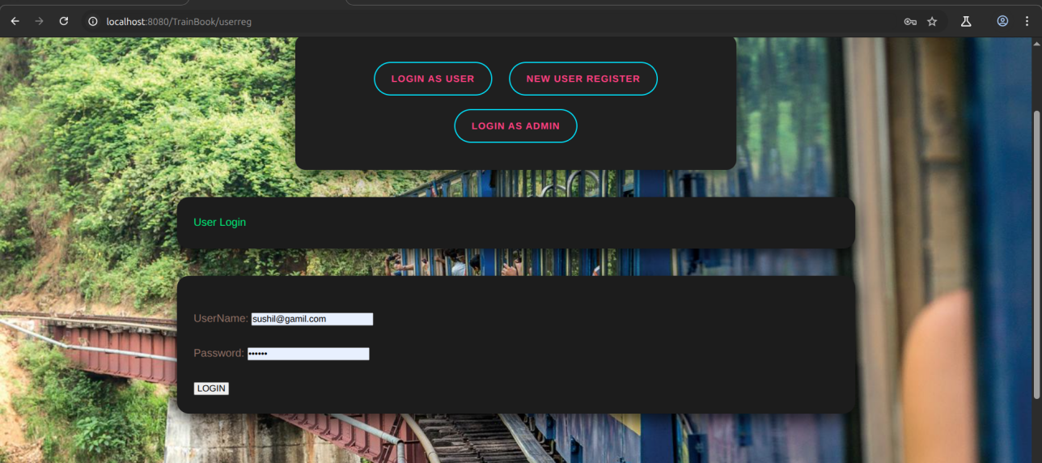
Application Snapshots
Home

Slide 15
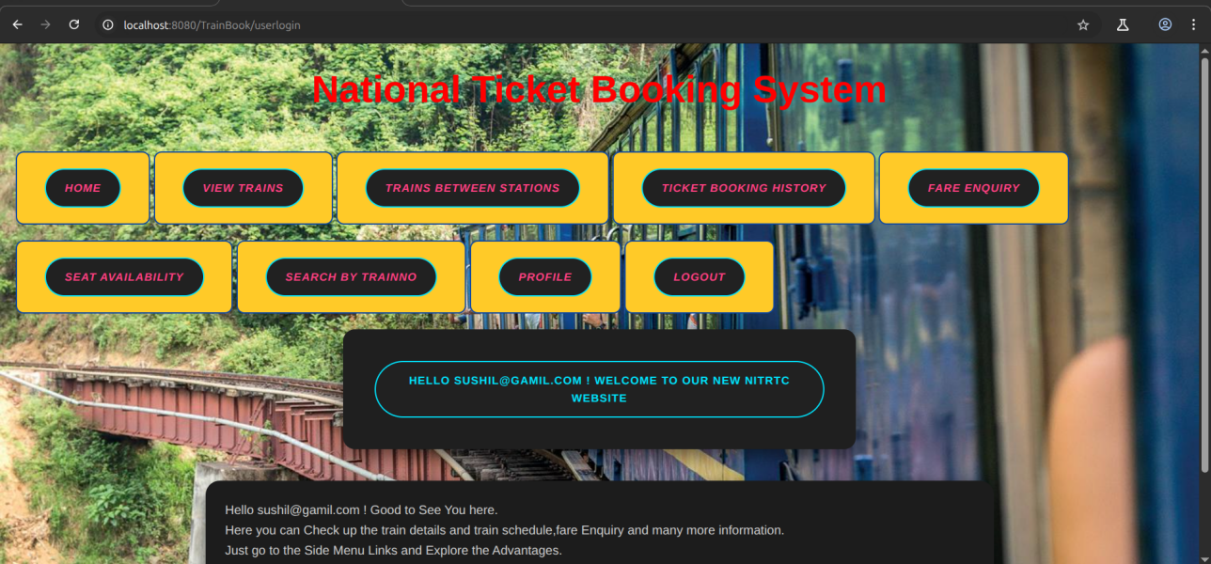
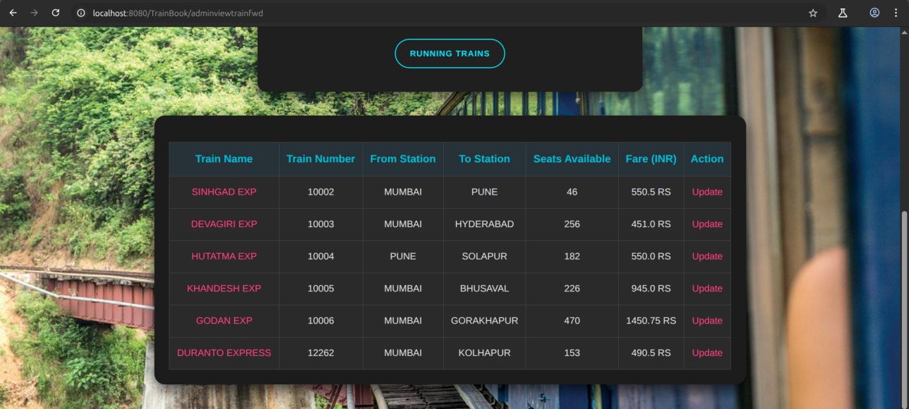

Slide 16
Evalution
The evaluation of the Train Ticket Booking System involves assessing its functionality, performance, security, user experience, and scalability. This evaluation will ensure that the system meets the specified requirements and performs effectively in a real-world environment. Below are the key areas to evaluate the system:
Functional Evaluation
a. User Functionality:
Registration & Login
Train Search & Availability
Ticket Booking & Confirmation
Admin Panel Functionality

Slide 17
Results & Analysis
System Functionality
Ticket Booking Process
Booking Confirmation
Payment Integration
User Interface (UI)
Ease of Use
Responsive Design
Performance Metrics
System Load Handling
Speed & Efficiency
Error Handling
Security Features
Feedback and User Acceptance

Slide 18
Future Scope & Improvements
Real-Time Updates: The system can be enhanced to provide real-time updates about train delays, cancellations, and seat availability.
Payment Gateway Integration: Future development could include integration with popular payment gateways (such as PayPal, Stripe) to facilitate online payments.
Mobile Application: A mobile app could be developed to complement the web version, offering even more convenience for users on the go.
Advanced Security Features: Implementing features like two-factor authentication (2FA) and enhanced encryption techniques would further improve security.

Slide 19
Conclusion
User-Friendly Interface:The application provides an intuitive and responsive design with HTML and CSS, ensuring accessibility across different devices, such as desktops and mobiles. The UI ensures that users can easily search for trains, book tickets, and view their bookings.
Dynamic & Interactive Features: Java Servlets were used to create dynamic, server-side processing, handling user requests, managing session states, and interacting with the database.
Data Management: The MySQL database ensures efficient storage and retrieval of train schedules, booking details, and user information. It provides a solid backbone for data integrity, consistency, and fast access.
Security Measures: Basic security protocols such as input validation, session management, and password protection were implemented to safeguard user data and protect the system from vulnerabilities.
Seamless Integration of Backend and Frontend: The use of Java for backend logic and HTML/CSS for frontend ensures the application is highly functional and visually appealing, with smooth interactions between the client-side and server-side components.

Slide 20
Q&A
At this stage, if you have any questions related to project forum is open for you.

