Slide 1
Data Analysis on cab service using R programming
Presented by: Rohan Gulve
Himalaya Patel
Rohith Pabbathi
Jeffray Abanilla

Slide 2
Project Summary
The idea behind this project is to analyze the cab services based on the patterns and trends
R programming can be used to find the busiest times of the day
This information can help provide a better overall service to customers during times of overload

Slide 3
R Programming and Why?
R is a language and environment for statistical computing and graphics.
R provides wide variety of statistical and graphical techniques , and is highly extensible
It is designed to seamlessly incorporate compiled code which gives you all benefits of a interactive language while allowing you to capitalize on the speed of compiled code

Slide 4
Benefits of R programming
An effective data handling and storage facility
A large , coherent , integrated collection of
Intermediate tools for data analysis
Graphical facilities for data analysis and
Display either on-screen

Slide 5
Dataset includes
Each individual trip record contains:
Transaction ID
Pick-up and drop-off locations
Days
Booking Time
Date
Car type

Slide 6
Technology Used
Data Cleaning: R-Studio for Data Analysis
CSV file for Data Storage

Slide 7
Approach
Increase the number of vehicles based on traffic
Increase the number of drivers based on traffic
Discounts: Coupons / Free rides

Slide 8
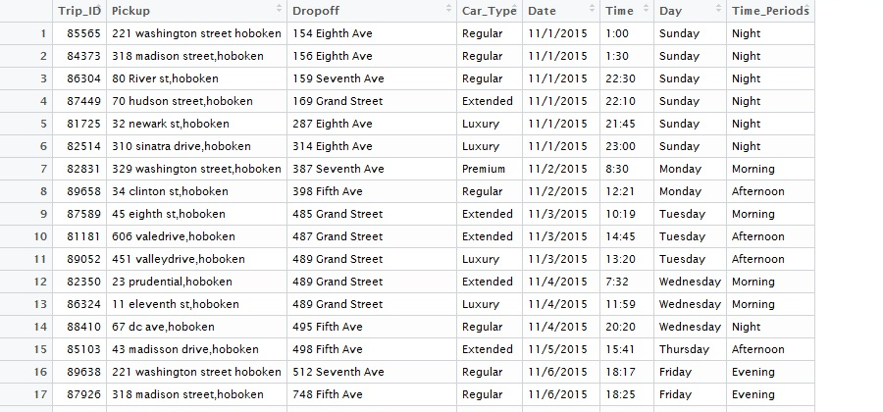
Sample of Hoboken Dataset

Slide 9
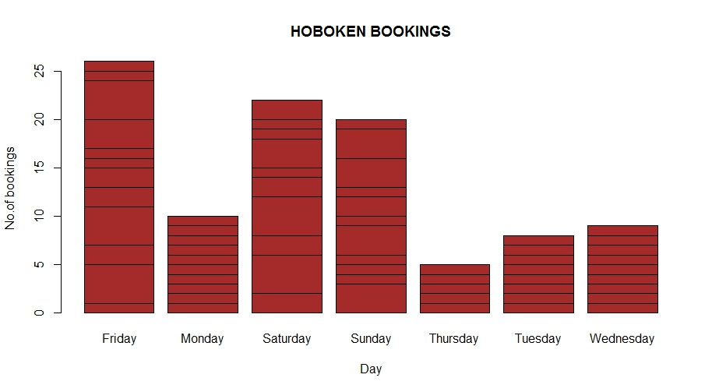
Graphical Analysis of Hoboken

Slide 10
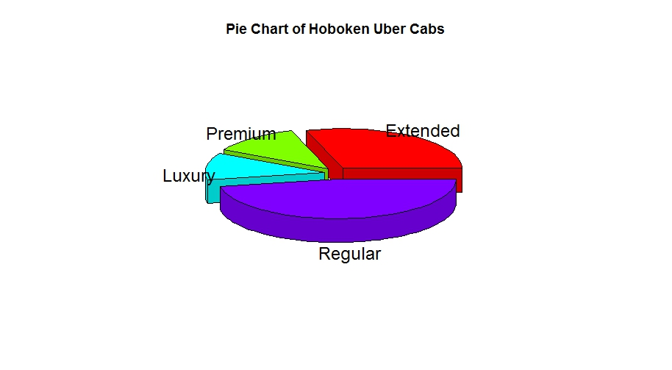
Graphical Analysis of Hoboken

Slide 11
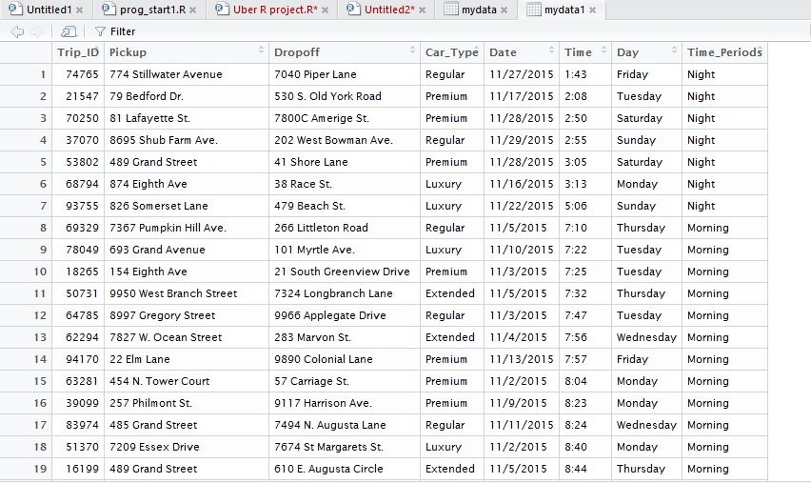
Sample of Manhattan Dataset

Slide 12
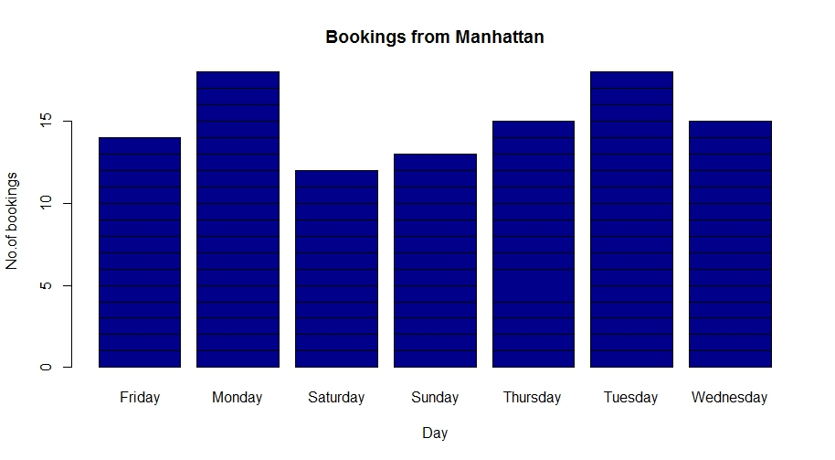
Graphical Analysis of Manhattan

Slide 13
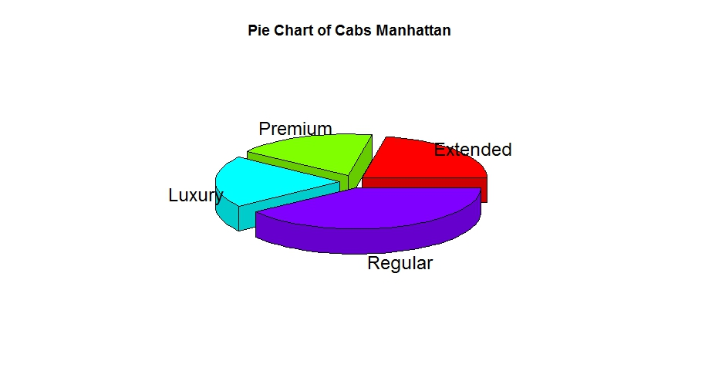
Graphical Analysis of Manhattan

Slide 14
Conclusions from Graphs
At Hoboken: More number of cab requests during the weekend
At Manhattan: More number of cab requests during the weekdays

Slide 15
Analysis from Patterns
At Hoboken:
Due to the night life in Hoboken, the number of requests were more on the weekends as compared to the weekdays
At Manhattan:
Due to the corporate hub, Manhattan has a completely opposite pattern of bookings than at Hoboken.

Slide 16
How To Improve Services
Allocate more cabs to Hoboken during weekend nights
Allocate more cabs to Manhattan during rush hour in weekdays
Provide discounts to users where cab request intensity is low
Fare hike to users where cab request intensity is high

