Slide 1
HOME AUTOMATION USING MOBILE
BY
U Amith Sai 2451-12-733-044
T Sai Kiran 2451-12-733-028
P.V.K Rohith 2451-12-733-045
GUIDE:G Vijay Kumar

Slide 2
What is Home Automation?
Home automation (also known as domotics) refers to the automatic and electronic control of household features, activity, and appliances. Various control systems are utilized in this residential extension of building automation.
Home automation gives you access to control devices in your home from a mobile device anywhere in the world.
Some devices that can be controlled are lights,fans,Air conditioner ,TV etc.
From Home security perspective, this also includes alarm system and all of the doors , windows , locks etc.
This comes under the field “Internet of Things”(IOT).

Slide 3
Internet of things
The Internet of Things (IoT) is the network of physical objects or"things" embedded with electronics, software, sensors, and network connectivity, which enables these objects to collect and exchange data.^{[1]} The Internet of Things allows objects to be sensed and controlled remotely across existing network infrastructure,^{[2]} creating opportunities for more direct integration between the physical world and computer-based systems, and resulting efficiency, accuracy and economic benefit.

Slide 4
Requirements
The basic requirements for developing this system are
Mobile Phone
Arduino Board
GSM SIM300 module
Arduino software

Slide 5
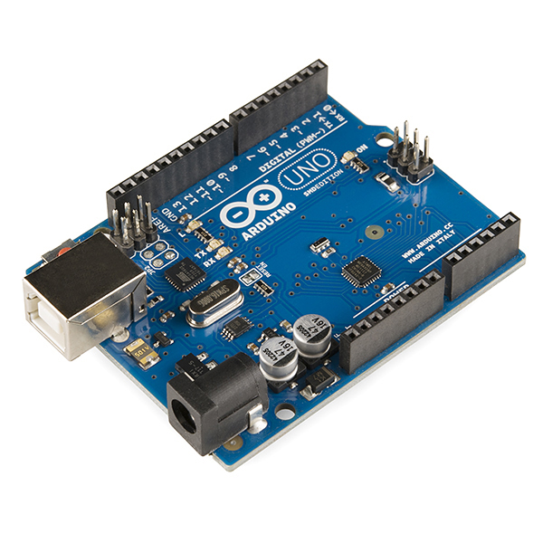
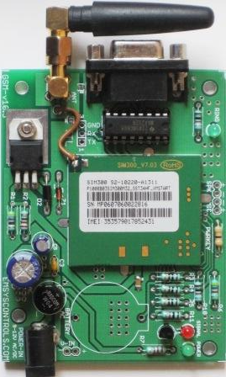
Ardunio and GSM SIM300

Slide 6
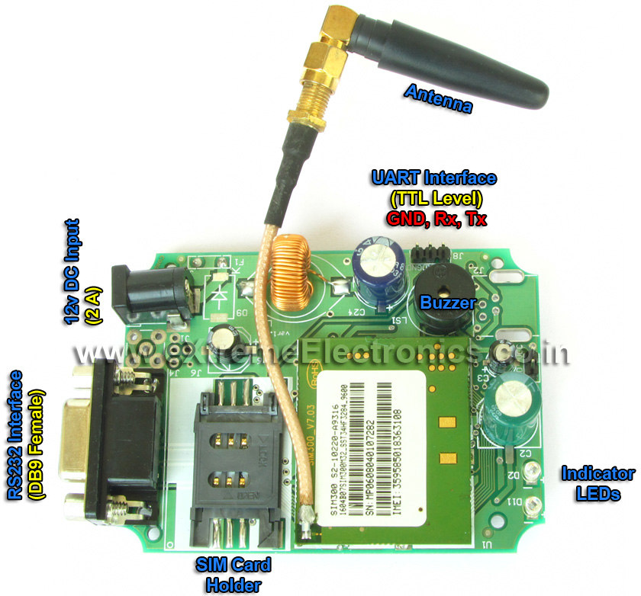
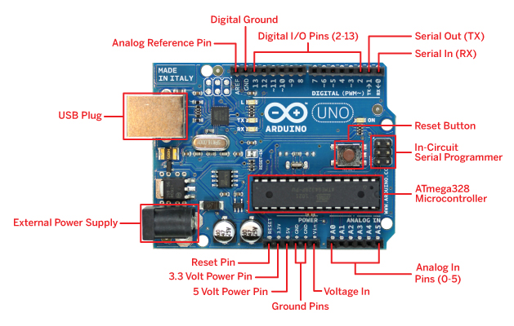
GSM module and Arduino components

Slide 7
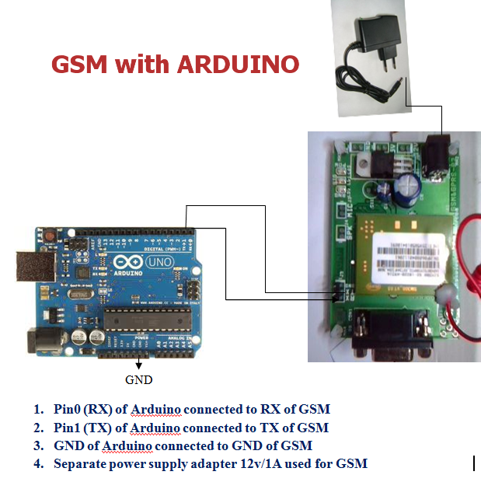

Slide 8
How does it work?
First we need to insert a activated SIM card into GSM module
When the user dials to that number gsm module will get activated and is responsible for sending and receiving signals.
Arduino board which is the heart of the system will receive signals from gsm module and control the appliances connected to it.

Slide 9
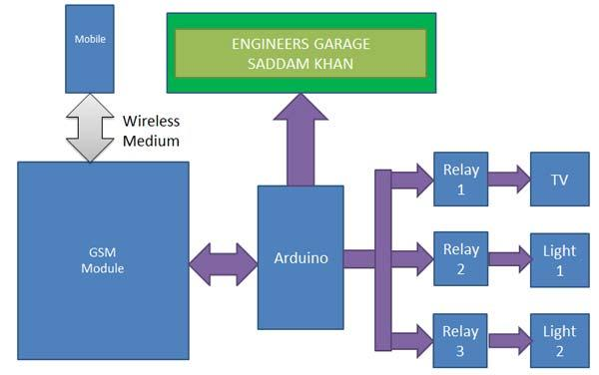
Block Diagram

Slide 10
Applications
Lighting control
HVAC
Outdoor Lawn irrigation
Kitchen appliances
Security Systems

Slide 11
Uses
Convenience
Low energy consumption
Wireless Home Security
It saves lot of time
This will contribute to economy with its low cost
Increases awareness and reduces Physical work.

Slide 12
THANK YOU

