Slide 1

Using Recursion
© 2010 Goodrich, Tamassia
Using Recursion
Notes:
Sequences

Slide 2
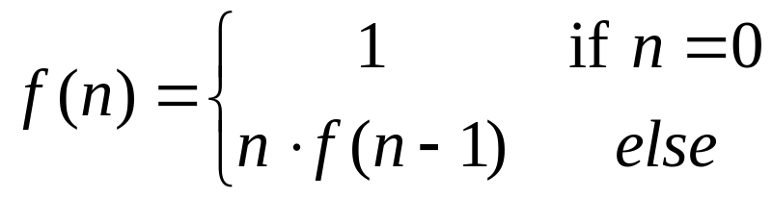
The Recursion Pattern
Recursion: when a method calls itself
Classic example--the factorial function:
  n! = 1· 2· 3· ··· · (n-1)· n
Recursive definition:
As a C++ method:
  // recursive factorial function
  recursiveFactorial( n)
  if (n == 0) return 1; // basis case
  else return n * recursiveFactorial(n- 1); // recursive case
© 2010 Goodrich, Tamassia
Using Recursion

Slide 3
Linear Recursion
Test for base cases
  Begin by testing for a set of base cases (there should be at least one).
  Every possible chain of recursive calls must eventually reach a base case, and the handling of each base case should not use recursion.
Recur once
  Perform a single recursive call
  This step may have a test that decides which of several possible recursive calls to make, but it should ultimately make just one of these calls
  Define each possible recursive call so that it makes progress towards a base case.
© 2010 Goodrich, Tamassia
Using Recursion

Slide 4
Example of Linear Recursion
Example recursion trace:
Algorithm LinearSum(A, n):
Input:
A integer array A and an integer n = 1, such that A has at least n elements
Output:
The sum of the first n integers in A
if n = 1 then
return A[0]
else
return LinearSum(A, n - 1) + A[n - 1]
call
return
15
+
A
[
4
] =
15
+
5
=
20
LinearSum
(
A
,
5
)
call
return
13
+
A
[
3
] =
13
+
2
=
15
LinearSum
(
A
,
4
)
call
return
7
+
A
[
2
] =
7
+
6
=
13
LinearSum
(
A
,
3
)
call
return
4
+
A
[
1
] =
4
+
3
=
7
LinearSum
(
A
,
2
)
call
return
A
[
0
] =
4
LinearSum
(
A
,
1
)
© 2010 Goodrich, Tamassia
Using Recursion

Slide 5
Reversing an Array
Algorithm ReverseArray(A, i, j):
Input: An array A and nonnegative integer indices i and j
Output: The reversal of the elements in A starting at index i and ending at j
if i < j then
Swap A[i] and A[ j]
ReverseArray(A, i + 1, j - 1)
return
© 2010 Goodrich, Tamassia
Using Recursion

Slide 6
Defining Arguments for Recursion
In creating recursive methods, it is important to define the methods in ways that facilitate recursion.
This sometimes requires we define additional paramaters that are passed to the method.
For example, we defined the array reversal method as ReverseArray(A, i, j), not ReverseArray(A).
© 2010 Goodrich, Tamassia
Using Recursion

Slide 7
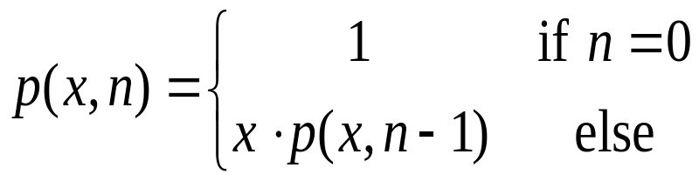
Computing Powers
The power function, p(x,n)=x^{n}, can be defined recursively:
This leads to an power function that runs in O(n) time (for we make n recursive calls).
We can do better than this, however.
© 2010 Goodrich, Tamassia
Using Recursion

Slide 8
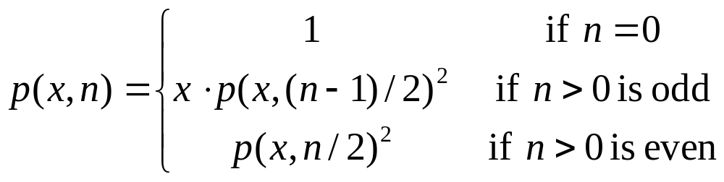
Recursive Squaring
We can derive a more efficient linearly recursive algorithm by using repeated squaring:
For example,
  2⁴ = 2^{(4/2)2} = (2^{4/2})² = (2²)² = 4² = 16
  2⁵ = 2^{1+(4/2)2} = 2(2^{4/2})² = 2(2²)² = 2(4²) = 32
  2⁶ = 2^{(6/ 2)2} = (2^{6/2})² = (2³)² = 8² = 64
  2⁷ = 2^{1+(6/2)2} = 2(2^{6/2})² = 2(2³)² = 2(8²) = 128.
© 2010 Goodrich, Tamassia
Using Recursion

Slide 9
Recursive Squaring Method
Algorithm Power(x, n):
Input: A number x and integer n = 0
Output: The value x^{n}
if n = 0 then
return 1
if n is odd then
y = Power(x, (n - 1)/ 2)
return x · y ·y
else
y = Power(x, n/ 2)
return y · y
© 2010 Goodrich, Tamassia
Using Recursion

Slide 10
Analysis
Algorithm Power(x, n):
Input: A number x and integer n = 0
Output: The value x^{n}
if n = 0 then
return 1
if n is odd then
y = Power(x, (n - 1)/ 2)
return x · y · y
else
y = Power(x, n/ 2)
return y · y
Each time we make a recursive call we halve the value of n; hence, we make log n recursive calls. That is, this method runs in O(log n) time.
It is important that we use a variable twice here rather than calling the method twice.
© 2010 Goodrich, Tamassia
Using Recursion

Slide 11
Tail Recursion
Tail recursion occurs when a linearly recursive method makes its recursive call as its last step.
The array reversal method is an example.
Such methods can be easily converted to non-recursive methods (which saves on some resources).
Example:
  Algorithm IterativeReverseArray(A, i, j ):
  Input: An array A and nonnegative integer indices i and j
  Output: The reversal of the elements in A starting at index i and ending at j
  while i < j do
    Swap A[i ] and A[ j ]
    i = i + 1
    j = j - 1
  return
© 2010 Goodrich, Tamassia
Using Recursion

Slide 12
Another Binary Recusive Method
Problem: add all the numbers in an integer array A:
  Algorithm BinarySum(A, i, n):
  Input: An array A and integers i and n
  Output: The sum of the n integers in A starting at index i
  if n = 1 then
  return A[i ]
  return BinarySum(A, i, n/ 2) + BinarySum(A, i + n/ 2, n/ 2)
Example trace:
0
,
8
0
,
4
4
,
4
0
,
2
2
,
2
4
,
2
6
,
2
0
,
1
1
,
1
2
,
1
3
,
1
4
,
1
5
,
1
6
,
1
7
,
1
© 2010 Goodrich, Tamassia
Using Recursion

Slide 13
Computing Fibonacci Numbers
Fibonacci numbers are defined recursively:
    F₀ = 0
    F₁ = 1
    F_{i} = F_{i-1} ⁺ F_{i-2} for i > 1.
Recursive algorithm (first attempt):
      Algorithm BinaryFib(k):
      Input: Nonnegative integer k
      Output: The kth Fibonacci number F_{k}
      _{if K = 0 then return} 0
      if k = 1 then return 1
      else
      return BinaryFib(k - 1) + BinaryFib(k - 2)
© 2010 Goodrich, Tamassia
Using Recursion

Slide 14
Analysis
Let n_{k} be the number of recursive calls by BinaryFib(k)
  n₀ = 1
  n₁ = 1
  n₂ = n₁ + n₀ + 1 = 1 + 1 + 1 = 3
  n₃ = n₂ + n₁ + 1 = 3 + 1 + 1 = 5
  n₄ = n₃ + n₂ + 1 = 5 + 3 + 1 = 9
  n₅ = n₄ + n₃ + 1 = 9 + 5 + 1 = 15
  n₆ = n₅ + n₄ + 1 = 15 + 9 + 1 = 25
  n₇ = n₆ + n₅ + 1 = 25 + 15 + 1 = 41
  n₈ = n₇ + n₆ + 1 = 41 + 25 + 1 = 67.
Note that n_{k} at least doubles every other time
That is, n_{k} > 2^{k/2}. It is exponential!
© 2010 Goodrich, Tamassia
Using Recursion

Slide 15
Analysis
  T(N) = T(N-1) + T(N-2) + 1
  = [T(N-2)+T(N-3)+1]+[T(N-3)+T(N-4)+1]+1
  = T(N-2) + T(N-3) + T(N-3) + T(N-4) + 3
  If we repeat the recurrence, we're going to get 8 T's on level 3. Then 16, 32, and so on...
  So we get 2^k T's at level k.
  To get down T(N-1) to the base case T(2), we'll need to go to level k = N-2.
  We'll have 2^N-2 T's there, so T(N) = O(2^N).
© 2010 Goodrich, Tamassia
Using Recursion

Slide 16
GCD
  Function definition:
  gcd(x,y) = x, if y = 0
  = gcd(y, reminder(x,y)) if y > 0
  function gcd is:
  input: integer x, integer y such that x >= y and y >= 0
  1. if y is 0, return x
  2. otherwise, return [ gcd( y, (remainder of x/y) ) ]
  end gcd
© 2010 Goodrich, Tamassia
Using Recursion

Slide 17
GCD Analysis
  To see why notice that: GCD(a,b) = GCD(b,a mod b) = GCD(a mod b, b mod (a mod b)). Now since a mod b = r such that a = bq + r, it follows that r<b, so a>2r. So every two iterations, the larger number is reduced by a factor of 2 (at least) so there are at most O(lgn) iterations.
© 2010 Goodrich, Tamassia
Using Recursion

Slide 18
Examples- Recursion
void myFunction( int counter)
{
cout<<"hello"<<counter<<endl;
if ( counter ==0 ) {
myFunction(--counter);
cout<<counter<<endl;
}
return;
}
Linked Lists

Slide 19
Examples- Recursion 1
What will it do if Counter is 8 ?
What will it do if counter is set to -8 ?
  What to do about it ?
Linked Lists

Slide 20
Examples- Recursion 2
Write a recursive program to find prime number.
The main is as follows:
int main(int argc, char** argv) {
int b;
int n;
n = 13;
b = isPrime(n,2);
cout << b << '\n';
return 0;
}
Linked Lists

Slide 21
isPrime(n, p ) {
if ( n == p ) { return true; }
if ( n % p == 0 ) { return false }
return( isPrime(n, p+1) );
}
Linked Lists

Slide 22
Examples- Recursion 2
bool isPrime(int p, int i) {
if (I == p) return 1; //or better if (i*i>p) return 1;
if (p % i == 0) return 0;
return isPrime(p, i + 1);
}
Linked Lists

Slide 23
Exercise - Recursion 3
Write a recursive program to find if a string is palindrome or not ?
The main is as follows:
int main() {
cout << "Enter a string: ";
char str[20];
cin.getline(str, 20, '\n');
cout << "The entered string " << ((palindrome(str, strlen(str) + 1)) ? "is" : "is not") << " a Palindrome string." << endl;
return 0;
}
Linked Lists

Slide 24
Examples- Recursion 3
Linked Lists

