Slide 1
Directed Graphs
BOS
ORD
JFK
SFO
DFW
LAX
MIA
Directed Graphs
Notes:
Shortest Path

Slide 2
Digraphs
A digraph is a graph whose edges are all directed
  Short for “directed graph”
Applications
  one-way streets
  flights
  task scheduling
E
D
C
B
A
Directed Graphs

Slide 3
Digraph Properties
E
D
C
A graph G=(V,E) such that
  Each edge goes in one direction:
  Edge (a,b) goes from a to b, but not b to a
If G is simple, m < n⋅(n − 1)
If we keep in-edges and out-edges in separate adjacency lists, we can perform listing of incoming edges and outgoing edges in time proportional to their size
B
A
Directed Graphs

Slide 4
Digraph Application
Scheduling: edge (a,b) means task a must be completed before b can be started
ics21
ics22
ics23
ics51
ics53
ics52
ics161
ics131
ics141
ics121
ics171
The good life
ics151
Directed Graphs

Slide 5
Directed DFS
We can specialize the traversal algorithms (DFS and BFS) to digraphs by traversing edges only along their direction
In the directed DFS algorithm, we have four types of edges
  discovery edges
  back edges
  forward edges
  cross edges
A directed DFS starting at a vertex s determines the vertices reachable from s
E
D
C
B
A
Directed Graphs

Slide 6
Directed DFS
Back edge (v,w)
  w is an ancestor of v in the tree of discovery edges
Forward edge (v,w)
  v is an ancestor (but not the parent) of w in the tree of discovery edges
E
D
Cross edge (v,w)
  w is in the same level as v or in the next level in the tree of discovery edges
Discovery edge (v,w)
  v is the parent of w in the tree of discovery edges
C
B
A
Directed Graphs

Slide 7

Reachability
DFS tree rooted at v: vertices reachable from v via directed paths
E
D
E
D
C
A
C
F
E
D
A
B
C
F
A
B
Directed Graphs

Slide 8
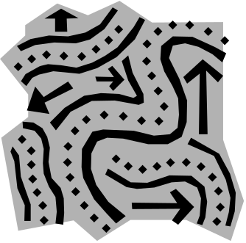
Strong Connectivity
Each vertex can reach all other vertices
a
g
c
d
e
b
f
Directed Graphs

Slide 9
Strong Connectivity
How do you determine if a digraph is strongly connected ?
a
g
c
d
e
b
f
Directed Graphs

Slide 10
Strong Connectivity Algorithm
Pick a vertex v in G
Perform a DFS from v in G
  If there’s a w not visited, print “no”
Let G’ be G with edges reversed
Perform a DFS from v in G’
  If there’s a w not visited, print “no”
  Else, print “yes”
Running time: O(n+m)
Transpose of Graph G
G:
a
c
g
d
e
f
b
a
G’:
c
g
d
e
f
b
Directed Graphs

Slide 11
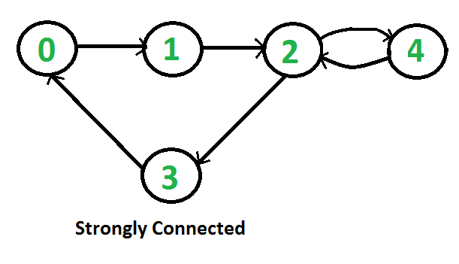
Graph connectivity
Strongly
Directed Graphs

Slide 12
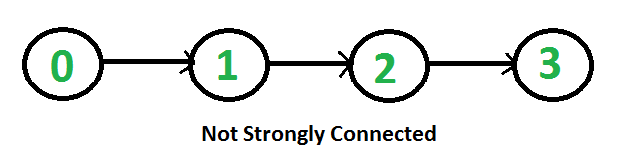
Graph connectivity
Strongly
Directed Graphs

Slide 13

Strongly Connected Components
Maximal subgraphs such that each vertex can reach all other vertices in the subgraph
Can also be done in O(n+m) time using DFS, but is more complicated (similar to biconnectivity).
a
g
{ a , c , g }
c
d
e
{ f , d , e , b }
f
b
Directed Graphs

Slide 14
Transitive Closure
Given a digraph G, the transitive closure of G is the digraph G* such that
  G* has the same vertices as G
  if G has a directed path from u to v (u ≠ v), G* has a directed edge from u to v
The transitive closure provides reachability information about a digraph
D
E
B
G
C
A
D
E
B
C
A
G*
Directed Graphs

Slide 15

Computing the Transitive Closure
If there's a way to get from A to B and from B to C, then there's a way to get from A to C.
We can perform DFS starting at each vertex
  O(n(n+m))
Alternatively ... Use dynamic programming: The Floyd-Warshall Algorithm
Directed Graphs

Slide 16
Floyd-Warshall Transitive Closure
Idea #1: Number the vertices 1, 2, …, n.
Idea #2: Consider paths that use only vertices numbered 1, 2, …, k, as intermediate vertices:
Uses only vertices numbered 1,…,k
(add this edge if it’s not already in)
i
j
Uses only vertices
numbered 1,…,k-1
Uses only vertices
numbered 1,…,k-1
k
Directed Graphs

Slide 17
Floyd-Warshall’s Algorithm
Number vertices v₁ , …, v_{n}
Compute digraphs G₀, …, G_{n}
  G₀=G
  G_{k} has directed edge (v_{i}, v_{j}) if G has a directed path from v_{i} to v_{j} with intermediate vertices in
  {v₁ , …, v_{k}}
We have that G_{n} = G*
In phase k, digraph G_{k} is computed from G_{k − 1}
Running time: O(n³), assuming areAdjacent is O(1) (e.g., adjacency matrix)
Algorithm FloydWarshall(G)
Input digraph G
Output transitive closure G* of G
i ← 1
for all v ∈ G.vertices()
denote v as v_{i}
i ← i + 1
G₀ ← G
for k ← 1 to n do
G_{k} ← G_{k − 1}
for i ← 1 to n (i ≠ k) do
for j ← 1 to n (j ≠ i, k) do
if G_{k − 1}.areAdjacent(v_{i}, v_{k}) ∧
G_{k − 1}.areAdjacent(v_{k}, v_{j})
if ¬G_{k}.areAdjacent(v_{i}, v_{j})
G_{k}.insertDirectedEdge(v_{i}, v_{j} , k)
return G_{n}
Directed Graphs

Slide 18

Floyd-Warshall Example
BOS
ORD
v
4
JFK
v
2
v
6
SFO
DFW
LAX
v
v
3
1
MIA
v
5
Directed Graphs

Slide 19
Floyd-Warshall, Iteration 1
BOS
ORD
v
4
JFK
v
2
v
6
SFO
DFW
LAX
v
v
3
1
MIA
v
5
Directed Graphs

Slide 20
Floyd-Warshall, Iteration 2
BOS
ORD
v
4
JFK
v
2
v
6
SFO
DFW
LAX
v
v
3
1
MIA
v
5
Directed Graphs

Slide 21
Floyd-Warshall, Iteration 3
BOS
ORD
v
4
JFK
v
2
v
6
SFO
DFW
LAX
v
v
3
1
MIA
v
5
Directed Graphs

Slide 22
Floyd-Warshall, Iteration 4
BOS
ORD
v
4
JFK
v
2
v
6
SFO
DFW
LAX
v
v
3
1
MIA
v
5
Directed Graphs

Slide 23
Floyd-Warshall, Iteration 5
BOS
ORD
v
4
JFK
v
2
v
6
SFO
DFW
LAX
v
v
3
1
MIA
v
5
Directed Graphs

Slide 24
Floyd-Warshall, Iteration 6
BOS
ORD
v
4
JFK
v
2
v
6
SFO
DFW
LAX
v
v
3
1
MIA
v
5
Directed Graphs

Slide 25
Floyd-Warshall, Conclusion
BOS
ORD
v
4
JFK
v
2
v
6
SFO
DFW
LAX
v
v
3
1
MIA
v
5
Directed Graphs

Slide 26
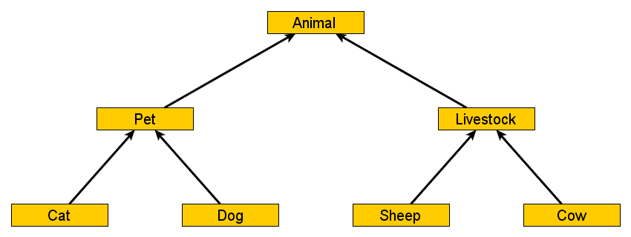
Transitive closure
Directed Graphs

Slide 27
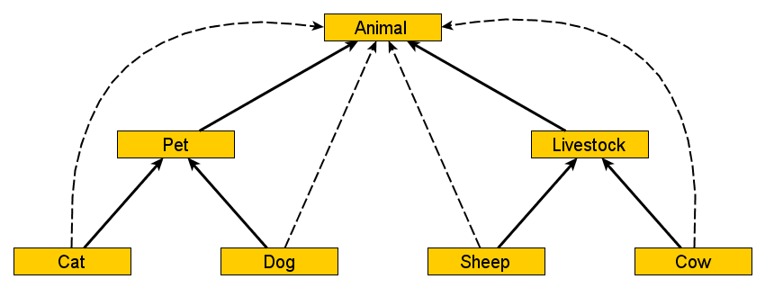
Transitive closure
Directed Graphs

Slide 28
Transitive closure
3
1
4
2
Directed Graphs

Slide 29
Transitive closure
3
1
4
2
Directed Graphs

Slide 30
DAGs and Topological Ordering
D
E
A directed acyclic graph (DAG) is a digraph that has no directed cycles
A topological ordering of a digraph is a numbering
v₁ , …, v_{n}
of the vertices such that for every edge (v_{i} , v_{j}), we have i < j
Example: in a task scheduling digraph, a topological ordering a task sequence that satisfies the precedence constraints
Theorem
A digraph admits a topological ordering if and only if it is a DAG
B
C
A
DAG G
v₄
v₅
D
E
v₂
B
v₃
v₁
C
Topological ordering of G
A
Directed Graphs

Slide 31

Topological Sorting
Number vertices, so that (u,v) in E implies u < v
wake up
1
A typical student day
2
3
eat
study computer sci.
4
5
nap
more c.s.
7
play
8
write c.s. program
6
9
work out
bake cookies
10
sleep
11
dream about graphs
Directed Graphs

Slide 32
Algorithm for Topological Sorting
Note: This algorithm is different than the one in the book
Running time: O(n + m)
Algorithm TopologicalSort(G)
H ← G // Temporary copy of G
n ← G.numVertices()
while H is not empty do
Let v be a vertex with no outgoing edges
Label v ← n
n ← n − 1
Remove v from H
Directed Graphs

Slide 33
Implementation with DFS
Simulate the algorithm by using depth-first search
O(n+m) time.
Algorithm topologicalDFS(G, v)
Input graph G and a start vertex v of G
Output labeling of the vertices of G
in the connected component of v
v.setLabel(VISITED)
  for all e ∈ v.outEdges()
  { outgoing edges }
  w ← e.opposite(v)
  if w.getLabel() = UNEXPLORED
  { e is a discovery edge }
  topologicalDFS(G, w)
  else
  { e is a forward or cross edge }
  Label v with topological number n
  n ← n - 1
Algorithm topologicalDFS(G)
Input dag G
Output topological ordering of G
n ← G.numVertices()
  for all u ∈ G.vertices()
  u.setLabel(UNEXPLORED)
  for all v ∈ G.vertices()
  if v.getLabel() = UNEXPLORED
  topologicalDFS(G, v)
Directed Graphs

Slide 34
Topological Sort Algorithm
We can use a DFS in our algorithm to determine a topological sort!
  The idea is:
    When you do a DFS on a directed acyclic graph, eventually you will reach a node with no outgoing edges. Why?
      Because if this never happened, you hit a cycle, because the number of nodes if finite.
    This node that you reach in a DFS is “safe” to place at the end of the topological sort.
      Think of leaving for work!
  Now what we find is
    If we have added each of the vertices “below” a vertex into our topological sort, it is safe then to add this one in.
      If we added in Leaving for work at the end, then we can surely add taking a shower.

Slide 35
Topological Sorting Example
Directed Graphs

Slide 36
Topological Sorting Example
9
Directed Graphs

Slide 37
Topological Sorting Example
8
9
Directed Graphs

Slide 38
Topological Sorting Example
7
8
9
Directed Graphs

Slide 39
Topological Sorting Example
6
7
8
9
Directed Graphs

Slide 40
Topological Sorting Example
6
5
7
8
9
Directed Graphs

Slide 41
Topological Sorting Example
4
6
5
7
8
9
Directed Graphs

Slide 42
Topological Sorting Example
3
4
6
5
7
8
9
Directed Graphs

Slide 43
Topological Sorting Example
2
3
4
6
5
7
8
9
Directed Graphs

Slide 44
Topological Sorting Example
2
1
3
4
6
5
7
8
9
Directed Graphs

Slide 45
Topological Sort: DFS
C
G
A
B
D
E
F
H

Slide 46
Topological Sort: DFS
C
dfs(A)
G
A
B
D
E
F
H

Slide 47
Topological Sort: DFS
C
dfs(A)
dfs(D)
G
A
B
D
E
F
H

Slide 48
Topological Sort: DFS
C
dfs(A)
dfs(D)
dfs(E)
G
A
B
D
E
F
H

Slide 49
Topological Sort: DFS
C
dfs(A)
dfs(D)
dfs(E)
dfs(F)
G
A
B
D
E
F
H

Slide 50
Topological Sort: DFS
C
dfs(A)
dfs(D)
dfs(E)
dfs(F)
dfs(H)
G
A
B
D
E
F
H

Slide 51
Topological Sort: DFS
C
dfs(A)
dfs(D)
dfs(E)
dfs(F)
G
A
B
D
E
F
H
7

Slide 52
Topological Sort: DFS
C
dfs(A)
dfs(D)
dfs(E)
G
A
B
D
E
F
6
H
7

Slide 53
Topological Sort: DFS
C
dfs(A)
dfs(D)
G
A
B
D
E
5
F
6
H
7

Slide 54
Topological Sort: DFS
C
dfs(A)
dfs(D)
G
A
B
D
E
5
F
6
H
7

Slide 55
Topological Sort: DFS
C
dfs(A)
G
A
B
D
E
4
5
F
6
H
7

Slide 56
Topological Sort: DFS
C
dfs(A)
G
A
B
D
E
4
5
F
6
H
7

Slide 57
Topological Sort: DFS
C
G
A
3
B
D
E
4
5
F
6
H
7

Slide 58
Topological Sort: DFS
C
dfs(B)
G
A
3
B
D
E
4
5
F
6
H
7

Slide 59
Topological Sort: DFS
C
dfs(B)
G
A
3
B
D
E
4
5
F
6
H
7

Slide 60
Topological Sort: DFS
C
G
A
3
B
2
D
E
4
5
F
6
H
7

Slide 61
Topological Sort: DFS
C
dfs(C)
G
A
3
B
2
D
E
4
5
F
6
H
7

Slide 62
Topological Sort: DFS
C
dfs(C)
G
A
3
B
2
D
E
4
5
F
6
H
7

Slide 63
Topological Sort: DFS
C
dfs(C)
G
A
3
B
2
D
E
4
5
F
6
H
7

Slide 64
Topological Sort: DFS
C
dfs(C)
G
A
3
B
2
D
E
4
5
F
6
H
7

Slide 65
Topological Sort: DFS
C
dfs(C)
dfs(G)
G
A
3
B
2
D
E
4
5
F
6
H
7

Slide 66
Topological Sort: DFS
C
dfs(C)
G
1
A
3
B
2
D
E
4
5
F
6
H
7

Slide 67
Topological Sort: DFS
0
C
G
1
A
3
B
2
D
E
4
5
F
6
H
7

Slide 68
Topological Sort: DFS
0
C
G
1
A
3
B
2
D
E
4
5
F
6
H
7
Topological order: C G B A D E F H

Slide 69
In the breadth first topological ordering we first find a vertex that has no predecessor vertex and place it first in the topological ordering.
We next find the vertex, say v, all of whose predecessors have been placed in the topological ordering and place v next in the topological ordering.
To keep track of the number of vertices of a vertex we use the array predCount.
Initially, predCount[j] is the number of predecessors of the vertex v_{j}.
The queue used to guide the breadth first traversal is initialized to those vertices v_{k} such that predCount[k] is zero.

Slide 70
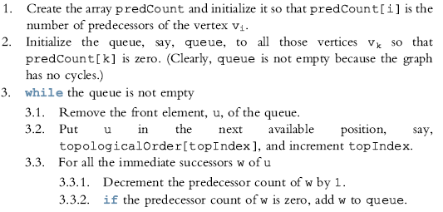
The general algorithm is:

Slide 71
More on Topological Sorting
Runs in O(n+m) time.
Useful starting point for many algorithms that involve acyclic graphs.

Slide 72
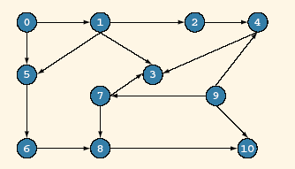
The vertices of G₃ in breadth first topological ordering are
0 9 1 7 2 5 4 6 3 8 10
We illustrate the breadth first topological ordering of the graph G₃

Slide 73
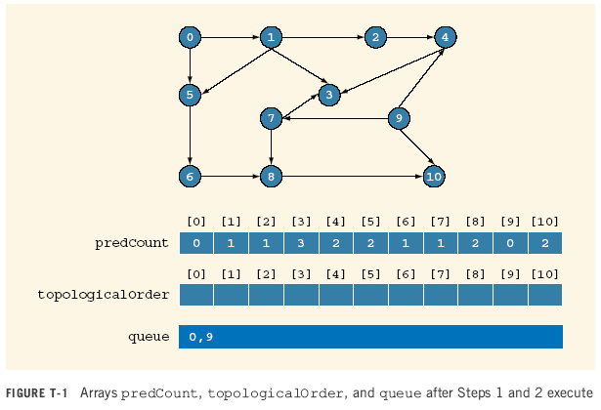

Slide 74
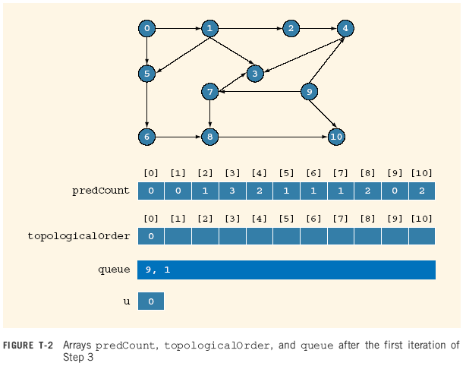

Slide 75


Slide 76


Slide 77
Pred Count
0 1 2 3 4 5 6 7 8 9 10
0 0 0 2 1 0 1 0 2 0 1
Topological order
0 9 1 7
queue
2 5
7

Slide 78
Pred Count
0 1 2 3 4 5 6 7 8 9 10
0 0 0 1 1 0 1 0 1 0 1
Topological order
0 9 1 7
queue
2 5
7

Slide 79
Pred Count
0 1 2 3 4 5 6 7 8 9 10
0 0 0 1 1 0 1 0 1 0 1
Topological order
0 9 1 7 2
queue
5
2

Slide 80
Pred Count
0 1 2 3 4 5 6 7 8 9 10
0 0 0 1 0 0 1 0 1 0 1
Topological order
0 9 1 7 2
queue
5 4
2

Slide 81
Pred Count
0 1 2 3 4 5 6 7 8 9 10
0 0 0 1 0 0 1 0 1 0 1
Topological order
0 9 1 7 2
queue
4
5

Slide 82
Pred Count
0 1 2 3 4 5 6 7 8 9 10
0 0 0 1 0 0 0 0 1 0 1
Topological order
0 9 1 7 2 5
queue
4 6
5

Slide 83
Pred Count
0 1 2 3 4 5 6 7 8 9 10
0 0 0 1 0 0 0 0 1 0 1
Topological order
0 9 1 7 2 5
queue
6
4

Slide 84
Pred Count
0 1 2 3 4 5 6 7 8 9 10
0 0 0 0 0 0 0 0 1 0 1
Topological order
0 9 1 7 2 5 4
queue
6 3
4

Slide 85
Pred Count
0 1 2 3 4 5 6 7 8 9 10
0 0 0 0 0 0 0 0 1 0 1
Topological order
0 9 1 7 2 5 4 6
queue
3
6

Slide 86
Pred Count
0 1 2 3 4 5 6 7 8 9 10
0 0 0 0 0 0 0 0 0 0 1
Topological order
0 9 1 7 2 5 4 6
queue
3 8
6

Slide 87
Pred Count
0 1 2 3 4 5 6 7 8 9 10
0 0 0 0 0 0 0 0 0 0 1
Topological order
0 9 1 7 2 5 4 6 3
queue
8
3

Slide 88
Pred Count
0 1 2 3 4 5 6 7 8 9 10
0 0 0 0 0 0 0 0 0 0 1
Topological order
0 9 1 7 2 5 4 6 3 8
queue
8

Slide 89
Pred Count
0 1 2 3 4 5 6 7 8 9 10
0 0 0 0 0 0 0 0 0 0 0
Topological order
0 9 1 7 2 5 4 6 3 8
queue
10
8

Slide 90
Pred Count
0 1 2 3 4 5 6 7 8 9 10
0 0 0 0 0 0 0 0 0 0 0
Topological order
0 9 1 7 2 5 4 6 3 8 10
queue
10

Slide 91
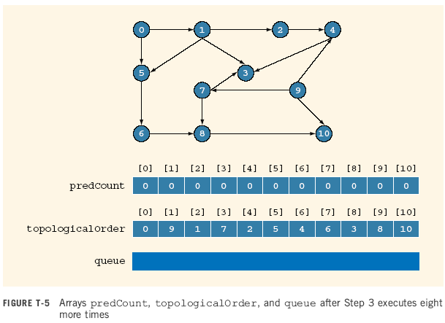

Slide 92
Find a topological order for the following graph
H
E
I
A
D
G
J
C
F
K
B
L

Slide 93
Find a topological order for the following graph
E
H
I
A
D
G
J
C
F
K
B
L
Pred Count
A B C D E F G H I J K L
0 1 1 3 1 2 3 0 0 2 1 3
Topological order
queue
A H I

Slide 94
Find a topological order for the following graph
E
H
I
A
D
G
J
C
F
K
B
L
Pred Count
A B C D E F G H I J K L
0 1 1 3 1 2 3 0 0 2 1 3
Topological order
A
queue
H I
A

Slide 95
Find a topological order for the following graph
E
H
I
D
G
J
C
F
K
B
L
Pred Count
A B C D E F G H I J K L
0 1 0 2 0 2 3 0 0 2 1 3
Topological order
A
queue
H I C E
A

Slide 96
Find a topological order for the following graph
E
H
I
D
G
J
C
F
K
B
L
Pred Count
A B C D E F G H I J K L
0 1 0 2 0 2 3 0 0 2 1 3
Topological order
A H
queue
I C E
H

Slide 97
Find a topological order for the following graph
E
I
D
G
J
C
F
K
B
L
Pred Count
A B C D E F G H I J K L
0 1 0 2 0 2 2 0 0 2 1 3
Topological order
A H
queue
I C E
H

Slide 98
Find a topological order for the following graph
E
I
D
G
J
C
F
K
B
L
Pred Count
A B C D E F G H I J K L
0 1 0 2 0 2 2 0 0 2 1 3
Topological order
A H I
queue
C E
I

Slide 99
Find a topological order for the following graph
E
D
G
J
C
F
K
B
L
Pred Count
A B C D E F G H I J K L
0 1 0 2 0 2 1 0 0 1 1 3
Topological order
A H I
queue
C E
I

Slide 100
Find a topological order for the following graph
E
D
G
J
C
F
K
B
L
Pred Count
A B C D E F G H I J K L
0 1 0 2 0 2 1 0 0 1 1 3
Topological order
A H I C
queue
E
C

Slide 101
Find a topological order for the following graph
E
D
G
J
F
K
B
L
Pred Count
A B C D E F G H I J K L
0 0 0 2 0 1 1 0 0 1 1 3
Topological order
A H I C
queue
E B
C

Slide 102
Find a topological order for the following graph
E
D
G
J
F
K
B
L
Pred Count
A B C D E F G H I J K L
0 0 0 2 0 1 1 0 0 1 1 3
Topological order
A H I C E
queue
B
E

Slide 103
Find a topological order for the following graph
D
G
J
F
K
B
L
Pred Count
A B C D E F G H I J K L
0 0 0 1 0 1 1 0 0 1 1 3
Topological order
A H I C E
queue
B
E

Slide 104
Find a topological order for the following graph
D
G
J
F
K
L
Pred Count
A B C D E F G H I J K L
0 0 0 1 0 1 1 0 0 1 1 3
Topological order
A H I C E B
queue
B

