Slide 1
AI-Driven Stock Behavioural Clustering for Risk and Diversification Analysis
23CSE322: Financial Engineering
Mid-Semester Review
Btech(AI & DS)
Team B7:
B Karthikeya (CB.AI.U4AID23109)
M Karthik Reddy (CB.AI.U4AID23123)
Satya Karthikeya (CB.AI.U4AID23128)
P Rohith (CB.AI.U4AID23131)

Slide 2
Table of contents
Introduction
Problem Statement
Objectives
Dataset Description
Methodology
Tools and Technologies
Behavioural Features & Financial Measures

Slide 3
Introduction
Traditional diversification relies heavily on sectors, but sector labels do not always reflect how stocks actually move
Stocks from different sectors can exhibit similar risk, volatility, momentum, and market behaviour
AI can analyse these behavioural characteristics and automatically group stocks with similar historical patterns
This project explores whether behaviour-based clustering can provide useful insights for risk analysis and portfolio diversification

Slide 4
Problem Statement
Sector-based diversification does not always capture how stocks actually behave in the market. Stocks from different sectors can exhibit similar patterns in risk, volatility, momentum, and market sensitivity. Therefore, an AI-driven approach is needed to identify hidden behavioural relationships and evaluate their potential for better diversification

Slide 5
Objectives
To develop behavioural fingerprints for NSE-listed stocks using historical market data
To apply unsupervised machine learning to identify stocks with similar behavioural patterns
To analyse the risk, return, and correlation characteristics of the identified behavioural clusters
To evaluate whether behaviour-based stock selection can provide meaningful diversification compared with sector-based selection

Slide 6
Dataset
75 selected NSE-listed companies are included in the dataset
Daily stock-market records cover the period from January 2022 to August 2026
The dataset contains 85,500 records across all selected companies
Each record represents one stock on a specific trading day
Each record contains eight market-related attributes
The dataset captures historical price and trading behaviour of the selected stocks

Slide 7
Stock Fingerprint Dataset
The raw daily stock data was processed to represent each company through a set of behavioural characteristics
This produced a Stock Fingerprint dataset containing 75 stocks and 14 behavioural features
The features describe aspects such as return, volatility, momentum, market sensitivity, trends, and trading behaviour
Each row now represents one stock and its overall historical behavioural profile

Slide 8
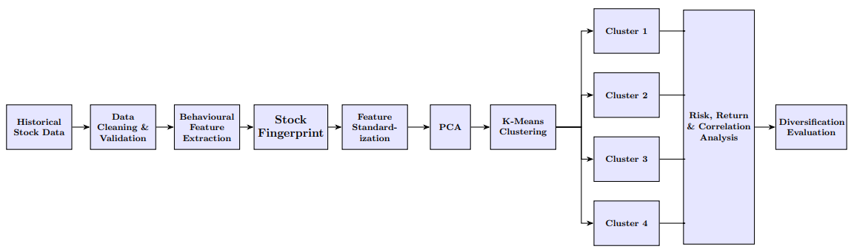
Methodology
Transform daily stock data into behavioural characteristics for each company
Represent every stock as a numerical behavioural fingerprint
Use unsupervised learning to identify groups of similarly behaving stocks
Evaluate the financial characteristics and diversification potential of the identified groups

Slide 9
Tools & Technologies
Programming & Data Processing
Python
Pandas & NumPy
Scikit-learn
Data & Analysis
Historical Stock Market Data
Statistical Feature Engineering
PCA & K-Means Clustering
Visualization & Application
Matplotlib / Seaborn
Plotly
Streamlit
Development
Jupyter Notebook
VS Code
Git & GitHub

Slide 10
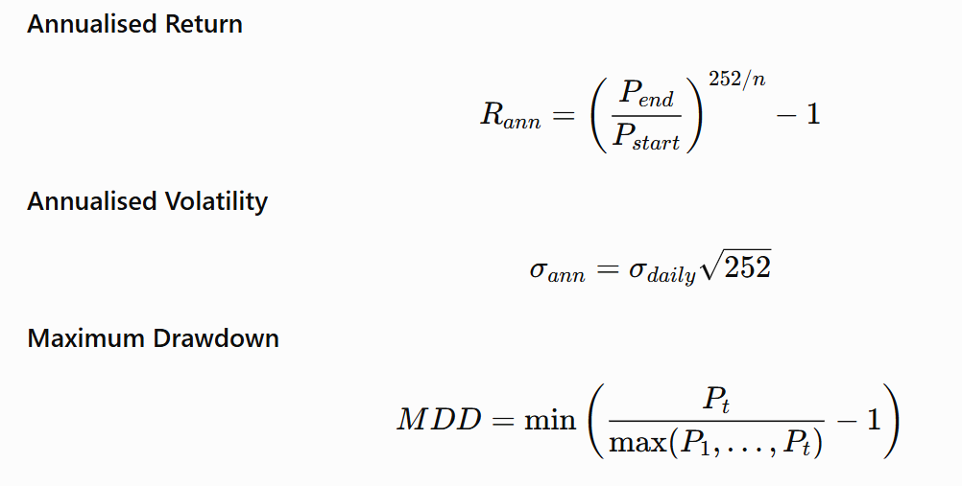
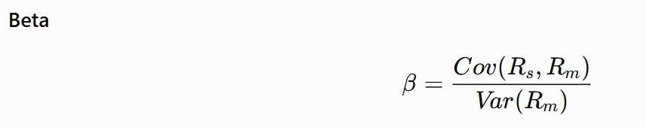
Behavioural Features & Financial Measures

Slide 11
Expected Outcomes
Expected Deliverables
AI-based Stock Behavioural Clustering System with an interactive Streamlit dashboard
Processed stock fingerprint dataset containing behavioural features for 75 NSE-listed companies
Behavioural clustering results with PCA-based visualizations and cluster analysis
Stock similarity analysis for identifying historically similar behavioural patterns
Risk, return and correlation analysis of the identified behavioural clusters
Target Results
Identify distinct behavioural patterns among the selected stocks
Discover similar stocks across different sectors based on market behaviour
Compare risk and return characteristics across behavioural clusters
Evaluate the diversification characteristics of same-cluster and cross-cluster portfolios
Determine whether behavioural clustering provides useful diversification insights beyond sector classification

Slide 12
Thank You

