Slide 1
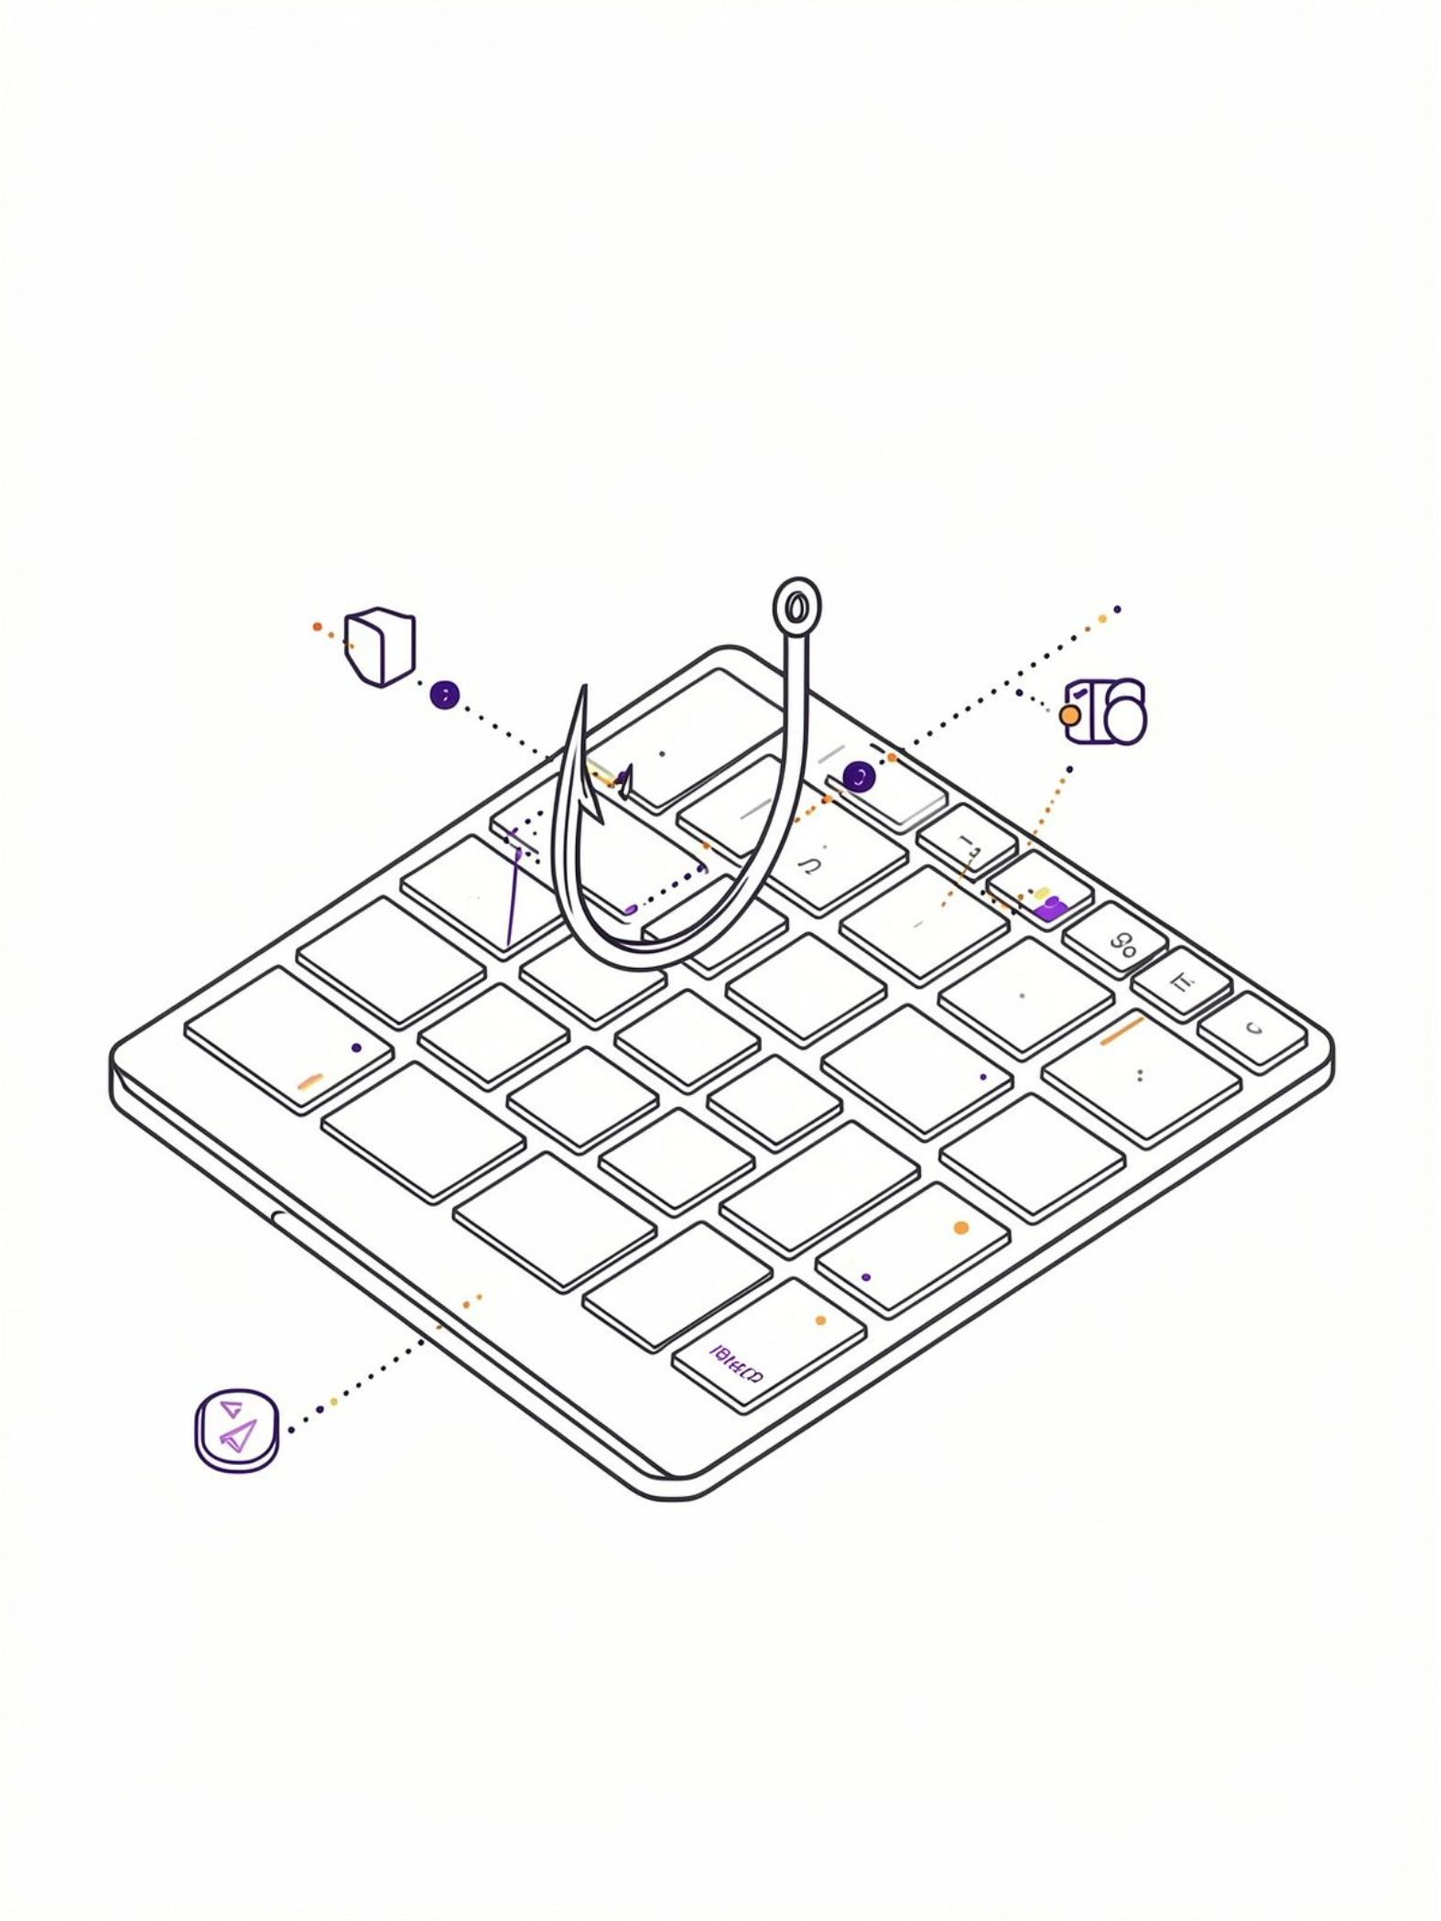
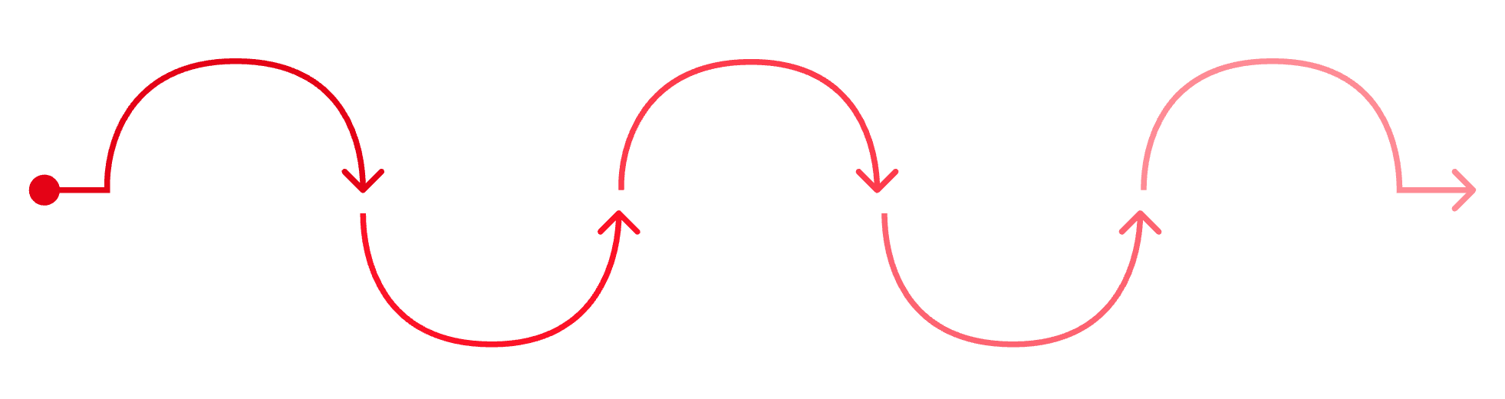
Phishing Awareness Training
Protecting yourself and our organization from today's most common cyber threat.
Recognize
Verify
Report
Respond
Reinforce
Identify phishing signs in messages
Confirm sender and links before acting
Escalate suspicious emails to security
Follow incident guidance promptly
Apply lessons and refresh training

Slide 2
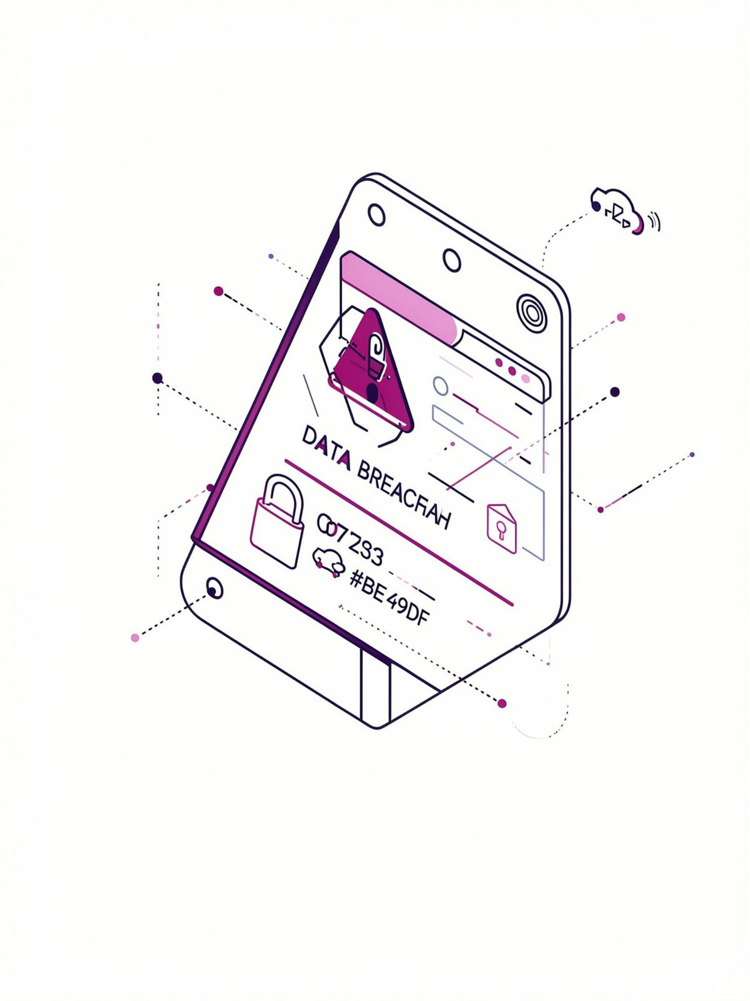
The Scale of the Threat
893M
1.96M
Phishing Attempts Blocked
Attacks Per Year
By Kaspersky alone in 2024 — a 26% increase from 2023
A 182% increase since 2021
1
Click to Compromise
A single click can put the entire network at risk

Slide 3
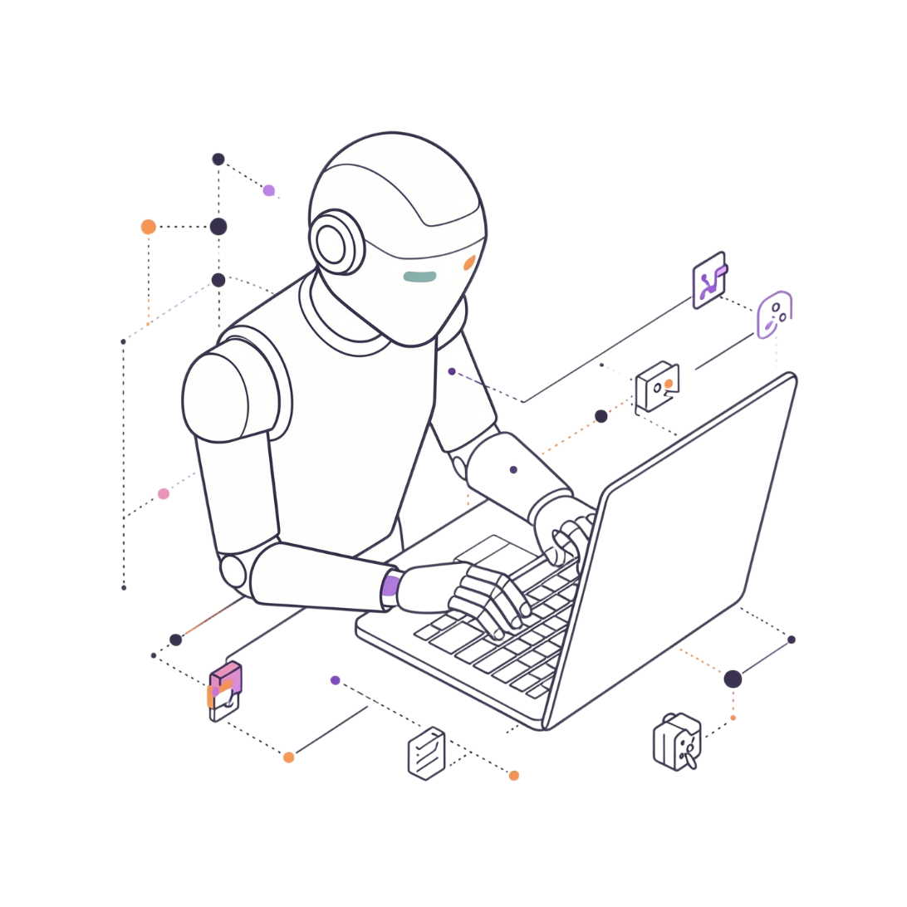

Why Phishing Works
AI-Powered Perfection
Under 60 Seconds
Trusted Brand Impersonation
Attackers now use AI to craft flawless grammar and spelling — the old red flags no longer apply.
The median time for an employee to click a phishing link — faster than most people realize.
Attackers clone Booking, Airbnb, TikTok, Microsoft, and Google to appear completely legitimate.

Slide 4
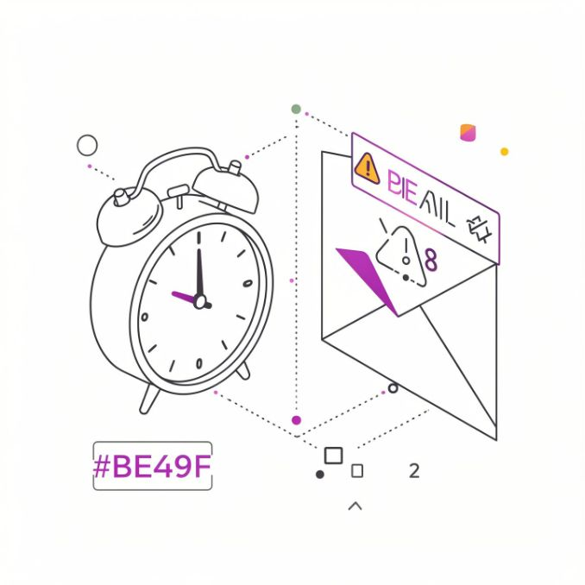

Email Red Flag #1: Urgent or Threatening Language
What It Looks Like
"Act now or your account will be closed!"
"Confirm immediately — you have 24 hours."
"Verify your identity or lose access."
Real companies rarely demand immediate action via email. Urgency is a manipulation tactic.

Slide 5
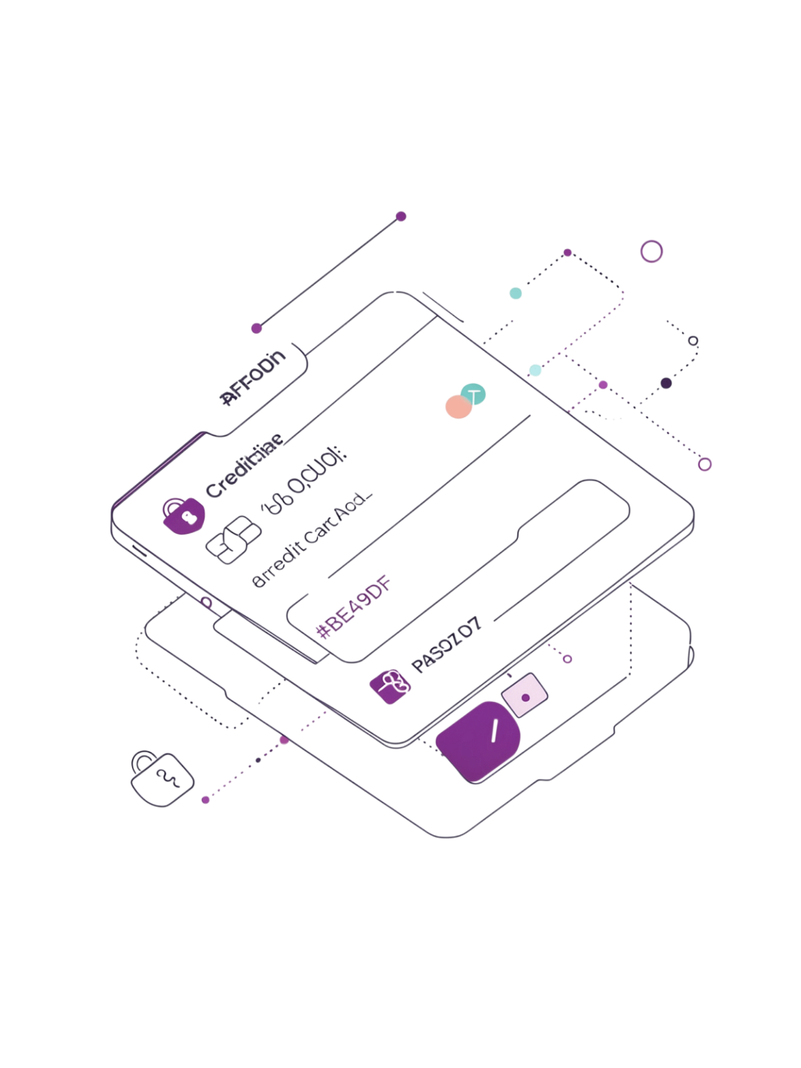
Email Red Flag #2: Requests for Personal Information
🚫 Never Via Email
🏦 Banks Don't Ask
Legitimate companies will never ask for passwords, Social Security Numbers, or credit card details over email.
Your bank will never email you asking to "confirm" your account details — that's always a scam.
📞 When in Doubt, Call
Contact the company directly using a phone number from their official website — not from the email itself.

Slide 6

Email Red Flag #3: Suspicious Links and URLs
Lookalike Domains to Watch For
Attackers register domains that are nearly identical to trusted brands — differing by just one character.
Shortened URLs also hide the real destination. Never click a shortened link in an unsolicited email.
Hover to Preview
Check the Domain
Avoid Shortened Links
✅ amazon.com
⚠️ amazan.com

Slide 7
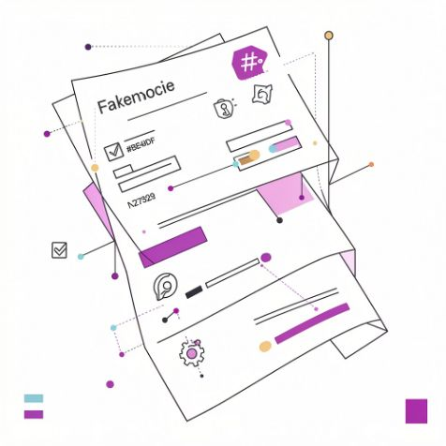
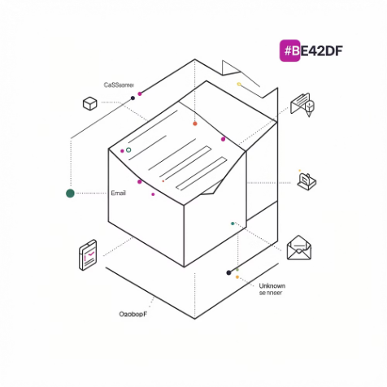
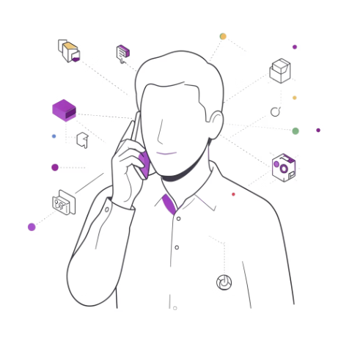
Email Red Flag #4: Unexpected Attachments
Disguised as Invoices
Unknown Senders
Verify First
Malicious files frequently arrive dressed as routine invoices, receipts, or financial documents.
Never open attachments from senders you don't recognize — even if the email looks professional.
If an attachment seems suspicious, call the sender directly by phone to confirm before opening.

Slide 8
Email Red Flag #5 & #6: Address Mismatch and Generic Greetings
Red Flag #5: Sender Address Mismatch
Red Flag #6: Generic Greetings
Always check the full email address — not just the display name shown in your inbox.
Real companies know your name. A vague greeting is a sign of a mass phishing campaign.
If the greeting doesn't use your name, treat the email with extra suspicion.
Scammers use addresses like support@amaz0n-help.com (zero instead of the letter O)
Legitimate companies always use their official domain name
⚠️ "Dear Customer"
⚠️ "Dear User"

Slide 9
Social Engineering Tactics (Part 1)
Pretexting
Baiting
Quid Pro Quo
The attacker invents a believable story — "I'm from IT, I need your login to fix an urgent issue" — to earn trust before asking for information.
A tempting offer — a free download, a USB drive left in the parking lot, a "prize" link — lures the target into taking the bait.
The attacker offers something in exchange for access — "free tech support" for your password, or a survey "reward" for your details.

Slide 10
Social Engineering Tactics (Part 2)
Vishing & Smishing
Tailgating
CEO Fraud (BEC)
Voice calls (vishing) or text messages (smishing) impersonate IT, delivery services, or banks to pressure victims outside of email.
An attacker follows an employee through a secured door, relying on politeness to bypass physical access controls.
A spoofed email from an "executive" pressures an employee to urgently wire funds or share sensitive data.

Slide 11
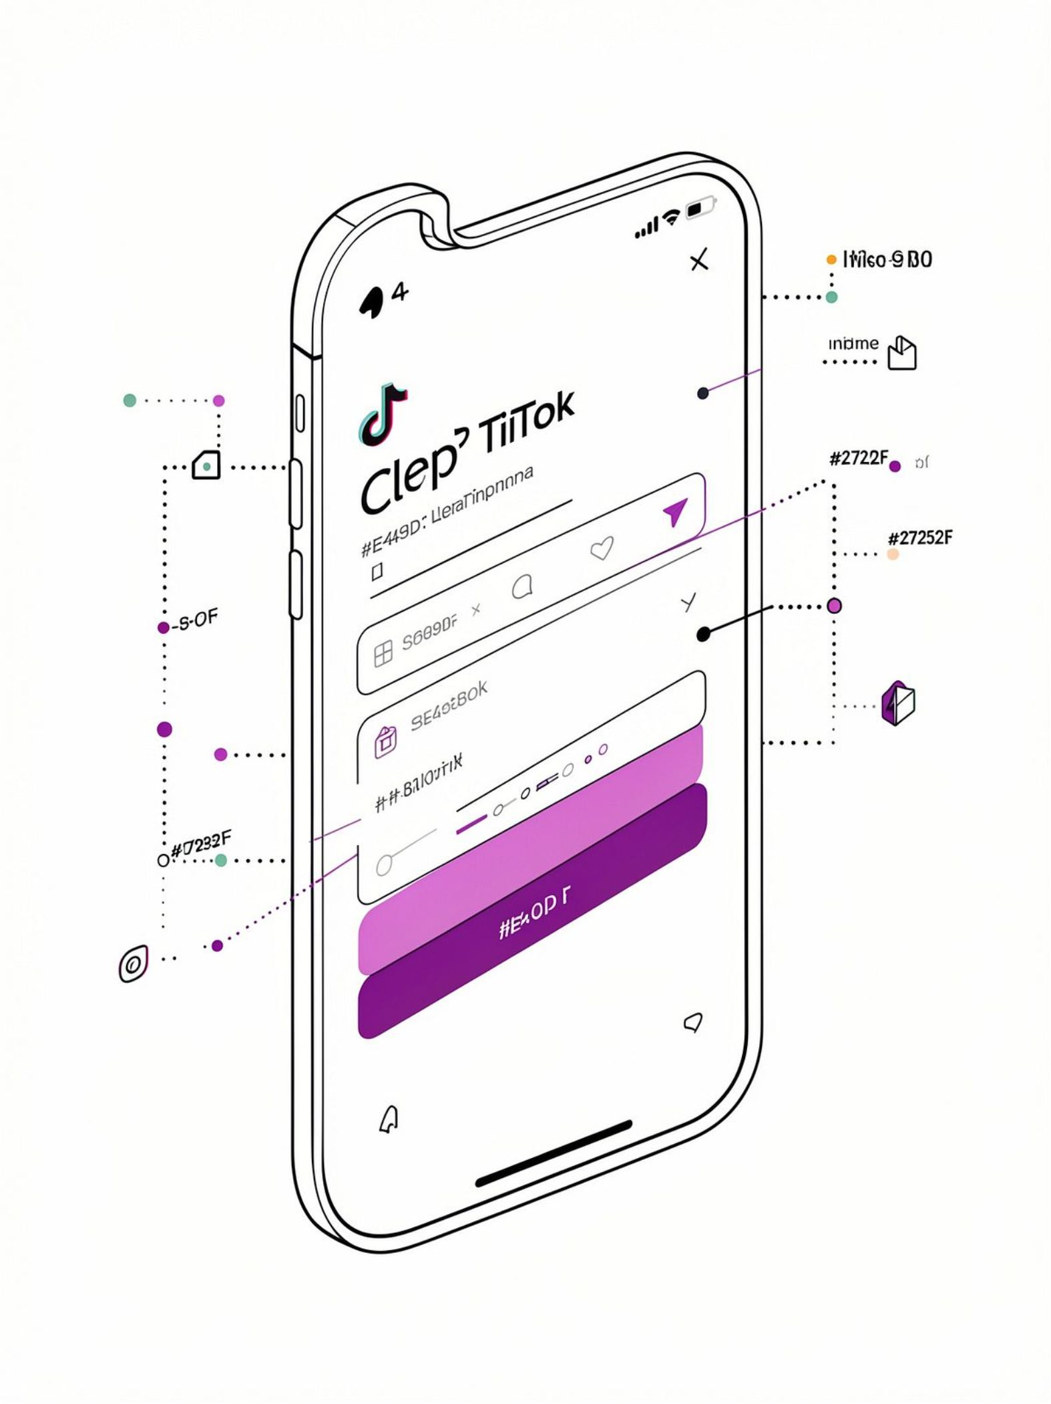



Real-World Example: The TikTok Shop Scam
Fake Login Pages Created
Attackers built convincing replicas of the TikTok Shop seller portal.
Sellers Targeted
Phishing emails directed TikTok Shop sellers to these fake pages with credential-stealing forms.
Millions Blocked
Kaspersky blocked millions of these attempts in 2024 — a reminder that no platform is off-limits.

Slide 12
Real-World Example: The MGM Resorts Breach
A LinkedIn Profile Was Enough
Attackers found an MGM employee on LinkedIn and used that identity to impersonate them.
One Phone Call to the Help Desk
Posing as the employee, they called the IT service desk and talked an agent into resetting the account’s login and MFA.
$100 Million in Damages
That single vishing call led to a 2023 ransomware attack that shut down MGM’s systems for days and cost an estimated $100 million.

Slide 13
Real-World Example: The $120M Fake Invoice Scam
A Fake Company, A Real Name
A scammer set up a shell company impersonating Quanta Computer, a real hardware supplier to Google and Facebook.
Forged Invoices, Real Payments
Fake invoices, contracts, and executive signatures convinced employees at both companies to approve the wire transfers.
Over $120M Stolen (2013–2015)
Google and Facebook wired a combined $121 million before the fraud was caught — proof that even tech giants fall for a convincing email.

Slide 14

What To Do If You're Targeted
If You Receive a Suspicious Email
Your Best Defenses
1
Don't Click
Enable MFA (Multi-Factor Authentication) — a second login step that stops stolen passwords from working
Use a password manager to create and store unique passwords for every account
Verify before you trust — when in doubt, pick up the phone
Avoid clicking links, opening attachments, or replying to the email.
2
Report It
Forward it to your IT or security team immediately using the official reporting channel.
You are the last line of defense — and now you know exactly what to look for. Stay alert and report anything suspicious
3
Already Clicked? Act Fast
Disconnect from the network, change your passwords, and notify IT right away — no blame, just action.

Slide 15
Quick Quiz — Question 1 of 3
The Scenario: Spot the Phish
Your Options: Choose the Best Response
You receive: "URGENT: Your account will be suspended in 2 hours! Click here to verify: amaz0n-support-verify.net"
C) Reply and ask them for more details first
D) Forward it to a coworker to check before deciding
A) It’s legitimate — Amazon sends these often
B) Urgent language + a lookalike domain — likely phishing
✅ Correct: B) Urgency + lookalike domain
💡 Never click — just report it.

Slide 16
Quick Quiz — Question 2 of 3
The Scenario: Name the Tactic
Your Options: Choose the Best Answer
A caller says: "Hi, this is IT — we’ve seen suspicious activity on your account. Just confirm your password so I can secure it."
C) Pretexting
D) Quid Pro Quo
A) Baiting
B) Tailgating
✅ Correct: C) Pretexting
💡 Fake identity + urgency = pretexting.

Slide 17
Quick Quiz — Question 3 of 3
The Scenario: The Invoice Trap
Your Options: Choose the Safest Move
An invoice looks exactly like your usual vendor’s, but the reply-to address is slightly off, and it asks you to update the payment bank account before Friday.
C) Call the vendor on a known number to verify before changing anything
D) Ignore it — it’s probably nothing
A) Pay it — it looks routine
B) Reply to the email to confirm the new details
✅ Correct: C) Verify separately
💡 Just like the $120M invoice scam.

