Slide 1
P
PULSE
ENERGY INTELLIGENCE TERMINAL
From headline to distribution
A probabilistic framework for pricing geopolitical supply shocks into Brent calendar spreads
THE HEADLINE
“Israel launches strikes on Iranian energy infrastructure. Iran threatens closure of the Strait of Hormuz.”
Deliverable 1-week probability distributions for Brent M1-M2, M2-M4, M1-M6 — expected value, 50% and 90% ranges, scenario probabilities
Method Historical event study (13 events, 2018-2025) · scenario tree · Monte Carlo mixture (200k draws) · regime-conditional vol
Peruka Pranav · Futures First internship · data as of 2026-05-26
PULSE · Event-to-Distribution Framework · June 2026
1 / 10

Slide 2
FRAMEWORK
Four steps from headline to tradeable distribution
1 · TYPE THE EVENT
2 · MEASURE ANALOGS
3 · BUILD SCENARIOS
4 · MIX & SIMULATE
Severity-tier the headline against a 13-event catalogue (2018-2025). This one: kinetic strike on energy infrastructure (Tier 3) with a threatened Tier-4 escalation.
Event study: Δ spread over the 5 trading days after each event, from the last close before it. The June 2025 Israel-Iran war is the direct analog — it is in our data.
Four exhaustive outcomes for the week, probabilities anchored to historical escalation frequency + structural arguments. Each gets a per-spread conditional (μ, σ).
Monte Carlo: draw scenario, then spread changes with one-factor correlation (ρ = 0.84 measured). 200k draws → EV, 50%, 90% intervals per spread.
PRINCIPLE The objective is not a point forecast. A geopolitical shock is a mixture of regimes with very different outcomes — the honest answer is the whole distribution, with the scenario weights stated so they can be argued with.
PULSE · Event-to-Distribution Framework · June 2026
2 / 10

Slide 3
MECHANISM
How a supply threat prices into the futures curve
Prompt scarcity premium
Physical barrels at risk are near-dated. Buyers pay up for prompt delivery → M1 rallies vs deferred → backwardation steepens, front spreads widen first.
STARTING CONDITIONS
Regime BACK / LOW / STRESSED
backwardation + storage deficit + stressed vol (PULSE classifier)
Belly repricing
If the outage is expected to PERSIST, the 2-6 month curve reprices too. Abqaiq 2019: M2-M4 moved +0.69 while M1-M2 moved only +0.07 — SPR-release expectations cap the prompt.
M1-M2 2.91
M2-M4 5.77
M1-M6 12.98
Freight, insurance & routing
War-risk premia on Hormuz transits push landed costs up and slow flows even with the strait open — a tax on prompt supply.
Base is already STRETCHED: M1-M2 at 2.91 vs 10-yr p99 of 5.22. The geopolitical premium partially priced → de-escalation has real downside.
Demand offsets & releases
Strategic reserve releases and demand destruction act with a lag — they cap the FRONT more than the belly, skewing event risk toward M2-M4 / M1-M6.
PULSE · Event-to-Distribution Framework · June 2026
3 / 10

Slide 4
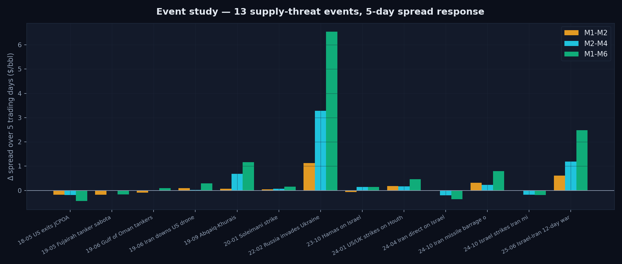
STEP 1-2 · HISTORICAL EVIDENCE
13 supply-threat events, measured 5-day spread response
Tier 1 — verbal / proxy
JCPOA, drone, Soleimani, 2024 exchanges: ±0.0-0.3 — noise
Tier 2-3 — kinetic on infra
Abqaiq: belly +0.7 to +1.2 · June 2025 war: +0.6 / +1.2 / +2.5
Tier 4 — supply war
Russia 2022: +1.1 / +3.3 / +6.5 — observed ceiling for one week
PULSE · Event-to-Distribution Framework · June 2026
4 / 10

Slide 5
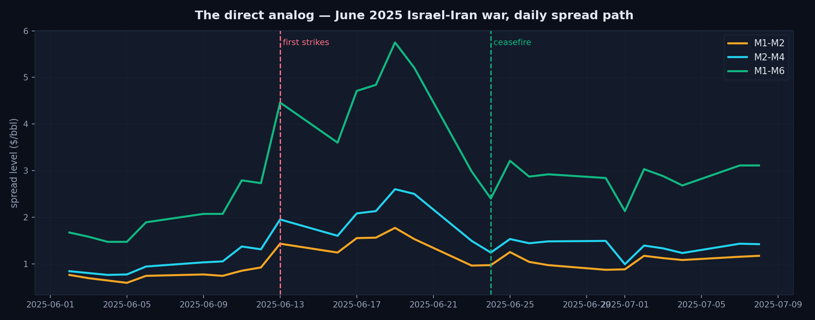
THE DIRECT ANALOG
June 2025: the same headline, watched day by day
What it teaches: (1) spreads spike within 2-4 sessions while strikes continue — D+5 deltas were +0.61 / +1.19 / +2.48; (2) the premium COLLAPSES on ceasefire — M1-M2 gave back 0.57 in one session; (3) the week-end outcome is therefore binary-ish around the ceasefire question → exactly why we model a scenario mixture.
PULSE · Event-to-Distribution Framework · June 2026
5 / 10

Slide 6
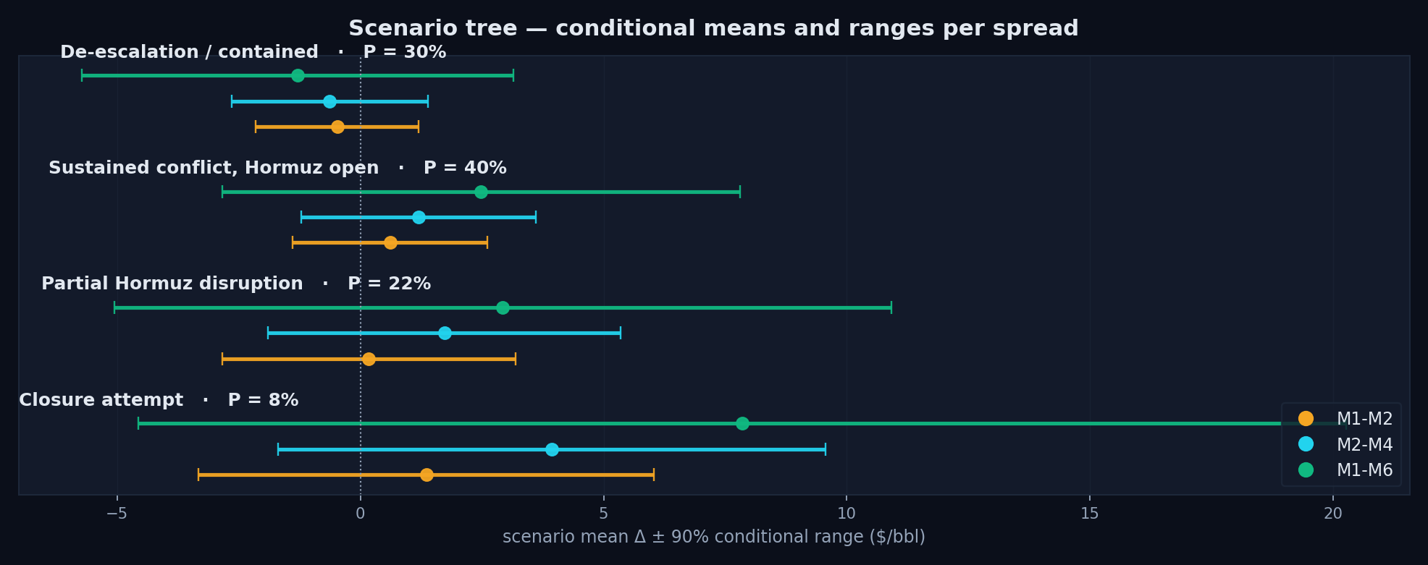
STEP 3 · SCENARIOS
Four outcomes for the week — probabilities you can argue with
30% De-escalation
June 2025 reached ceasefire in 8 trading days; symbolic-response precedent (Apr & Oct 2024)
40% Sustained, Hormuz open
Base case: strikes continue, shipping flows — the June-2025 D+5 state
22% Partial disruption
Tanker War 1984-88 precedent: harassment, mining, seizures — flows impaired, not stopped
8% Closure attempt
Never observed in 40 yrs. Iran exports 1.5-1.7 mb/d through Hormuz itself — self-deterrence + US 5th Fleet
Parameterisation: scenario means anchored to measured event deltas (S2 = June-2025 verbatim; S3 = 2.5× Abqaiq; S4 = 1.2× Russia-2022 + lognormal right tail). σ floors at BACK-regime weekly vol (1.02 / 1.23 / 2.71) — a scenario never claims more precision than baseline regime noise. De-escalation mean is tilted NEGATIVE (-0.48 / -0.63 / -1.29): the stretched base unwinds, as on 2025-06-23.
PULSE · Event-to-Distribution Framework · June 2026
6 / 10

Slide 7
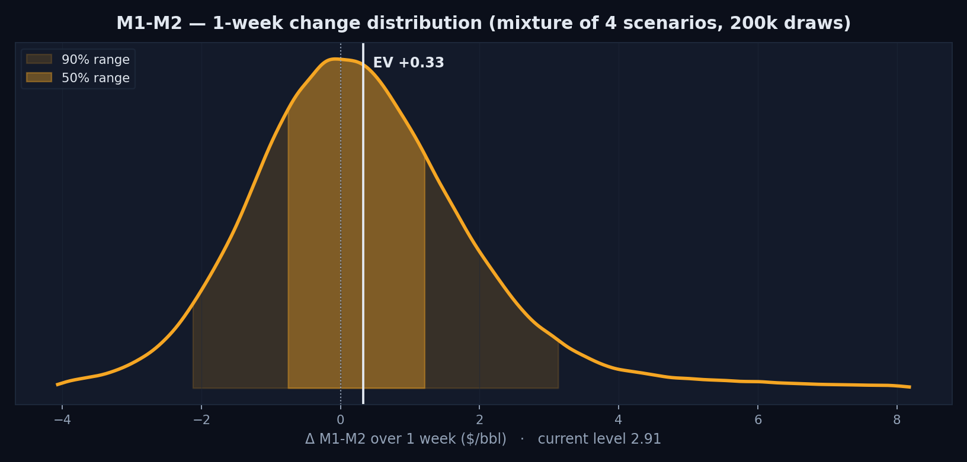
STEP 4 · RESULTS 1 OF 3
M1-M2 — one-week distribution
CURRENT LEVEL
2.91
as of 2026-05-26
EXPECTED VALUE (1 WK)
3.24
Δ +0.33 $/bbl
P(SPREAD WIDENS)
55%
share of 200k draws above 0
50% range 2.15 – 4.13 90% range 0.78 – 6.04 ($/bbl, spread LEVEL)
The coin-flip of the three: P(widen) only 55% — the stretched 2.91 base unwinds hardest on de-escalation; fat right tail through 5.0 if Hormuz is touched.
PULSE · Event-to-Distribution Framework · June 2026
7 / 10

Slide 8
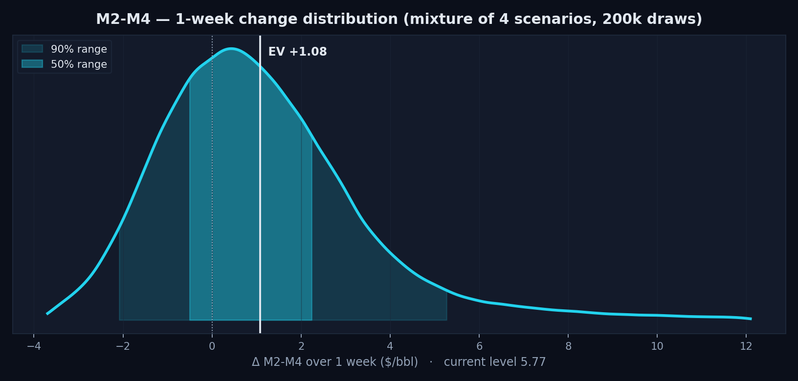
STEP 4 · RESULTS 2 OF 3
M2-M4 — one-week distribution
CURRENT LEVEL
5.77
as of 2026-05-26
EXPECTED VALUE (1 WK)
6.85
Δ +1.08 $/bbl
P(SPREAD WIDENS)
65%
share of 200k draws above 0
50% range 5.26 – 8.01 90% range 3.66 – 11.05 ($/bbl, spread LEVEL)
The cleanest event signal: P(widen) 65%. Infrastructure damage reprices 2-4 month supply with no SPR offset — the Abqaiq lesson.
PULSE · Event-to-Distribution Framework · June 2026
8 / 10

Slide 9
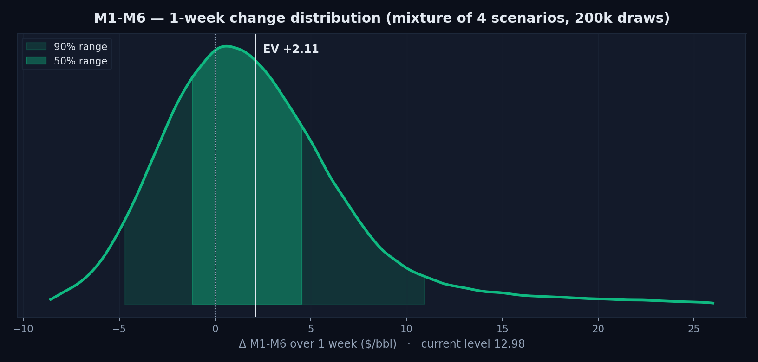
STEP 4 · RESULTS 3 OF 3
M1-M6 — one-week distribution
CURRENT LEVEL
12.98
as of 2026-05-26
EXPECTED VALUE (1 WK)
15.09
Δ +2.11 $/bbl
P(SPREAD WIDENS)
64%
share of 200k draws above 0
50% range 11.73 – 17.54 90% range 8.22 – 23.91 ($/bbl, spread LEVEL)
Biggest absolute range (90%: 8.2 - 23.9) — where a closure attempt is most visible: the S4 conditional mean alone is +7.8.
PULSE · Event-to-Distribution Framework · June 2026
9 / 10

Slide 10
SUMMARY
The answer, on one slide
SPREAD | NOW | EV (1 WK) | 50% RANGE | 90% RANGE | P(WIDEN)
M1-M2 | 2.91 | 3.24 (+0.33) | 2.15 – 4.13 | 0.78 – 6.04 | 55%
M2-M4 | 5.77 | 6.85 (+1.08) | 5.26 – 8.01 | 3.66 – 11.05 | 65%
M1-M6 | 12.98 | 15.09 (+2.11) | 11.73 – 17.54 | 8.22 – 23.91 | 64%
HONEST CAVEATS
WHAT WOULD RE-WEIGHT THE SCENARIOS
n=13 events, one Tier-4 — the closure tail is judgment anchored on Russia-2022, not estimated
Base levels already stretched (p97+): symmetric vol assumptions understate downside on de-escalation
Scenario probabilities are priors — built to be argued with, then re-run in seconds
One-factor ρ=0.84 understates tail co-movement; spreads decouple in squeezes
Tanker war-risk insurance quotes (first to move on real Hormuz risk)
Iranian export loadings at Kharg Island (satellite-tracked)
US carrier-group positioning + ceasefire backchannel headlines
Framework runs live in PULSE: event → tier → mixture → distribution, refreshed daily against the regime classifier
PULSE · Event-to-Distribution Framework · June 2026
10 / 10

