Slide 1

RAJEEV GANDHI MEMORIAL COLLEGE OF ENGINEERING & TECHNOLOGY (AUTONOMOUS) ​
Nandyal-518501, Kurnool – Dt. AP. India​
Department Of Computer Science And Engineering(Data Science)​
Handling Extreme Object Scale Variation for Helmet Compliance and License Plate Detection using Attention-Enhanced YOLOv8
Project Supervisor:
Dr. P. Penchala Prasad
Associate Professor CSE(DS)
Team members:
M. V. Rohith Reddy - 22091A32G0
P. Bhargavi - 23095A3204
A. Srujana - 22091A32E7

Slide 2
Introduction
🌍 Global Road Safety
🪖 Helmet Effectiveness
Road traffic injuries cause 1.35 million deaths per year worldwide, with 28% involving motorcyclists — a major preventable public health crisis.
Wearing a helmet reduces fatality risk by ~42% and head injury risk by ~69%, yet violations remain rampant due to poor monitoring infrastructure.
🚦 Monitoring Challenge
🤖 AI-Powered Solution
Traditional traffic enforcement relies on manual observation — prone to fatigue, limited coverage, and inconsistent rule application.
Deep learning models like YOLO enable automated, real-time multi-object detection for helmets, license plates, and riders from camera feeds.
This study proposes an attention-enhanced YOLOv8m framework achieving 96.47% mAP@0.5 at 22 FPS for simultaneous detection of motorbikes, helmets, violations, and license plates.
2 / 20

Slide 3
Problem Statement
1.35M
28%
42%
Road deaths per year
(WHO 2023)
Of fatalities are
motorcyclists
Death risk reduction
with helmet use
Core Problems to Solve
Scale Extremes
Tiny Object Loss
Objects range from 0.004% (license plate) to 94.22% of the image — a 5-order scale gap CNN models struggle with
License plates shrink to just ~37 pixels at 640×640 — below the threshold for reliable detection
Manual Bottleneck
No Systematic Tuning
Human-based enforcement misses violations, tires quickly, and cannot monitor multiple lanes
Existing models use default hyperparameters, leaving significant accuracy gains unexplored
3 / 20

Slide 4
Literature Survey — Key Prior Work
Redmon et al. (2016) — YOLOv1
Ren et al. (2017) — Faster R-CNN
✓ Introduced single-stage real-time detection as a regression problem
✓ Two-stage detector with region proposal networks, high precision
✗ Low accuracy on small objects
✗ Too slow for real-time traffic monitoring
Lin et al. (2017) — FPN
Woo et al. (2018) — CBAM
✓ Feature Pyramid Networks for multi-scale feature fusion
✓ Channel + spatial attention modules improve feature focus
✗ Still struggles with extreme scale variation
✗ Does not encode directional spatial location
Deng et al. (2024) — HelmetNet (YOLOv8)
Mukherjee et al. (2025) — Helmet + Plate
✓ YOLO-based helmet detection with improved accuracy
✓ Multi-object detection combining helmet and plate detection
✗ No license plate detection or hyperparameter tuning
✗ Extreme scale variation not systematically evaluated
5 / 20

Slide 5
Limitations of Existing Systems
🔍
Poor Small Object Detection
License plates (<32×32 px) are lost in deeper CNN feature maps at standard 640×640 resolution — recall drops to ~78% for plates
⚙️
No Systematic Hyperparameter Tuning
Prior models use default learning rates and momentum — no Bayesian search performed; optimal accuracy remains unexplored
📏
Scale Variation Not Evaluated
Existing benchmarks don't test objects spanning 0.004%–94% of image area in the same scene — the real-world condition
🌧️
No Adverse Condition Evaluation
Dense traffic occlusion, motion blur, headlight glare, and night conditions are rarely benchmarked in prior helmet detection papers
⏱️
Insufficient Real-Time Analysis
Many published systems exceed 100 ms/frame, making them unsuitable for live traffic monitoring or edge deployment
6 / 20

Slide 6

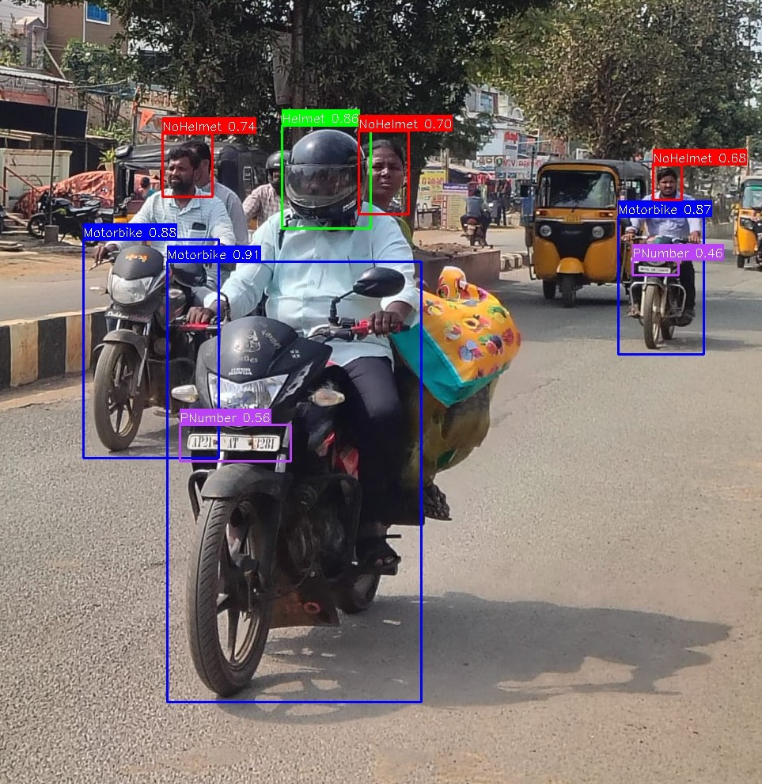
Proposed Methodology
To enhance small object detection with effective feature extraction.
To improve model generalization.
Input size
Normalization
Image preprocessing
Feature Extraction
YOLOv8m + CA Detection
Frame Extraction
Live Footage
Image captured
Optimized hyperparameters
Detects
Motorcycle, Helmet, NoHelmet, PNumber
Learning rate
Batch size
Confidence threshold
Predicting
Bounding Box and class
To identify the most suitable hyperparameters.

Slide 7
Objectives
To improve model generalization.
To enhance small object detection with effective feature extraction.
To identify the most suitable hyperparameters.

Slide 8
Dataset Description
2,887
8,832
4
4.39
21
Images
Annotations
Classes
Avg objects/image
Max objects/image
Class Distribution
Class | Count | Percentage
Motorbike | 3,013 | 34.1%
Helmet | 2,306 | 26.1%
NoHelmet | 2,033 | 23.0%
PNumber | 1,480 | 16.8%
Total | 8,832 | 100%
Train / Val / Test Split
70%
15%
15%
Training
2,021 images
Validation
433 images
Testing
433 images
9 / 20

Slide 9
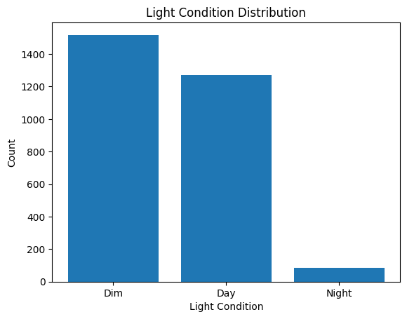
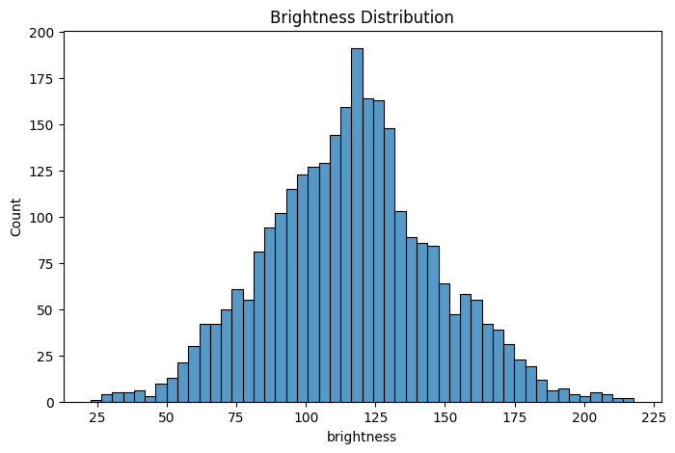
Objective 1: To improve model generalization
Applied data augmentation techniques such as brightness, HSV, scaling, and mix up.
Increased dataset diversity by simulating different lighting and environmental conditions.

Slide 10
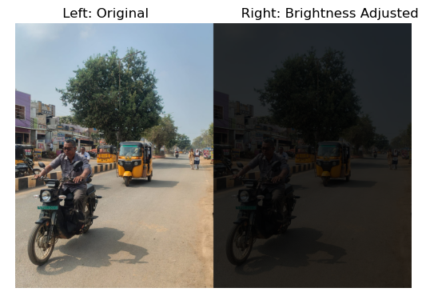
Data Preprocessing & Augmentation
PREPROCESSING
AUGMENTATION TECHNIQUES
Resize all images → 960 × 960 pixels
Pixel normalization → [0, 1] range
YOLO annotation format: (class, xc, yc, w, h)
Batch size: 8 (Mosaic → 32 effective images/iter)
Mosaic (p=1.0) — 4 images stitched per sample
MixUp (p=0.062) — blends two image pairs
HSV jitter: H±2.2% S±80.8% V±40%
Random Erasing (p=0.4) — simulates occlusion
Translation
10 / 20

Slide 11
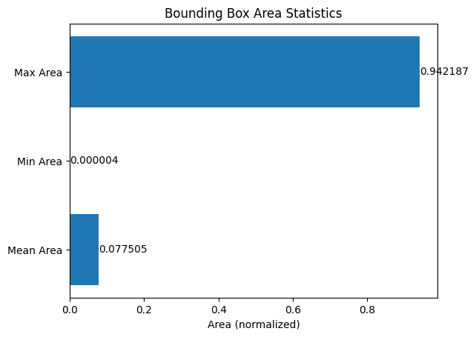
Objective 2 — Reliable Small Object Detection
Object Scale Spectrum in Dataset (% of image area)
MOTORBIKE — 94.22% of image area (868,377 px²)
HELMET ~5%
PLATE
0.004% of image → just 16 px² at 640×640 input
Why Small Object Detection is Hard
📉 Spatial Detail Lost
🔬 Tiny Pixel Footprint
🎯 Our Fix
Each conv layer with stride 2 halves spatial dimensions — deep features lose position info for tiny objects
At 640×640, a plate is ~16 px — insufficient texture for CNN filters to learn discriminative features
960×960 input a plate is ~36 px + Coordinate Attention preserves spatial context → PNumber mAP jumps from 78.3% to 93.9%
12 / 20

Slide 12
Why 960×960? — Resolution Impact on Small Object Detection
How Downsampling Destroys Tiny Objects
→
→
→
Input
960×960
÷8 →
120×120
÷16 →
60×60
÷32 →
30×30
P3 feature map (highest res.) still has 120×120 cells at 960 input → each cell covers only 8px → license plates survive!
1280×1280
640×640
960×960 ✓
78.3% Plate mAP
93.9% Plate mAP
Plate = ~16 px
Plate = ~36 px
Best balance
Fast but inaccurate
13 / 20

Slide 13
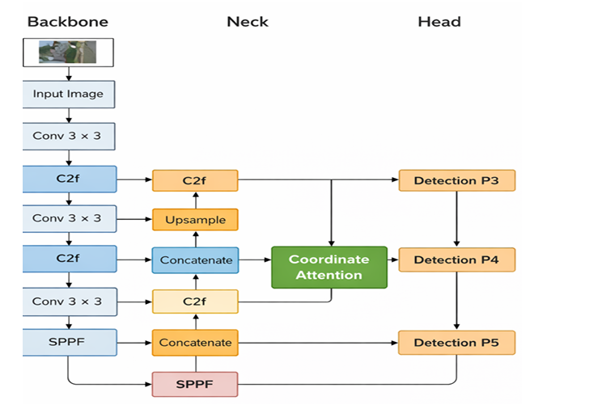
YOLOv8m Architecture
One-stage, anchor-free object detection model
Detects objects at multiple scales
Uses Backbone, Neck, and Head modules
Provides high accuracy and real-time performance
Uses Coordinate Attention to improve feature focus on important regions
𝐼𝑚𝑎𝑔𝑒→𝐵𝑎𝑐𝑘𝑏𝑜𝑛𝑒→𝑁𝑒𝑐𝑘→𝐻𝑒𝑎𝑑→𝐷𝑒𝑡𝑒𝑐𝑡𝑖𝑜𝑛
Feature Map Sizes at 960×960 Input:
P3 120×120
Detects small objects:
Helmets, License Plates
P4 60×60
Detects medium objects:
Riders, Partial Bikes
P5 30×30
Detects large objects:
Full Motorbikes
14 / 20

Slide 14
Coordinate Attention Mechanism
What it Does
CA Module Flow
Encodes spatial information separately along the horizontal (X) and vertical (Y) axes — unlike standard channel attention that collapses spatial dimensions.
Input Feature Map
F ∈ R^(C×H×W)
↓
Why It Helps
Horizontal Pool fh(x)
avg over height H
Preserves exact spatial location of tiny objects. A license plate at the far corner of an image retains its coordinates through the attention output.
↓
Vertical Pool fw(y)
avg over width W
Where Placed
↓
Concat → Conv1×1
→ Split → Sigmoid
Inserted AFTER PANet feature fusion, BEFORE detection heads — focuses the network on relevant spatial regions while suppressing background.
↓
Attention-Weighted
Output Feature
Overhead
Minimal parameter and compute cost — net accuracy gain of +1.67% mAP with negligible inference time increase.
15 / 20

Slide 15
Hyperparameter Optimization — Optuna
Optuna uses the Tree-structured Parzen Estimator (TPE) — a Bayesian method that models the search space and samples promising hyperparameter regions based on past trial results.
Optimal Hyperparameters Found
Optimization Process
Parameter | Search Range | Best Value
Learning Rate (lr0) | [1×10⁻⁵, 1×10⁻³] | 0.000115
Momentum | [0.80, 0.99] | 0.9533
Weight Decay | [1×10⁻⁵, 1×10⁻²] | 0.001361
Box Loss Weight | [5.0, 10.0] | ~7.5
Classification Loss | [0.5, 1.5] | ~0.9
MixUp Probability | [0.0, 0.15] | 0.062
HSV Saturation Gain | [0.0, 1.0] | 0.808
1
15 Trials
Total optimization budget
2
TPE Sampler
Bayesian-guided search
3
Median Pruning
Stops underperforming trials early
4
Objective
Maximize mAP@0.5–0.95 on val set
5
Gain
90.6% → 96.47% (+5.87%)
16 / 20

Slide 16
Training Configuration & Evaluation Metrics
30
8
960×960
Evaluation Metrics
Epochs
Batch Size
Resolution
Precision
How accurate are the detections?
TP ÷ (TP+FP)
AdamW
Cosine
~1 hr
Recall
What fraction of real objects are found?
Optimizer
LR Schedule
Train Time (T4)
TP ÷ (TP+FN)
mAP@0.5
Overall detection accuracy
Training Convergence (Epoch 1 → Best at Epoch 26)
Area under P-R curve, IoU≥0.5
Box Loss
Class Loss
mAP@0.5
Recall
mAP@0.5–0.95
Localization quality metric
1.302 → 0.749
2.797 → 0.717
81.1% → 96.3%
74.6% → 92.9%
Stricter multi-threshold average
FPS
Real-time performance measure
Frames Per Second
17 / 20

Slide 17
Results & Performance
96.47%
94.42%
92.93%
22 FPS
mAP@0.5
(Overall)
Precision
Recall
45 ms/frame
(NVIDIA T4)
Ablation Study
Model Config | mAP@0.5
YOLOv8m Baseline | 90.6%
+ Data Augmentation | 91.0%
+ Optuna Tuning | 94.8%
+ Coord. Attention (Proposed) | 96.47%
18 / 20

Slide 18
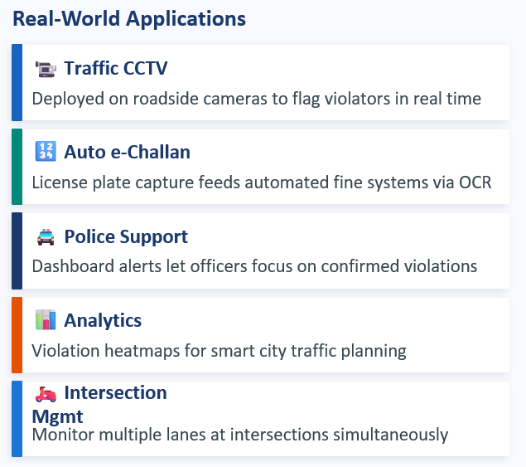
Applications
System achieves 22 FPS (45 ms/frame) on NVIDIA T4 Tensor Core GPU — suitable for live camera monitoring

Slide 19
Conclusion & Future Scope
Key Achievements
LIMITATIONS
96.47% mAP@0.5 with 94.42% Precision and 92.93% Recall
22 FPS real-time performance on NVIDIA T4 GPU (45 ms/frame)
Coordinate Attention raises PNumber mAP from 78.3% → 93.9%
Optuna tuning contributes +5.87% accuracy over baseline
960×960 input provides optimal accuracy-efficiency tradeoff
Single-shot 4-class detection: Bike + Helmet + NoHelmet + Plate
Asian traffic dataset — may not generalize to Western roads
Failure cases in extreme glare, blur, and long distances
Plates <10 px remain a detection boundary
FUTURE SCOPE
OCR integration for automated e-challan generation
Night-time and adverse weather robustness
Cross-regional dataset expansion & re-validation
Edge device deployment (Jetson Nano, Raspberry Pi)
Extension to 4-wheelers and pedestrian safety
github.com/rohithredddy/HelmetCompliance-and-License-Plate-Detection · RGMCET, Nandyal · Dept. of CSE (Data Science)

