Slide 1
REVIEW-1

Slide 2
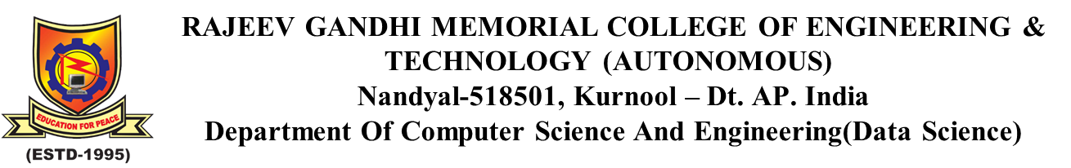
A deep learning framework for helmet detection and number plate recognition
Project Supervisor
Dr. P. Penchal Prasad
Associate Professor CSE(DS)
Team members M. V. Rohith Reddy-22091A32G0
P. Bhargavi-23095A3204
A. Srujana-22091A32E7

Slide 3
Abstract
AI-based traffic violation detection system for real-time helmet detection and automatic number plate recognition. Using deep learning and computer vision techniques, the system identifies violations, captures evidence, and enables automated enforcement. The solution improves traffic monitoring efficiency and supports intelligent urban traffic management.

Slide 4
Introduction
Traffic Safety Overview
Increasing two-wheeler usage has intensified road safety concerns, particularly due to helmet non-compliance.
Manual traffic monitoring systems lack scalability and real-time enforcement capability.
Proposed Solution: AI-Based Traffic Violation Detection System
Developed an intelligent system for real-time helmet detection and automatic number plate recognition using deep learning techniques.
Enables automated violation identification, evidence capture, and efficient digital enforcement.

Slide 5
Individual contributions

Slide 6
Existing methodology
Input image from video
Preprocessing
Identifying motorcycle
Find Helmet?
Yes
Stop
No
Extract licensed number plate
Automatically generates fine
Stop

Slide 7
Step 1 : Data Collection
Collect traffic images and video frames containing motorcycles, helmet and no-helmet riders, and vehicle number plates.
Step 2 : Feature Extraction
Extract visual features using YOLOv8m for object detection:
Bounding box coordinates (x, y, width, height)
Class labels (Helmet, No Helmet, Motorcycle, Number Plate)
Confidence scores
Intersection over Union (IoU)
Rider count for triple riding detection

Slide 8
Step 3 : Data Preparation and Augmentation
Apply data augmentation techniques to improve model generalization and handle class imbalance between helmet and no-helmet samples.
Techniques applied: Image flipping, rotation, brightness adjustment, scaling, and normalization to enhance dataset diversity.
Step 4 : Model Selection and Training
Train the detection model using:
YOLOv8m (You Only Look Once – Medium Variant) for real-time object detection
Tesseract OCR for automatic number plate recognition

Slide 9
Step 5 : Model Evaluation
Evaluate the detection model using:
Precision, Recall, F1-Score, mAP@50 and mAP@50–95, Confusion Matrix, and IoU (Intersection over Union).
Step 6 : Performance Analysis
Analyze the confusion matrix and mAP scores to assess helmet and number plate detection performance.
Identify false positives (incorrect violation detection) and false negatives (missed helmet or number plate detection) to improve model accuracy and reliability.

Slide 10
Limitations
Detection accuracy decreases during night, low light, and rain.
Multiple riders overlapping make triple riding detection difficult.
OCR struggles with unclear or blurred number plates.
Limited datasets reduce model accuracy and generalization.

Slide 11
Dataset
This work uses the publicly available Roboflow dataset:
Helmet Detection Dataset (Roboflow Universe) https://universe.roboflow.com/hele/helmet-detection-nsbwm-ftr3v/dataset/4
Dataset Format: YOLO Classes:
Helmet
NoHelmet
Motorbike
PNumber
The dataset includes both day and night traffic images to improve generalization under varying lighting conditions.

Slide 12
Modules used for traffic violation detection
pip install ultralytics
This command installs the Ultralytics library to train and run the YOLOv8m object detection model.
pip install opencv-python
Used for video capture, frame extraction, and image preprocessing.
pip install matplotlib
Used for visualization of detection outputs and performance graphs.

Slide 13
Objective 1: Perform Object Detection and Feature Extraction
Identify and extract important visual features from traffic frames to enhance model efficiency and detection performance.
Contribution: Extracting Relevant Visual Features Using YOLOv8m
Bounding Box Regression: Predicts object location (x, y, width, height) in the image.
Class Probability Estimation: Classifies objects as Helmet, No Helmet, Motorcycle, or Number Plate.
Confidence Score Calculation: Measures prediction reliability.
Intersection over Union (IoU): Evaluates overlap between predicted and ground truth boxes.
Non-Maximum Suppression (NMS): Eliminates redundant overlapping detections.

Slide 14
Features Extracted
Method / Technique | Features obtained
Bounding Box Regression | 4 (x, y, w, h)
Class Probability Estimation | 4 (Helmet, No Helmet, Motorcycle, Number Plate)
Confidence Score | 1
Intersection over Union (IoU) | 1
Non-Maximum Suppression (NMS) | 1
Rider Count Detection | 1
OCR Character Extraction | Variable (Alphanumeric Text)
Text Confidence Score (OCR) | 1

Slide 15
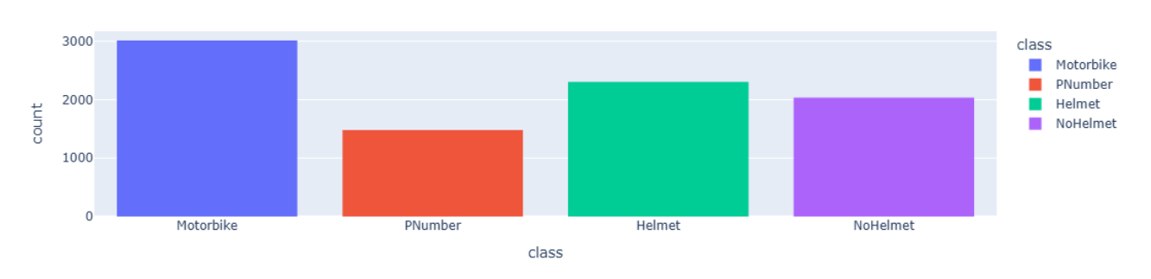
Class Distribution

Slide 16
Objective 2: Handling Class Imbalance in Traffic Violation Data
In traffic surveillance datasets, certain classes such as Helmet may contain significantly more samples than No Helmet or Number Plate classes. This imbalance can lead to biased predictions and reduced detection performance for violation cases.
Contribution: Improving Class Distribution through Data Augmentation
1. Data Augmentation Techniques
Applied transformation techniques to increase diversity in minority classes:
Image Rotation
Horizontal Flipping
Brightness and Contrast Adjustment
Scaling and Cropping
Noise Injection
These techniques enhance dataset balance and improve model generalization.

Slide 17
Objective 3: Optimizing Model Performance and Detection Accuracy
Optimization techniques are applied to minimize detection loss, improve bounding box localization, and enhance real-time inference accuracy.
Contribution: Implementing YOLOv8m Optimization Strategy
YOLOv8m utilizes advanced optimization techniques during training to improve convergence speed, stability, and detection precision.
Key optimization components include:
Adaptive Learning Rate Scheduling
Confidence Threshold Tuning
IoU Threshold Adjustment
Non-Maximum Suppression (NMS)
Batch Normalization for Stable Training
These techniques improve overall detection reliability in traffic scenarios.

Slide 18
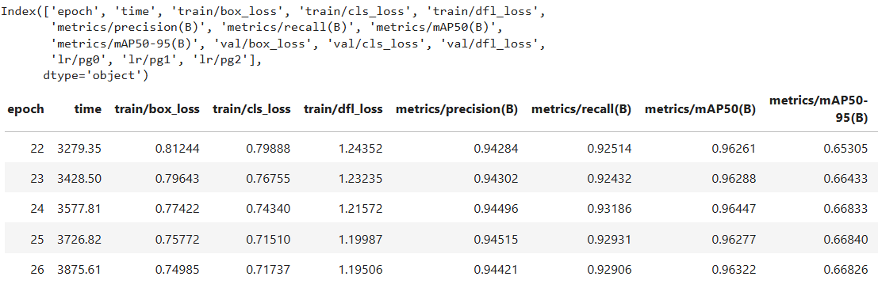
Training Performance Analysis

Slide 19
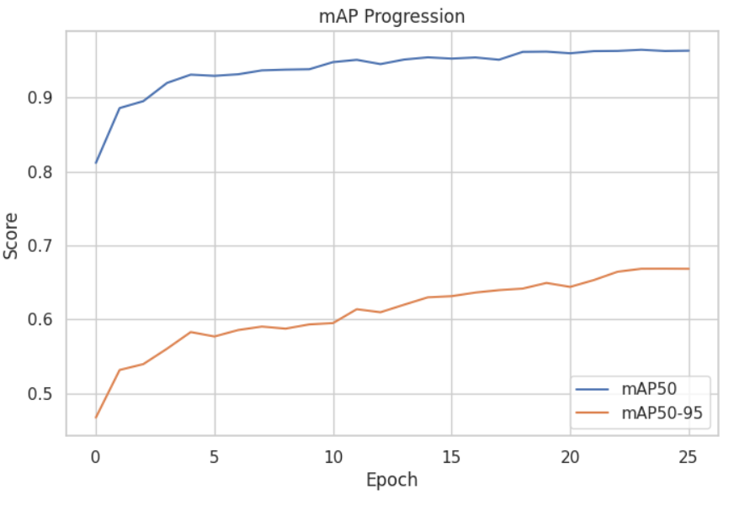
Training Performance Curve (mAP@50 and mAP@50–95)

Slide 20
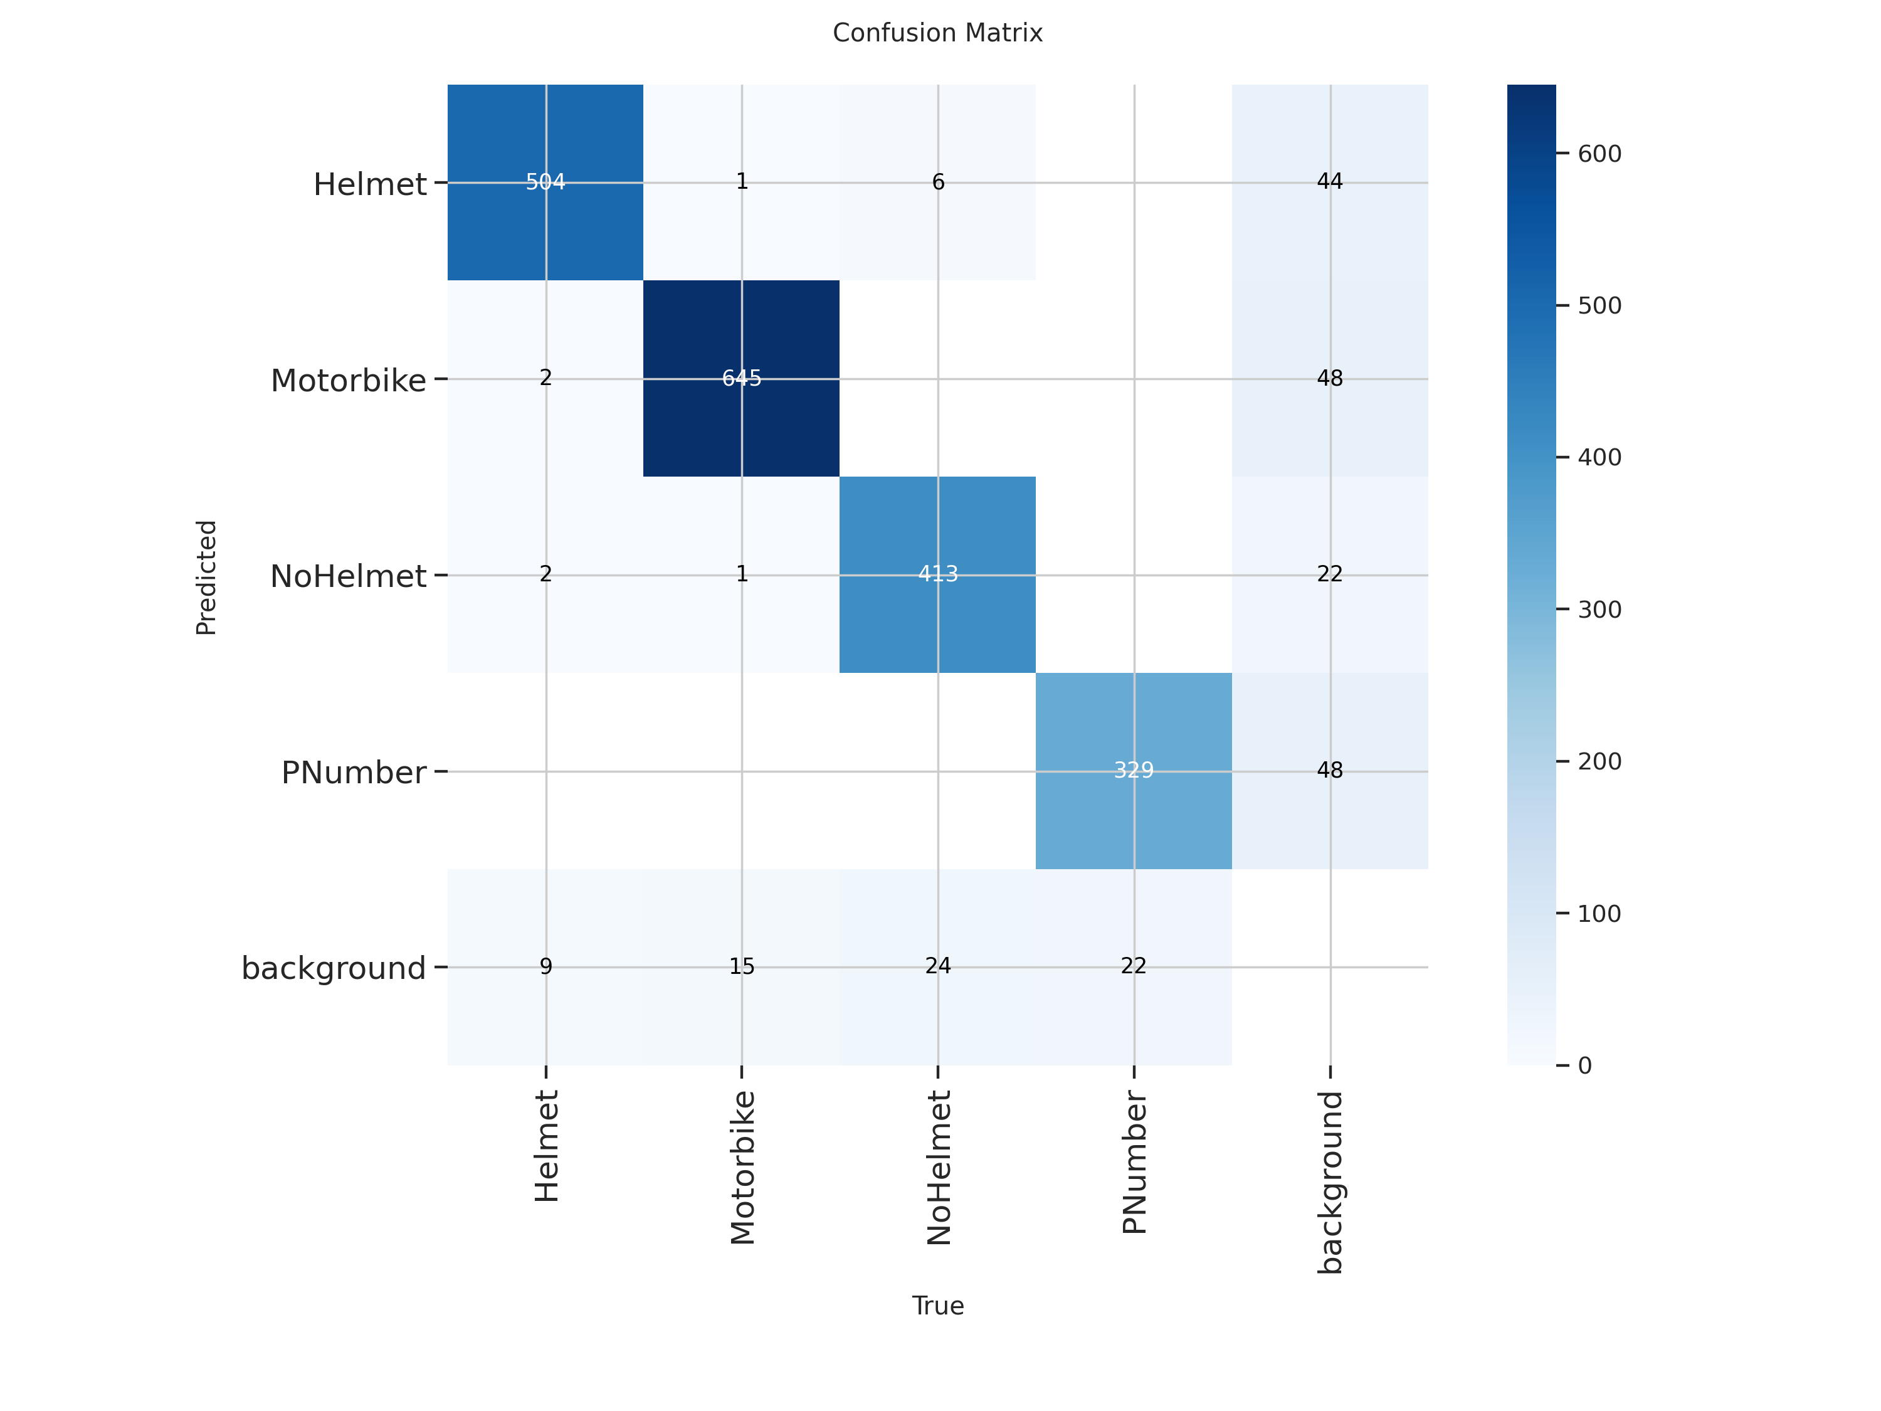
Confusion matrix

