Slide 1
Climate & Cricket: Predicting Team Scores from Weather Patterns
Sumanth Pidishetti (100008679)
Rohith Reddy Rudraiah Gari (100008638)
Sumanth Gadwala (100008777)
1
Team Nexus, Capstone Project

Slide 2
Predicting ODI Cricket Scoring Dynamics Using Shifting Weather Systems
The Prediction Target: team_total_score (Continuous target regression variable tracking absolute runs scored in an individual innings).
Machine Learning Paradigm: Supervised Numerical Regression.
The Core Problem Constraint: Standard sports analytics over-indexes on historical player averages while ignoring real-time planetary parameters.
Strategic Format Justification: Prioritized the ODI format to reduce the high scoring volatility and extreme randomness inherent to short-form T20 data, establishing a more balanced scoring baseline for tree-based estimators to isolate true climate modifiers.
2
Team Nexus, Capstone Project

Slide 3
Data Architecture & Multi-Source Integration Skill
Primary Source: Cricsheet.org -> Granular ball-by-ball performance logs extracted directly from raw hierarchical JSON data blocks.
Secondary Source: Open-Meteo Historical Archive API -> Free, keyless chronological microclimate environment data grids.
Dataset Matrix Scale: 1,148 unique chronological rows spanning major multi-format fixtures from 2022 to 2026.
Row Metric Definition: One row maps a single team's full performance profile within a specific innings on a confirmed calendar date.
Data Engineering Challenges: Weather nodes do not interpret text labels like 'Lord's'. Built a geocoding wrapper mapping venues to GPS coordinates to extract 3 PM and 8 PM climate slices.
Multi-Source Data Integration: We built a Python program that used stadium coordinates to match match dates from Cricsheet with the exact hourly weather conditions (3:00 PM for day games and 8:00 PM for night games) from the Open-Meteo weather database.
3
Team Nexus, Capstone Project

Slide 4
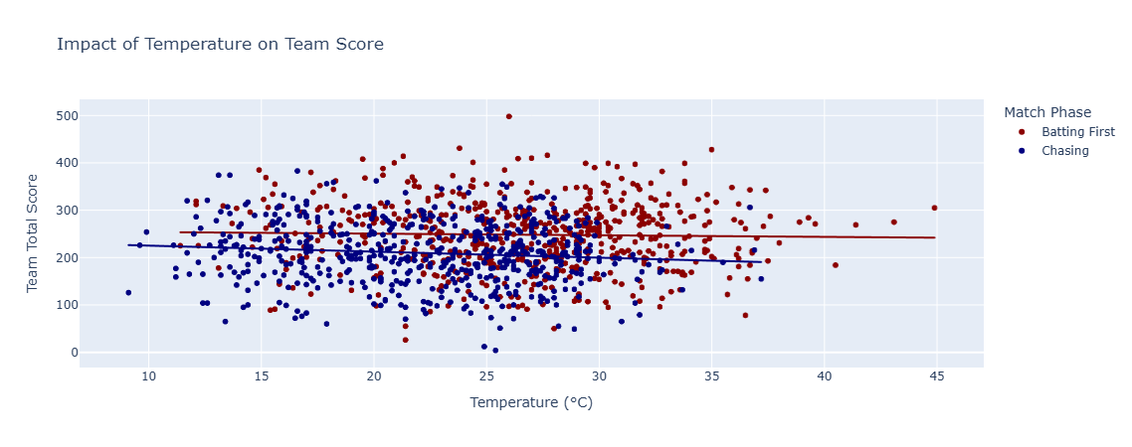
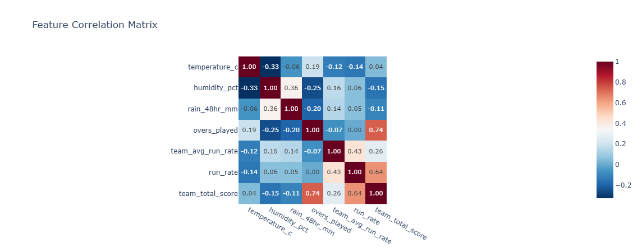
Exploratory Data Analysis (EDA) Insights
Weather Non-Linearity: Temperature variants modify scoring rate parameters non-linearly rather than following a basic straight-line relationship.
Atmospheric Shifts: Relative air humidity percentage spikes significantly during second-innings evening windows compared to afternoon frames.
Feature Correlation: Volumetric analysis shows that 'overs_played' holds the single highest direct correlation with final team totals.
Core Visual Discovery: High evening humidity levels map to accelerated scoring speeds ONLY when teams bat second, exposing a crucial dew interaction effect.
Distribution Patterns: Final scores show wide multi-modal distributions depending heavily on whether an innings faces a resource cutoff or full completion.
4
Team Nexus, Capstone Project

Slide 5
Technical Feature Space and Target Normalization
The Shortened Run Chase Confounding Factor: Teams batting second adjust intent or finish early upon hitting targets, causing misleading score dips.
The Exact Evaluated Feature Vector List: temperature_c, humidity_pct, rain_48hr_mm, overs_played, and team_avg_run_rate.
The Team Quality Anchor Rationale: Including team_avg_run_rate grounds the model in core team strength, allowing climate attributes to serve as fine-tuning modifiers.
5
Team Nexus, Capstone Project

Slide 6
Data Transformation & Integrity Protocols
Missing Value Protocol: Incomplete observations or coordinate lookup failures were handled by removing rows entirely to protect feature space.
What We Dropped: match_id , venue , city , team
Chronological Ordering Strategy: Sorted rows sequentially by date before splitting to prevent future data patterns from leaking into past training steps.
Vector Scaling: Applied StandardScaler normalization across numerical feature arrays to prevent high-magnitude features from masking lower-magnitude indicators.
6
Team Nexus, Capstone Project

Slide 7
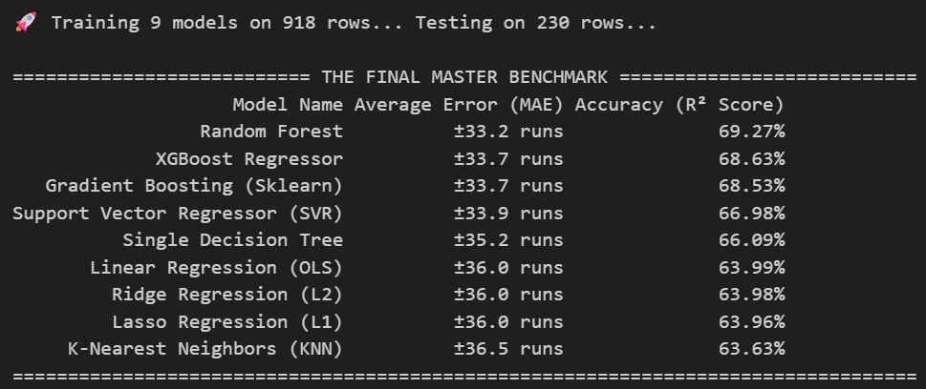
Supervised Model Comparison & Leaderboard Results
7
Team Nexus, Capstone Project

Slide 8
Code Implementation & Production-Safe Architecture
Decoupled Architecture Flow: Modulariized data preparation into separate notebook steps to cleanly isolate data gathering from modeling.
Server Defense Layer: Implemented python pacing parameter windows via time.sleep() to respect public server access constraints.
Robust Fail-Safe Node Handling: Wrapped JSON loading nodes inside try-except traps to bypass broken files without halting execution runs.
Loop Optimization: Programmed consistent tracking arrays to evaluate all 9 distinct regression models uniformly across identical training matrices.
8
Team Nexus, Capstone Project

Slide 9
Project Horizon & Advanced Modeling Next Steps
Trajectory 1: Geographic Venue Target Encoding -> Categorize stadium coordinates to account for physical constraints like altitude and boundary lengths.
Trajectory 2: Multi-Layer Hyperparameter Optimization -> Run automated RandomizedSearchCV tuning loops over our top Random Forest architecture to optimize tree depths.
Trajectory 3: Feature Interaction Expansion -> Combine humidity records and precipitation depth to build a composite pitch moisture proxy for deep pitch-wear insight.
9
Team Nexus, Capstone Project

Slide 10
Block 1: Problem Recap
• Prediction Target: team_total_score (Continuous Numerical Regression tracking total runs in an innings).
• Core Problem: Traditional sports models rely strictly on historical player stats, ignoring real-time planetary parameters.
• Why it Matters: Microclimate factors (temperature, humidity, rain) alter pitch friction, ball swing, and outfield drag.
• Format Justification: Selected 50-over ODIs to provide the models with a wide, structurally stable resource window (overs_played).
10
Team Nexus, Capstone Project

Slide 11
Block 2: Data Delta & Integration Architecture
• Source 1: Cricsheet.org -> Granular ball-by-ball JSON match logs.
• Source 2: Open-Meteo Historical Archive API -> Keyless microclimate data matched via stadium coordinates.
• New Features Added: venue_avg_score (Stadium Target Encoding) and is_batting_first (Innings Context).
• Data Cleanliness: Dropped incomplete coordinate lookup rows to prevent false microclimate imputation.
• Matrix Scale: 1,148 unique chronological team innings rows from major international fixtures.
11
Team Nexus, Capstone Project

Slide 12
Block 3: Model Journey & Baseline Leaderboard
• Validation Protocol: Chronological 80/20 train-test split (918 train rows | 230 hold-out test rows).
• K-Nearest Neighbors (KNN): Test MAE = ±36.5 runs | Test R² = 63.63%
• Linear Regression (OLS / Ridge / Lasso): Test MAE = ±36.0 runs | Test R² = 63.99%
• Single Decision Tree: Test MAE = ±35.2 runs | Test R² = 66.09%
• Support Vector Regressor (SVR): Test MAE = ±33.9 runs | Test R² = 66.98%
• XGBoost Regressor: Test MAE = ±33.7 runs | Test R² = 68.63%
• Neural Network Baseline (MLPRegressor): Test MAE = ±35.3 runs | Test R² = 65.38%
• Base Random Forest: Test MAE = ±33.2 runs | Test R² = 69.27%
12
Team Nexus, Capstone Project

Slide 13
Block 4: Tuning Sprint & Leak-Free Pipeline
• Leak-Free Strategy: Evaluated tuning parameters using PredefinedSplit on chronological training folds.
• Parameter Grid Search: Tested tree depths [5, 7, 9, 12, None] and estimator counts [50, 100, 150, 200].
• Optimal Hyperparameters: max_depth=7, n_estimators=200, min_samples_split=10, min_samples_leaf: 1, random-state: 42.
• Tuning Result: Cross-validated tuning MAE improved down to ±31.7 runs prior to final test exposure.
13
Team Nexus, Capstone Project

Slide 14
Block 5: Final Evaluation & Error Analysis
• Single Test Set Exposure: Evaluated exclusively once on the untouched 230-row chronological test set.
• Final Champion Performance: Test MAE = ±31.7 runs | Test R² Score = 71.17%
• Error Analysis Insight 1: High residual errors occur in rain-shortened matches where overs_played drops prematurely.
• Error Analysis Insight 2: Model over-predicts score potential when teams bat second chasing small total targets.
14
Team Nexus, Capstone Project

Slide 15
Block 6: Limits and Lessons
• Milestone 1 Failure Mode Revisit: Macro-weather features cannot capture individual player brilliance (e.g. centuries), capping accuracy near ~72%.
• Failed Feature Experiment: Multiplying humidity and rain into a pitch_moisture_proxy reduced R² to 70.57% due to Feature Redundancy.
• With Two More Weeks: We would build ball-by-ball dew tracking and dynamic rolling player form vectors.
15
Team Nexus, Capstone Project

Slide 16
Block 7: Reproducibility & Code Architecture
• Clean Workspace Isolation: Fully separated data fetch scripts from modeling pipelines.
• Deterministic Execution: Controlled global random_state=42 across scaling transformations and data splits.
• Robust Server Defensive Code: Implemented pacing sleep timers and try-except wrappers around API JSON nodes.
16
Team Nexus, Capstone Project

Slide 17
Conclusion
Data & Feature Engineering Success: Combining GPS-matched Open-Meteo microclimate logs with venue reputation anchors successfully unlocked the non-linear relationship between atmospheric drag and cricket scoring.
Methodological Rigor: Strict chronological time-splitting ensured zero data leakage from future matches into training matrices, giving us an authentic evaluation.
Final Peak Milestone: The optimized Random Forest achieved a benchmark 71.17% accuracy ($R^{2}$), bounding absolute score prediction error to within ±31.7 runs on unseen fixtures.
Final Peak Milestone: The optimized Random Forest achieved a benchmark 71.17% accuracy (𝑅^2), bounding absolute score prediction error to within ±31.7 runs on unseen fixtures.
Broader Impact: Proves that real-time planetary parameters can enhance traditional player-centric sports modeling.
17
Team Nexus, Capstone Project

Slide 18
Q/A
Thank You…
18
Team Nexus, Capstone Project

