Slide 1
Climate & Cricket: Predicting Team Scores from Weather Patterns
Sumanth Pidishetti (100008679)
Rohith Reddy Rudraiah Gari (100008638)
Sumanth Gadwala (100008777)
1
Team Nexus, Capstone Project

Slide 2
Predicting ODI Cricket Scoring Dynamics Using Shifting Weather Systems
The Prediction Target: team_total_score (Continuous target regression variable tracking absolute runs scored in an individual innings).
Machine Learning Paradigm: Supervised Numerical Regression.
The Core Problem Constraint: Standard sports analytics over-indexes on historical player averages while ignoring real-time planetary parameters.
Strategic Format Justification: Prioritized the ODI format to reduce the high scoring volatility and extreme randomness inherent to short-form T20 data, establishing a more balanced scoring baseline for tree-based estimators to isolate true climate modifiers.
2
Team Nexus, Capstone Project

Slide 3
Data Architecture & Multi-Source Integration Skill
Primary Source: Cricsheet.org -> Granular ball-by-ball performance logs extracted directly from raw hierarchical JSON data blocks.
Secondary Source: Open-Meteo Historical Archive API -> Free, keyless chronological microclimate environment data grids.
Dataset Matrix Scale: 1,148 unique chronological rows spanning major multi-format fixtures from 2022 to 2026.
Row Metric Definition: One row maps a single team's full performance profile within a specific innings on a confirmed calendar date.
Data Engineering Challenges: Weather nodes do not interpret text labels like 'Lord's'. Built a geocoding wrapper mapping venues to GPS coordinates to extract 3 PM and 8 PM climate slices.
Multi-Source Data Integration: We built a Python program that used stadium coordinates to match match dates from Cricsheet with the exact hourly weather conditions (3:00 PM for day games and 8:00 PM for night games) from the Open-Meteo weather database.
3
Team Nexus, Capstone Project

Slide 4
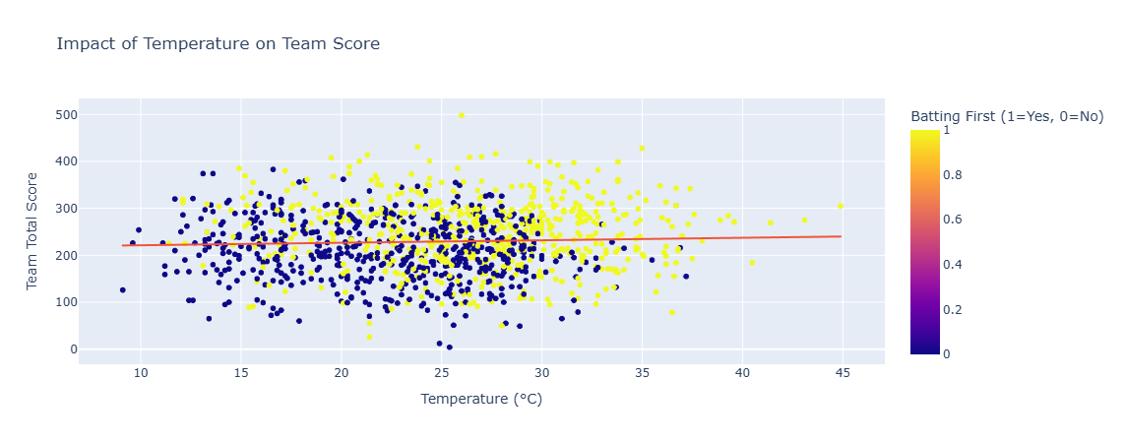
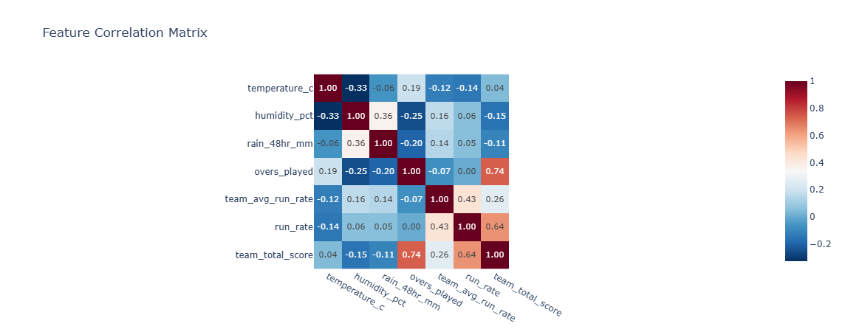
Exploratory Data Analysis (EDA) Insights
Weather Non-Linearity: Temperature variants modify scoring rate parameters non-linearly rather than following a basic straight-line relationship.
Atmospheric Shifts: Relative air humidity percentage spikes significantly during second-innings evening windows compared to afternoon frames.
Feature Correlation: Volumetric analysis shows that 'overs_played' holds the single highest direct correlation with final team totals.
Core Visual Discovery: High evening humidity levels map to accelerated scoring speeds ONLY when teams bat second, exposing a crucial dew interaction effect.
Distribution Patterns: Final scores show wide multi-modal distributions depending heavily on whether an innings faces a resource cutoff or full completion.
4
Team Nexus, Capstone Project

Slide 5
Technical Feature Space and Target Normalization
The Shortened Run Chase Confounding Factor: Teams batting second adjust intent or finish early upon hitting targets, causing misleading score dips.
The Exact Evaluated Feature Vector List: temperature_c, humidity_pct, rain_48hr_mm, overs_played, and team_avg_run_rate.
The Team Quality Anchor Rationale: Including team_avg_run_rate grounds the model in core team strength, allowing climate attributes to serve as fine-tuning modifiers.
5
Team Nexus, Capstone Project

Slide 6
Data Transformation & Integrity Protocols
Missing Value Protocol: Incomplete observations or coordinate lookup failures were handled by removing rows entirely to protect feature space.
What We Dropped: match_id , venue , city , team
Chronological Ordering Strategy: Sorted rows sequentially by date before splitting to prevent future data patterns from leaking into past training steps.
Vector Scaling: Applied StandardScaler normalization across numerical feature arrays to prevent high-magnitude features from masking lower-magnitude indicators.
6
Team Nexus, Capstone Project

Slide 7
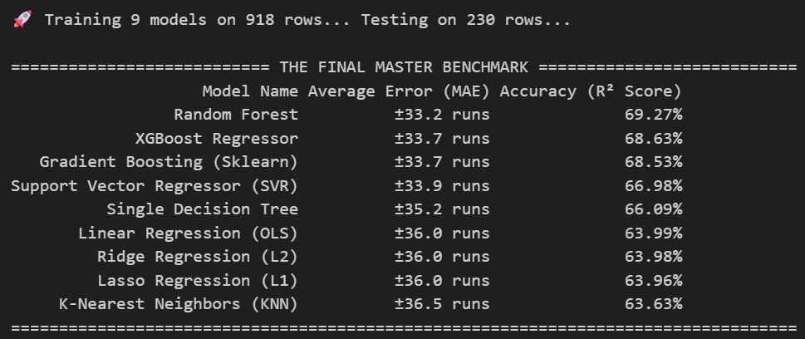
Supervised Model Comparison & Leaderboard Results
7
Team Nexus, Capstone Project

Slide 8
Code Implementation & Production-Safe Architecture
Decoupled Architecture Flow: Modulariized data preparation into separate notebook steps to cleanly isolate data gathering from modeling.
Server Defense Layer: Implemented python pacing parameter windows via time.sleep() to respect public server access constraints.
Robust Fail-Safe Node Handling: Wrapped JSON loading nodes inside try-except traps to bypass broken files without halting execution runs.
Loop Optimization: Programmed consistent tracking arrays to evaluate all 9 distinct regression models uniformly across identical training matrices.
8
Team Nexus, Capstone Project

Slide 9
Project Horizon & Advanced Modeling Next Steps
Trajectory 1: Geographic Venue Target Encoding -> Categorize stadium coordinates to account for physical constraints like altitude and boundary lengths.
Trajectory 2: Multi-Layer Hyperparameter Optimization -> Run automated RandomizedSearchCV tuning loops over our top Random Forest architecture to optimize tree depths.
Trajectory 3: Feature Interaction Expansion -> Combine humidity records and precipitation depth to build a composite pitch moisture proxy for deep pitch-wear insight.
9
Team Nexus, Capstone Project

Slide 10
Q/A
Thank You…
10
Team Nexus, Capstone Project

