Slide 1



CMR COLLEGE OF ENGINEERING & TECHNOLOGY
Kandlakoya, Medchal, Hyderabad - 501401
DEPARTMENT OF COMPUTER SCIENCE AND ENGINEERING
COVID19 TRACKER
NAME OF THE STUDENT & ROLL NO:
G. ARCHITH KUMAR - 19H51A05D5
MOHD IFTEQUARUDDIN - 19H51A05E0
R. ROHITH REDDY - 19H51A05E8
Under Esteemed Guidance Of
MAJOR Dr. V.A. NARAYANA - PROFESSOR, PRINCIPAL

Slide 2
OUTLINE
Abstract
Introduction
Literature survey
Existing system
Problems in existed system
Research Objective of Presentation
Problem Definition
Research work
- Proposed system architecture
- Methods
Results
Conclusion
Future Work
Notes:
2

Slide 3
ABSTRACT
Notes:
3

Slide 4
ABSTRACT
The novel coronavirus (COVID-19) that was first reported at the end of 2019 has impacted almost every aspect of life as we know it.
It is a novel infection with serious clinical manifestations, including death, and it has reached at least 124 countries and territories.
Modeling the Covid-19 pandemic spread is challenging. But there are data that can be used to project resource demands.

Slide 5
INTRODUCTION
Notes:
5

Slide 6
INTRODUCTION
Coronavirus disease (COVID-19) is an infectious disease caused by the SARS-CoV-2 virus. Anyone can get sick with COVID-19 and become seriously ill or die at any age.
Most people infected with the virus will experience mild to moderate respiratory illness and recover without requiring special treatment.
However, some will become seriously ill and require medical attention. Older people and those with underlying medical conditions like cardiovascular disease, diabetes, chronic respiratory disease, or cancer are more likely to develop serious illness.
The best way to prevent and slow down transmission is to be well informed about the disease and how the virus spreads. Get vaccinated when it’s your turn and follow local guidance.
Notes:
6

Slide 7
LITERATURE SURVEY
Notes:
7

Slide 8
EXISTED SYSTEM
COVID19-SEVERITY-PREDICTION
COVID-19 continues to spread across the United States. As of Oct 29, 2020, more than 9 million confirmed cases and 225 thousand deaths have been reported due to COVID-19 in the US. Outbreaks are not isolated to small geographic regions in the US and continue to appear across the country. Though many visualization tools exist to track these outbreaks, there is still a need for a rigorous and accessible interface for short-term forecasting and comparative exploration of COVID19 outbreaks at the county-level. We develop such an interface at covidseverity.com to provide the public with information and short-term forecasts on COVID-19 outbreaks for individual counties. The interface allows users to explore eight different metrics for every US county as well as compare each county with counties like it based on several characteristics.
Notes:
8

Slide 9
RESEARCH OBJECTIVE
Notes:
9

Slide 10
RESEARCH OBJECTIVE
STUDY OBJECTIVES
The main objectives are:
To quantify hospital-based outcomes and deaths, including in relation to sociodemographic characteristics and comorbidities as ascertained from hospital AND general practice data.
To estimate the strength of association between these outcomes and sociodemographic and health characteristics.

Slide 11
PROBLEM DEFINITION
Notes:
11

Slide 12
PROBLEM DEFINITION
Maintaining the data of Covid 19 cases day to day and analysing the data is a huge factor. To maintain the data and analyse the situation across the world is not so simple and will not get that accurate results so need a good efficient algorithms to get the accurate results.

Slide 13
RESEARCH WORK
Notes:
13

Slide 14
PROPOSED SYSTEM ARCHITECTURE
Data Collection
Data Pre Processing
Exploratory Data Analysis
Conclusion

Slide 15
PROPOSED METHODS
COVID 19 TRACKER
The work of Covid 19 tracker is to analyse the covid 19 cases data across the world using the data provided, and it shows the result in the form of graphs that includes the categories like :
The tracker can able to show the results according to the user requirements like if user want to see a particular country details then user can able to see that particular country in separate graph. This is a user-friendly tracker which is easy to use and gives accurate results and live results.

Slide 16
SYSTEM REQUIREMENTS
HARDWARE REQUIREMENTS:
PROCESSOR : DUAL CORE 2 DUOS
RAM : 4 GB DD
HARD DISK : 250 GB
SOFTWARE REQUIREMENTS:
OPERATING SYSTEM : WINDOWS 7/8/10/11
PLATFORM : GOOGLE COLAB
PROGRAMMING LANGUAGE : PYTHON WITH DATA ANALYSIS

Slide 17
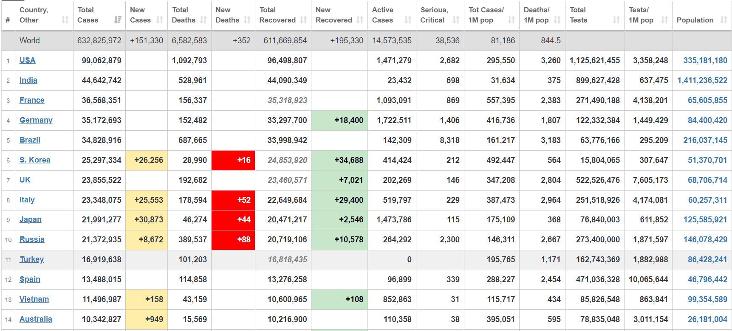
SOURCE – [ https://www.worldometers.info/coronavirus/ ]

Slide 18
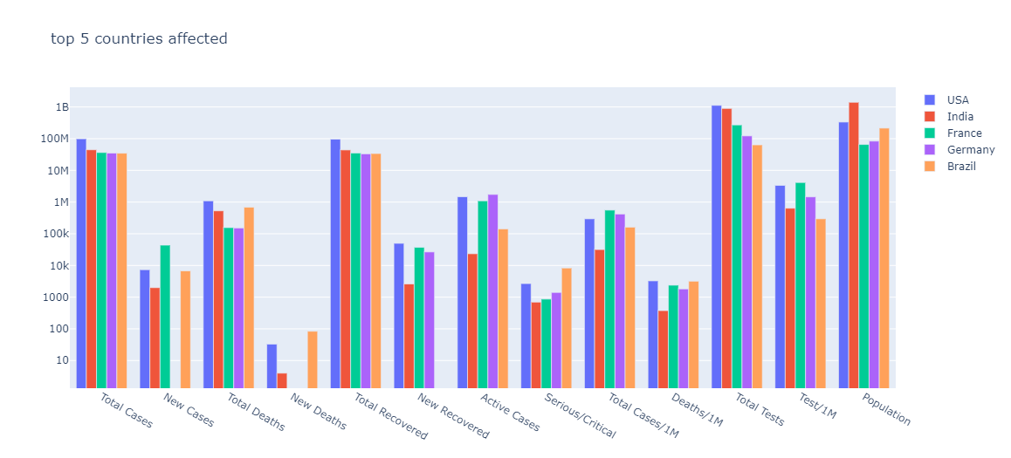
RESULT ANALYSIS
TOP 5 COUNTRIES

Slide 19
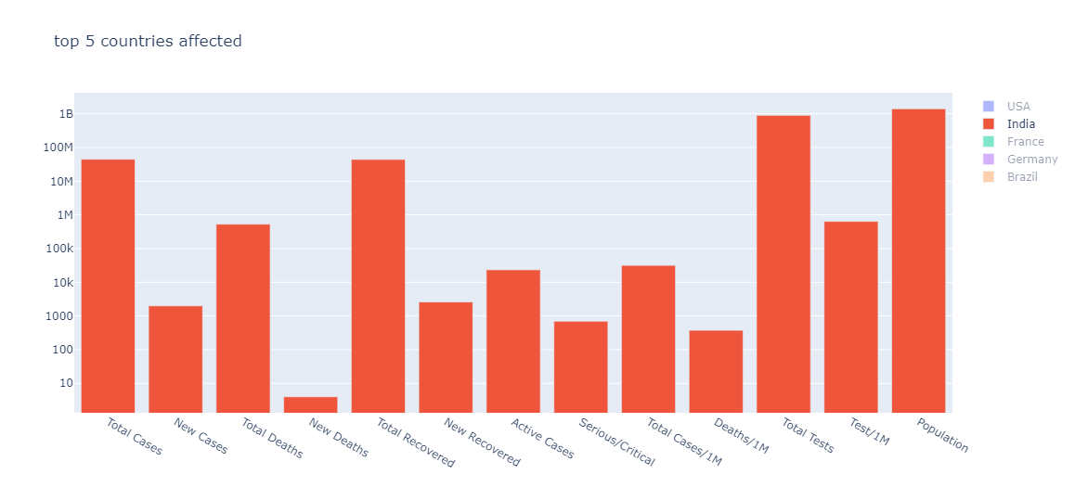
SINGLE COUNTRY

Slide 20
CONCLUSION
With this project, one hope to educate people on how easily viruses can be transmitted and infect an entire population and how social distancing and home isolation are key strategies in halting the spread of the virus.
This project will help people to know the situation of their country and, they come to know where exactly the covid spreading rapidly and they will plan according to that.

Slide 21
FUTURE WORK
In future may the tracking analysis will change with the different technologies developing day by day and lot of features can add.
This tracker can be developed in so many ways for example the tracking will not only in countries but also can develop in states and districts.

Slide 22
REFERENCES
[1] The New York Times. COVID-19 Data in the United States. https://github.com/nytimes/covid-19-data, 2020. Accessed on 04-01-2020 at https://github.com/nytimes/covid-19-data.
[2] Ensheng Dong, Hongru Du, and Lauren Gardner. An interactive web-based dashboard to track covid-19 in real time. The Lancet infectious diseases, 20(5):533–534, 2020.
[3] Benjamin D Wissel, PJ Van Camp, Michal Kouril, Chad Weis, Tracy A Glauser, Peter S White, Isaac S Kohane, and Judith W Dexheimer. An interactive online dashboard for tracking covid-19 in us counties, cities, and states in real time. Journal of the American Medical Informatics Association, 2020.
[4] Douglas Arneson, Matthew Elliott, Arman Mosenia, Boris Oskotsky, Rohit Vashisht, Travis Zack, Paul Bleicher, Atul J Butte, and Vivek A Rudrapatna. Covidcounties-an interactive, real-time tracker of the covid-19 pandemic at the level of us counties. medRxiv, 2020.
[5] Plotly Technologies Inc. Collaborative data science. 2015.

Slide 23
[6] Nick Altieri, Rebecca L Barter, James Duncan, Raaz Dwivedi, Karl Kumbier, Xiao Li, Robert Netzorg, Briton Park, Chandan Singh, Yan Shoo Tan, Tiffany Tang, Yu Wang, Chao Zhang, and Bin Yu. Curating a covid-19 data repository and forecasting county-level death counts in the united states. Harvard Data Science Review, 11 2020. https://hdsr.mitpress.mit.edu/pub/p6isyf0g.
[7] USA Facts. COVID-19 Deaths Data. Accessed on 03-31-2020 at https://www.reuters.com/article/ us-health-coronavirus-who/covid-19-spread-map.
[8] Response4life. Response4life. https://response4life.org, 2020. Accessed on 10-01-2020 at https://github.com/ nytimes/covid-19-data.
[9] COVID-19: A History of Coronavirus.https:// www.labmanager.com › lab-health-andsafety.
[10] Coronavirus Update (Live).https:// www.worldometers.info › coronavirus

Slide 24


