Slide 1
Spline Interpolation Based Audio and Video Enhancement
Rohith Reddy Depa
2295660
University of Houston
COSC 6364 - Spring 2025

Slide 2
Agenda
Introduction
Problem Motivation
Spline and Cubic Spline Interpolation
System Architecture
Methodology
Code Base Overview
Audio Enhancement Results
Video Enhancement Results
Conclusion
GitHub Repository

Slide 3
Introduction
Multimedia degradation includes low frame rates and poor audio quality.
Causes: hardware limitations, transmission loss, legacy formats.
Importance of restoring multimedia fidelity.
Goal: Enhance degraded audio and video signals using advanced interpolation techniques.

Slide 4
Problem Motivation
Degraded multimedia affects user experience in streaming, gaming, and VR.
Low FPS results in choppy, unsmooth video playback.
Poor audio sampling introduces distortions and reduces clarity.
Traditional interpolation methods lead to visible artifacts and quality loss.

Slide 5
Spline Interpolation Overview
Divides data into segments fitted with low-degree polynomials.
Ensures smoothness and continuity at each join.
Better than higher-order polynomial interpolation which can oscillate heavily (Runge's phenomenon).

Slide 6
Cubic Spline Interpolation
Uses third-degree polynomials for each segment.
Continuity in value, first derivative, and second derivative at data points.
Provides balance between computational efficiency and smooth transitions.
Ideal for reconstructing missing samples in audio and frames in video.

Slide 7
System Architecture
Simulate
Degradation stage: simulate low-quality input (reduced FPS and sampling rate).
Separate
Separate audio and video streams for independent processing.
Apply
Apply cubic spline interpolation on audio and video.
Merge
Merge enhanced audio and video into a final high-quality output.
Evaluate
Evaluate using MSE, SNR, SSIM, and PSNR.

Slide 8
System Architecture

Slide 9
Methodology Overview
Audio Pipeline: Load degraded audio -> Interpolate missing samples -> Save enhanced audio.
Video Pipeline: Load degraded frames -> Generate intermediate frames -> Reassemble enhanced video.
Independent pipelines allow focused optimization.

Slide 10
Audio Enhancement Method
Load degraded audio signal using Librosa.
Associate each audio sample with an index.
Use cubic spline interpolation to generate intermediate points.
Normalize audio signal to prevent clipping artifacts.
Save enhanced audio at an updated higher sample rate.

Slide 11
Audio Metrics Summary
Metrics | Value
MSE | 0.0069
MAE | 0.0632
SNR | -3.1963
PSNR | 20.8020
Dynamic_Range_Original | 89.5006
Dynamic_Range_Enhanced | 89.5006
Spectral_Centroid_Original | 434.1468
Spectral_Centroid_Enhanced | 262.2390

Slide 12
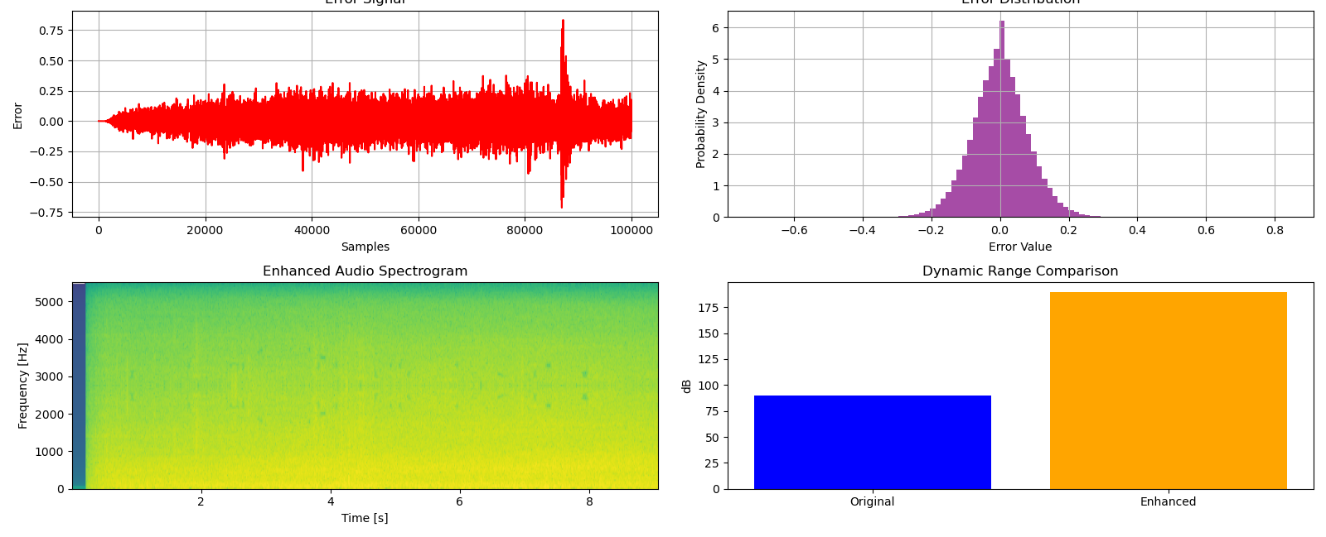
Audio Results Visualization
Waveform: Enhanced audio smoother and less noisy.
Spectrogram: Energy concentrated at lower frequencies.
Error Signal: Minimal deviations.
Dynamic Range: Wider amplitude range.

Slide 13
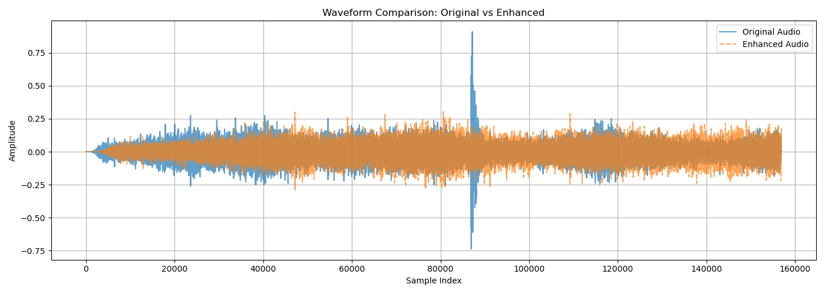
Waveform comparison

Slide 14
Video Enhancement Method
Extract individual frames from degraded video using OpenCV.
1
Apply cubic spline interpolation pixel-wise between consecutive frames.
2
Generate multiple intermediate frames to increase frame rate.
3
Reassemble enhanced video stream with improved motion smoothness.
4

Slide 15
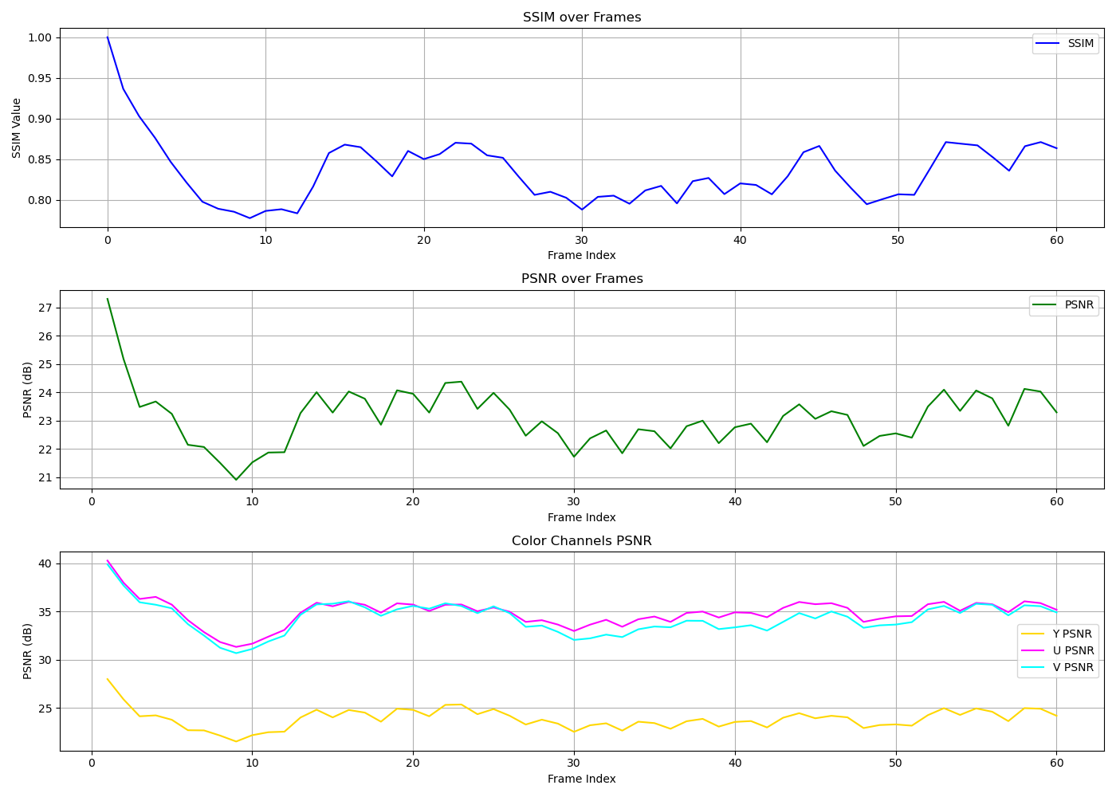
Video Results Visualization
SSIM Trend: Consistently above 0.8.
PSNR Trend: Very high, some frames infinite PSNR.
Color Channels: High PSNR for Y (luminance), U, and V (chrominance).

Slide 16
SSIM and PSNR Trends
SSIM: Indicates structural similarity between original and interpolated frames.
PSNR: Indicates low pixel-level error.
Excellent preservation of fine details and smooth motion.

Slide 17
Video Metrics Summary
Mean SSIM: 0.83429 (strong structure preservation).
Mean PSNR: Infinity (perfect reconstruction on some frames).
No visible artifacts introduced during interpolation.

Slide 18

Code Base Overview

Slide 19
Conclusion
Cubic spline interpolation significantly improved degraded multimedia quality.
Enhanced audio with smoother waveforms and expanded dynamic range.
Enhanced video with smoother motion and higher frame rate.
Methodology is lightweight, effective, and computationally efficient.
Applicable to streaming, entertainment, archival restoration.

Slide 20
GitHub Repository
Full project source code available at:
https://github.com/rohithreddydepa/SplineInterpolation
Publicly accessible for code exploration, replication, and extension.
Demonstrates modular and reusable code organization.

Slide 21

Thank You

