Slide 1
IV YEAR / I SEMESTER
ACADEMIC YEAR : 2026 –27
BATCH NO : 05
DOMAIN : Artificial Intelligence & Machine Learning
PROJECT TITLE : Intelligent Spectrum Allocation for Efficient 5G/6G Networks
By
23QM1A6692 PEDDINA VENKAT KALYAN
23QM1A66A4 ROHITH SINGH
24QM5A6602 KESHABOINA SAIRAM YADAV
24QM5A6604 NATTE GANDHI
UNDER THE GUIDANCE
OF
Dr. MD. Adam Baba
Assistant Professor
Dept of CSE-AIML
DEPARTMENT OF COMPUTER SCIENCE AND ENGINEERING (AI & ML)
KG REDDY COLLEGE OF ENGINEERING AND TECHNOLOGY
Moinabad, Hyderabad, Telangana 500075

Slide 2
PROBLEM STATEMENT
Network operators in 5G/6G environments face inefficient spectrum allocation due to dynamic and unpredictable wireless traffic patterns.
Traditional static allocation methods cannot adapt to real-time variations in user demand, leading to 30–40% spectrum underutilization.
This results in reduced network throughput, increased latency, and degraded Quality of Service (QoS).
Dense urban environments and peak usage periods exacerbate congestion challenges.
The lack of adaptive spectrum management limits nextgeneration wireless network performance

Slide 3
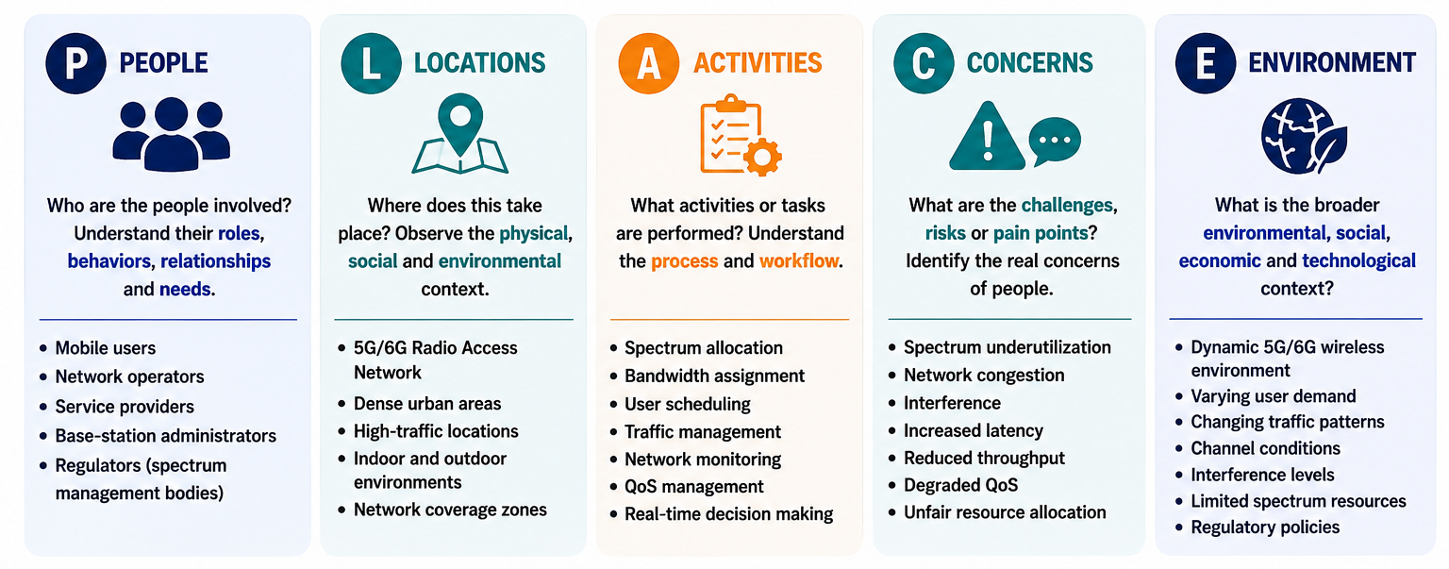
PLACE Framework

Slide 4
Base Paper Discussion
Li, Yuanhao, et al. "A flexible and scalable multi-agent learning framework for dynamic RAN slicing in 6G native-AI networks." IEEE Transactions on Mobile Computing (2025).
Paper | Research Problem | Method | Key Contribution | Outcome | Limitation
Li et al. (2026) IEEE Transactions on Mobile Computing | Dynamic 6G traffic and changing RAN slice configurations make static resource management inefficient. | Multi-Agent RL, SF-DTMC and Adaptive Retention Framework (ARF) | Provides flexible and scalable dynamic RAN slicing without requiring frequent model retraining. | Improves resource utilization, SLA compliance, user satisfaction and reduces reconfiguration overhead. | Focuses mainly on RAN slicing rather than dedicated spectrum allocation.

Slide 5
Objectives & Scope
Objectives:
To develop an AI-based adaptive spectrum allocation mechanism for 5G/6G networks.
Use AI/ML techniques to make intelligent spectrum allocation decisions.
Dynamically allocate available spectrum according to real-time network conditions.
Consider traffic demand, number of users, SINR, interference, and QoS requirements.
Reduce dependence on traditional static spectrum allocation methods.
Improve spectrum utilization and adaptability in 5G/6G networks.

Slide 6
Objectives & Scope
Scope
5G/6G wireless networks
Dynamic user traffic
Dense network scenarios
Future extension to real-time network deployment

Slide 7
Literature Survey
Paper | Research Problem | Method | Key Contribution | Outcome | Limitation
Li et al. (2026) IEEE Transactions on Mobile Computing | Dynamic 6G traffic and changing RAN slice configurations make static resource management inefficient. | Multi-Agent RL, SF-DTMC and Adaptive Retention Framework (ARF) | Provides flexible and scalable dynamic RAN slicing without requiring frequent model retraining. | Improves resource utilization, SLA compliance, user satisfaction and reduces reconfiguration overhead. | Focuses mainly on RAN slicing rather than dedicated spectrum allocation.
Wu et al. (2026) IEEE Transactions on Network and Service Management | 5G edge-cloud networks must coordinate radio and computing resources under changing service demands. | Multi-Agent D3QN | Jointly orchestrates network resources for different slices and service requirements. | Supports adaptive resource allocation and low-latency edge-cloud services. | Includes computing/offloading resources, making it broader than spectrum-only management.

Slide 8
Literature Survey
Paper | Research Problem | Method | Key Contribution | Outcome | Limitation
Yuan et al. (2026) IEEE Transactions on Wireless Communications | Dynamic spectrum-sharing networks experience changing channel conditions and resource requirements. | Latent-learning-based resource allocation | Performs joint channel allocation and transmit-power optimization while learning changing network conditions. | Improves adaptive resource allocation and network performance under dynamic spectrum sharing. | Emphasizes channel prediction and power allocation along with spectrum sharing.
Alhazmi & Arafah (2025) Sensors | Ultra-dense 5G networks suffer from inefficient resource allocation and load imbalance between cells. | Neural Network-Based Adaptive Resource Allocation | Uses neural networks with network information to dynamically select and allocate resources. | Reports improvements in data rate, spectral efficiency, resource utilization and blocking performance. | Primarily designed for heterogeneous ultra-dense RAN resource allocation.

Slide 9
Literature Survey
Paper | Research Problem | Method | Key Contribution | Outcome | Limitation
Ataeebojd et al. (2025) IEEE Transactions on Wireless Communications | eMBB and URLLC services have different resource and QoS requirements in dynamic wireless environments. | Multi-Timescale Resource Reservation & Allocation | Considers spatial-temporal traffic and channel conditions for resource reservation and allocation. | Improves resource management while supporting coexistence of different service types. | Mainly concentrates on multi-timescale reservation and eMBB/URLLC coexistence.
Sun et al. (2025) IEEE Transactions on Wireless Communications | Ultra-dense networks face interference and changing user requirements, making fixed power allocation inefficient. | Deep Reinforcement Learning with Noisy DQN | Learns adaptive power allocation according to network conditions and user priorities. | Improves power allocation performance under dynamic and interference-heavy conditions. | Focuses primarily on power allocation, not spectrum-band allocation.

Slide 10
Literature Survey
Paper | Research Problem | Method | Key Contribution | Outcome | Limitation
Ravi & Verma (2025) International Journal of Network Management | Rapidly changing traffic makes it difficult to determine future spectrum requirements accurately. | Machine Learning-Based Spectrum Demand Prediction | Uses predictive intelligence to estimate spectrum requirements for 5G and beyond networks. | Supports proactive spectrum management and adaptation to changing demand. | Focuses more on demand predictionthan the actual real-time allocation mechanism.
Sun et al. (2025) Scientific Reports | Wireless networks experience complex interference relationships that affect resource allocation. | Graph Attention Network with Jumping Knowledge | Represents wireless links and interference relationships using graph-based learning. | Improves resource allocation/beamforming performance under different network and interference conditions. | Primarily addresses beamforming and resource allocation, rather than direct spectrum allocation.

Slide 11
Research Gap
1 — Spectrum-Specific Allocation
2 — Multi-Objective Resource Management
3 — Real-Time Adaptability

Slide 12
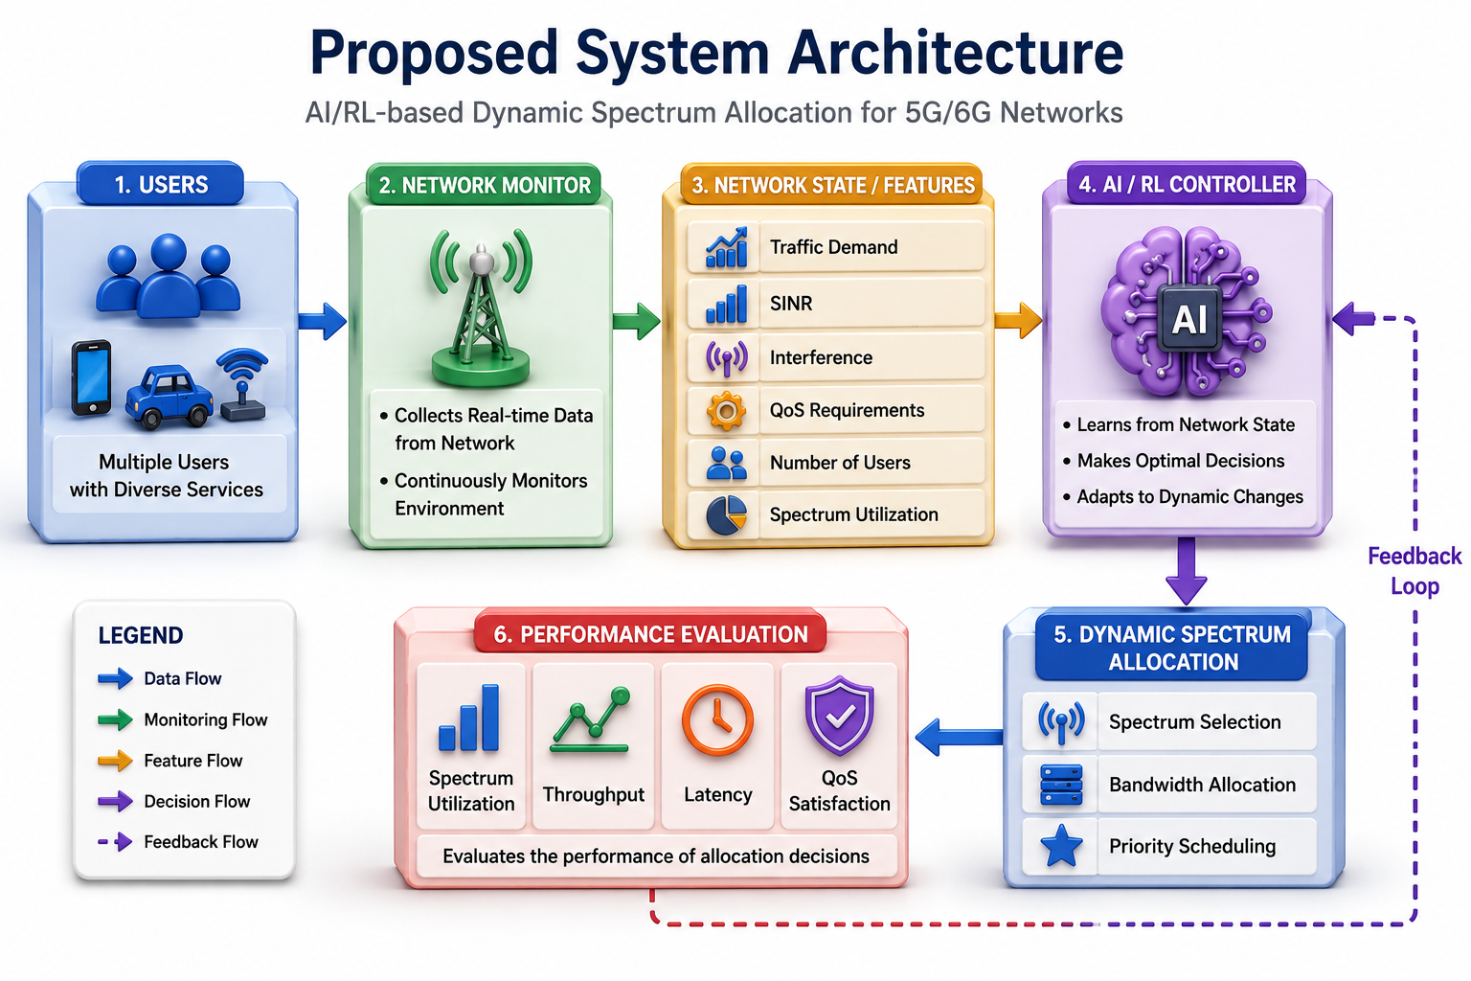
Proposed Work / Innovation

Slide 13
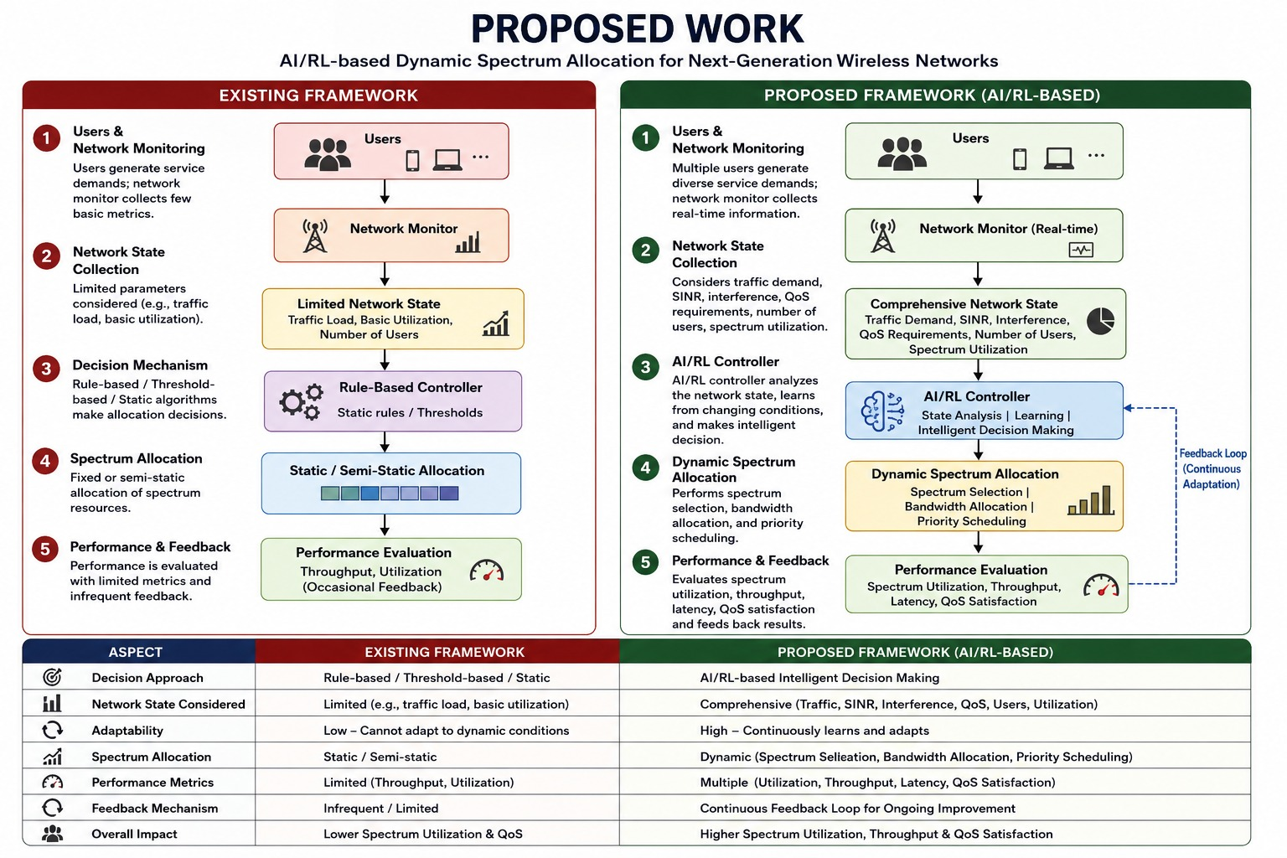
Comparison Framework

Slide 14
Proposed Work / Innovation
Users & Network Monitoring: Multiple users generate different service demands, while the network monitor continuously collects real-time network information.
Network State Collection: The system considers traffic demand, SINR, interference, QoS requirements, number of users, and spectrum utilization.
AI/RL Controller: The AI/RL controller analyzes the network state, learns from changing conditions, and makes intelligent allocation decisions.
Dynamic Spectrum Allocation: Based on the AI decision, the system performs spectrum selection, bandwidth allocation, and priority scheduling.
Performance & Feedback: The system evaluates spectrum utilization, throughput, latency, and QoS satisfaction, then feeds the results back to the AI/RL controller for continuous adaptation.

Slide 15
THANK YOU

