Slide 1
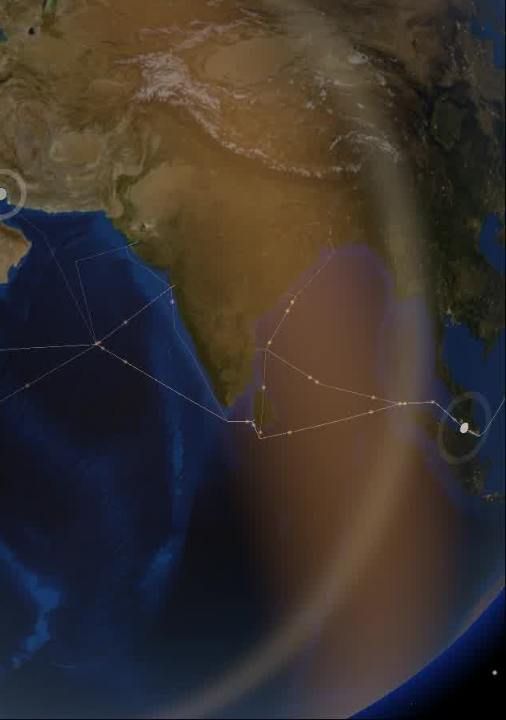

DHRUVA / FORGE GEN AI BUILDATHON / TEAM ZORVIX
THEME 02
Climate, Resource Infrastructure
& Global Supply Resilience
DHRUVA
PROBLEM STATEMENT / SHOCKWAVE
A live supply-shock desk for India's
small importers and exporters.
TEAM ZORVIX
ROHITH MS · SAKTHI P · PARTHASARATHY S
KNOW BEFORE IT LANDS. • Forge Gen AI buildathon
01 / 08
Notes:
Theme 2: Climate, Resource Infrastructure & Global Supply Resilience. The attached problem statement is titled SHOCKWAVE, drafted 30 October 2026. The implemented product in the repository is named Dhruva. Team: Zorvix. Members: ROHITH MS, SAKTHI P, PARTHASARATHY S. Distinguish the proposal's document-photo intake and suggested SQLite/SSE architecture from the implemented Next.js, NDJSON, no-database workflow. All eight slides are intentionally retained per the user's request.
Design: 700 ms fade between slides, followed by automatic staggered object entrances. Use PowerPoint Slide Show for native motion. Canva import may simplify or discard PowerPoint animation timing. The companion HTML provides independently tested browser animations.

Slide 2
DHRUVA / THE PROBLEM
Public signals. No shipment-level answer.
For Indian MSME importers, exporters, small forwarders and procurement teams.
01
02
03
Scattered
public signals
Risk crosses
transport modes
Advice stops
before hand-over
Weather, cyclones, alerts and
transport feeds live in different
places, formats and timeframes.
A sea leg, airport transfer and
road delivery have different
exposures and blind spots.
The shipper still needs to select
a nearby agency and review
when and where to hand over.
THE PS: TRANSLATE A SUPPLY SHOCK INTO WHAT IT MEANS FOR THIS CONSIGNMENT.
KNOW BEFORE IT LANDS. • Forge Gen AI buildathon
02 / 08
Notes:
Frame the user problem without claiming measured cost savings or adoption. A small business needs an explanation tied to its own consignment, with coverage limits clearly visible. The final mile of the decision is a practical hand-over plan.
Design: 700 ms fade between slides, followed by automatic staggered object entrances. Use PowerPoint Slide Show for native motion. Canva import may simplify or discard PowerPoint animation timing. The companion HTML provides independently tested browser animations.

Slide 3
DHRUVA / THE SOLUTION
One desk, from description to hand-over.
A connected workflow across sea, air, rail and road.
01
02
03
04
05
DESCRIBE
›
PLAN
›
CHECK
›
DECIDE
›
HAND OVER
Pick places or type
the shipment in a sentence.
Build candidate routes
with real coordinates.
Read the sources relevant
to each transport leg.
Inspect risk, confidence
and possible alternatives.
Find an agency, review
details, create a signed slip.
Real data
Inspectable reasoning
A human decides
Missing sources stay visible.
Verdicts cite evidence and freshness.
Approval precedes the booking slip.
KNOW BEFORE IT LANDS. • Forge Gen AI buildathon
03 / 08
Notes:
Walk through the five steps. Routes are planned before risk is judged. Confidence depends on independent fresh evidence. The human reviews the result before generating the hand-over slip. Do not equate the signed slip with a carrier-confirmed reservation.
Design: 700 ms fade between slides, followed by automatic staggered object entrances. Use PowerPoint Slide Show for native motion. Canva import may simplify or discard PowerPoint animation timing. The companion HTML provides independently tested browser animations.

Slide 4
DHRUVA / ARCHITECTURE
Eleven specialist roles. One checkable answer.
Next.js + React + TypeScript • NDJSON analysis stream • No database requirement
UNDERSTAND
Intake
Planner
Resolve the shipment and candidate itineraries.
WATCH
Maritime
Storm
Aviation
Surface
Alerts
News
Read source-specific evidence for the relevant legs.
DECIDE
Corroborator
Deterministic code judges agreement and confidence.
ACT
Strategist
Comms
Compare alternatives and explain the next step.
The language model can polish parsing and prose. It does not invent the risk score.
KNOW BEFORE IT LANDS. • Forge Gen AI buildathon
04 / 08
Notes:
These are specialist roles shown by the project, not a claim that eleven independent LLM calls always run. The corroborator is deterministic. Optional AI Gateway access can help with intake and narrative; rules and templates remain available without a key. API handlers stream trace events back to the desk.
Design: 700 ms fade between slides, followed by automatic staggered object entrances. Use PowerPoint Slide Show for native motion. Canva import may simplify or discard PowerPoint animation timing. The companion HTML provides independently tested browser animations.

Slide 5
DHRUVA / EVIDENCE & CONFIDENCE
Every signal carries its receipt.
The desk reports where a reading came from, when it was fetched and what it can cover.
Confidence needs
corroboration.
Sea
IMF PortWatch • Open-Meteo Marine
Weather + hazards
Independent evidence matters.
Stale and unavailable feeds
reduce coverage and certainty.
Open-Meteo • GDACS • USGS
Official + aviation
NDMA Sachet • AviationWeather • FAA NAS
Routes + agencies
GREEN
WATCH
RED
OSRM • OpenStreetMap / Overpass / Nominatim
No fresh evidence → “Unsure”.
KNOW BEFORE IT LANDS. • Forge Gen AI buildathon
05 / 08
Notes:
Sources have different scopes and terms. GDELT news is a weaker, best-effort signal; the table lists representative sources rather than an exhaustive catalog. Google Places, Resend and AI Gateway are optional. An outage is not permission to fill in numbers. Confidence is not an independently validated prediction-accuracy metric.
Design: 700 ms fade between slides, followed by automatic staggered object entrances. Use PowerPoint Slide Show for native motion. Canva import may simplify or discard PowerPoint animation timing. The companion HTML provides independently tested browser animations.

Slide 6
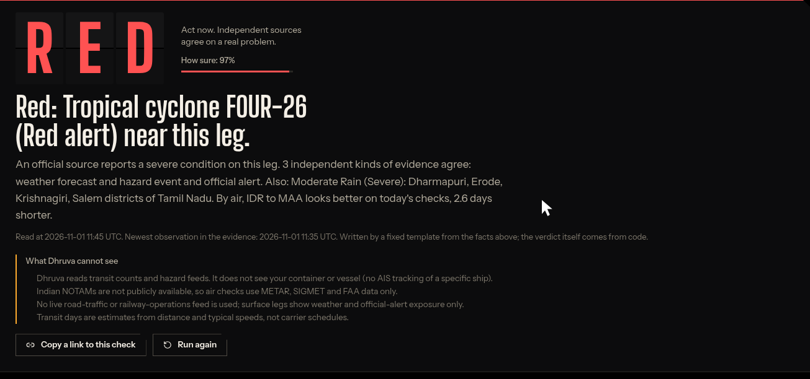
DHRUVA / REAL DEMO / 1 NOV 2026
Indore → Chennai: the evidence changes the plan.
Road shipment • 20 kg of textile samples • Actual project output captured during the demo
RED
97% confidence
1,447 km • about 3.6 days
Cyclone + severe rain evidence
Three independent families:
weather, hazard, official alerts.
DATED DEMO SNAPSHOT — not a current travel advisory or a promise of safe passage.
KNOW BEFORE IT LANDS. • Forge Gen AI buildathon
06 / 08
Notes:
The live demo on 1 November 2026 showed a red verdict with 97% confidence. It cited tropical cyclone FOUR-26, severe corridor weather, and official rain alerts. The OSRM road plan was 1,447 km and about 3.6 days using the project estimate. Both road and air alternatives had warnings; an alternative is not automatically safe. These are a dated application output, not claims about current conditions or model accuracy.
Design: 700 ms fade between slides, followed by automatic staggered object entrances. Use PowerPoint Slide Show for native motion. Canva import may simplify or discard PowerPoint animation timing. The companion HTML provides independently tested browser animations.

Slide 7
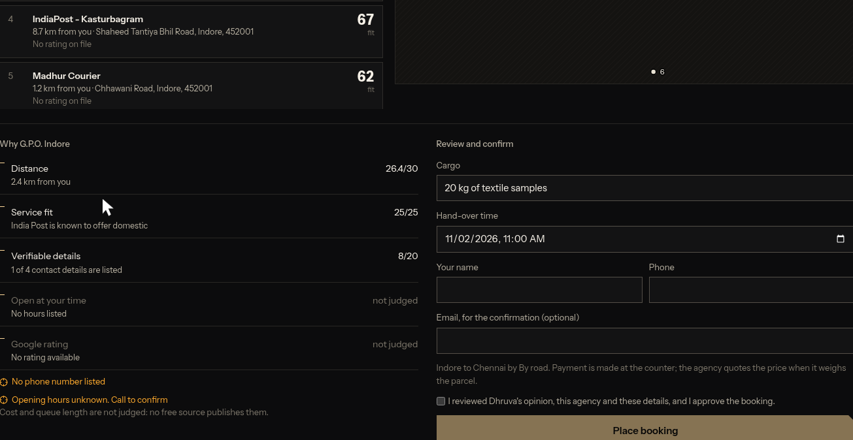
DHRUVA / AGENCY HAND-OVER
Carry the reviewed decision to the counter.
Find nearby agencies, compare their fit and approve a hand-over plan.
01
Find near the origin
Actual Indore post-office and courier listings.
02
Review the fit
Distance, capabilities and known details.
03
Approve the details
Cargo, sender and proposed hand-over time.
04
Keep the signed slip
Shipment + selected agency + risk snapshot.
Demo selection: G.P.O. Indore. Signed slip + calendar export completed.
The slip records the approved plan; it does not automatically reserve a carrier slot or notify the agency.
KNOW BEFORE IT LANDS. • Forge Gen AI buildathon
07 / 08
Notes:
The demo found six nearby listings and selected G.P.O. Indore. The user reviewed the agency fit and hand-over form, entered the synthetic name Demo Shipper, and generated a signed booking slip plus an ICS calendar event. No email or agency message was sent. No agency booking API is integrated. Profiles stay in the browser; the signed link carries the plan.
Design: 700 ms fade between slides, followed by automatic staggered object entrances. Use PowerPoint Slide Show for native motion. Canva import may simplify or discard PowerPoint animation timing. The companion HTML provides independently tested browser animations.

Slide 8
DHRUVA / VALUE & ROADMAP
Make the next shipment an informed decision.
IMPLEMENTED TODAY
PROPOSED NEXT STEPS
Multimodal route planning
Source-linked risk explanations
Freshness and confidence visibility
Nearby agency + signed hand-over slip
Document-photo intake from the proposal
Deeper operational feeds and monitoring
Carrier integrations for confirmed slots
MSME pilots and outcome validation
DHRUVA
VIEW SOURCE
WATCH THE DEMO
Know the route. Read the evidence. Make an informed decision.
KNOW BEFORE IT LANDS. • Forge Gen AI buildathon
08 / 08
Notes:
Close on shipped capabilities and clearly proposed work. Do not claim customers, commercial traction, carrier partnerships, pricing accuracy, queue estimates or validated risk-prediction accuracy. The buttons link to the public repository and the completed 4:03 demo. This is an editable PowerPoint deck suitable for Canva import; it was not created inside Canva.
Design: 700 ms fade between slides, followed by automatic staggered object entrances. Use PowerPoint Slide Show for native motion. Canva import may simplify or discard PowerPoint animation timing. The companion HTML provides independently tested browser animations.

