Slide 2
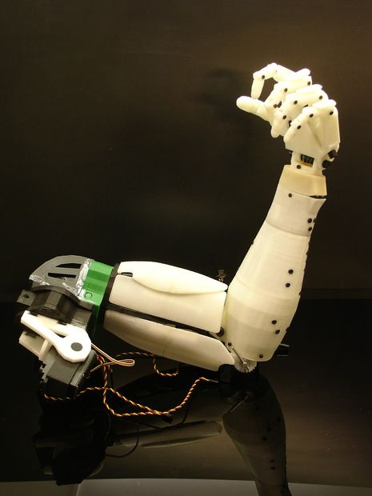
EEG Mind Controlled Smart Prosthetic Arm
Presented by Under the guidance of
ROHITH UDUPA R Prof. UMESHA H S

Slide 3
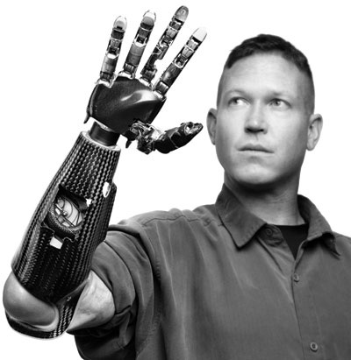
CONTENTS
Introduction
Motivation
Brain Computer Interface
System architecture
Preliminary Results
Merits and Demerits
Scope for future works
Reference

Slide 4
INTRODUCTION
Electroencephalography (EEG) method to record electrical
activity of the brain. It is typically noninvasive, with the
Electrodes used as sensors placed along the scalp.
Prosthetics are the artificial device either external or implanted
that replaces a missing body part.
Objective
Study of development of prosthetic arm that can be controlled by brain thoughts with the help of EEG sensors.

Slide 5
MOTIVATION
About 15% of the world's population suffers from any form of disability.
There are over 10 million amputees worldwide, out of which 30% are arm amputees.
Existing prosthetic arms/limbs are not very
natural in terms of operation and interaction with the
environment.
They require undergoing invasive surgical
Procedure.

Slide 6
BRAIN COMPUTER INTERFACE
A brain–computer interface (BCI), or mind-machine interface (MMI), is a direct communication pathway between brain and an external device.
The external devices are controlled using brain waves captured by EEG technique
Signal acquisition
Signal Processing
Application
(prosthetic arm)
Commands
Signal detection (EEG Sensors)

Slide 7
SYSTEM ARCHITECTURE
EEG
Sensors
Placed on head
Processing unit
Control unit
bluetooth
X bee
Electro mechanical unit
Sensor network
The architecture of the proposed design has 4 units.
1- The Input Unit – EEG sensors
2- The Processing Unit – Pattern recognition
3- The Electro-Mechanical Unit - The arm
4- The Interface Unit – Smart sensor network

Slide 8
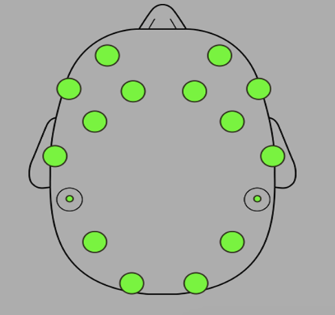
Input Unit
EEG sensors used to capture the brain waves.
EEG signals are acquired using the Emotiv EPOC wireless recording headset bearing 14 channels.
14 sensors arranged according to the international 10-20 System as shown in Figure 2

Slide 9
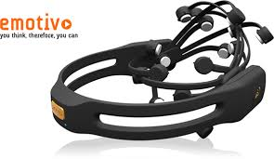
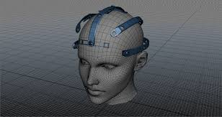
Contd….
Brain signals are captured by an array of advanced EEG sensors.
The headset detects and converts the signal into digital form.
The digitalized signals are then sent to processing unit via low power and secure connectivity using Bluetooth technology.

Slide 10
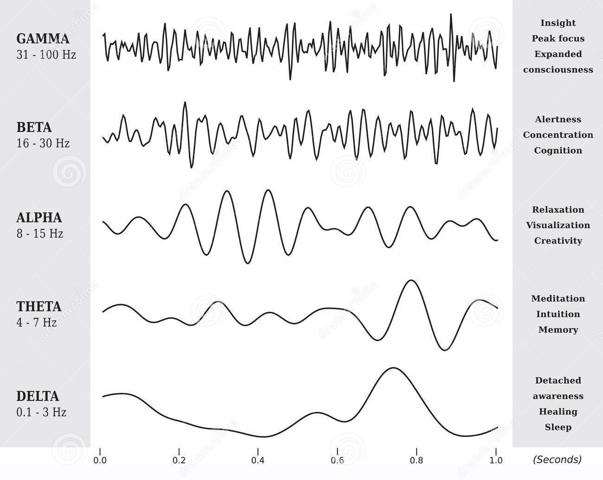
Typical EEG signals of human brain

Slide 11
B. Processing Unit
The processing activity consists of two main parts:
1. A pattern recognition part that identifies different brain behavior captured by the input unit.
2. A command part that generates a series of commands to be sent to the mechetronics system of the arm.
Every mind state is captured and encoded to represent a set of desired tasks to be performed by the arm.

Slide 12
Contd…
Raspberry PI 3 SoC processor is connected wirelessly with Arduino mega used to drive electromechanical elements of the arm and sensor network.
The command will be transferred to arduino mega via xbee module.
Arduino mega board drives the electromechanical unit as per the command generated in the processing unit.

Slide 13
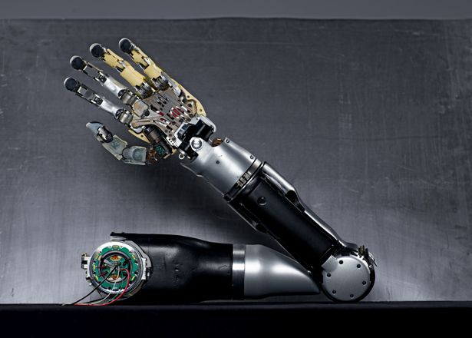
C. Electromechanical unit
It consists of 3D printed model of hand made of various lightweight high-strength materials that can handle high impacts.
Servo motors are used at the joints to provide hand movements in three degree of freedom.
These servos are controlled by Arduino mega.

Slide 14
D. Interface Unit – smart sensor network
Smart sensors includes temperature, skin pressure and ultrasonic proximity sensors, accelerometers, strain gauges and gyroscopes placed on the prosthetic arm.
To interact with and adapt to the surrounding environment, by providing intelligent feedback about critical condition, such as high temperature or pressure, etc.
.

Slide 15
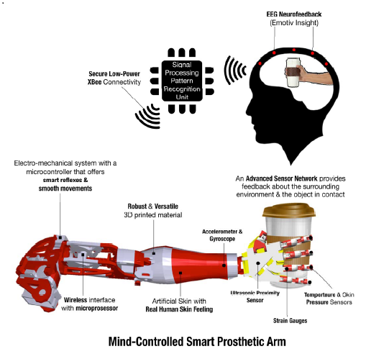

Slide 16
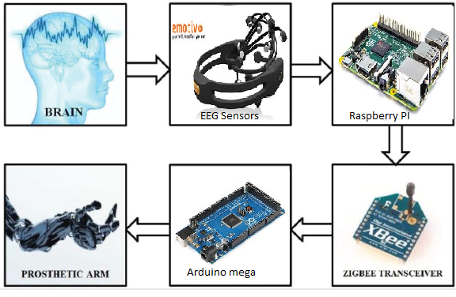
Block diagram of actual components used

Slide 17
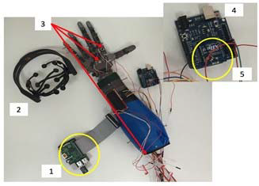
Prosthetic arm with actual components assembled

Slide 18
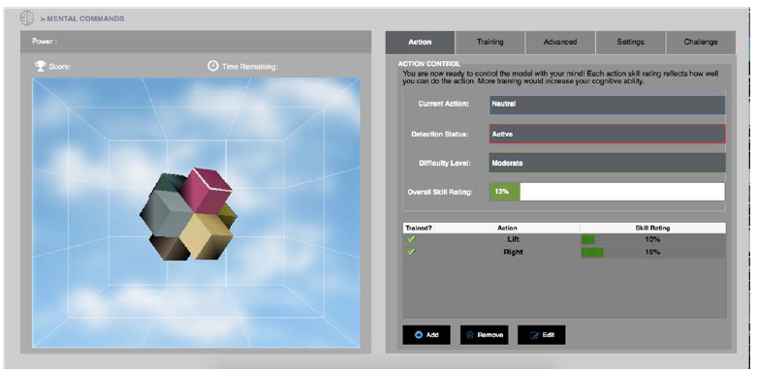
PRELIMINARY RESULTS
A virtual environment with a 3-d cube was created.
Different patterns of brain waves were recorded for moving the cube in different direction and were stored in the processing unit.

Slide 19
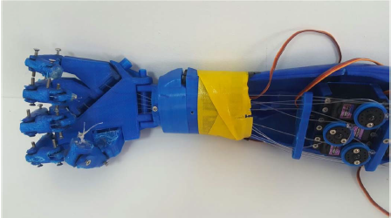
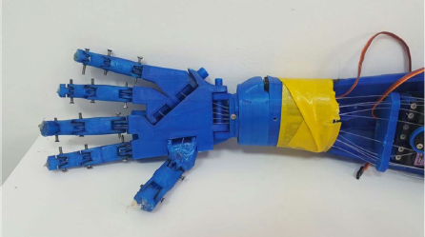
Contd…
Thinking of moving the cube to the left stimulates the set of
servo motors placed on the prosthetic arm to close the hand (left Figure).
Similarly, thinking of moving the cube to the right
stimulates the hand to open (right Figure ).

Slide 20
Advantages
Very near to natural arm.
More accurate than the existing smart arms
Non invasive process and arms are removable
Less cost compared to existing surgical arms
Disadvantages
Complexity in processing of brain waves
User has to undergo prolonged training to get good accuracy

Slide 21
Scope for future works
Mind controlled Humanoid robots
Home automation
Screen mobile phone calls
Automatic driving of wheelchair and car from brain thoughts

Slide 22
References
[1] Luzheng Bi, Xin-An Fan, Yili Liu, “EEG-Based Brain- Controlled
Mobile Robots: A Survey “, IEEE transaction on human machine
systems”, vol. 43, March 2013, pp. 161-176.
[2] Wei Li, Christain Jaramillo,Yunyi Li, “Development of Mind Control System for humanoid Robot through a Brain Computer Interface”, IEEE, International Conference on Intelligent Systems Design and Engineering Application, 2012,
pp. 679-682.
[3] Jose del R. Millan, Frederic Renkens, Josep Mouriño, “Noninvasive
Brain-Actuated Control of a Mobile Robot by Human EEG” IEEE
Transactions on Biomedical Engineering, vol. 51, June 2004, pp.
1026-1033.

