Slide 1
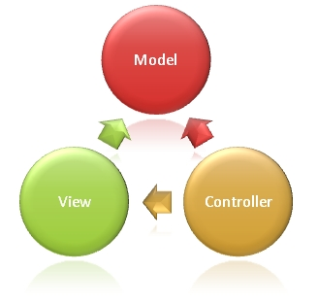
The 3 Circles
Odessa Technologies Inc.

Slide 2
What is MVC?
MVC (Model View Controller)
MVC is an architectural pattern for web based applications.
The application is separated among Model, View and Controller which provides a loose coupling among business logic, UI logic and input logic.
ASP.NET MVC framework provides an alternative to ASP.NET web forms for building ASP.NET web applications.
Lets Start…

Slide 3
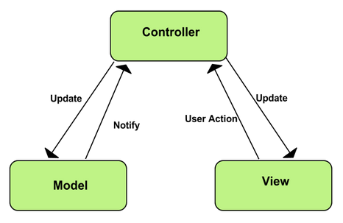
Lets make it a little bit more clear…

Slide 4
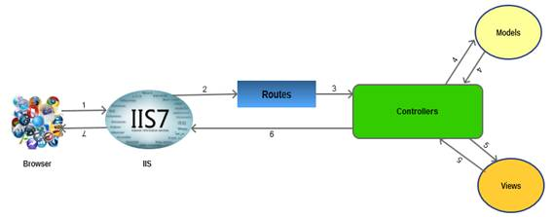

Slide 5
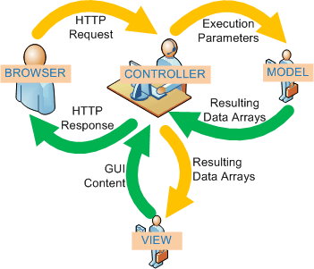

Slide 6
MVC MODEL
The browser (as usual) sends a request to IIS, IIS searches for the route defined in MVC application and passes the request to the controller as per route.
The controller communicates with the model and passes the populated model (entity) to View (front end).
Views are populated with model properties, and are rendered on the browser, passing the response to browser through IIS via controllers which invoked the particular View.

Slide 7
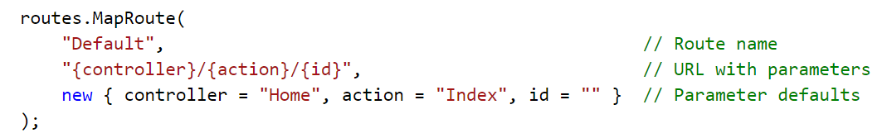
Routing

Slide 8
Controller
The ASP.NET MVC framework maps URLs to classes that are referred to as controllers.
Controllers process incoming requests, handle user input and interactions, and execute appropriate application logic.
A controller class typically calls a separate view component to generate the HTML markup for the request.
The Controller class inherits from ControllerBase and is the default implement of a controller.

Slide 9
Controller (Contd..)
The Controller class is responsible for the following processing stages:
Locating the appropriate action method to call and validating that it can be called.
Getting the values to use as the action method's arguments.
Handling all errors that might occur during the execution of the action method.
Providing the default WebFormViewEngine class for rendering ASP.NET page types (views).
Note: All controller classes must be named by using the "Controller" suffix.

Slide 10
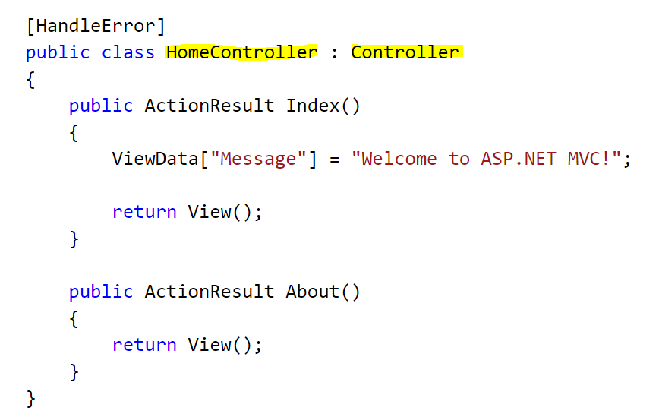

Slide 11
Controller (Contd..)
Action Method
ActionResult Return Type
Non – Action Methods
Action Method Parameters

Slide 12
DEMO

Slide 13
VIEW
The ASP.NET MVC framework supports the use of a view engine to generate views (UI).
By default, the MVC framework uses custom types (ViewPage, ViewMasterPage, and ViewUserControl) that inherit from the existing ASP.NET page (.aspx), master page (.master), and user control (.ascx) types as views.
In the typical workflow of an MVC Web application, controller action methods handle an incoming Web request. These action methods use the incoming parameter values to execute application code and to retrieve or update data model objects from a database.
The methods then select a view that renders a response to a browser.

Slide 14
VIEW (Contd..)
In the Model-View-Controller (MVC) pattern, views are intended exclusively for encapsulating presentation logic.
They should not contain any application logic or database retrieval code.
All application logic should be handled by the controller.
A view renders the appropriate UI by using the data that is passed to it from the controller.
This data is passed to a view from a controller action method by using the View method.

Slide 15
ASPX vs RAZOR
ASPX View Engine | Razor View Engine
System.Web.Mvc.WebFormViewEngine is the namespace for ASPX View Engine. | Namespace for Razor view Engine isSystem.Web.Razor.
File Extension for this View Engine is similar to WebForm as: .aspx, for Views just like Web Form pages. .ascx, for Partial Views & Editor Template just like User Controls. .master, for Layout and Master Pages just like Master Pages in Web Forms. | As it’s new and advanced View Engine, it’s extensions are totally different. .cshtml (Razor C#), For all including Views, Partial Views, Editor Template and Layout Pages. .vbhtml (Razor VB.NET), For all including Views, Partial Views, Editor Template and Layout Pages.
From the beginning, ASPX View Engine was part of ASP.NET MVC. | Razor View Engine was introduced in ASP.NET MVC v3.
ASPX View Engine uses syntax same as that of Web Form pages (already demonstrated above). | Razor Syntax is different as compared to Web Forms. Using Razor syntax, developer type comparatively less code which is is easy to understand.

Slide 16
ASPX vs RAZOR (Contd..)
ASPX View Engine | Razor View Engine
ASPX syntax is inherited from Web Forms, so it’s understandable for Web Forms developer but it’s not that much clean as compared to Razor View Engine. | As Razor View Engine is introduced later in MVC3, it’s syntax is designed to be clean, expressive and easy to learn.
ASPX View Engine does nothing to avoid Cross-Site Scripting attacks by default. | By default, Razor View Engine encodes html tags or scripts before it’s being rendered to view that avoids Cross-Site Scripting attacks.
ASPX View Engine is comparatively fast. | Razor View Engine is slow as compared to ASPX View Engine.
It supports design view in Visual Studio. | It doesn’t support design view in Visual Studio.
No support for TDD (Test Driven Development). | Supports TDD (Test Driven Development).

Slide 17
Model
The model represents the domain of the application.
The purpose of the model is to add meaning to the raw data.
Model also adds rules to the application which orchestrate how the application should work.
Model is not responsible for accessing the persistent storage mechanism.

Slide 18
Model (Contd..)
MVC model can be created manually or by leveraging the power of an object relational mapping tool.
LINQ to SQL can be used to generate a model by automatically creating the model classes from the database schema.
Entity Framework allows the developer to generate the model classes based on the database schema using a visual designer.
Entity Framework also allows the developer to generate the database schema based on the model classes.

Slide 19
Case Study
Register Speaker
The system should allow to register a speaker.
The speaker should be exceptional to participate in the seminar.
Speaker should be familiar with new technologies.
Lets discuss the business logic to register speaker…

Slide 20
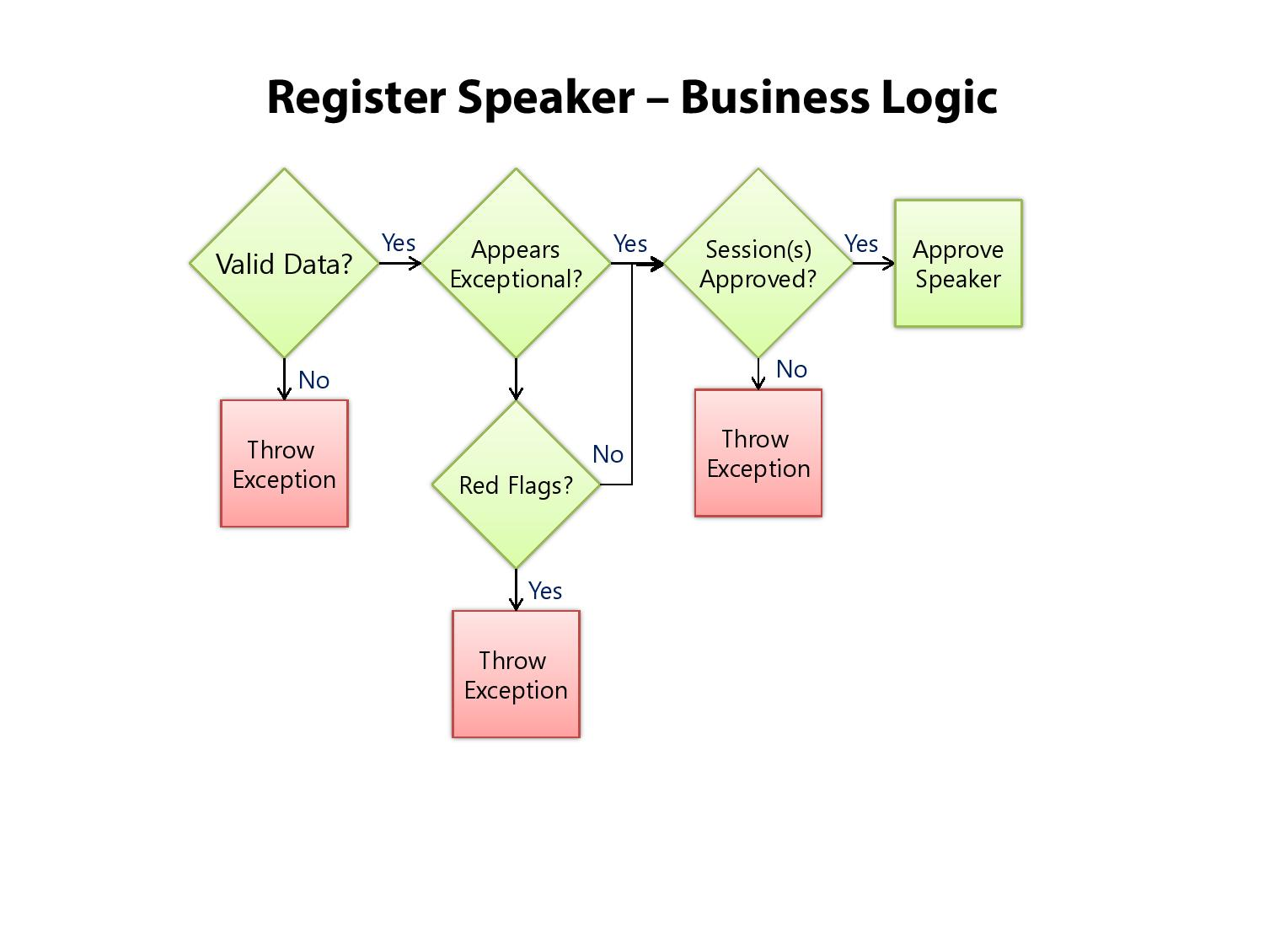
Case Study (Contd..)

Slide 21
DEMO

Slide 22


Slide 23
Case Study
E-Commerce Site (Shopping Cart)
All e-commerce sites have key features in common with one another, they are:
Ability to search for products
Ability to view product details
A shopping cart that allows you to store items for purchase and continue shopping
Some sort of check out functionality that allows you to purchase your items.
Without these key features, an e-commerce site would not be successful. Keep these features in mind when you design e-commerce site. Even make sure the similarities and differences with a e-commerce site you use for online shopping.

Slide 24
Functional Requirements : Shopping Cart
List product categories
Click a category to display products
Display products in a detailed view
Add products to the shopping cart
Remove products from the shopping cart
Submit the shopping cart

Slide 25


Slide 26

Ask your questions in our Q&A forum – http://192.168.10.75.question2answers

