Slide 1
Language Integrated Query (LINQ)
Language-Integrated Query (LINQ) is an innovation introduced in Visual Studio 2008 and .NET Framework version 3.5 that bridges the gap between the world of objects and the world of data.
LINQ, pronounced "link“
LINQ enables the query of data from any type of data source, including databases, XML, List, Array and so on.

Slide 2
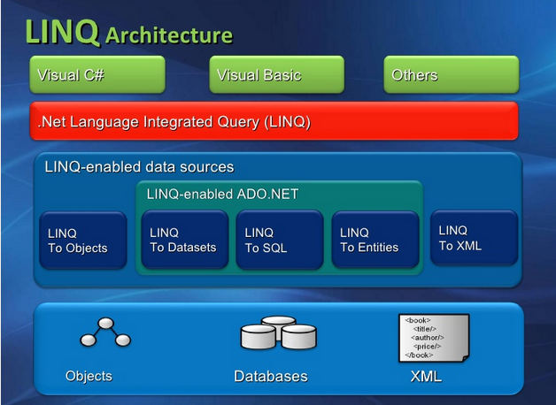

Slide 3
Advantages of using LINQ
Works with any data source.
Compile-time syntax checking, and debugging support.
IntelliSense, Design time support.
Same basic syntax for different types of data sources.
Providing designer tools that create object-relational mappings.

Slide 4
Language features supporting the LINQ project
Lambda expressions
Extension methods
Initialization of objects and collections in expression context
Local types inference
Anonymous types
Lazy evaluation +Query Expressions = LINQ

Slide 5
To access data by using LINQ, you need to perform the following steps:
Specify the data source.
Create the query.
Execute the query.
1. Specifying the data source:
The data source in a LINQ query can be an XML file, an array, a collection, or a database

Slide 6
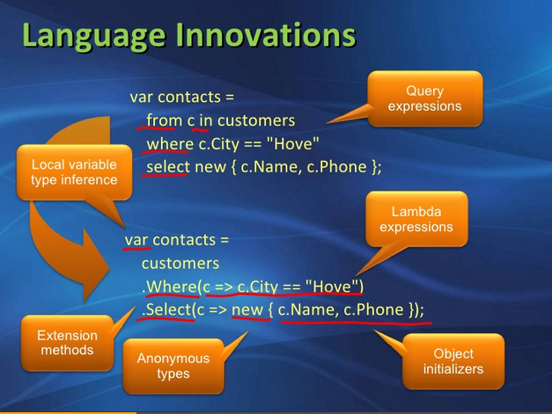
2. Create the Query

Slide 7
3. Execute the Query :
In LINQ, the query variable only stores the query.
The actual execution of the query is deferred until the query variable is iterated by using the foreach loop
In LINQ, queries have two different behaviours of execution:
Deferred execution.
Immediate execution.

Slide 8
Deferred execution :
The query is actually executed when the query variable is iterated over, not when the query variable is created. This is called deferred execution.
Immediate execution :
You can also force a query to execute immediately, which is useful for caching query results.

Slide 9
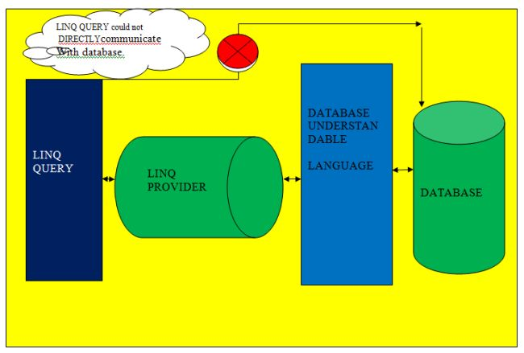
LINQ Provider
LINQ provider is a component between the LINQ query and actual data source that converts the LINQ query into a format that the data source can understand.

Slide 10
LINQ Providers :
LINQ to Objects
LINQ to SQL (formerly known as DLINQ)
LINQ to XML (formerly known as XLINQ)
LINQ to Entities (ADO.NET Entities)

Slide 11
LINQ Providers (Contd.) :
LINQ to Twitter
LINQ to Google (GLINQ)
LINQ to FQL (Facebook Query Language)
LINQ to Amazon
LINQ to SAP
LINQ to CRM
LINQ to Sharepoint
LINQ to Flickr
LINQ to Excel
LINQ to Parallel(PLINQ)
LINQ to JSON etc….

Slide 12
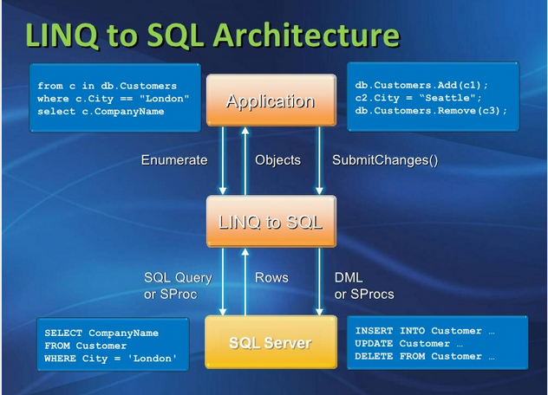

Slide 13
LINQ Operators :
Filtering
Projecting
Ordering
Grouping
Conversions
Sets
Aggregation
Quantifiers
Generation
Elements
Joining
Partition

Slide 14
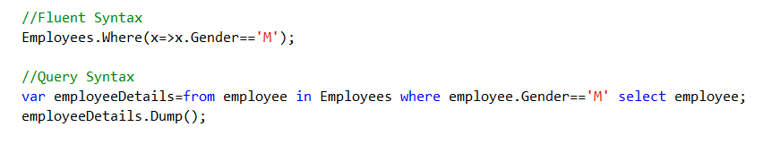

Filtering Operators
Where
The Where operator generally translates to a WHERE clause when
working with a relational database and has an associated keyword in C#
OfType
The OfType operator can be used to coax a non-generic collection
(like an ArrayList) into a LINQ query

Slide 15
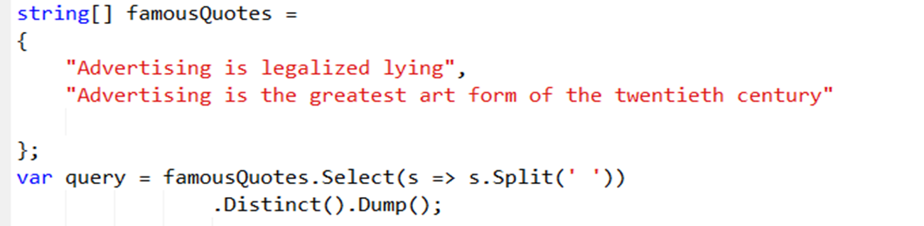
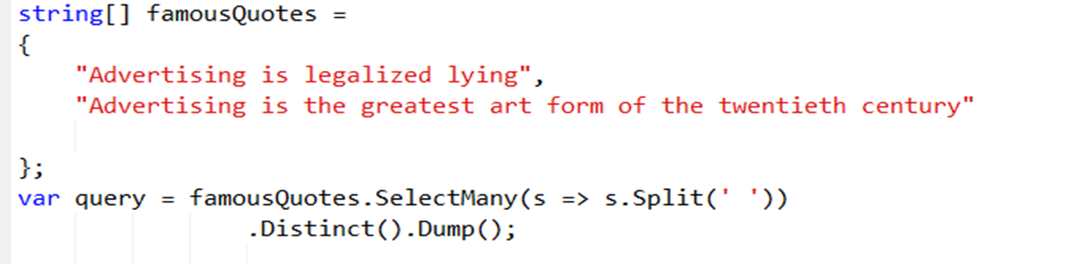
Projecting :
Select : It selects value from collection
SelectMany : It selects value from multiple collection

Slide 16
Sorting Operators
OrderBy
OrderByDescending
ThenBy
ThenByDescending
Reverse
OrderBy :Sorts the elements of a sequence

Slide 17
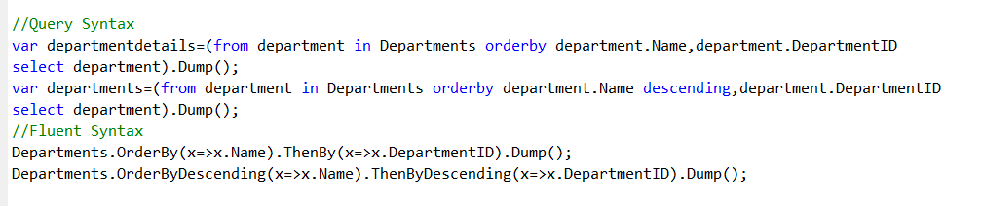

ThenBy : Performs a subsequent ordering of the elements in a sequence
Reverse : Inverts the order of the elements in a sequence.

Slide 18
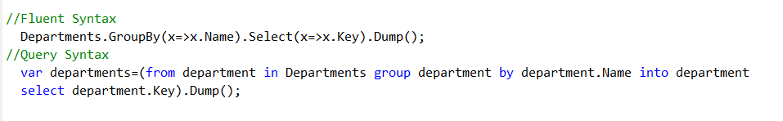
Grouping : groups the elements of a sequence
GroupBy operators return a sequence of IGrouping<K,V> objects. This interface specifies that the object exposes a Key property, and this Key property will represent the grouping value.

Slide 19
Conversion Operators
AsEnumerable():
It makes a queryable sequence (a sequence backed by a LINQ provider
and typically a remote datasource, like a database) into an in-memory
collection(IEnumerable<T>)
AsQueryable():
It makes an in-memory collection appear as if it is backed by a remote
LINQ provider(Iqueryable<T>)
OfType<Type>():
Converts a non-generic IEnumerable collection to one of IEnumerable<T>.
Alternately converts a generic IEnumerable<T> to another
generic IEnumerable<R> by attempting to cast each element from type T to
type R. In both cases, only the subset of elements successfully cast to the target
type are included. No exceptions are thrown.

Slide 20
Conversion Operators (Contd.)
Cast<Type>():
Converts a non-generic IEnumerable collection to one of IEnumerable<T> by
casting each element to type T. Alternately converts a
generic IEnumerable<T> to another generic IEnumerable<R>
by casting each element from type T to type R.
Throws an exception in any element cannot be cast to the indicated type.
ToList :
Creates a List<T> from the collection.
ToArray :
Creates an array T[] from the collection.

Slide 21
Conversion Operators (Contd.)
ToDictionary :
Creates a Dictionary<K, T> from the collection, indexed by the key K. A user
supplied projection function extracts a key from each element.
ToLookup :
Creates a Lookup<K, T> from the collection, indexed by the key K. A user
supplied projection function extracts a key from each element.

Slide 22
Sets Operators
Distinct () : To remove duplicate values.
Union () : returns the unique elements from two sequences
Intersect () : returns the intersection of two sequences
Except () : returns the difference of two sequences.

Slide 23
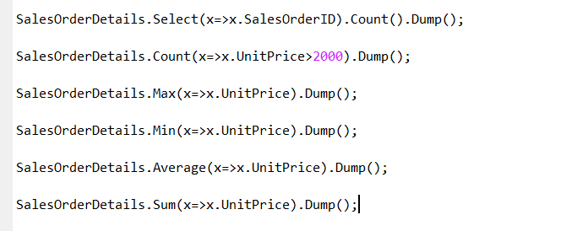
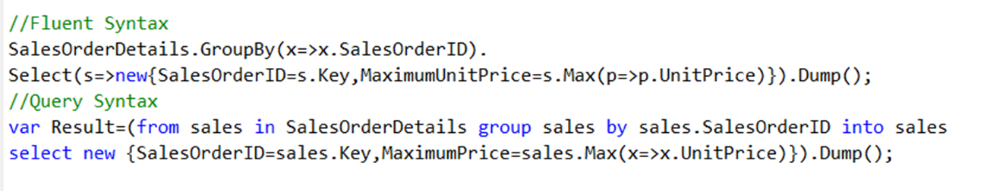
Aggregation Operators
Average, Count, LongCount (for big results), Max, Min, and Sum.
Example : GroupBy with Aggregation

Slide 24
Quantifiers :
All() :
Determines whether all elements of a sequence satisfy a condition.
Any() :
Determines whether any element of a sequence exists or satisfies a
condition.
Contains() :
Determines whether a sequence contains a specified element.

Slide 25
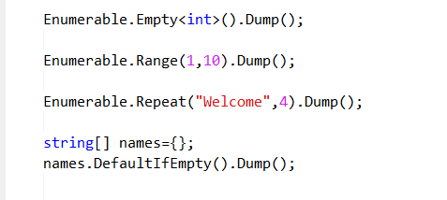
Generation Operators
Empty<Type>():
The Empty operator will create an empty sequence for IEnumerable<T>
Range():
can generate a sequence of numbers
Repeat():
can generate a sequence of any value.
DefaultIfEmpty() :
can generate an empty collection using the default value of a type when it is
applied to an empty sequence.
Example:

Slide 26
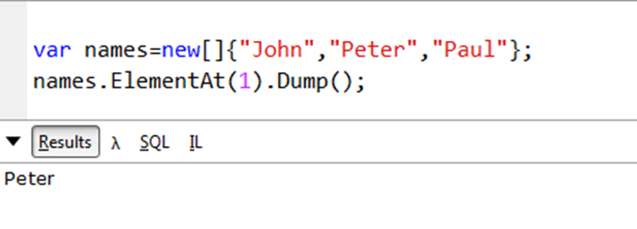

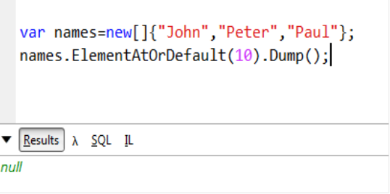
Elements Operators
ElementAt() :
Returns the element at a specified index in a sequence
ElementAtOrDefault() :
Returns the element at a specified index in a sequence or a default
value if the index is out of range

Slide 27

Elements Operators(Contd.)
First() :
Returns the first element of a sequence.
FirstOrDefault() :
Returns the first element of a sequence, or a default value if no
element is found.

Slide 28
Elements Operators(Contd.)
Last() :
Returns the last element of a sequence.
LastOrDefault() :
Returns the last element of a sequence, or a default value if no
element is found.

Slide 29
Elements Operators(Contd.)
Single() :
Returns a single, specific element of a sequence.
SingleOrDefault() :
Returns a single, specific element of a sequence, or a default value if
that element is not found

Slide 30
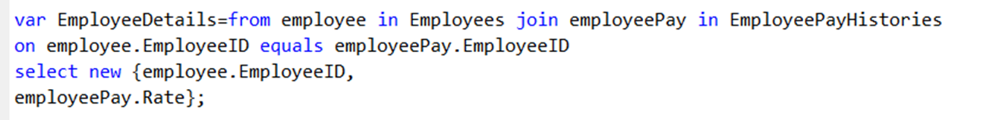
Joining Operators
Join
Correlates the elements of two sequences based on matching keys.
Following are the types of Join
Simple Join(Inner Join):
it only outputs results when it finds a match between two sequences.

Slide 31
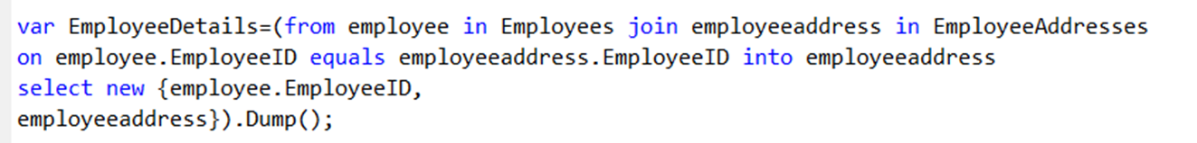
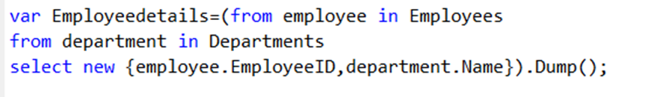
Joining Operators(Contd.)
Group Join:
It will return all results from the collection identified on the left side of the Group Join operator.
Cross Join:
It performs a Cartesian product on the tuples of the two sets.

Slide 32
Joining Operators(Contd.)
Left Outer Join:
A left outer join is a join in which each element of the first collection is returned, regardless of whether it has any correlated elements in the second collection.

Slide 33
Partition Operators
Take() :
Returns a specified number of contiguous elements from the start of a sequence.
Skip() :
Bypasses a specified number of elements in a sequence and then returns the
remaining elements.

Slide 34
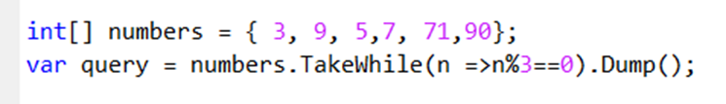


Partition Operators(Contd.)
TakeWhile() :
Returns elements from a sequence as long as a specified condition is true. The
element's index is used in the logic of the predicate function.
SkipWhile() :
Bypasses elements in a sequence as long as a specified condition is true and then
returns the remaining elements. The element's index is used in the logic of the
predicate function

Slide 35
Best Practises :
Avoid fetching all the fields if not required.
Retrieve only required number of records(use Take(),First() etc when required)
Filter before ToList()
Avoid join with in-memory collections

Slide 36

Ask your questions in our Q&A forum – http://192.168.10.75.question2answers

