Slide 1
Sentiment Analysis using Apache Spark
By
Rohith.V
RA1411003010245

Slide 2

Training details
Company Profile:
The National Informatics Centre (NIC) is the premier science & technology organisation of India's Union Government in informatics services and information-and-communication- technology (ICT) applications. The NIC is a part of the Indian Ministry of Communications and Information Technology's Department of Electronics & Information Technology.
It has played a pivotal role in steering e-governance applications in the governmental departments at national, state and district levels, enabling the improvement in, and a wider transparency of, government services. Almost all Indian-government websites are developed / managed by NIC.

Slide 3
THE TEAM
Rohith V
SUPERVISOR: Mr. R. Ramesh, Technical Director
CO-ORDINATOR: Ms. Agalya
Duration: June 5th – 23rd, 2017

Slide 4
Abstract
Sentiment analysis (sometimes known as opinion mining or emotion AI) refers to the use of natural language processing, text analysis, computational linguistics, and biometrics to systematically identify, extract, quantify, and study affective states and subjective information. Sentiment analysis is widely applied to voice of the
customer materials such as reviews and survey responses, online and social media, and healthcare materials for applications that range from marketing to customer service to clinical medicine.
Generally speaking, sentiment analysis aims to determine the attitude of a speaker, writer, or other subject
with respect to some topic or the overall contextual polarity or emotional reaction to a document, interaction, or event.
The attitude may be a judgment or evaluation (see appraisal theory), affective state (that is to say, the emotional state
of the author or speaker), or the intended emotional communication (that is to say, the emotional effect intended
by the author or interlocutor).

Slide 5
Technologies Used
Apache Spark
Apache Open NLP
Twitter API for Developers
Eclipse IDE
Java
Maven Repository

Slide 6

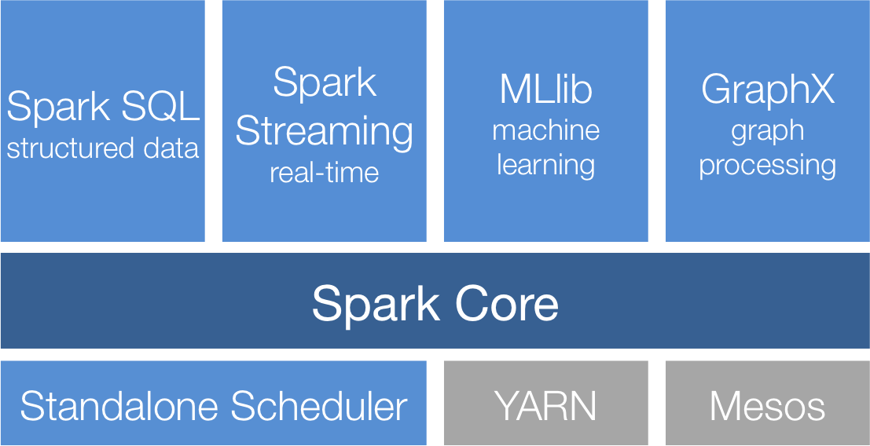
Apache Spark
Architecture

Slide 7

Apache Open NLP
The Apache OpenNLP library is a machine learning based toolkit for the processing of natural language text. It supports the most common NLP tasks, such as
tokenization,
sentence segmentation,
part-of-speech tagging,
named entity extraction,
chunking,
parsing, and
coreference resolution.
These tasks are usually required to build more advanced text processing services.

Slide 8

Twitter API
Twitter is an online news and social networking service where users post and interact with messages, "tweets", restricted to 140 characters. Registered users can post tweets, but those who are unregistered can only read them. Users access Twitter through its website interface, SMS or a mobile device app. Twitter Inc. is based in San Francisco, California, United States, and has more than 25 offices around the world.
Twitter is recognized for having one of the most open and powerful developer APIs of any major technology company. Developer interest in Twitter began immediately following its launch, prompting the company to release the first version of its public API in September 2006. The API quickly became iconic as a reference implementation for public REST APIs and is widely cited in programming tutorials.

Slide 9

Eclipse IDE
Eclipse is an integrated development environment (IDE) used in computer programming, and is the most widely used Java IDE. It contains a base workspace and an extensible plug-in system for customizing the environment. Eclipse is written mostly in Java and its primary use is for developing Java applications, but it may also be used to develop applications in other programming languages via plug-ins, including Ada, ABAP, C, C++, COBOL, D, Fortran, Haskell, JavaScript, Julia,Lasso, Lua, NATURAL, Perl, PHP, Prolog, Python, R, Ruby (including Ruby on Rails framework), Rust, Scala, Clojure, Groovy, Scheme, and Erlang. It can also be used to develop documents with LaTeX (via a TeXlipse plug-in) and packages for the software Mathematica. Development environments include the Eclipse Java development tools (JDT) for Java and Scala, Eclipse CDT for C/C++, and Eclipse PDT for PHP, among others.

Slide 10

Java
Java is a general-purpose computer programming language that is concurrent, class-based, object-oriented,0 and specifically designed to have as few implementation dependencies as possible. It is intended to let application developers "write once, run anywhere" (WORA),[ meaning that compiled Java code can run on all platforms that support Java without the need for recompilation. Java applications are typically compiled to bytecode that can run on any Java virtual machine (JVM) regardless of computer architecture. As of 2016, Java is one of the most popular programming languages in use, particularly for client-server web applications, with a reported 9 million developers. Java was originally developed by James Gosling at Sun Microsystems (which has since been acquired by Oracle Corporation) and released in 1995 as a core component of Sun Microsystems' Java platform. The language derives much of its syntax from C and C++, but it has fewer low-level facilities than either of them.

Slide 11
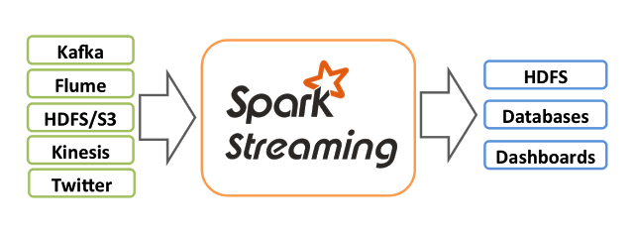
Spark Streaming

Slide 12
Thank you

